Slide 1
Noise, batches, constraints — and the assumptions behind BO
MODULE 12 · LESSON 3 OF 3 · ≈ 10 MIN
12.3
Module 12: Sequential learning and Bayesian optimization
Extensions and honest caveats
Notes:
Welcome to Module 12, Lesson 3 of the self-paced course Machine Learning Fundamentals for Surrogate-Based Engineering Optimization: Noise, batches, constraints — and the assumptions behind BO. This lesson belongs to the module Sequential learning and Bayesian optimization and takes about 10 minutes. In this lesson: Extensions and honest caveats.

Slide 2
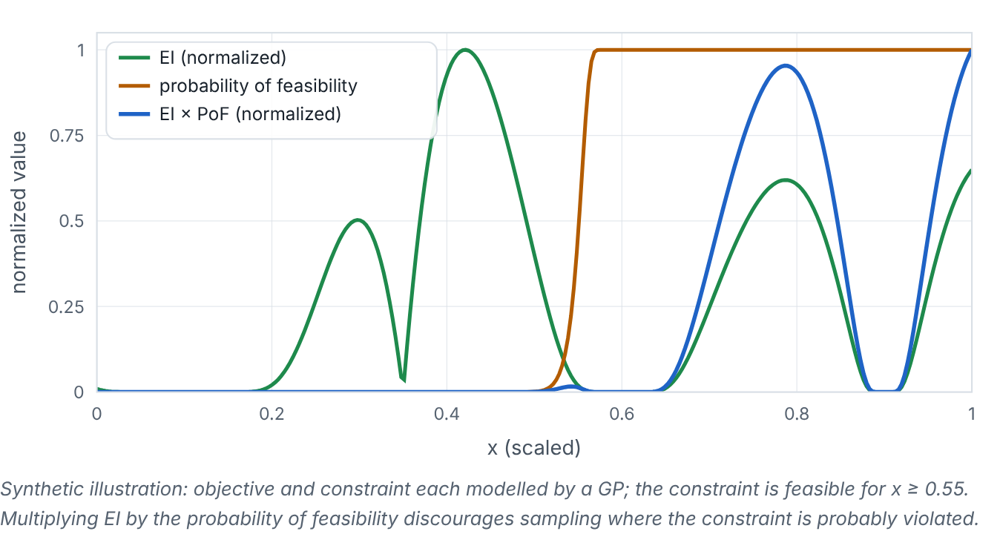

Extensions and honest caveats
Lesson 3 · Noise, batches, constraints — and the assumptions behind BO · Intuition
Noisy evaluations (experiments): use a GP with a noise term. A simple incumbent heuristic is to take f_{best} as the lowest GP mean at sampled points rather than the luckiest noisy observation. This is a pragmatic plug-in, not a complete noise-aware method: proper noisy-EI variants (e.g., noisy or augmented EI, or knowledge-gradient) account for the noise in both the incumbent and the candidate and are beyond this course. Batch selection: when several simulations can run in parallel, choose several points per iteration (e.g., by temporarily “fantasizing” outcomes or penalizing nearby points). Constrained BO: multiply EI by the probability of feasibility from constraint GPs.
Synthetic illustration: EI, probability of feasibility (PoF) and their product.
Notes:
Extensions and honest caveats. Noisy evaluations (experiments): use a GP with a noise term. A simple incumbent heuristic is to take f_{best} as the lowest GP mean at sampled points rather than the luckiest noisy observation. This is a pragmatic plug-in, not a complete noise-aware method: proper noisy-EI variants (e.g., noisy or augmented EI, or knowledge-gradient) account for the noise in both the incumbent and the candidate and are beyond this course. Batch selection: when several simulations can run in parallel, choose several points per iteration (e.g., by temporarily “fantasizing” outcomes or penalizing nearby points). Constrained BO: multiply EI by the probability of feasibility from constraint GPs. Look at the figure. Synthetic illustration: EI, probability of feasibility (PoF) and their product. Three curves over a 1-D variable: EI with peaks in several places, PoF rising from 0 to 1 near x = 0.55, and their product, which suppresses EI peaks in the infeasible region.

Slide 3

Extensions and honest caveats
Lesson 3 · Noise, batches, constraints — and the assumptions behind BO · The mathematics
PoF(x) = Π_{j} Φ( (0 − μ_{gj}(x))/(σ_{gj}(x)) ), acquisition = EI(x) · PoF(x)
The product form assumes independent constraint GPs. Cheap constraints (mass) are enforced exactly by excluding infeasible designs from the search instead.
Notes:
Now the mathematics. PoF(x) = Π_j Φ( (0 − μ_{gj}(x))/(σ_{gj}(x)) ), acquisition = EI(x) · PoF(x) The product form assumes independent constraint GPs. Cheap constraints (mass) are enforced exactly by excluding infeasible designs from the search instead.

Slide 4


Extensions and honest caveats
Lesson 3 · Noise, batches, constraints — and the assumptions behind BO · In engineering practice
Engineering application
Practical tip
Lab 9 implements constrained EI for the heat sink: EI on log₁₀R, PoF from a GP of log₁₀ΔT_{air} with limit log₁₀12, and exact mass exclusion. In the course’s convergence study, BO and simple sequential SBO perform similarly on this smooth 2-D problem — BO’s advantages are larger on multimodal problems.
Refit GP hyperparameters as data accumulate and inspect them; track the best verified value per evaluation, and stop on budget or stagnation.
Notes:
Where does this matter in engineering? Lab 9 implements constrained EI for the heat sink: EI on log₁₀R, PoF from a GP of log₁₀ΔT_{air} with limit log₁₀12, and exact mass exclusion. In the course’s convergence study, BO and simple sequential SBO perform similarly on this smooth 2-D problem — BO’s advantages are larger on multimodal problems. A practical tip: Refit GP hyperparameters as data accumulate and inspect them; track the best verified value per evaluation, and stop on budget or stagnation.

Slide 5

Pause and predict
Lesson 3 · Noise, batches, constraints — and the assumptions behind BO · Predict before you look
Which uncertainty does EI rely on?
Write down your answer, then continue to the next slide.
Notes:
Time to predict. Which uncertainty does EI rely on? Pause here and commit to an answer before moving on.

Slide 6

What happens, and why
Lesson 3 · Noise, batches, constraints — and the assumptions behind BO · Answer
Question: Which uncertainty does EI rely on?
The GP’s predictive σ — a model-based, mostly epistemic uncertainty that depends on kernel, length scales and scaling. If σ is badly calibrated, EI misjudges where to explore.
Notes:
Here is the answer. The GP’s predictive σ — a model-based, mostly epistemic uncertainty that depends on kernel, length scales and scaling. If σ is badly calibrated, EI misjudges where to explore.

Slide 7


Extensions and honest caveats
Lesson 3 · Noise, batches, constraints — and the assumptions behind BO · Common misconception
Misconception
What is actually true
BO is guaranteed to find the global optimum efficiently.
Its efficiency depends on the GP being a reasonable model of the function. With a poor kernel or wrong length scale it can over-exploit or waste evaluations. Theoretical guarantees exist only under assumptions.
Takeaway BO extends to noise, batches and constraints, but relies on the GP’s assumptions and calibration.
Notes:
A common misconception is this: BO is guaranteed to find the global optimum efficiently. In fact: Its efficiency depends on the GP being a reasonable model of the function. With a poor kernel or wrong length scale it can over-exploit or waste evaluations. Theoretical guarantees exist only under assumptions. The takeaway: BO extends to noise, batches and constraints, but relies on the GP’s assumptions and calibration.

Slide 8
Key takeaways from this lesson
Summary
1
Extensions and honest caveats
BO extends to noise, batches and constraints, but relies on the GP’s assumptions and calibration.
Notes:
To sum up this lesson. Extensions and honest caveats: BO extends to noise, batches and constraints, but relies on the GP’s assumptions and calibration.

Slide 9

Provenance: seeds, versions, units and budgets
UP NEXT · LESSON 13.1
That completes Module 12. Before moving on, review the Module 12 flashcards and take its quiz in the course (pass mark 70%). Next: Module 13, Reproducible engineering research.
Notes:
That completes Lesson 3 of Module 12: Noise, batches, constraints — and the assumptions behind BO. This was the last lesson of the module, so review the flashcards and take the Module 12 quiz in the course. Next comes Module 13, Reproducible engineering research, starting with Provenance: seeds, versions, units and budgets.

