Slide 1
Baselines, fair comparisons, repeated experiments and variability
MODULE 13 · LESSON 2 OF 3 · ≈ 10 MIN
13.2
Module 13: Reproducible engineering research
One run is an anecdote
Notes:
Welcome to Module 13, Lesson 2 of the self-paced course Machine Learning Fundamentals for Surrogate-Based Engineering Optimization: Baselines, fair comparisons, repeated experiments and variability. This lesson belongs to the module Reproducible engineering research and takes about 10 minutes. In this lesson: One run is an anecdote.

Slide 2
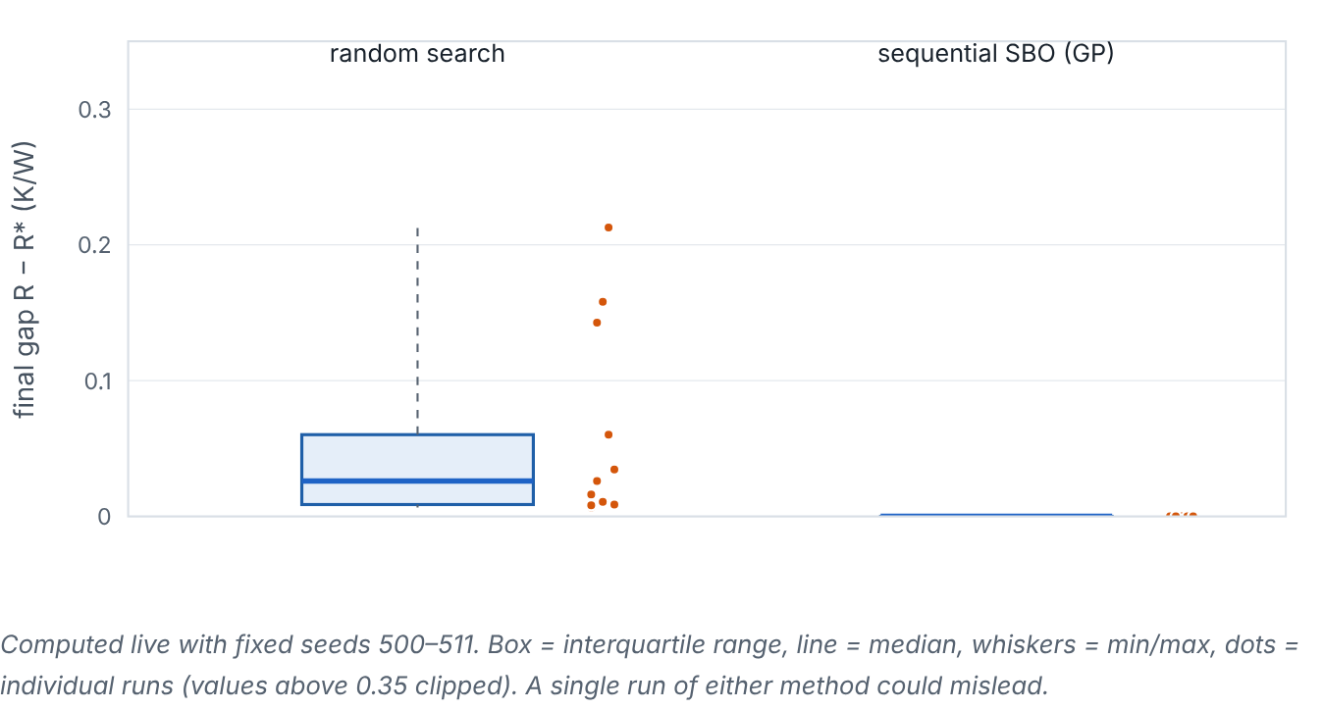

One run is an anecdote
Lesson 2 · Baselines, fair comparisons, repeated experiments and variability · Intuition
Surrogate-optimization results depend on the initial sample, the optimizer start points and hyperparameter fits. One run can be lucky or unlucky. Repeat with several seeds, compare against simple baselines with the same evaluation budget, and report the spread.
Computed live: final optimality gap of random search and sequential SBO over 12 seeds each, with a 16-evaluation budget.
Notes:
One run is an anecdote. Surrogate-optimization results depend on the initial sample, the optimizer start points and hyperparameter fits. One run can be lucky or unlucky. Repeat with several seeds, compare against simple baselines with the same evaluation budget, and report the spread. Look at the figure. Computed live: final optimality gap of random search and sequential SBO over 12 seeds each, with a 16-evaluation budget. Box plots with individual points: random search shows a wide spread of gaps; sequential SBO shows a lower median and narrower spread, though individual runs vary.

Slide 3

One run is an anecdote
Lesson 2 · Baselines, fair comparisons, repeated experiments and variability · The mathematics
Summaries for r repeated runs with final gaps Δ₁…Δ_{r}: median, interquartile range, min–max, and the fraction of runs reaching a target (e.g., within 1% of the best known). Avoid reporting only the best run.
Notes:
Now the mathematics. Summaries for r repeated runs with final gaps Δ_1…Δ_r: median, interquartile range, min–max, and the fraction of runs reaching a target (e.g., within 1% of the best known). Avoid reporting only the best run.

Slide 4


One run is an anecdote
Lesson 2 · Baselines, fair comparisons, repeated experiments and variability · In engineering practice
Engineering application
Practical tip
Fair comparison checklist: same budget of original-model evaluations; same bounds and constraints; same initial design (or same sampler with matched seeds); the same number of repeats; report verified values only.
Decide the number of repeats and the comparison metric before running the study, to avoid selective reporting.
Notes:
Where does this matter in engineering? Fair comparison checklist: same budget of original-model evaluations; same bounds and constraints; same initial design (or same sampler with matched seeds); the same number of repeats; report verified values only. A practical tip: Decide the number of repeats and the comparison metric before running the study, to avoid selective reporting.

Slide 5

Pause and predict
Lesson 2 · Baselines, fair comparisons, repeated experiments and variability · Predict before you look
Method A beats method B in 1 run out of 1. Method B beats A in 8 of 10 seeds. Which statement is defensible?
Write down your answer, then continue to the next slide.
Notes:
Time to predict. Method A beats method B in 1 run out of 1. Method B beats A in 8 of 10 seeds. Which statement is defensible? Pause here and commit to an answer before moving on.

Slide 6

What happens, and why
Lesson 2 · Baselines, fair comparisons, repeated experiments and variability · Answer
Question: Method A beats method B in 1 run out of 1. Method B beats A in 8 of 10 seeds. Which statement is defensible?
That B tends to outperform A on this problem with this budget (8/10 seeds) — not a universal claim, and not that A is better.
Notes:
Here is the answer. That B tends to outperform A on this problem with this budget (8/10 seeds) — not a universal claim, and not that A is better.

Slide 7


One run is an anecdote
Lesson 2 · Baselines, fair comparisons, repeated experiments and variability · Common misconception
Misconception
What is actually true
Reporting the best of several runs shows what the method can do.
It shows what luck can do. Report the distribution, or at least the median and range.
Takeaway Repeat with seeds, compare with baselines at equal budgets, report distributions.
Notes:
A common misconception is this: Reporting the best of several runs shows what the method can do. In fact: It shows what luck can do. Report the distribution, or at least the median and range. The takeaway: Repeat with seeds, compare with baselines at equal budgets, report distributions.

Slide 8
Key takeaways from this lesson
Summary
1
One run is an anecdote
Repeat with seeds, compare with baselines at equal budgets, report distributions.
Notes:
To sum up this lesson. One run is an anecdote: Repeat with seeds, compare with baselines at equal budgets, report distributions.

Slide 9

Reporting, synthetic vs experimental evidence, ethics
UP NEXT · LESSON 13.3
Next in Module 13: Lesson 3. Mark this lesson complete in the course before continuing.
Notes:
That completes Lesson 2 of Module 13: Baselines, fair comparisons, repeated experiments and variability. Next comes Lesson 3: Reporting, synthetic vs experimental evidence, ethics.

