Slide 1
Reporting, synthetic vs experimental evidence, ethics
MODULE 13 · LESSON 3 OF 3 · ≈ 12 MIN
13.3
Module 13: Reproducible engineering research
Claims proportional to evidence
Notes:
Welcome to Module 13, Lesson 3 of the self-paced course Machine Learning Fundamentals for Surrogate-Based Engineering Optimization: Reporting, synthetic vs experimental evidence, ethics. This lesson belongs to the module Reproducible engineering research and takes about 12 minutes. In this lesson: Claims proportional to evidence.

Slide 2

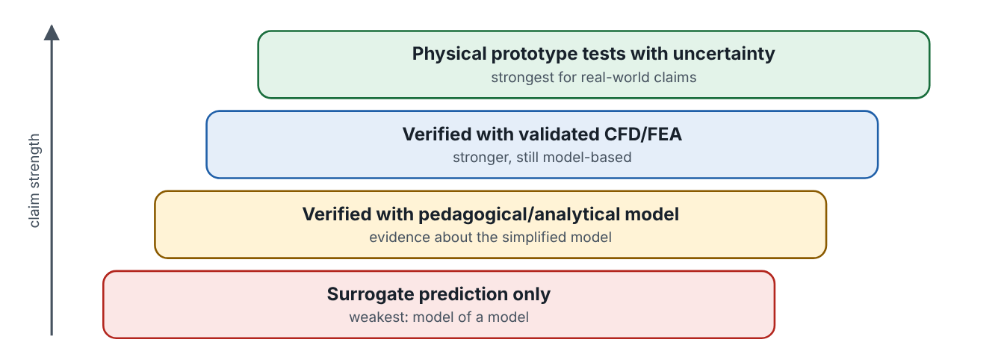
Claims proportional to evidence
Lesson 3 · Reporting, synthetic vs experimental evidence, ethics · Intuition
A good report states what was done, what was found, and what it does not show. Evidence has levels: a surrogate prediction is weakest; verification with a simplified model shows something about that model; verification with validated CFD/FEA is stronger; physical tests with uncertainty are strongest for real-world claims.
Strength of evidence, from surrogate predictions to physical tests.
Notes:
Claims proportional to evidence. A good report states what was done, what was found, and what it does not show. Evidence has levels: a surrogate prediction is weakest; verification with a simplified model shows something about that model; verification with validated CFD/FEA is stronger; physical tests with uncertainty are strongest for real-world claims. Look at the figure. Strength of evidence, from surrogate predictions to physical tests. Four stacked steps from bottom to top: surrogate prediction only; verified with pedagogical/analytical model; verified with validated CFD/FEA; physical prototype tests with uncertainty.

Slide 3

Claims proportional to evidence
Lesson 3 · Reporting, synthetic vs experimental evidence, ethics · The mathematics
Report at least: validation RMSE/MAE/max error (units, on held-out data); predicted vs verified objective and constraints for each candidate; verified best feasible design and its constraint margins; number of original evaluations; variability over seeds; limitations. Phrase optimality claims carefully: “best design found within B evaluations; local optimality verified by …” rather than “the global optimum”.
Notes:
Now the mathematics. Report at least: validation RMSE/MAE/max error (units, on held-out data); predicted vs verified objective and constraints for each candidate; verified best feasible design and its constraint margins; number of original evaluations; variability over seeds; limitations. Phrase optimality claims carefully: “best design found within B evaluations; local optimality verified by …” rather than “the global optimum”.

Slide 4


Claims proportional to evidence
Lesson 3 · Reporting, synthetic vs experimental evidence, ethics · In engineering practice
Engineering application
Practical tip
Ethical use of AI in study and research: follow any rules that apply to you (e.g., your institution’s or employer’s); disclose AI assistance (e.g., code suggestions, text drafting); you remain responsible for correctness — check AI-generated code and claims against sources and calculations; never fabricate data, results or citations; do not present AI-generated text as your own original analysis where that is prohibited; protect confidential or proprietary data (do not paste it into external tools without permission). Engineering decisions affecting safety need qualified human review.
Write a “Limitations” paragraph in every study: model simplifications, extrapolation risk, uncertainty calibration, budget, and what further evidence would be needed.
Notes:
Where does this matter in engineering? Ethical use of AI in study and research: follow any rules that apply to you (e.g., your institution’s or employer’s); disclose AI assistance (e.g., code suggestions, text drafting); you remain responsible for correctness — check AI-generated code and claims against sources and calculations; never fabricate data, results or citations; do not present AI-generated text as your own original analysis where that is prohibited; protect confidential or proprietary data (do not paste it into external tools without permission). Engineering decisions affecting safety need qualified human review. A practical tip: Write a “Limitations” paragraph in every study: model simplifications, extrapolation risk, uncertainty calibration, budget, and what further evidence would be needed.

Slide 5

Pause and predict
Lesson 3 · Reporting, synthetic vs experimental evidence, ethics · Predict before you look
Your verified heat-sink design has R = 0.579 K/W from the pedagogical model. Can you claim a real heat sink built this way will achieve 0.579 K/W?
Write down your answer, then continue to the next slide.
Notes:
Time to predict. Your verified heat-sink design has R = 0.579 K/W from the pedagogical model. Can you claim a real heat sink built this way will achieve 0.579 K/W? Pause here and commit to an answer before moving on.

Slide 6

What happens, and why
Lesson 3 · Reporting, synthetic vs experimental evidence, ethics · Answer
Question: Your verified heat-sink design has R = 0.579 K/W from the pedagogical model. Can you claim a real heat sink built this way will achieve 0.579 K/W?
No. You can claim it for the pedagogical model. Real performance needs a validated model or tests; developing-flow effects, bypass and fan curves would change the number.
Notes:
Here is the answer. No. You can claim it for the pedagogical model. Real performance needs a validated model or tests; developing-flow effects, bypass and fan curves would change the number.

Slide 7


Claims proportional to evidence
Lesson 3 · Reporting, synthetic vs experimental evidence, ethics · Common misconception
Misconception
What is actually true
If the optimizer converged, you can call the result “the global optimum”.
Convergence is local; global claims need global search evidence or problem structure, and even then only for the model used.
Takeaway Match claims to the level of evidence; disclose AI use; never claim global or real-world optimality without support.
Notes:
A common misconception is this: If the optimizer converged, you can call the result “the global optimum”. In fact: Convergence is local; global claims need global search evidence or problem structure, and even then only for the model used. The takeaway: Match claims to the level of evidence; disclose AI use; never claim global or real-world optimality without support.

Slide 8
Key takeaways from this lesson
Summary
1
Claims proportional to evidence
Match claims to the level of evidence; disclose AI use; never claim global or real-world optimality without support.
Notes:
To sum up this lesson. Claims proportional to evidence: Match claims to the level of evidence; disclose AI use; never claim global or real-world optimality without support.

Slide 9

Planning the study
UP NEXT · LESSON 14.1
That completes Module 13. Before moving on, review the Module 13 flashcards and take its quiz in the course (pass mark 70%). Next: Module 14, Guided capstone and final assessment.
Notes:
That completes Lesson 3 of Module 13: Reporting, synthetic vs experimental evidence, ethics. This was the last lesson of the module, so review the flashcards and take the Module 13 quiz in the course. Next comes Module 14, Guided capstone and final assessment, starting with Planning the study.

