Slide 1
What AI, ML, deep learning and generative AI mean
MODULE 01 · LESSON 1 OF 4 · ≈ 9 MIN
1.1
Module 1: AI and ML from the beginning
A family of ideas, not one technology
When a physics model or simple numerical method is preferable
Notes:
Welcome to Module 1, Lesson 1 of the self-paced course Machine Learning Fundamentals for Surrogate-Based Engineering Optimization: What AI, ML, deep learning and generative AI mean. This lesson belongs to the module AI and ML from the beginning and takes about 9 minutes. In this lesson: A family of ideas, not one technology; When a physics model or simple numerical method is preferable.

Slide 2
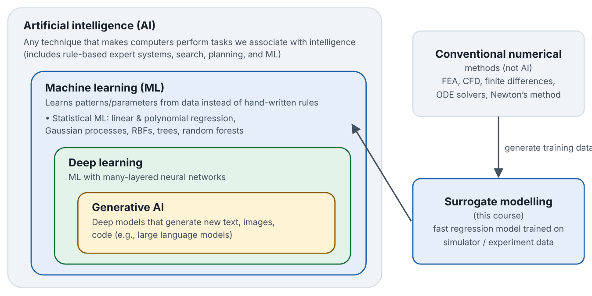

A family of ideas, not one technology
Lesson 1 · What AI, ML, deep learning and generative AI mean · Intuition
Artificial intelligence (AI) is the broad goal of getting computers to perform tasks we associate with intelligence: reasoning, planning, recognizing, predicting. Machine learning (ML) is the part of AI in which the computer learns a rule from data rather than having every rule written by a programmer. Deep learning is ML that uses neural networks with many layers. Generative AI refers to (mostly deep-learning) models that produce new content — text, images, code — such as large language models.
Conventional numerical methods — finite-element analysis (FEA), computational fluid dynamics (CFD), finite differences, ODE solvers — are not AI. They solve known governing equations (equilibrium, Navier–Stokes, energy conservation). In this course they are the expensive simulators whose results we want to approximate.
AI contains ML, which contains deep learning; generative AI is one family within deep learning. Numerical methods sit outside AI and supply training data for surrogates.
Notes:
A family of ideas, not one technology. Artificial intelligence (AI) is the broad goal of getting computers to perform tasks we associate with intelligence: reasoning, planning, recognizing, predicting. Machine learning (ML) is the part of AI in which the computer learns a rule from data rather than having every rule written by a programmer. Deep learning is ML that uses neural networks with many layers. Generative AI refers to (mostly deep-learning) models that produce new content — text, images, code — such as large language models. Conventional numerical methods — finite-element analysis (FEA), computational fluid dynamics (CFD), finite differences, ODE solvers — are not AI. They solve known governing equations (equilibrium, Navier–Stokes, energy conservation). In this course they are the expensive simulators whose results we want to approximate. Look at the figure. AI contains ML, which contains deep learning; generative AI is one family within deep learning. Numerical methods sit outside AI and supply training data for surrogates. Nested boxes: AI ⊃ ML ⊃ deep learning ⊃ generative AI. A separate box “Conventional numerical methods: FEA, CFD, finite differences, ODE solvers” is linked by an arrow labelled “generate training data” to a box “Surrogate modelling (this course)”, which points into the ML box.

Slide 3

A family of ideas, not one technology
Lesson 1 · What AI, ML, deep learning and generative AI mean · The mathematics
Most of this course uses statistical ML: we assume an unknown relationship y = f(x) and fit a model
ŷ = f̂(x; θ)
Symbol | Meaning | Unit
x | input vector (e.g., fin gap and thickness) | mixed (here mm)
y | true output (e.g., thermal resistance) | K/W
ŷ | model prediction of y | K/W
θ | model parameters learned from data | depends on model
Notes:
Now the mathematics. Most of this course uses statistical ML: we assume an unknown relationship y = f(x) and fit a model ŷ = f̂(x; θ) x is the input vector (e.g., fin gap and thickness), in mixed (here mm). y is the true output (e.g., thermal resistance), in K/W. ŷ is the model prediction of y, in K/W. θ is the model parameters learned from data, in depends on model.

Slide 4


A family of ideas, not one technology
Lesson 1 · What AI, ML, deep learning and generative AI mean · In engineering practice
Engineering application
Practical tip
A CFD study of a heat sink might take an hour per design. A regression model fitted to 30 such runs predicts R for a new design in microseconds. That fitted model is a surrogate. A large language model, by contrast, could help you write code or a report, but it is not a surrogate of your heat sink and its text can be wrong.
When someone says “we used AI”, ask: which model, trained on what data, validated how? Those three answers matter more than the label.
Notes:
Where does this matter in engineering? A CFD study of a heat sink might take an hour per design. A regression model fitted to 30 such runs predicts R for a new design in microseconds. That fitted model is a surrogate. A large language model, by contrast, could help you write code or a report, but it is not a surrogate of your heat sink and its text can be wrong. A practical tip: When someone says “we used AI”, ask: which model, trained on what data, validated how? Those three answers matter more than the label.

Slide 5

Pause and predict
Lesson 1 · What AI, ML, deep learning and generative AI mean · Predict before you look
Is a CFD solver that computes the airflow through a heat sink an example of machine learning?
Write down your answer, then continue to the next slide.
Notes:
Time to predict. Is a CFD solver that computes the airflow through a heat sink an example of machine learning? Pause here and commit to an answer before moving on.

Slide 6

What happens, and why
Lesson 1 · What AI, ML, deep learning and generative AI mean · Answer
Question: Is a CFD solver that computes the airflow through a heat sink an example of machine learning?
No. CFD solves known conservation equations numerically; it does not learn its rules from data. It can, however, generate data from which an ML surrogate is trained.
Notes:
Here is the answer. No. CFD solves known conservation equations numerically; it does not learn its rules from data. It can, however, generate data from which an ML surrogate is trained.

Slide 7


A family of ideas, not one technology
Lesson 1 · What AI, ML, deep learning and generative AI mean · Common misconception
Misconception
What is actually true
“AI” and “ML” mean the same thing, and both mean neural networks.
ML is one approach within AI, and neural networks (deep learning) are one family within ML. Linear regression and Gaussian processes are ML too, and are often the best choice for small engineering datasets.
Takeaway AI ⊃ ML ⊃ deep learning ⊃ generative AI. Numerical solvers are not AI; they are the expensive models that surrogates approximate.
Notes:
A common misconception is this: “AI” and “ML” mean the same thing, and both mean neural networks. In fact: ML is one approach within AI, and neural networks (deep learning) are one family within ML. Linear regression and Gaussian processes are ML too, and are often the best choice for small engineering datasets. The takeaway: AI ⊃ ML ⊃ deep learning ⊃ generative AI. Numerical solvers are not AI; they are the expensive models that surrogates approximate.

Slide 8
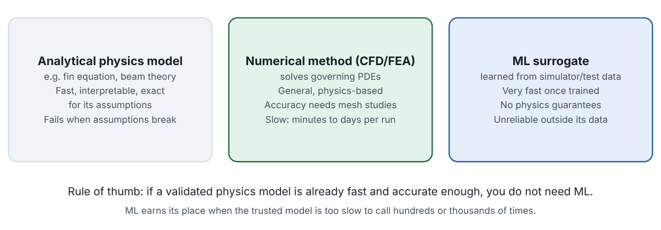
When a physics model or simple numerical method is preferable
Lesson 1 · What AI, ML, deep learning and generative AI mean · Intuition
ML is not automatically an upgrade. If a trusted physics model is already fast enough, an ML model adds cost (data generation), risk (errors, extrapolation) and opacity. ML earns its place when the trusted model is too slow to call the hundreds or thousands of times that design exploration needs, or when no adequate physics model exists but good data do.
Strengths and weaknesses of analytical physics models, numerical methods and ML surrogates.
Notes:
When a physics model or simple numerical method is preferable. ML is not automatically an upgrade. If a trusted physics model is already fast enough, an ML model adds cost (data generation), risk (errors, extrapolation) and opacity. ML earns its place when the trusted model is too slow to call the hundreds or thousands of times that design exploration needs, or when no adequate physics model exists but good data do. Look at the figure. Strengths and weaknesses of analytical physics models, numerical methods and ML surrogates. Three boxes compare analytical physics models (fast, interpretable, limited by assumptions), numerical methods such as CFD/FEA (general and physics-based but slow), and ML surrogates (very fast once trained but without physics guarantees and unreliable outside data).

Slide 9
When a physics model or simple numerical method is preferable
Lesson 1 · What AI, ML, deep learning and generative AI mean · The mathematics (1/2)
A rough cost comparison for a study needing M model calls:
cost_{direct} = M · c_{sim} vs. cost_{surrogate} ≈ n · c_{sim} + c_{fit} + M · c_{pred} + k · c_{sim}
Notes:
Now the mathematics. A rough cost comparison for a study needing M model calls: cost_{direct} = M · c_{sim} vs. cost_{surrogate} ≈ n · c_{sim} + c_{fit} + M · c_{pred} + k · c_{sim}

Slide 10
When a physics model or simple numerical method is preferable
Lesson 1 · What AI, ML, deep learning and generative AI mean · The mathematics (2/2)
Symbol | Meaning | Unit
M | number of evaluations the study needs (e.g., by an optimizer) | count
c_{sim} | cost of one original simulation | s
n | training simulations | count
c_{fit}, c_{pred} | cost to fit the surrogate, cost per prediction | s
k | verification runs of the original model | count
A surrogate pays off when n + k ≪ M and c_{pred} ≪ c_{sim}.
Notes:
Continuing. M is the number of evaluations the study needs (e.g., by an optimizer), in count. c_{sim} is the cost of one original simulation, in s. n is the training simulations, in count. c_{fit}, c_{pred} is the cost to fit the surrogate, cost per prediction, in s. k is the verification runs of the original model, in count. A surrogate pays off when n + k ≪ M and c_{pred} ≪ c_{sim}.

Slide 11
When a physics model or simple numerical method is preferable
Lesson 1 · What AI, ML, deep learning and generative AI mean · In engineering practice
Engineering application
Practical tip
Sizing a shaft for torsion uses τ = T r/J — instant and exact enough; ML would be pointless. Optimizing the 3-D shape of a turbine blade with CFD costing hours per run is a classic surrogate application.
Before proposing ML, write down the time per evaluation of your trusted model and how many evaluations your study needs. If the product is small, skip ML.
Notes:
Where does this matter in engineering? Sizing a shaft for torsion uses τ = T r/J — instant and exact enough; ML would be pointless. Optimizing the 3-D shape of a turbine blade with CFD costing hours per run is a classic surrogate application. A practical tip: Before proposing ML, write down the time per evaluation of your trusted model and how many evaluations your study needs. If the product is small, skip ML.

Slide 12
Pause and predict
Lesson 1 · What AI, ML, deep learning and generative AI mean · Predict before you look
An optimizer needs M = 2 000 evaluations. Each CFD run costs 1 h. A surrogate needs n = 40 training runs and k = 5 verification runs. Roughly how many CFD hours does the surrogate route need?
Write down your answer, then continue to the next slide.
Notes:
Time to predict. An optimizer needs M = 2 000 evaluations. Each CFD run costs 1 h. A surrogate needs n = 40 training runs and k = 5 verification runs. Roughly how many CFD hours does the surrogate route need? Pause here and commit to an answer before moving on.

Slide 13
What happens, and why
Lesson 1 · What AI, ML, deep learning and generative AI mean · Answer
Question: An optimizer needs M = 2 000 evaluations. Each CFD run costs 1 h. A surrogate needs n = 40 training runs and k = 5 verification runs. Roughly how many CFD hours does the surrogate route need?
About 45 h (40 + 5), versus 2 000 h directly — if the surrogate is accurate enough. The fitting and prediction cost is negligible by comparison.
Notes:
Here is the answer. About 45 h (40 + 5), versus 2 000 h directly — if the surrogate is accurate enough. The fitting and prediction cost is negligible by comparison.

Slide 14
When a physics model or simple numerical method is preferable
Lesson 1 · What AI, ML, deep learning and generative AI mean · Common misconception
Misconception
What is actually true
If ML is faster, it is always better.
Speed is useless without adequate accuracy where it matters. If the physics model is already fast and validated, use it.
Takeaway Use ML surrogates when trusted evaluations are expensive and many are needed; otherwise prefer the physics model.
Notes:
A common misconception is this: If ML is faster, it is always better. In fact: Speed is useless without adequate accuracy where it matters. If the physics model is already fast and validated, use it. The takeaway: Use ML surrogates when trusted evaluations are expensive and many are needed; otherwise prefer the physics model.

Slide 15
Key takeaways from this lesson
Summary
1
A family of ideas, not one technology
AI ⊃ ML ⊃ deep learning ⊃ generative AI. Numerical solvers are not AI; they are the expensive models that surrogates approximate.
2
When a physics model or simple numerical method is preferable
Use ML surrogates when trusted evaluations are expensive and many are needed; otherwise prefer the physics model.
Notes:
To sum up this lesson. A family of ideas, not one technology: AI ⊃ ML ⊃ deep learning ⊃ generative AI. Numerical solvers are not AI; they are the expensive models that surrogates approximate. When a physics model or simple numerical method is preferable: Use ML surrogates when trusted evaluations are expensive and many are needed; otherwise prefer the physics model.

Slide 16

Learning from examples, and three kinds of learning
UP NEXT · LESSON 1.2
Next in Module 1: Lesson 2. Mark this lesson complete in the course before continuing.
Notes:
That completes Lesson 1 of Module 1: What AI, ML, deep learning and generative AI mean. Next comes Lesson 2: Learning from examples, and three kinds of learning.

