Slide 1
Regression vs classification; features, targets, samples, parameters
MODULE 01 · LESSON 3 OF 4 · ≈ 9 MIN
1.3
Module 1: AI and ML from the beginning
The vocabulary of a dataset
Regression versus classification
Notes:
Welcome to Module 1, Lesson 3 of the self-paced course Machine Learning Fundamentals for Surrogate-Based Engineering Optimization: Regression vs classification; features, targets, samples, parameters. This lesson belongs to the module AI and ML from the beginning and takes about 9 minutes. In this lesson: The vocabulary of a dataset; Regression versus classification.

Slide 2

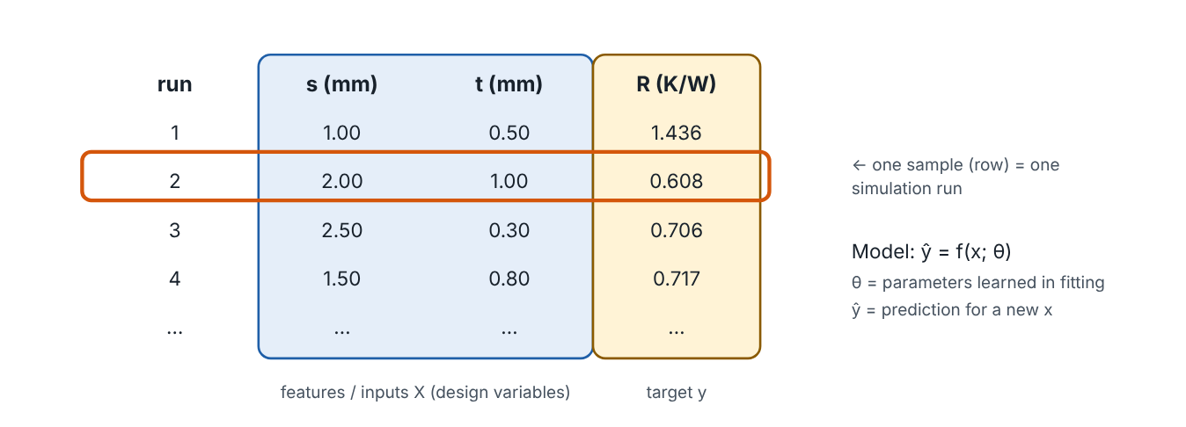
The vocabulary of a dataset
Lesson 3 · Regression vs classification; features, targets, samples, parameters · Intuition
Picture a table. Each row is a sample (one simulation run, one test). The input columns are features (also called inputs, predictors or, in design, design variables). The column we want to predict is the target (output, response). Fitting adjusts the model’s parameters. Applying the fitted model to new inputs gives predictions.
A small heat-sink dataset: features s and t, target R; each row is one run of the model.
Notes:
The vocabulary of a dataset. Picture a table. Each row is a sample (one simulation run, one test). The input columns are features (also called inputs, predictors or, in design, design variables). The column we want to predict is the target (output, response). Fitting adjusts the model’s parameters. Applying the fitted model to new inputs gives predictions. Look at the figure. A small heat-sink dataset: features s and t, target R; each row is one run of the model. A table with columns run, s (mm), t (mm), R (K/W). The s and t columns are highlighted as features, the R column as target, and one row is outlined as a single sample. Beside it: model ŷ = f(x; θ), θ are parameters learned in fitting, ŷ is the prediction for new x.

Slide 3

The vocabulary of a dataset
Lesson 3 · Regression vs classification; features, targets, samples, parameters · The mathematics
We store features in a matrix X of shape n × d (samples × features) and targets in a vector y of length n.
X = [ x₁^{T} ; … ; x_{n}^{T} ] ∈ ℝ^{n×d}, y ∈ ℝ^{n}
For the heat sink, d = 2 (s, t) and y = R in K/W.
Notes:
Now the mathematics. We store features in a matrix X of shape n × d (samples × features) and targets in a vector y of length n. X = [ x_1^T ; … ; x_n^T ] ∈ ℝ^n^×^d, y ∈ ℝ^n For the heat sink, d = 2 (s, t) and y = R in K/W.

Slide 4


The vocabulary of a dataset
Lesson 3 · Regression vs classification; features, targets, samples, parameters · In engineering practice
Engineering application
Practical tip
In a structural study the features might be plate thickness (mm) and rib height (mm); the target the tip deflection (mm). Parameters are internal to the model (e.g., regression coefficients) — they are not design variables.
Put units in column names (s_mm, R_KperW). It prevents the most common engineering ML bug: mixed units.
Notes:
Where does this matter in engineering? In a structural study the features might be plate thickness (mm) and rib height (mm); the target the tip deflection (mm). Parameters are internal to the model (e.g., regression coefficients) — they are not design variables. A practical tip: Put units in column names (s_mm, R_KperW). It prevents the most common engineering ML bug: mixed units.

Slide 5

Pause and predict
Lesson 3 · Regression vs classification; features, targets, samples, parameters · Predict before you look
In the heat-sink table, is the fin thickness t a parameter or a feature?
Write down your answer, then continue to the next slide.
Notes:
Time to predict. In the heat-sink table, is the fin thickness t a parameter or a feature? Pause here and commit to an answer before moving on.

Slide 6

What happens, and why
Lesson 3 · Regression vs classification; features, targets, samples, parameters · Answer
Question: In the heat-sink table, is the fin thickness t a parameter or a feature?
A feature (and design variable). Parameters are the numbers inside the fitted model, such as polynomial coefficients.
Notes:
Here is the answer. A feature (and design variable). Parameters are the numbers inside the fitted model, such as polynomial coefficients.

Slide 7


The vocabulary of a dataset
Lesson 3 · Regression vs classification; features, targets, samples, parameters · Common misconception
Misconception
What is actually true
“Parameters” and “design variables” are interchangeable.
In this course, design variables are inputs you choose; parameters are fitted model coefficients. (Some texts use “design parameters” for inputs — always check the context.)
Takeaway Rows = samples; input columns = features/design variables; output column = target; fitted coefficients = parameters.
Notes:
A common misconception is this: “Parameters” and “design variables” are interchangeable. In fact: In this course, design variables are inputs you choose; parameters are fitted model coefficients. (Some texts use “design parameters” for inputs — always check the context.) The takeaway: Rows = samples; input columns = features/design variables; output column = target; fitted coefficients = parameters.

Slide 8
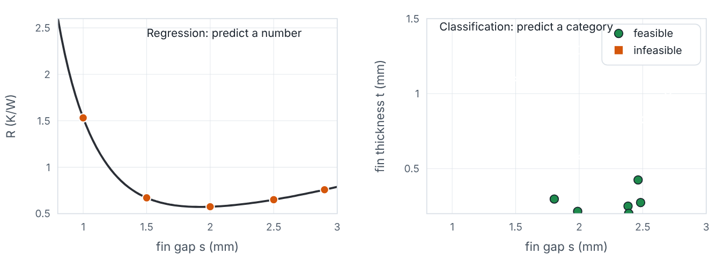
Regression versus classification
Lesson 3 · Regression vs classification; features, targets, samples, parameters · Intuition
Regression predicts a continuous number (thermal resistance, stress, efficiency). Classification predicts a category (feasible/infeasible, defect/no defect, failure mode). Surrogates of simulator outputs are almost always regression; feasibility can be treated either way.
Left: regression predicts R as a number. Right: classification labels designs as feasible or infeasible.
Notes:
Regression versus classification. Regression predicts a continuous number (thermal resistance, stress, efficiency). Classification predicts a category (feasible/infeasible, defect/no defect, failure mode). Surrogates of simulator outputs are almost always regression; feasibility can be treated either way. Look at the figure. Left: regression predicts R as a number. Right: classification labels designs as feasible or infeasible. Left plot: a smooth curve of thermal resistance versus fin gap with sample points. Right plot: scattered designs in the s–t plane marked as feasible (circles) or infeasible (crosses).

Slide 9
Regression versus classification
Lesson 3 · Regression vs classification; features, targets, samples, parameters · The mathematics
Regression: ŷ ∈ ℝ, often trained with squared-error loss. Classification: ŷ ∈ {class 1, …, class K}, often trained to output class probabilities.
Notes:
Now the mathematics. Regression: ŷ ∈ ℝ, often trained with squared-error loss. Classification: ŷ ∈ {class 1, …, class K}, often trained to output class probabilities.

Slide 10
Regression versus classification
Lesson 3 · Regression vs classification; features, targets, samples, parameters · In engineering practice
Engineering application
Practical tip
Heat sink: predicting R is regression. Predicting whether a design meets the mass limit is classification — but since mass is a simple formula we compute it exactly instead. Machining: predicting R_{a} (µm) is regression; predicting chatter / no chatter is classification.
If a constraint can be predicted as a continuous margin (e.g., stress − allowable), regress the margin rather than a yes/no label: you keep information about how close to the limit you are.
Notes:
Where does this matter in engineering? Heat sink: predicting R is regression. Predicting whether a design meets the mass limit is classification — but since mass is a simple formula we compute it exactly instead. Machining: predicting R_a (µm) is regression; predicting chatter / no chatter is classification. A practical tip: If a constraint can be predicted as a continuous margin (e.g., stress − allowable), regress the margin rather than a yes/no label: you keep information about how close to the limit you are.

Slide 11
Pause and predict
Lesson 3 · Regression vs classification; features, targets, samples, parameters · Predict before you look
Predicting the number of cycles to fatigue failure of a welded joint — regression or classification?
Write down your answer, then continue to the next slide.
Notes:
Time to predict. Predicting the number of cycles to fatigue failure of a welded joint — regression or classification? Pause here and commit to an answer before moving on.

Slide 12
What happens, and why
Lesson 3 · Regression vs classification; features, targets, samples, parameters · Answer
Question: Predicting the number of cycles to fatigue failure of a welded joint — regression or classification?
Regression (a positive number, often modelled on a log scale). Predicting “survives 10⁶ cycles: yes/no” would be classification.
Notes:
Here is the answer. Regression (a positive number, often modelled on a log scale). Predicting “survives 10⁶ cycles: yes/no” would be classification.

Slide 13
Regression versus classification
Lesson 3 · Regression vs classification; features, targets, samples, parameters · Common misconception
Misconception
What is actually true
If outputs are integers, it must be classification.
Counts like cycles to failure are numbers with order and magnitude; regression is appropriate.
Takeaway Number → regression; category → classification. Surrogate optimization is mainly regression.
Notes:
A common misconception is this: If outputs are integers, it must be classification. In fact: Counts like cycles to failure are numbers with order and magnitude; regression is appropriate. The takeaway: Number → regression; category → classification. Surrogate optimization is mainly regression.

Slide 14
Key takeaways from this lesson
Summary
1
The vocabulary of a dataset
Rows = samples; input columns = features/design variables; output column = target; fitted coefficients = parameters.
2
Regression versus classification
Number → regression; category → classification. Surrogate optimization is mainly regression.
Notes:
To sum up this lesson. The vocabulary of a dataset: Rows = samples; input columns = features/design variables; output column = target; fitted coefficients = parameters. Regression versus classification: Number → regression; category → classification. Surrogate optimization is mainly regression.

Slide 15

When ML is useful — and when it is unnecessary
UP NEXT · LESSON 1.4
Next in Module 1: Lesson 4. Mark this lesson complete in the course before continuing.
Notes:
That completes Lesson 3 of Module 1: Regression vs classification; features, targets, samples, parameters. Next comes Lesson 4: When ML is useful — and when it is unnecessary.

