Slide 1
When ML is useful — and when it is unnecessary
MODULE 01 · LESSON 4 OF 4 · ≈ 7 MIN
1.4
Module 1: AI and ML from the beginning
A decision checklist
Notes:
Welcome to Module 1, Lesson 4 of the self-paced course Machine Learning Fundamentals for Surrogate-Based Engineering Optimization: When ML is useful — and when it is unnecessary. This lesson belongs to the module AI and ML from the beginning and takes about 7 minutes. In this lesson: A decision checklist.

Slide 2

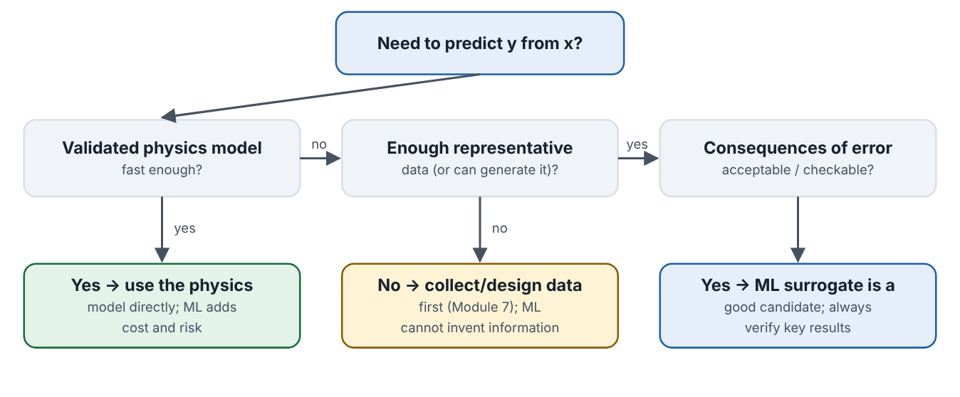
A decision checklist
Lesson 4 · When ML is useful — and when it is unnecessary · Intuition
Three questions decide whether ML is a sensible tool: (1) Is there a validated model that is already fast enough? (2) Can you get enough representative data? (3) Are errors acceptable and checkable? Only if the first answer is “no” and the others “yes” does an ML surrogate make sense.
Decision flow for choosing between a physics model, more data, or an ML surrogate.
Notes:
A decision checklist. Three questions decide whether ML is a sensible tool: (1) Is there a validated model that is already fast enough? (2) Can you get enough representative data? (3) Are errors acceptable and checkable? Only if the first answer is “no” and the others “yes” does an ML surrogate make sense. Look at the figure. Decision flow for choosing between a physics model, more data, or an ML surrogate. Flowchart starting from “Need to predict y from x?”. If a validated physics model is fast enough, use it. Otherwise, if not enough representative data exist, collect or design data first. If data exist and errors are acceptable and checkable, an ML surrogate is a good candidate, with verification of key results.

Slide 3

A decision checklist
Lesson 4 · When ML is useful — and when it is unnecessary · The mathematics
No new mathematics — but note the information argument: a model fitted to n samples cannot reliably represent features of f(x) that the samples never revealed. More model flexibility cannot replace missing data.
Notes:
Now the mathematics. No new mathematics — but note the information argument: a model fitted to n samples cannot reliably represent features of f(x) that the samples never revealed. More model flexibility cannot replace missing data.

Slide 4


A decision checklist
Lesson 4 · When ML is useful — and when it is unnecessary · In engineering practice
Engineering application
Practical tip
Thermal systems: LMTD/ε-NTU calculations for a standard shell-and-tube exchanger are instant — no ML needed. Fluid machinery: a full-annulus unsteady CFD of a turbine stage — strong surrogate candidate. Additive manufacturing: porosity vs laser power and scan speed from 25 printed coupons — feasible, but small data and noisy measurements call for simple models and honest uncertainty.
Write the decision down in your report: why a surrogate was needed, what it replaces, and how its key outputs were verified.
Notes:
Where does this matter in engineering? Thermal systems: LMTD/ε-NTU calculations for a standard shell-and-tube exchanger are instant — no ML needed. Fluid machinery: a full-annulus unsteady CFD of a turbine stage — strong surrogate candidate. Additive manufacturing: porosity vs laser power and scan speed from 25 printed coupons — feasible, but small data and noisy measurements call for simple models and honest uncertainty. A practical tip: Write the decision down in your report: why a surrogate was needed, what it replaces, and how its key outputs were verified.

Slide 5

Pause and predict
Lesson 4 · When ML is useful — and when it is unnecessary · Predict before you look
A beam-deflection formula gives results in microseconds and agrees with tests within 3%. A student proposes a neural network trained on the formula’s outputs. Good idea?
Write down your answer, then continue to the next slide.
Notes:
Time to predict. A beam-deflection formula gives results in microseconds and agrees with tests within 3%. A student proposes a neural network trained on the formula’s outputs. Good idea? Pause here and commit to an answer before moving on.

Slide 6

What happens, and why
Lesson 4 · When ML is useful — and when it is unnecessary · Answer
Question: A beam-deflection formula gives results in microseconds and agrees with tests within 3%. A student proposes a neural network trained on the formula’s outputs. Good idea?
No. The network can only reproduce the formula (with added error) and adds training cost and extrapolation risk. Use the formula.
Notes:
Here is the answer. No. The network can only reproduce the formula (with added error) and adds training cost and extrapolation risk. Use the formula.

Slide 7


A decision checklist
Lesson 4 · When ML is useful — and when it is unnecessary · Common misconception
Misconception
What is actually true
More data always fixes a bad ML model.
Data must be representative of where the model will be used; 10 000 samples from the wrong region do not help near the optimum.
Takeaway ML is a tool for expensive or missing physics, not a default. Verification remains your responsibility.
Notes:
A common misconception is this: More data always fixes a bad ML model. In fact: Data must be representative of where the model will be used; 10 000 samples from the wrong region do not help near the optimum. The takeaway: ML is a tool for expensive or missing physics, not a default. Verification remains your responsibility.

Slide 8
Key takeaways from this lesson
Summary
1
A decision checklist
ML is a tool for expensive or missing physics, not a default. Verification remains your responsibility.
Notes:
To sum up this lesson. A decision checklist: ML is a tool for expensive or missing physics, not a default. Verification remains your responsibility.

Slide 9

Notebooks, cells, execution order and variables
UP NEXT · LESSON 2.1
That completes Module 1. Before moving on, review the Module 1 flashcards and take its quiz in the course (pass mark 70%). Next: Module 2, Python and Jupyter foundations.
Notes:
That completes Lesson 4 of Module 1: When ML is useful — and when it is unnecessary. This was the last lesson of the module, so review the flashcards and take the Module 1 quiz in the course. Next comes Module 2, Python and Jupyter foundations, starting with Notebooks, cells, execution order and variables.

