Slide 1
Notebooks, cells, execution order and variables
MODULE 02 · LESSON 1 OF 4 · ≈ 9 MIN
2.1
Module 2: Python and Jupyter foundations
What a notebook is
Notes:
Welcome to Module 2, Lesson 1 of the self-paced course Machine Learning Fundamentals for Surrogate-Based Engineering Optimization: Notebooks, cells, execution order and variables. This lesson belongs to the module Python and Jupyter foundations and takes about 9 minutes. In this lesson: What a notebook is.

Slide 2

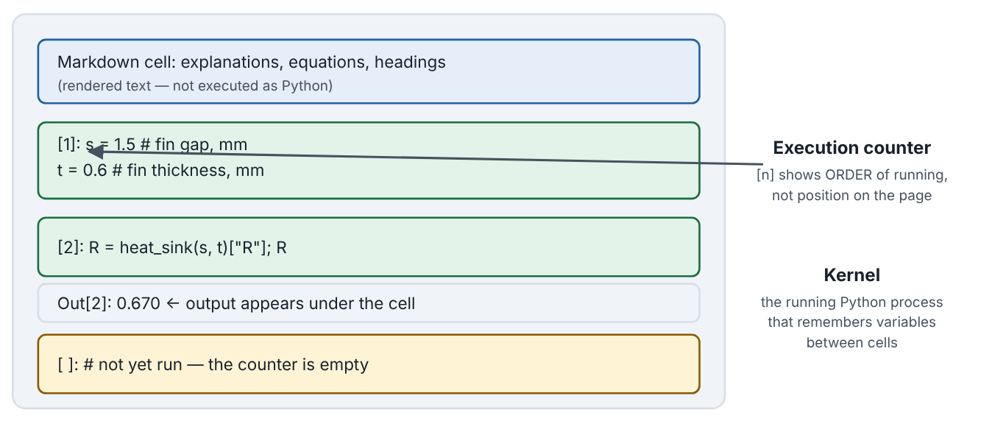
What a notebook is
Lesson 1 · Notebooks, cells, execution order and variables · Intuition
A Jupyter notebook (.ipynb file) mixes explanatory text (Markdown cells) with runnable Python (code cells). Code runs in a kernel — a Python process that remembers variables between cells. Outputs (numbers, tables, plots) appear under each cell. The number in [ ] beside a cell records the order in which cells were run, which may differ from their order on the page.
Anatomy of a notebook: Markdown cell, code cells with execution counters, output, and an unexecuted cell.
Notes:
What a notebook is. A Jupyter notebook (.ipynb file) mixes explanatory text (Markdown cells) with runnable Python (code cells). Code runs in a kernel — a Python process that remembers variables between cells. Outputs (numbers, tables, plots) appear under each cell. The number in [ ] beside a cell records the order in which cells were run, which may differ from their order on the page. Look at the figure. Anatomy of a notebook: Markdown cell, code cells with execution counters, output, and an unexecuted cell. A notebook mock-up: a Markdown cell with text; code cell [1] setting s and t; code cell [2] computing R with output 0.889 shown below it; an empty-counter cell not yet run. Annotations explain that the counter shows run order and that the kernel remembers variables.

Slide 3

What a notebook is
Lesson 1 · Notebooks, cells, execution order and variables · The mathematics
Code is not an equation. N_fins = W_mm / (s_mm + t_mm) means “compute the right-hand side now and store it under the name on the left”. If you later change s_mm, N_fins does not update until you re-run its cell.
# A first notebook cell: variables with units in their names
s_mm = 1.5 # fin gap, mm
t_mm = 0.6 # fin thickness, mm
W_mm = 50.0 # heat-sink width, mm
N_fins = W_mm / (s_mm + t_mm) # continuous fin count
print("Number of fins:", round(N_fins, 2))
Notes:
Now the mathematics. Code is not an equation. N_fins = W_mm / (s_mm + t_mm) means “compute the right-hand side now and store it under the name on the left”. If you later change s_mm, N_fins does not update until you re-run its cell. (The code listing is shown on the slide: # A first notebook cell: variables with units in their names; s_mm = 1.5 # fin gap, mm; t_mm = 0.6 # fin thickness, mm; W_mm = 50.0 # heat-sink width, mm; N_fins = W_mm / (s_mm + t_mm) # continuous fin count; print("Number of fins:", round(N_fins, 2)))

Slide 4


What a notebook is
Lesson 1 · Notebooks, cells, execution order and variables · In engineering practice
Engineering application
Practical tip
Notebooks are ideal for engineering studies because the narrative (assumptions, units, interpretation) sits next to the calculation and the plot — a living lab report.
Before submitting or reporting: Kernel → Restart Kernel and Run All Cells. If it runs cleanly, your notebook is reproducible.
Notes:
Where does this matter in engineering? Notebooks are ideal for engineering studies because the narrative (assumptions, units, interpretation) sits next to the calculation and the plot — a living lab report. A practical tip: Before submitting or reporting: Kernel → Restart Kernel and Run All Cells. If it runs cleanly, your notebook is reproducible.

Slide 5

Pause and predict
Lesson 1 · Notebooks, cells, execution order and variables · Predict before you look
You run a cell setting s_mm = 1.5, then a cell computing N_fins, then go back and change the first cell to s_mm = 2.0 and run only that cell. What value does N_fins hold?
Write down your answer, then continue to the next slide.
Notes:
Time to predict. You run a cell setting s_mm = 1.5, then a cell computing N_fins, then go back and change the first cell to s_mm = 2.0 and run only that cell. What value does N_fins hold? Pause here and commit to an answer before moving on.

Slide 6

What happens, and why
Lesson 1 · Notebooks, cells, execution order and variables · Answer
Question: You run a cell setting s_mm = 1.5, then a cell computing N_fins, then go back and change the first cell to s_mm = 2.0 and run only that cell. What value does N_fins hold?
The old value computed with 1.5 mm. Variables are not live formulas; you must re-run the dependent cell. Use “Restart Kernel and Run All Cells” before trusting results.
Notes:
Here is the answer. The old value computed with 1.5 mm. Variables are not live formulas; you must re-run the dependent cell. Use “Restart Kernel and Run All Cells” before trusting results.

Slide 7


What a notebook is
Lesson 1 · Notebooks, cells, execution order and variables · Common misconception
Misconception
What is actually true
The notebook runs top to bottom automatically, like a script.
Cells run only when you execute them, in whatever order you choose. Hidden state from out-of-order execution is a major source of irreproducible results.
Takeaway Notebook = text + code + outputs. Execution order, not page order, determines variable values.
Notes:
A common misconception is this: The notebook runs top to bottom automatically, like a script. In fact: Cells run only when you execute them, in whatever order you choose. Hidden state from out-of-order execution is a major source of irreproducible results. The takeaway: Notebook = text + code + outputs. Execution order, not page order, determines variable values.

Slide 8
Key takeaways from this lesson
Summary
1
What a notebook is
Notebook = text + code + outputs. Execution order, not page order, determines variable values.
Notes:
To sum up this lesson. What a notebook is: Notebook = text + code + outputs. Execution order, not page order, determines variable values.

Slide 9

Lists, arrays, functions, tables and plots
UP NEXT · LESSON 2.2
Next in Module 2: Lesson 2. Mark this lesson complete in the course before continuing.
Notes:
That completes Lesson 1 of Module 2: Notebooks, cells, execution order and variables. Next comes Lesson 2: Lists, arrays, functions, tables and plots.

