Slide 1
Functions, vectors, matrices and gradients
MODULE 03 · LESSON 1 OF 4 · ≈ 10 MIN
3.1
Module 3: Mathematics and data intuition
A design response is a function of a vector
Notes:
Welcome to Module 3, Lesson 1 of the self-paced course Machine Learning Fundamentals for Surrogate-Based Engineering Optimization: Functions, vectors, matrices and gradients. This lesson belongs to the module Mathematics and data intuition and takes about 10 minutes. In this lesson: A design response is a function of a vector.

Slide 2
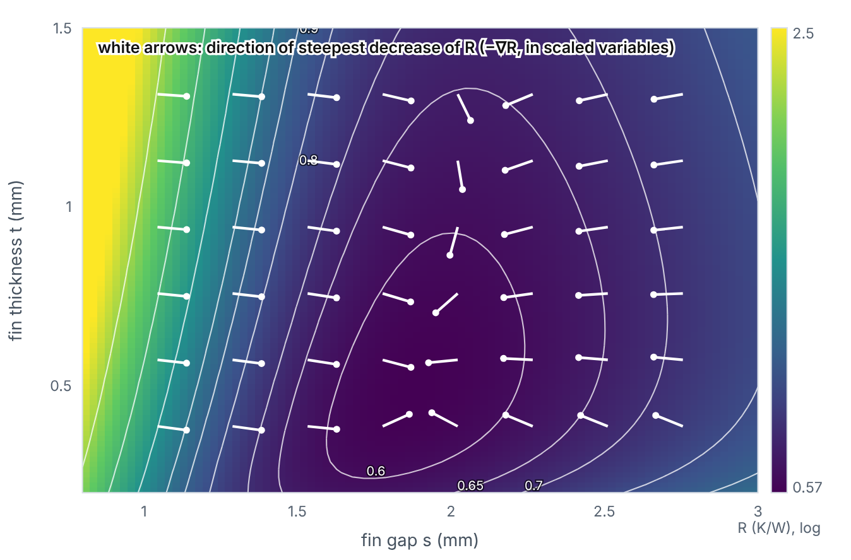

A design response is a function of a vector
Lesson 1 · Functions, vectors, matrices and gradients · Intuition
The heat sink’s thermal resistance depends on two numbers: R = f(s, t). Collect them into a vector x = (s, t). The set of all allowed x is the design space. A colour map of R over the design space is the response surface. The gradient ∇R points uphill; −∇R points in the direction of fastest decrease.
Thermal resistance over the design space, with arrows showing the direction of steepest decrease (−∇R in scaled variables).
Notes:
A design response is a function of a vector. The heat sink’s thermal resistance depends on two numbers: R = f(s, t). Collect them into a vector x = (s, t). The set of all allowed x is the design space. A colour map of R over the design space is the response surface. The gradient ∇R points uphill; −∇R points in the direction of fastest decrease. Look at the figure. Thermal resistance over the design space, with arrows showing the direction of steepest decrease (−∇R in scaled variables). Colour map of R over fin gap and fin thickness, with white arrows. At small gaps arrows point strongly toward larger gaps; near the valley around s ≈ 1.9 mm arrows are short or point toward thinner fins.

Slide 3

A design response is a function of a vector
Lesson 1 · Functions, vectors, matrices and gradients · The mathematics
∇R(x) = ( (∂R)/(∂s), (∂R)/(∂t) )
Symbol | Meaning | Unit
x | design vector (s, t) | mm
∂R/∂s | change of R per unit change of s with t fixed | K/(W·mm)
∇R | gradient vector | K/(W·mm)
A matrix is a 2-D array of numbers; the dataset X (n × d) is one. A linear model computes ŷ = Xβ — a matrix–vector product: each prediction is a weighted sum of the features. Derivatives can be approximated numerically: ∂R/∂s ≈ [R(s+h, t) − R(s−h, t)]/(2h).
Notes:
Now the mathematics. ∇R(x) = ( (∂R)/(∂s), (∂R)/(∂t) ) x is the design vector (s, t), in mm. ∂R/∂s is the change of R per unit change of s with t fixed, in K/(W·mm). ∇R is the gradient vector, in K/(W·mm). A matrix is a 2-D array of numbers; the dataset X (n × d) is one. A linear model computes ŷ = Xβ — a matrix–vector product: each prediction is a weighted sum of the features. Derivatives can be approximated numerically: ∂R/∂s ≈ [R(s+h, t) − R(s−h, t)]/(2h).

Slide 4


A design response is a function of a vector
Lesson 1 · Functions, vectors, matrices and gradients · In engineering practice
Engineering application
Practical tip
At s = 1.0 mm, t = 0.6 mm the model gives ∂R/∂s ≈ -3.608 K/(W·mm): widening the gap by 0.1 mm lowers R by about 0.36 K/W. Gradient-based optimizers (Module 10) follow such derivatives.
Compare sensitivities only after scaling or normalizing (next lessons); ∂R/∂s and ∂R/∂t share units here, but in general variables have different units and ranges.
Notes:
Where does this matter in engineering? At s = 1.0 mm, t = 0.6 mm the model gives ∂R/∂s ≈ -3.608 K/(W·mm): widening the gap by 0.1 mm lowers R by about 0.36 K/W. Gradient-based optimizers (Module 10) follow such derivatives. A practical tip: Compare sensitivities only after scaling or normalizing (next lessons); ∂R/∂s and ∂R/∂t share units here, but in general variables have different units and ranges.

Slide 5

Pause and predict
Lesson 1 · Functions, vectors, matrices and gradients · Predict before you look
Near the bottom of the valley in R, what is the magnitude of the gradient?
Write down your answer, then continue to the next slide.
Notes:
Time to predict. Near the bottom of the valley in R, what is the magnitude of the gradient? Pause here and commit to an answer before moving on.

Slide 6

What happens, and why
Lesson 1 · Functions, vectors, matrices and gradients · Answer
Question: Near the bottom of the valley in R, what is the magnitude of the gradient?
Close to zero: at an interior minimum the slope in every direction vanishes (∇R = 0). Constrained optima are an exception — the gradient need not vanish there (Module 10).
Notes:
Here is the answer. Close to zero: at an interior minimum the slope in every direction vanishes (∇R = 0). Constrained optima are an exception — the gradient need not vanish there (Module 10).

Slide 7


A design response is a function of a vector
Lesson 1 · Functions, vectors, matrices and gradients · Common misconception
Misconception
What is actually true
The gradient points toward the minimum.
It points uphill, in the direction of steepest increase. Its negative points downhill — and only locally; the true minimum may lie elsewhere.
Takeaway R = f(x) over a design space; the gradient gives local slopes, with units of output per unit input.
Notes:
A common misconception is this: The gradient points toward the minimum. In fact: It points uphill, in the direction of steepest increase. Its negative points downhill — and only locally; the true minimum may lie elsewhere. The takeaway: R = f(x) over a design space; the gradient gives local slopes, with units of output per unit input.

Slide 8
Key takeaways from this lesson
Summary
1
A design response is a function of a vector
R = f(x) over a design space; the gradient gives local slopes, with units of output per unit input.
Notes:
To sum up this lesson. A design response is a function of a vector: R = f(x) over a design space; the gradient gives local slopes, with units of output per unit input.

Slide 9

Mean, variance, measurement noise and outliers
UP NEXT · LESSON 3.2
Next in Module 3: Lesson 2. Mark this lesson complete in the course before continuing.
Notes:
That completes Lesson 1 of Module 3: Functions, vectors, matrices and gradients. Next comes Lesson 2: Mean, variance, measurement noise and outliers.

