Slide 1
Mean, variance, measurement noise and outliers
MODULE 03 · LESSON 2 OF 4 · ≈ 9 MIN
3.2
Module 3: Mathematics and data intuition
Summarizing repeated measurements
Notes:
Welcome to Module 3, Lesson 2 of the self-paced course Machine Learning Fundamentals for Surrogate-Based Engineering Optimization: Mean, variance, measurement noise and outliers. This lesson belongs to the module Mathematics and data intuition and takes about 9 minutes. In this lesson: Summarizing repeated measurements.

Slide 2
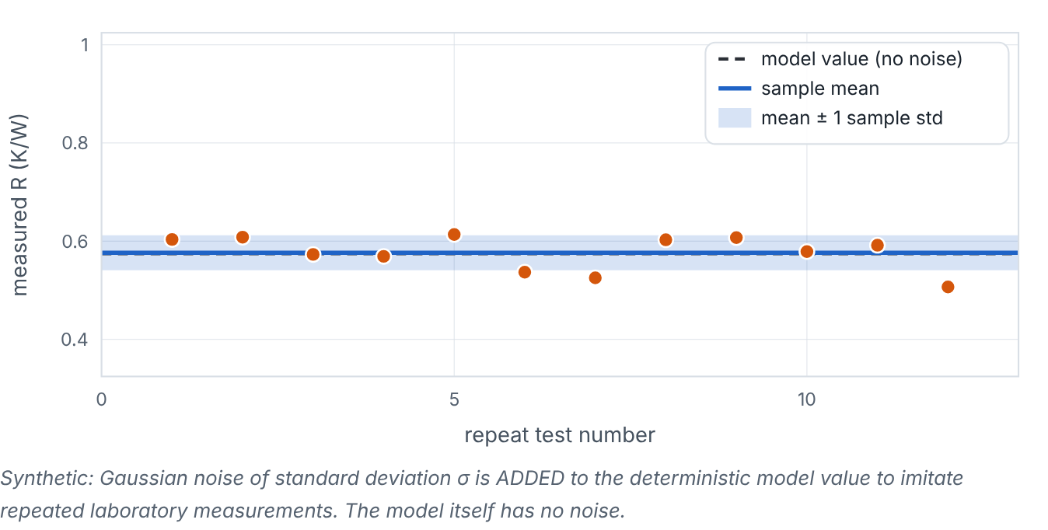

Summarizing repeated measurements
Lesson 2 · Mean, variance, measurement noise and outliers · Intuition
Real tests scatter: repeating a wind-tunnel measurement of R gives slightly different numbers each time because of sensor noise, ambient changes and setup. The mean summarizes the centre; the variance and standard deviation summarize the spread. An outlier is a point far from the rest — maybe a real effect, maybe a mistake. Our pedagogical model is deterministic: it has no noise. Noise is added only in clearly labelled exercises.
Synthetic noisy repeat measurements around a model value; adjust noise and add an outlier. (Interactive in the online course.)
Notes:
Summarizing repeated measurements. Real tests scatter: repeating a wind-tunnel measurement of R gives slightly different numbers each time because of sensor noise, ambient changes and setup. The mean summarizes the centre; the variance and standard deviation summarize the spread. An outlier is a point far from the rest — maybe a real effect, maybe a mistake. Our pedagogical model is deterministic: it has no noise. Noise is added only in clearly labelled exercises. Look at the figure. Synthetic noisy repeat measurements around a model value; adjust noise and add an outlier. Twelve scattered points around a horizontal dashed line (model value). A blue line shows their mean and a band shows mean ± one standard deviation. Adding an outlier shifts the mean and widens the band, while the median barely changes.

Slide 3

Summarizing repeated measurements
Lesson 2 · Mean, variance, measurement noise and outliers · The mathematics
ȳ = (1)/(n) Σ y_{i}, s² = (1)/(n − 1) Σ (y_{i} − ȳ)², SE = (s)/(√n)
Symbol | Meaning | Unit
ȳ | sample mean | same as y (K/W)
s² | sample variance | (K/W)²
s | sample standard deviation | K/W
SE | standard error of the mean | K/W
A simple noise model: y_{i} = f(x) + ε_{i}, with ε_{i} ~ N(0, σ²) — independent Gaussian errors of standard deviation σ.
Notes:
Now the mathematics. ȳ = (1)/(n) Σ y_i, s^2 = (1)/(n − 1) Σ (y_i − ȳ)^2, SE = (s)/(√n) ȳ is the sample mean, in same as y (K/W). s² is the sample variance, in (K/W)². s is the sample standard deviation, in K/W. SE is the standard error of the mean, in K/W. A simple noise model: y_i = f(x) + ε_i, with ε_i ~ N(0, σ²) — independent Gaussian errors of standard deviation σ.

Slide 4


Summarizing repeated measurements
Lesson 2 · Mean, variance, measurement noise and outliers · In engineering practice
Engineering application
Practical tip
Additive-manufacturing coupons printed with identical settings show porosity scatter of several tenths of a percent. A surrogate should not chase that scatter (overfitting); it should capture the trend. Machining: three repeat cuts per setting give a direct estimate of σ for roughness.
If you can, repeat a few design points. Repeats estimate noise directly and tell you the best accuracy any surrogate can honestly achieve.
Notes:
Where does this matter in engineering? Additive-manufacturing coupons printed with identical settings show porosity scatter of several tenths of a percent. A surrogate should not chase that scatter (overfitting); it should capture the trend. Machining: three repeat cuts per setting give a direct estimate of σ for roughness. A practical tip: If you can, repeat a few design points. Repeats estimate noise directly and tell you the best accuracy any surrogate can honestly achieve.

Slide 5

Pause and predict
Lesson 2 · Mean, variance, measurement noise and outliers · Predict before you look
Five measurements: 0.70, 0.72, 0.71, 0.69, 0.98 K/W. Will the mean or the median be more affected by 0.98?
Write down your answer, then continue to the next slide.
Notes:
Time to predict. Five measurements: 0.70, 0.72, 0.71, 0.69, 0.98 K/W. Will the mean or the median be more affected by 0.98? Pause here and commit to an answer before moving on.

Slide 6

What happens, and why
Lesson 2 · Mean, variance, measurement noise and outliers · Answer
Question: Five measurements: 0.70, 0.72, 0.71, 0.69, 0.98 K/W. Will the mean or the median be more affected by 0.98?
The mean (0.760) is pulled up; the median (0.71) is barely affected. Investigate 0.98 before deleting it — it may be a real effect or a recording error.
Notes:
Here is the answer. The mean (0.760) is pulled up; the median (0.71) is barely affected. Investigate 0.98 before deleting it — it may be a real effect or a recording error.

Slide 7


Summarizing repeated measurements
Lesson 2 · Mean, variance, measurement noise and outliers · Common misconception
Misconception
What is actually true
Outliers should always be deleted.
Remove a point only with a documented physical reason (e.g., sensor fault). Otherwise report it, and consider robust metrics or models.
Takeaway Mean = centre, standard deviation = spread (same units as data). Deterministic simulators have no measurement noise.
Notes:
A common misconception is this: Outliers should always be deleted. In fact: Remove a point only with a documented physical reason (e.g., sensor fault). Otherwise report it, and consider robust metrics or models. The takeaway: Mean = centre, standard deviation = spread (same units as data). Deterministic simulators have no measurement noise.

Slide 8
Key takeaways from this lesson
Summary
1
Summarizing repeated measurements
Mean = centre, standard deviation = spread (same units as data). Deterministic simulators have no measurement noise.
Notes:
To sum up this lesson. Summarizing repeated measurements: Mean = centre, standard deviation = spread (same units as data). Deterministic simulators have no measurement noise.

Slide 9

Correlation versus causation
UP NEXT · LESSON 3.3
Next in Module 3: Lesson 3. Mark this lesson complete in the course before continuing.
Notes:
That completes Lesson 2 of Module 3: Mean, variance, measurement noise and outliers. Next comes Lesson 3: Correlation versus causation.

