Slide 1
Correlation versus causation
MODULE 03 · LESSON 3 OF 4 · ≈ 7 MIN
3.3
Module 3: Mathematics and data intuition
Variables can move together without one causing the other
Notes:
Welcome to Module 3, Lesson 3 of the self-paced course Machine Learning Fundamentals for Surrogate-Based Engineering Optimization: Correlation versus causation. This lesson belongs to the module Mathematics and data intuition and takes about 7 minutes. In this lesson: Variables can move together without one causing the other.

Slide 2

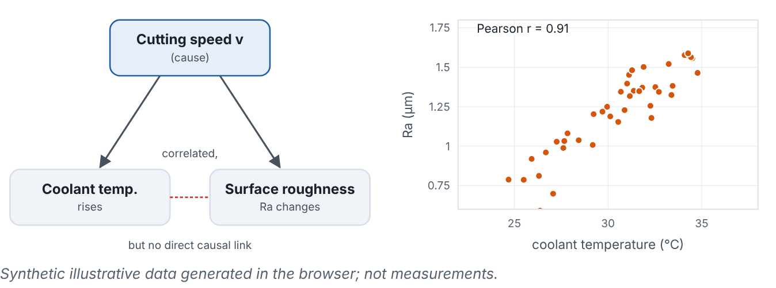
Variables can move together without one causing the other
Lesson 3 · Correlation versus causation · Intuition
Correlation measures how strongly two variables move together in data. Causation means changing one would change the other. A hidden common cause (a confounder) can produce correlation without causation.
Cutting speed raises both coolant temperature and roughness; the two are correlated in data although neither causes the other.
Notes:
Variables can move together without one causing the other. Correlation measures how strongly two variables move together in data. Causation means changing one would change the other. A hidden common cause (a confounder) can produce correlation without causation. Look at the figure. Cutting speed raises both coolant temperature and roughness; the two are correlated in data although neither causes the other. Left: a causal diagram with cutting speed pointing to coolant temperature and to surface roughness. Right: a scatter plot of roughness versus coolant temperature showing positive correlation, with the Pearson coefficient printed.

Slide 3

Variables can move together without one causing the other
Lesson 3 · Correlation versus causation · The mathematics
r = (Σ(x_{i} − x̄)(y_{i} − ȳ))/(√[Σ(x_{i} − x̄)² Σ(y_{i} − ȳ)²])
The Pearson coefficient r ∈ [−1, 1] is dimensionless and measures only linear association.
Notes:
Now the mathematics. r = (Σ(x_i − x̄)(y_i − ȳ))/(√[Σ(x_i − x̄)^2 Σ(y_i − ȳ)^2]) The Pearson coefficient r ∈ [−1, 1] is dimensionless and measures only linear association.

Slide 4


Variables can move together without one causing the other
Lesson 3 · Correlation versus causation · In engineering practice
Engineering application
Practical tip
In historical shop-floor data, high coolant temperature correlates with poor roughness. Cooling the coolant would not fix roughness if cutting speed drives both. In simulation-based surrogates, inputs are set by the designer and independently varied, so correlation in a well-designed sample does reflect the simulator’s cause–effect structure — one advantage of designed experiments (Module 7) over observational data.
Prefer designed experiments, where you set inputs independently, over mining historical data, whenever the goal is design decisions.
Notes:
Where does this matter in engineering? In historical shop-floor data, high coolant temperature correlates with poor roughness. Cooling the coolant would not fix roughness if cutting speed drives both. In simulation-based surrogates, inputs are set by the designer and independently varied, so correlation in a well-designed sample does reflect the simulator’s cause–effect structure — one advantage of designed experiments (Module 7) over observational data. A practical tip: Prefer designed experiments, where you set inputs independently, over mining historical data, whenever the goal is design decisions.

Slide 5

Pause and predict
Lesson 3 · Correlation versus causation · Predict before you look
A dataset shows r = 0.0 between fin gap and R across the full range. Does that mean fin gap does not affect R?
Write down your answer, then continue to the next slide.
Notes:
Time to predict. A dataset shows r = 0.0 between fin gap and R across the full range. Does that mean fin gap does not affect R? Pause here and commit to an answer before moving on.

Slide 6

What happens, and why
Lesson 3 · Correlation versus causation · Answer
Question: A dataset shows r = 0.0 between fin gap and R across the full range. Does that mean fin gap does not affect R?
No. R first falls and then rises with s (a U-shape); a strong nonlinear dependence can have near-zero linear correlation.
Notes:
Here is the answer. No. R first falls and then rises with s (a U-shape); a strong nonlinear dependence can have near-zero linear correlation.

Slide 7


Variables can move together without one causing the other
Lesson 3 · Correlation versus causation · Common misconception
Misconception
What is actually true
High correlation proves that one variable controls the other.
Correlation can come from confounders, coincidence or reverse causation. Controlled variation (experiments) is needed to establish cause.
Takeaway Correlation ≠ causation; designed sampling lets data reflect causal effects of the inputs.
Notes:
A common misconception is this: High correlation proves that one variable controls the other. In fact: Correlation can come from confounders, coincidence or reverse causation. Controlled variation (experiments) is needed to establish cause. The takeaway: Correlation ≠ causation; designed sampling lets data reflect causal effects of the inputs.

Slide 8
Key takeaways from this lesson
Summary
1
Variables can move together without one causing the other
Correlation ≠ causation; designed sampling lets data reflect causal effects of the inputs.
Notes:
To sum up this lesson. Variables can move together without one causing the other: Correlation ≠ causation; designed sampling lets data reflect causal effects of the inputs.

Slide 9

Scaling, normalization and sensitivity
UP NEXT · LESSON 3.4
Next in Module 3: Lesson 4. Mark this lesson complete in the course before continuing.
Notes:
That completes Lesson 3 of Module 3: Correlation versus causation. Next comes Lesson 4: Scaling, normalization and sensitivity.

