Slide 1
Scaling, normalization and sensitivity
MODULE 03 · LESSON 4 OF 4 · ≈ 10 MIN
3.4
Module 3: Mathematics and data intuition
Why scale variables?
Sensitivity of an engineering response
Notes:
Welcome to Module 3, Lesson 4 of the self-paced course Machine Learning Fundamentals for Surrogate-Based Engineering Optimization: Scaling, normalization and sensitivity. This lesson belongs to the module Mathematics and data intuition and takes about 10 minutes. In this lesson: Why scale variables?; Sensitivity of an engineering response.

Slide 2
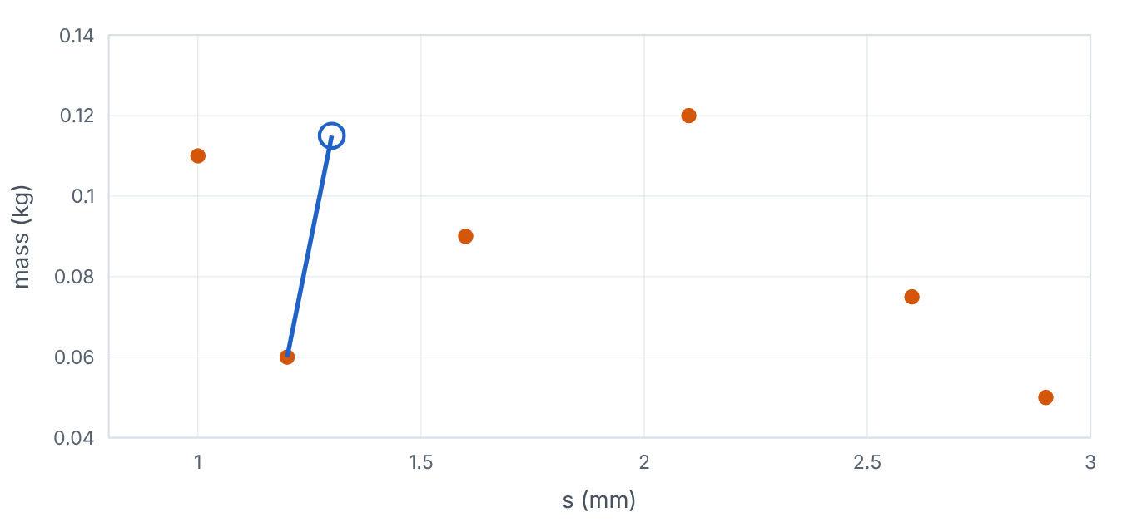

Why scale variables?
Lesson 4 · Scaling, normalization and sensitivity · Intuition
Many methods use distances between designs (nearest neighbours, RBFs, Gaussian processes) or penalize coefficient sizes. If one variable is measured in millimetres (range 2.2) and another in kilograms (range 0.1), the larger-range variable dominates the distance purely because of units. Scaling puts variables on comparable ranges.
The nearest neighbour of a query design changes after both variables are scaled to [0, 1]. (Interactive in the online course.)
Notes:
Why scale variables?. Many methods use distances between designs (nearest neighbours, RBFs, Gaussian processes) or penalize coefficient sizes. If one variable is measured in millimetres (range 2.2) and another in kilograms (range 0.1), the larger-range variable dominates the distance purely because of units. Scaling puts variables on comparable ranges. Look at the figure. The nearest neighbour of a query design changes after both variables are scaled to [0, 1]. Scatter of six designs in fin gap (mm) versus mass (kg) with a query point. In raw units the nearest neighbour is chosen almost entirely by fin gap. After min–max scaling, a different neighbour is closest because both variables count.

Slide 3

Why scale variables?
Lesson 4 · Scaling, normalization and sensitivity · The mathematics
min–max: z = (x − x_{min})/(x_{max} − x_{min}) ∈ [0, 1], standardization: z = (x − μ)/(σ)
Symbol | Meaning | Unit
x_{min}, x_{max} | design-variable bounds (preferred for design spaces) | units of x
μ, σ | mean and standard deviation of the TRAINING data | units of x
z | scaled variable | dimensionless
For bounded design spaces, scaling by the bounds is natural and does not depend on data. For data-based scaling, compute μ, σ from training data only (Module 5: leakage).
Notes:
Now the mathematics. min–max: z = (x − x_{min})/(x_{max} − x_{min}) ∈ [0, 1], standardization: z = (x − μ)/(σ) x_{min}, x_{max} is the design-variable bounds (preferred for design spaces), in units of x. μ, σ is the mean and standard deviation of the TRAINING data, in units of x. z is the scaled variable, in dimensionless. For bounded design spaces, scaling by the bounds is natural and does not depend on data. For data-based scaling, compute μ, σ from training data only (Module 5: leakage).

Slide 4


Why scale variables?
Lesson 4 · Scaling, normalization and sensitivity · In engineering practice
Engineering application
Practical tip
The heat sink in scaled units: z_{s} = (s − 0.8)/2.2, z_{t} = (t − 0.2)/1.3. All surrogates in this course are fitted in these scaled units.
Keep the scaling in your model pipeline and record it; reverse it when reporting designs in physical units.
Notes:
Where does this matter in engineering? The heat sink in scaled units: z_s = (s − 0.8)/2.2, z_t = (t − 0.2)/1.3. All surrogates in this course are fitted in these scaled units. A practical tip: Keep the scaling in your model pipeline and record it; reverse it when reporting designs in physical units.

Slide 5

Pause and predict
Lesson 4 · Scaling, normalization and sensitivity · Predict before you look
Does scaling change which design has the lowest R?
Write down your answer, then continue to the next slide.
Notes:
Time to predict. Does scaling change which design has the lowest R? Pause here and commit to an answer before moving on.

Slide 6

What happens, and why
Lesson 4 · Scaling, normalization and sensitivity · Answer
Question: Does scaling change which design has the lowest R?
No. Scaling is a change of coordinates; the physical optimum is the same. It changes how methods that use distances or step sizes behave.
Notes:
Here is the answer. No. Scaling is a change of coordinates; the physical optimum is the same. It changes how methods that use distances or step sizes behave.

Slide 7


Why scale variables?
Lesson 4 · Scaling, normalization and sensitivity · Common misconception
Misconception
What is actually true
Scaling is cosmetic and never changes results.
It changes distance-based models (GP, RBF, k-NN), regularized regression and optimizer step sizes — often dramatically.
Takeaway Scale inputs (by bounds or training statistics) before distance-based modelling; report results in physical units.
Notes:
A common misconception is this: Scaling is cosmetic and never changes results. In fact: It changes distance-based models (GP, RBF, k-NN), regularized regression and optimizer step sizes — often dramatically. The takeaway: Scale inputs (by bounds or training statistics) before distance-based modelling; report results in physical units.

Slide 8
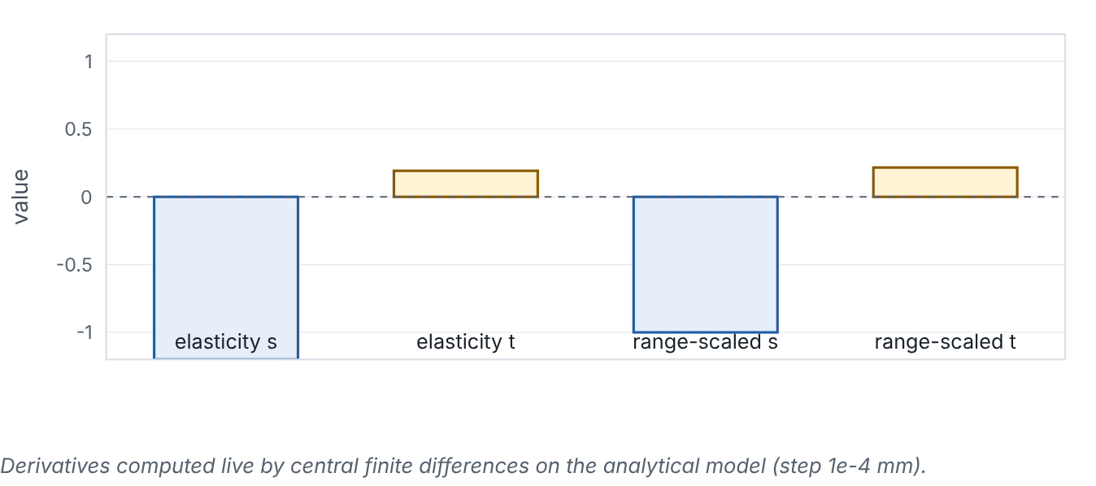
Sensitivity of an engineering response
Lesson 4 · Scaling, normalization and sensitivity · Intuition
Local sensitivity asks: if I nudge one variable, how much does the response change? Raw derivatives depend on units; elasticities (percentage change per percentage change) or range-scaled derivatives allow fair comparison.
Elasticities and range-scaled sensitivities of R to s and t at a chosen design. (Interactive in the online course.)
Notes:
Sensitivity of an engineering response. Local sensitivity asks: if I nudge one variable, how much does the response change? Raw derivatives depend on units; elasticities (percentage change per percentage change) or range-scaled derivatives allow fair comparison. Look at the figure. Elasticities and range-scaled sensitivities of R to s and t at a chosen design. Bar chart with four bars: elasticity with respect to s and t, and range-scaled sensitivities. Sliders choose s and t. At small gaps, R is very sensitive to s; near the valley, sensitivity to s is small.

Slide 9
Sensitivity of an engineering response
Lesson 4 · Scaling, normalization and sensitivity · The mathematics
elasticity E_{x} = (∂R)/(∂x) · (x)/(R), range-scaled S_{x} = (∂R)/(∂x) · (x_{max} − x_{min})
E_{x} is dimensionless; S_{x} has the units of R (K/W).
Notes:
Now the mathematics. elasticity E_x = (∂R)/(∂x) · (x)/(R), range-scaled S_x = (∂R)/(∂x) · (x_{max} − x_{min}) E_x is dimensionless; S_x has the units of R (K/W).

Slide 10
Sensitivity of an engineering response
Lesson 4 · Scaling, normalization and sensitivity · In engineering practice
Engineering application
Practical tip
Structural design: tip deflection of a cantilever, δ = F L³/(3EI), has elasticity 3 with respect to length and −1 with respect to modulus: a 1% longer beam deflects about 3% more. Such insight tells you which tolerances matter.
Sensitivities are local: they change across the design space. Evaluate them at several points or use global methods (beyond this course).
Notes:
Where does this matter in engineering? Structural design: tip deflection of a cantilever, δ = F L³/(3EI), has elasticity 3 with respect to length and −1 with respect to modulus: a 1% longer beam deflects about 3% more. Such insight tells you which tolerances matter. A practical tip: Sensitivities are local: they change across the design space. Evaluate them at several points or use global methods (beyond this course).

Slide 11
Pause and predict
Lesson 4 · Scaling, normalization and sensitivity · Predict before you look
For δ = F L³/(3 E I), what is the elasticity of δ with respect to F?
Write down your answer, then continue to the next slide.
Notes:
Time to predict. For δ = F L³/(3 E I), what is the elasticity of δ with respect to F? Pause here and commit to an answer before moving on.

Slide 12
What happens, and why
Lesson 4 · Scaling, normalization and sensitivity · Answer
Question: For δ = F L³/(3 E I), what is the elasticity of δ with respect to F?
Exactly 1: deflection is proportional to load, so a 1% load increase gives 1% more deflection.
Notes:
Here is the answer. Exactly 1: deflection is proportional to load, so a 1% load increase gives 1% more deflection.

Slide 13
Sensitivity of an engineering response
Lesson 4 · Scaling, normalization and sensitivity · Common misconception
Misconception
What is actually true
A large derivative always means an important variable.
Importance depends on how much the variable can actually vary (its range or tolerance). Multiply by the range, or use elasticities.
Takeaway Use elasticities or range-scaled derivatives to compare sensitivities across variables with different units and ranges.
Notes:
A common misconception is this: A large derivative always means an important variable. In fact: Importance depends on how much the variable can actually vary (its range or tolerance). Multiply by the range, or use elasticities. The takeaway: Use elasticities or range-scaled derivatives to compare sensitivities across variables with different units and ranges.

Slide 14
Key takeaways from this lesson
Summary
1
Why scale variables?
Scale inputs (by bounds or training statistics) before distance-based modelling; report results in physical units.
2
Sensitivity of an engineering response
Use elasticities or range-scaled derivatives to compare sensitivities across variables with different units and ranges.
Notes:
To sum up this lesson. Why scale variables?: Scale inputs (by bounds or training statistics) before distance-based modelling; report results in physical units. Sensitivity of an engineering response: Use elasticities or range-scaled derivatives to compare sensitivities across variables with different units and ranges.

Slide 15

Linear regression, residuals and least squares
UP NEXT · LESSON 4.1
That completes Module 3. Before moving on, review the Module 3 flashcards and take its quiz in the course (pass mark 70%). Next: Module 4, Your first regression model.
Notes:
That completes Lesson 4 of Module 3: Scaling, normalization and sensitivity. This was the last lesson of the module, so review the flashcards and take the Module 3 quiz in the course. Next comes Module 4, Your first regression model, starting with Linear regression, residuals and least squares.

