Slide 1
Linear regression, residuals and least squares
MODULE 04 · LESSON 1 OF 3 · ≈ 10 MIN
4.1
Module 4: Your first regression model
Fitting a line by minimizing squared residuals
Notes:
Welcome to Module 4, Lesson 1 of the self-paced course Machine Learning Fundamentals for Surrogate-Based Engineering Optimization: Linear regression, residuals and least squares. This lesson belongs to the module Your first regression model and takes about 10 minutes. In this lesson: Fitting a line by minimizing squared residuals.

Slide 2
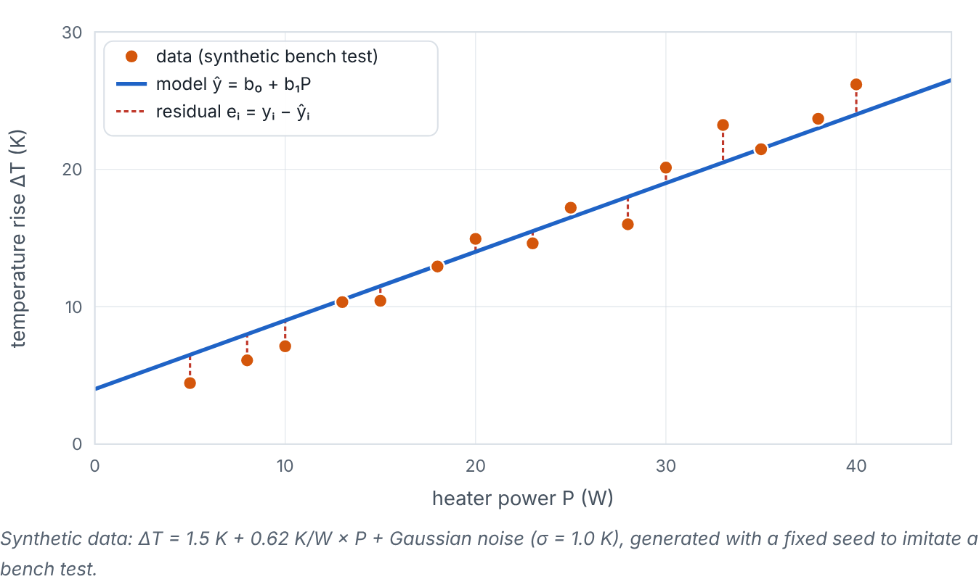

Fitting a line by minimizing squared residuals
Lesson 1 · Linear regression, residuals and least squares · Intuition
On a test bench, a heater dissipates power P into a heat sink and we measure the temperature rise ΔT. Physics suggests ΔT ≈ R P. Measurements scatter. Linear regression finds the line that best follows the points. Each vertical gap between a point and the line is a residual. Least squares chooses the line that makes the sum of squared residuals as small as possible.
Adjust intercept and slope; residuals (dashed red) and error metrics update; snap to the least-squares solution. (Interactive in the online course.)
Notes:
Fitting a line by minimizing squared residuals. On a test bench, a heater dissipates power P into a heat sink and we measure the temperature rise ΔT. Physics suggests ΔT ≈ R P. Measurements scatter. Linear regression finds the line that best follows the points. Each vertical gap between a point and the line is a residual. Least squares chooses the line that makes the sum of squared residuals as small as possible. Look at the figure. Adjust intercept and slope; residuals (dashed red) and error metrics update; snap to the least-squares solution. Scatter of temperature rise versus heater power with a fitted line and vertical dashed residual segments. Sliders set intercept and slope; the readout shows SSE, MAE, RMSE, R² and the least-squares coefficients.

Slide 3

Fitting a line by minimizing squared residuals
Lesson 1 · Linear regression, residuals and least squares · The mathematics (1/2)
ŷ_{i} = b₀ + b₁ x_{i}, e_{i} = y_{i} − ŷ_{i}, SSE = Σ e_{i}²
b₁ = (Σ(x_{i} − x̄)(y_{i} − ȳ))/(Σ(x_{i} − x̄)²), b₀ = ȳ − b₁x̄
Symbol | Meaning | Unit
x = P | heater power (feature) | W
y = ΔT | measured temperature rise (target) | K
b₀ | intercept: predicted ΔT at P = 0 | K
b₁ | slope: K per W, i.e. a thermal resistance | K/W
e_{i} | residual | K
Notes:
Now the mathematics. ŷ_i = b_0 + b_1 x_i, e_i = y_i − ŷ_i, SSE = Σ e_i^2 b_1 = (Σ(x_i − x̄)(y_i − ȳ))/(Σ(x_i − x̄)^2), b_0 = ȳ − b_1x̄ x = P is the heater power (feature), in W. y = ΔT is the measured temperature rise (target), in K. b_0 is the intercept: predicted ΔT at P = 0, in K. b_1 is the slope: K per W, i.e. a thermal resistance, in K/W. e_i is the residual, in K.

Slide 4
Fitting a line by minimizing squared residuals
Lesson 1 · Linear regression, residuals and least squares · The mathematics (2/2)
These formulas come from setting ∂SSE/∂b₀ = ∂SSE/∂b₁ = 0. With many features, the same idea gives β̂ = arg min ‖y − Xβ‖², solved by linear algebra (QR factorization in this page’s demos).
Notes:
Continuing. These formulas come from setting ∂SSE/∂b_0 = ∂SSE/∂b_1 = 0. With many features, the same idea gives β̂ = arg min ‖y − Xβ‖², solved by linear algebra (QR factorization in this page’s demos).

Slide 5


Fitting a line by minimizing squared residuals
Lesson 1 · Linear regression, residuals and least squares · In engineering practice
Engineering application
Practical tip
The fitted slope estimates the thermal resistance of the tested sink in K/W; the intercept captures an offset (e.g., sensor bias or ambient drift) in K. The same least-squares machinery fits polynomial response surfaces in Module 8: “linear” refers to linearity in the coefficients, not in x.
Always plot the data with the fitted line and the residuals. Patterns in residuals (curvature, funnel shape) reveal model inadequacy that a single number hides.
Notes:
Where does this matter in engineering? The fitted slope estimates the thermal resistance of the tested sink in K/W; the intercept captures an offset (e.g., sensor bias or ambient drift) in K. The same least-squares machinery fits polynomial response surfaces in Module 8: “linear” refers to linearity in the coefficients, not in x. A practical tip: Always plot the data with the fitted line and the residuals. Patterns in residuals (curvature, funnel shape) reveal model inadequacy that a single number hides.

Slide 6

Pause and predict
Lesson 1 · Linear regression, residuals and least squares · Predict before you look
Points: (P, ΔT) = (10 W, 7 K), (20 W, 13 K), (30 W, 19 K). What are the least-squares b₁ and b₀?
Write down your answer, then continue to the next slide.
Notes:
Time to predict. Points: (P, ΔT) = (10 W, 7 K), (20 W, 13 K), (30 W, 19 K). What are the least-squares b₁ and b₀? Pause here and commit to an answer before moving on.

Slide 7

What happens, and why
Lesson 1 · Linear regression, residuals and least squares · Answer
Question: Points: (P, ΔT) = (10 W, 7 K), (20 W, 13 K), (30 W, 19 K). What are the least-squares b₁ and b₀?
The points are exactly collinear: b₁ = 6 K / 10 W = 0.6 K/W, b₀ = 7 − 0.6 × 10 = 1 K. All residuals are zero.
Notes:
Here is the answer. The points are exactly collinear: b₁ = 6 K / 10 W = 0.6 K/W, b₀ = 7 − 0.6 × 10 = 1 K. All residuals are zero.

Slide 8


Fitting a line by minimizing squared residuals
Lesson 1 · Linear regression, residuals and least squares · Common misconception
Misconception
What is actually true
Least squares minimizes the perpendicular distances to the line.
Ordinary least squares minimizes vertical distances (errors in y), assuming x is known accurately.
Takeaway Least squares picks coefficients minimizing Σ residual²; the slope of ΔT vs P is a resistance in K/W.
Notes:
A common misconception is this: Least squares minimizes the perpendicular distances to the line. In fact: Ordinary least squares minimizes vertical distances (errors in y), assuming x is known accurately. The takeaway: Least squares picks coefficients minimizing Σ residual²; the slope of ΔT vs P is a resistance in K/W.

Slide 9
Key takeaways from this lesson
Summary
1
Fitting a line by minimizing squared residuals
Least squares picks coefficients minimizing Σ residual²; the slope of ΔT vs P is a resistance in K/W.
Notes:
To sum up this lesson. Fitting a line by minimizing squared residuals: Least squares picks coefficients minimizing Σ residual²; the slope of ΔT vs P is a resistance in K/W.

Slide 10

Measuring error: MAE, RMSE and R²
UP NEXT · LESSON 4.2
Next in Module 4: Lesson 2. Mark this lesson complete in the course before continuing.
Notes:
That completes Lesson 1 of Module 4: Linear regression, residuals and least squares. Next comes Lesson 2: Measuring error: MAE, RMSE and R².

