Slide 1
Measuring error: MAE, RMSE and R²
MODULE 04 · LESSON 2 OF 3 · ≈ 9 MIN
4.2
Module 4: Your first regression model
Three common metrics and what they hide
Notes:
Welcome to Module 4, Lesson 2 of the self-paced course Machine Learning Fundamentals for Surrogate-Based Engineering Optimization: Measuring error: MAE, RMSE and R². This lesson belongs to the module Your first regression model and takes about 9 minutes. In this lesson: Three common metrics and what they hide.

Slide 2

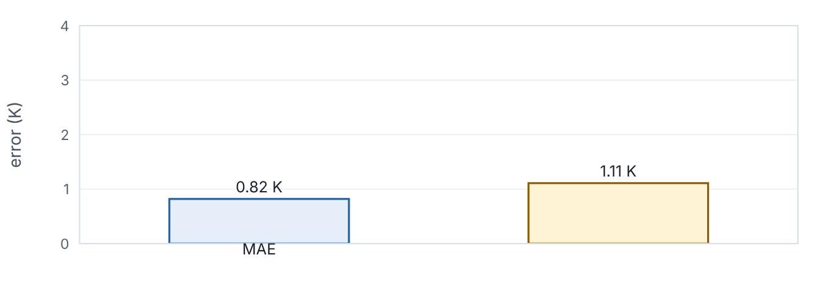
Three common metrics and what they hide
Lesson 2 · Measuring error: MAE, RMSE and R² · Intuition
MAE is the average size of errors. RMSE squares errors before averaging, so large errors count more. R² compares the model with the simplest possible predictor — the mean — and reports the fraction of variance explained. None tells you where errors occur.
One corrupted measurement raises RMSE far more than MAE. (Interactive in the online course.)
Notes:
Three common metrics and what they hide. MAE is the average size of errors. RMSE squares errors before averaging, so large errors count more. R² compares the model with the simplest possible predictor — the mean — and reports the fraction of variance explained. None tells you where errors occur. Look at the figure. One corrupted measurement raises RMSE far more than MAE. Two bars, MAE and RMSE, for the bench-test residuals. Toggling a +12 K corruption of one measurement raises RMSE much more than MAE; R² also falls.

Slide 3

Three common metrics and what they hide
Lesson 2 · Measuring error: MAE, RMSE and R² · The mathematics
MAE = (1)/(n)Σ|e_{i}|, RMSE = √[(1)/(n)Σe_{i}²], R² = 1 − (Σe_{i}²)/(Σ(y_{i} − ȳ)²)
MAE and RMSE have the units of y (here K); always RMSE ≥ MAE. R² is dimensionless, equals 1 for a perfect fit, 0 for a model no better than the mean, and can be negative on test data for a model worse than the mean.
Notes:
Now the mathematics. MAE = (1)/(n)Σ|e_i|, RMSE = √[(1)/(n)Σe_i^2], R^2 = 1 − (Σe_i^2)/(Σ(y_i − ȳ)^2) MAE and RMSE have the units of y (here K); always RMSE ≥ MAE. R² is dimensionless, equals 1 for a perfect fit, 0 for a model no better than the mean, and can be negative on test data for a model worse than the mean.

Slide 4


Three common metrics and what they hide
Lesson 2 · Measuring error: MAE, RMSE and R² · In engineering practice
Engineering application
Practical tip
For a heat-sink surrogate, “RMSE = 0.01 K/W” means typical errors of about 0.3 K in base temperature at 30 W — an engineer can judge whether that matters. “R² = 0.99” over a range where R varies from 0.6 to 4 K/W could still hide a 0.05 K/W error near the optimum, where R varies little.
Report RMSE and MAE in physical units, plus the maximum absolute error, on data not used for fitting.
Notes:
Where does this matter in engineering? For a heat-sink surrogate, “RMSE = 0.01 K/W” means typical errors of about 0.3 K in base temperature at 30 W — an engineer can judge whether that matters. “R² = 0.99” over a range where R varies from 0.6 to 4 K/W could still hide a 0.05 K/W error near the optimum, where R varies little. A practical tip: Report RMSE and MAE in physical units, plus the maximum absolute error, on data not used for fitting.

Slide 5

Pause and predict
Lesson 2 · Measuring error: MAE, RMSE and R² · Predict before you look
Residuals: +1, −1, +1, −1, +6 K. Compute MAE and RMSE.
Write down your answer, then continue to the next slide.
Notes:
Time to predict. Residuals: +1, −1, +1, −1, +6 K. Compute MAE and RMSE. Pause here and commit to an answer before moving on.

Slide 6

What happens, and why
Lesson 2 · Measuring error: MAE, RMSE and R² · Answer
Question: Residuals: +1, −1, +1, −1, +6 K. Compute MAE and RMSE.
MAE = (1+1+1+1+6)/5 = 2.0 K. RMSE = √[(1+1+1+1+36)/5] = √8 ≈ 2.83 K. The single large error inflates RMSE.
Notes:
Here is the answer. MAE = (1+1+1+1+6)/5 = 2.0 K. RMSE = √[(1+1+1+1+36)/5] = √8 ≈ 2.83 K. The single large error inflates RMSE.

Slide 7


Three common metrics and what they hide
Lesson 2 · Measuring error: MAE, RMSE and R² · Common misconception
Misconception
What is actually true
A high R² means the model is accurate enough for design.
R² depends on how much y varies in the dataset. Wide-ranging data inflate R². Use errors in engineering units, especially in the region you care about.
Takeaway MAE = typical error; RMSE emphasizes large errors; R² is relative to the mean. Report errors in engineering units.
Notes:
A common misconception is this: A high R² means the model is accurate enough for design. In fact: R² depends on how much y varies in the dataset. Wide-ranging data inflate R². Use errors in engineering units, especially in the region you care about. The takeaway: MAE = typical error; RMSE emphasizes large errors; R² is relative to the mean. Report errors in engineering units.

Slide 8
Key takeaways from this lesson
Summary
1
Three common metrics and what they hide
MAE = typical error; RMSE emphasizes large errors; R² is relative to the mean. Report errors in engineering units.
Notes:
To sum up this lesson. Three common metrics and what they hide: MAE = typical error; RMSE emphasizes large errors; R² is relative to the mean. Report errors in engineering units.

Slide 9

Interpreting coefficients and comparing with baselines
UP NEXT · LESSON 4.3
Next in Module 4: Lesson 3. Mark this lesson complete in the course before continuing.
Notes:
That completes Lesson 2 of Module 4: Measuring error: MAE, RMSE and R². Next comes Lesson 3: Interpreting coefficients and comparing with baselines.

