Slide 1
Interpreting coefficients and comparing with baselines
MODULE 04 · LESSON 3 OF 3 · ≈ 9 MIN
4.3
Module 4: Your first regression model
Coefficients have units — and a model needs a baseline
Notes:
Welcome to Module 4, Lesson 3 of the self-paced course Machine Learning Fundamentals for Surrogate-Based Engineering Optimization: Interpreting coefficients and comparing with baselines. This lesson belongs to the module Your first regression model and takes about 9 minutes. In this lesson: Coefficients have units — and a model needs a baseline.

Slide 2
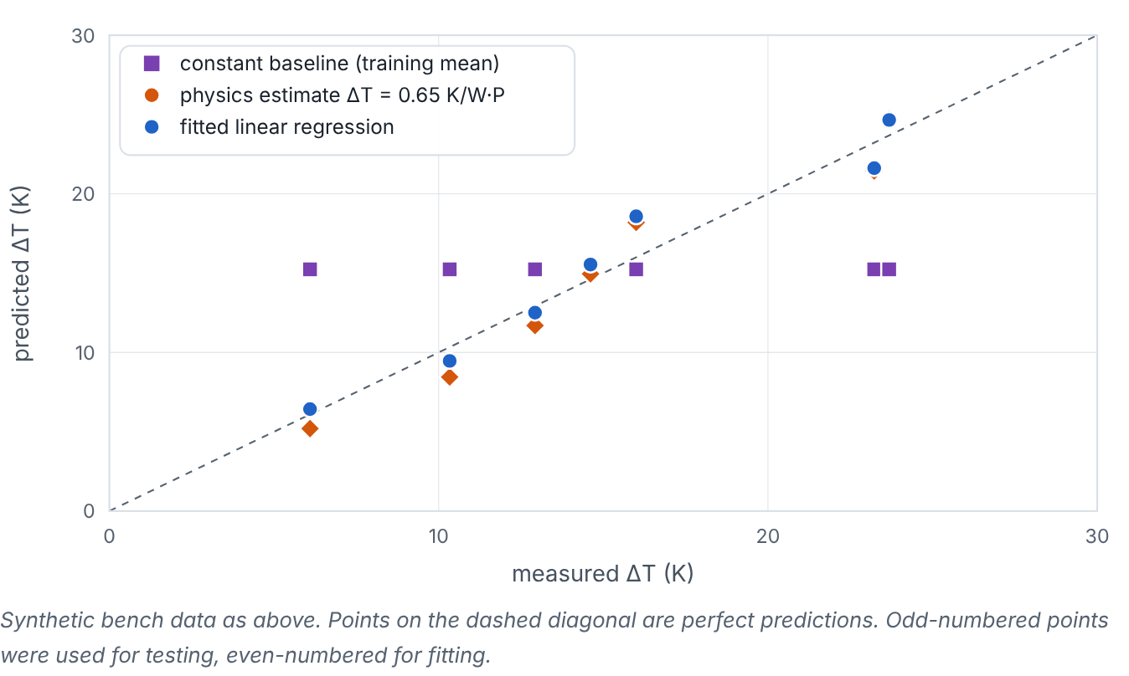

Coefficients have units — and a model needs a baseline
Lesson 3 · Interpreting coefficients and comparing with baselines · Intuition
A coefficient tells you how much the prediction changes per unit change of a feature, holding others fixed — so it carries units. A model is only useful if it beats simple alternatives: a constant baseline (always predict the training mean) and, when available, a physics-based estimate.
Predicted vs measured temperature rise on held-out points for a constant baseline, a physics estimate, and fitted linear regression.
Notes:
Coefficients have units — and a model needs a baseline. A coefficient tells you how much the prediction changes per unit change of a feature, holding others fixed — so it carries units. A model is only useful if it beats simple alternatives: a constant baseline (always predict the training mean) and, when available, a physics-based estimate. Look at the figure. Predicted vs measured temperature rise on held-out points for a constant baseline, a physics estimate, and fitted linear regression. Parity plot: measured ΔT on the x-axis, predicted on the y-axis, with a dashed 45° line. Constant-baseline squares form a horizontal band; physics-estimate diamonds lie near but slightly off the diagonal; regression circles lie closest to it. Test RMSE values are printed.

Slide 3

Coefficients have units — and a model needs a baseline
Lesson 3 · Interpreting coefficients and comparing with baselines · The mathematics
ŷ = b₀ + b₁x₁ + b₂x₂ ⇒ (∂ŷ)/(∂x₁) = b₁ [units of y per unit of x₁]
If features are scaled, coefficients are per scaled unit; convert back before interpreting physically.
Notes:
Now the mathematics. ŷ = b_0 + b_1x_1 + b_2x_2 ⇒ (∂ŷ)/(∂x_1) = b_1 [units of y per unit of x_1] If features are scaled, coefficients are per scaled unit; convert back before interpreting physically.

Slide 4


Coefficients have units — and a model needs a baseline
Lesson 3 · Interpreting coefficients and comparing with baselines · In engineering practice
Engineering application
Practical tip
Bench test: b₁ ≈ 0.6 K/W is the sink’s effective resistance; comparing with a datasheet value is a physics sanity check. Manufacturing: in R_{a} = b₀ + b₁·feed, b₁ has units µm per (mm/rev). Note: correlated features make individual coefficients unstable even when predictions are good.
Start every study with a constant baseline and the best simple physics estimate. Report how much your model improves on them on the same test data.
Notes:
Where does this matter in engineering? Bench test: b_1 ≈ 0.6 K/W is the sink’s effective resistance; comparing with a datasheet value is a physics sanity check. Manufacturing: in R_a = b_0 + b_1·feed, b_1 has units µm per (mm/rev). Note: correlated features make individual coefficients unstable even when predictions are good. A practical tip: Start every study with a constant baseline and the best simple physics estimate. Report how much your model improves on them on the same test data.

Slide 5

Pause and predict
Lesson 3 · Interpreting coefficients and comparing with baselines · Predict before you look
A model of fan power (W) has coefficient 0.8 on rotational speed in rpm. A colleague says “speed barely matters because 0.8 is small”. Correct?
Write down your answer, then continue to the next slide.
Notes:
Time to predict. A model of fan power (W) has coefficient 0.8 on rotational speed in rpm. A colleague says “speed barely matters because 0.8 is small”. Correct? Pause here and commit to an answer before moving on.

Slide 6

What happens, and why
Lesson 3 · Interpreting coefficients and comparing with baselines · Answer
Question: A model of fan power (W) has coefficient 0.8 on rotational speed in rpm. A colleague says “speed barely matters because 0.8 is small”. Correct?
No. 0.8 W per rpm over a range of, say, 1 000 rpm is 800 W. Coefficient size depends on units; multiply by the realistic range.
Notes:
Here is the answer. No. 0.8 W per rpm over a range of, say, 1 000 rpm is 800 W. Coefficient size depends on units; multiply by the realistic range.

Slide 7


Coefficients have units — and a model needs a baseline
Lesson 3 · Interpreting coefficients and comparing with baselines · Common misconception
Misconception
What is actually true
A complex model with low training error does not need a baseline.
Without a baseline you cannot tell whether the model adds value. Sometimes the constant or physics baseline is nearly as good — and simpler.
Takeaway Coefficients mean “change in ŷ per unit x” and carry units; always compare against constant and physics baselines.
Notes:
A common misconception is this: A complex model with low training error does not need a baseline. In fact: Without a baseline you cannot tell whether the model adds value. Sometimes the constant or physics baseline is nearly as good — and simpler. The takeaway: Coefficients mean “change in ŷ per unit x” and carry units; always compare against constant and physics baselines.

Slide 8
Key takeaways from this lesson
Summary
1
Coefficients have units — and a model needs a baseline
Coefficients mean “change in ŷ per unit x” and carry units; always compare against constant and physics baselines.
Notes:
To sum up this lesson. Coefficients have units — and a model needs a baseline: Coefficients mean “change in ŷ per unit x” and carry units; always compare against constant and physics baselines.

Slide 9

Training, validation and test sets
UP NEXT · LESSON 5.1
That completes Module 4. Before moving on, review the Module 4 flashcards and take its quiz in the course (pass mark 70%). Next: Module 5, Generalization and trustworthy validation.
Notes:
That completes Lesson 3 of Module 4: Interpreting coefficients and comparing with baselines. This was the last lesson of the module, so review the flashcards and take the Module 4 quiz in the course. Next comes Module 5, Generalization and trustworthy validation, starting with Training, validation and test sets.

