Slide 1
Underfitting, overfitting and the bias–variance trade-off
MODULE 05 · LESSON 2 OF 5 · ≈ 12 MIN
5.2
Module 5: Generalization and trustworthy validation
Too simple, about right, too flexible
Notes:
Welcome to Module 5, Lesson 2 of the self-paced course Machine Learning Fundamentals for Surrogate-Based Engineering Optimization: Underfitting, overfitting and the bias–variance trade-off. This lesson belongs to the module Generalization and trustworthy validation and takes about 12 minutes. In this lesson: Too simple, about right, too flexible.

Slide 2

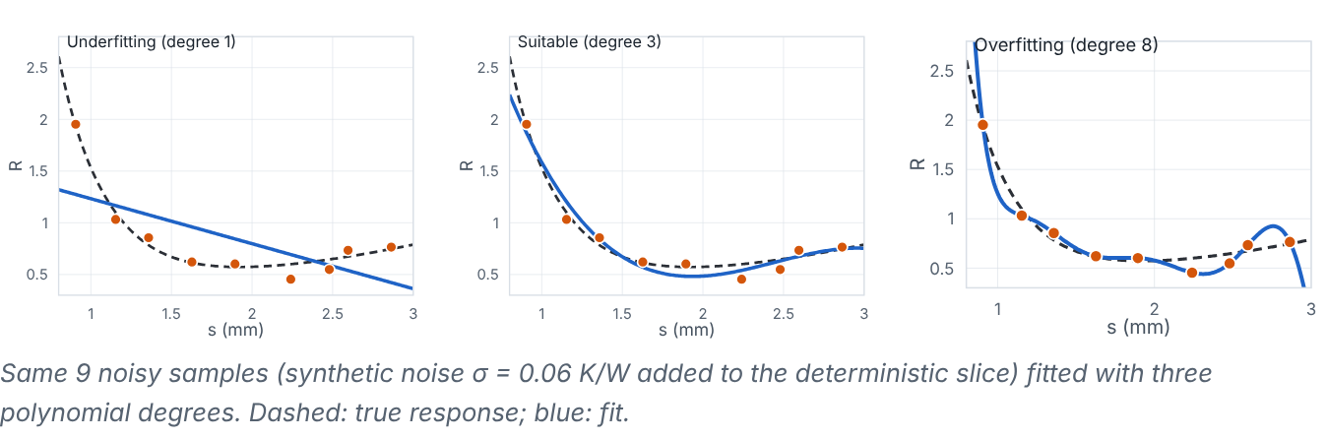
Too simple, about right, too flexible
Lesson 2 · Underfitting, overfitting and the bias–variance trade-off · Intuition
An underfitted model is too simple to follow the true trend (high error everywhere). An overfitted model is so flexible that it follows noise or wiggles between samples (low training error, high validation error). The goal is the flexibility that minimizes validation error.
The same nine noisy samples fitted with degree 1 (underfit), 3 (suitable) and 8 (overfit) polynomials.
Notes:
Too simple, about right, too flexible. An underfitted model is too simple to follow the true trend (high error everywhere). An overfitted model is so flexible that it follows noise or wiggles between samples (low training error, high validation error). The goal is the flexibility that minimizes validation error. Look at the figure. The same nine noisy samples fitted with degree 1 (underfit), 3 (suitable) and 8 (overfit) polynomials. Three panels. Degree 1: a straight line missing the U-shaped trend. Degree 3: a smooth curve close to the true response. Degree 8: a wiggly curve passing near every point but oscillating between them.

Slide 3
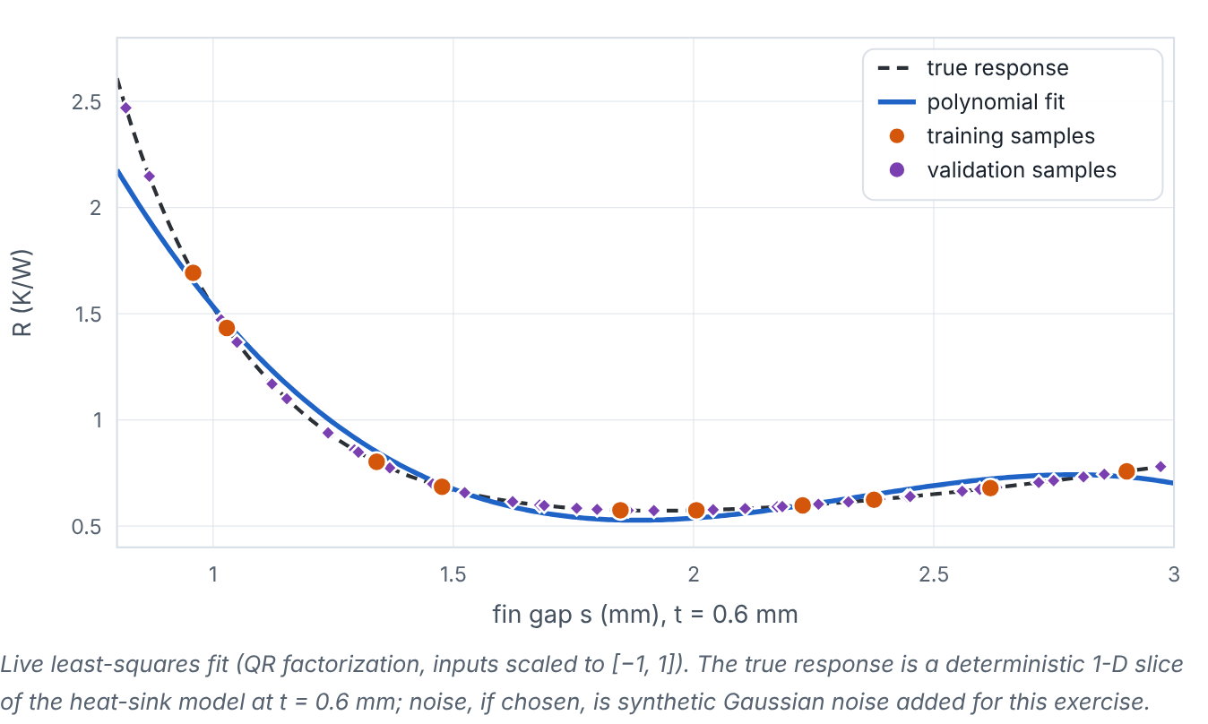
Too simple, about right, too flexible
Lesson 2 · Underfitting, overfitting and the bias–variance trade-off · Figure
Change polynomial degree, number of samples and noise; compare training and validation RMSE. (Interactive in the online course.)
Notes:
Here is another view. Change polynomial degree, number of samples and noise; compare training and validation RMSE. Plot of the true response R(s) at t = 0.6 mm, training samples, validation samples and a polynomial fit. Sliders control degree (1–12), sample size (4–40) and synthetic noise; the readout shows training and validation RMSE and a verdict.

Slide 4
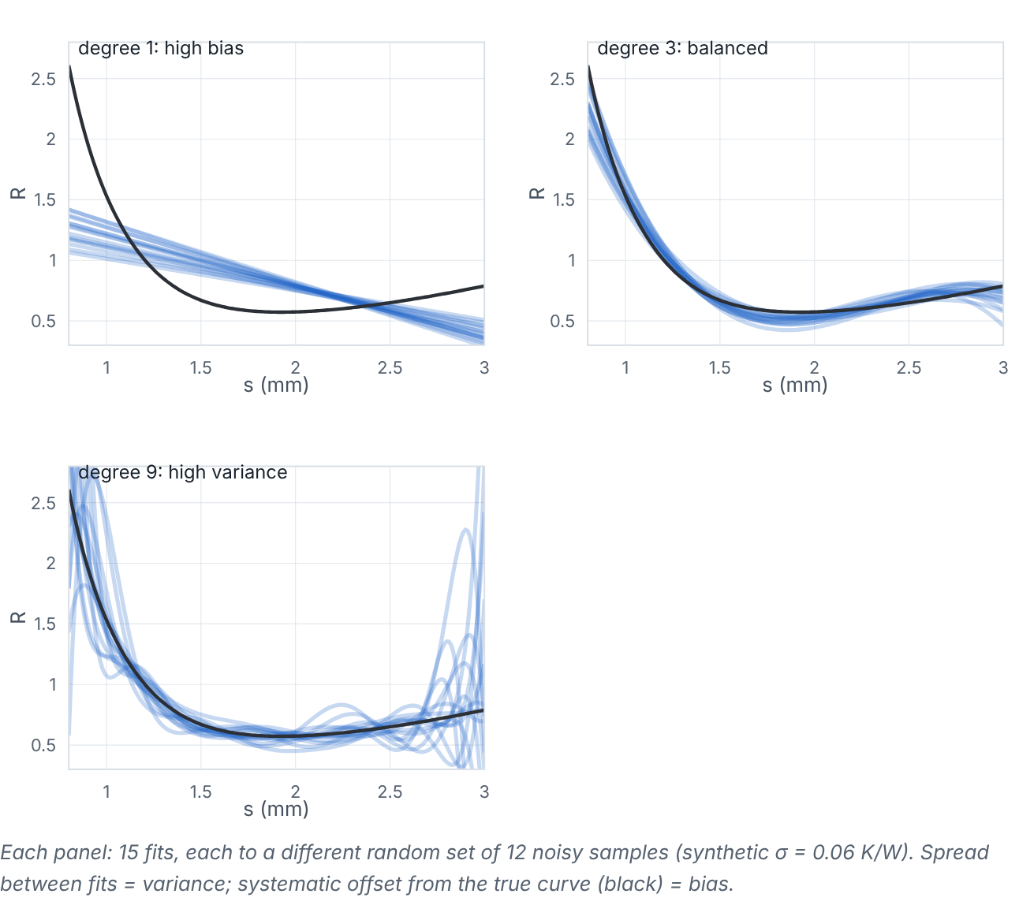
Too simple, about right, too flexible
Lesson 2 · Underfitting, overfitting and the bias–variance trade-off · Figure
Fifteen fits to different random samples for three degrees: spread = variance, offset = bias.
Notes:
Here is another view. Fifteen fits to different random samples for three degrees: spread = variance, offset = bias. Three panels with many faint blue curves: degree 1 curves agree with each other but miss the truth (bias); degree 3 curves cluster around the truth; degree 9 curves scatter widely (variance).

Slide 5

Too simple, about right, too flexible
Lesson 2 · Underfitting, overfitting and the bias–variance trade-off · The mathematics (1/2)
For a model trained on random data, the expected squared error at x decomposes as
𝔼[(y − f̂)²] = (bias)² + variance + σ²_{noise}
Symbol | Meaning | Unit
bias | systematic error: average prediction minus truth | units of y
variance | how much predictions change with different training sets | (units of y)²
σ²_{noise} | irreducible noise (zero for a deterministic simulator) | (units of y)²
Notes:
Now the mathematics. For a model trained on random data, the expected squared error at x decomposes as 𝔼[(y − f̂)^2] = (bias)^2 + variance + σ^2_{noise} bias is the systematic error: average prediction minus truth, in units of y. variance is the how much predictions change with different training sets, in (units of y)². σ²_{noise} is the irreducible noise (zero for a deterministic simulator), in (units of y)².

Slide 6
Too simple, about right, too flexible
Lesson 2 · Underfitting, overfitting and the bias–variance trade-off · The mathematics (2/2)
More flexibility lowers bias but raises variance. A polynomial of degree p in one variable has p + 1 coefficients; if p + 1 ≥ n, it can pass through every point.
Notes:
Continuing. More flexibility lowers bias but raises variance. A polynomial of degree p in one variable has p + 1 coefficients; if p + 1 ≥ n, it can pass through every point.

Slide 7


Too simple, about right, too flexible
Lesson 2 · Underfitting, overfitting and the bias–variance trade-off · In engineering practice
Engineering application
Practical tip
For a deterministic simulator, σ²_{noise} = 0 and an interpolating model (passing through all samples) is not automatically overfitting; the danger then is wild behaviour between samples. For noisy experiments (machining tests, AM coupons), interpolating the noise is overfitting.
Increase model flexibility only while validation error keeps dropping; stop when it rises.
Notes:
Where does this matter in engineering? For a deterministic simulator, σ²_{noise} = 0 and an interpolating model (passing through all samples) is not automatically overfitting; the danger then is wild behaviour between samples. For noisy experiments (machining tests, AM coupons), interpolating the noise is overfitting. A practical tip: Increase model flexibility only while validation error keeps dropping; stop when it rises.

Slide 8

Pause and predict
Lesson 2 · Underfitting, overfitting and the bias–variance trade-off · Predict before you look
With 6 noise-free samples, a degree-5 polynomial passes exactly through all of them. Is its training RMSE meaningful evidence of accuracy?
Write down your answer, then continue to the next slide.
Notes:
Time to predict. With 6 noise-free samples, a degree-5 polynomial passes exactly through all of them. Is its training RMSE meaningful evidence of accuracy? Pause here and commit to an answer before moving on.

Slide 9

What happens, and why
Lesson 2 · Underfitting, overfitting and the bias–variance trade-off · Answer
Question: With 6 noise-free samples, a degree-5 polynomial passes exactly through all of them. Is its training RMSE meaningful evidence of accuracy?
No — it is zero by construction (6 coefficients, 6 points). Only validation points between the samples reveal its real error, which may be large (oscillation).
Notes:
Here is the answer. No — it is zero by construction (6 coefficients, 6 points). Only validation points between the samples reveal its real error, which may be large (oscillation).

Slide 10


Too simple, about right, too flexible
Lesson 2 · Underfitting, overfitting and the bias–variance trade-off · Common misconception
Misconception
What is actually true
Overfitting only happens with noisy data.
With noise-free data the risk becomes oscillation between samples. Validation is needed either way.
Takeaway Choose flexibility by validation error; bias falls and variance rises with complexity.
Notes:
A common misconception is this: Overfitting only happens with noisy data. In fact: With noise-free data the risk becomes oscillation between samples. Validation is needed either way. The takeaway: Choose flexibility by validation error; bias falls and variance rises with complexity.

Slide 11
Key takeaways from this lesson
Summary
1
Too simple, about right, too flexible
Choose flexibility by validation error; bias falls and variance rises with complexity.
Notes:
To sum up this lesson. Too simple, about right, too flexible: Choose flexibility by validation error; bias falls and variance rises with complexity.

Slide 12

Cross-validation and learning curves
UP NEXT · LESSON 5.3
Next in Module 5: Lesson 3. Mark this lesson complete in the course before continuing.
Notes:
That completes Lesson 2 of Module 5: Underfitting, overfitting and the bias–variance trade-off. Next comes Lesson 3: Cross-validation and learning curves.

