Slide 1
Cross-validation and learning curves
MODULE 05 · LESSON 3 OF 5 · ≈ 10 MIN
5.3
Module 5: Generalization and trustworthy validation
Reusing scarce data for validation
Notes:
Welcome to Module 5, Lesson 3 of the self-paced course Machine Learning Fundamentals for Surrogate-Based Engineering Optimization: Cross-validation and learning curves. This lesson belongs to the module Generalization and trustworthy validation and takes about 10 minutes. In this lesson: Reusing scarce data for validation.

Slide 2
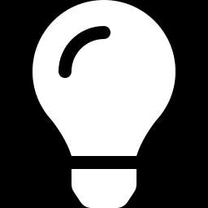
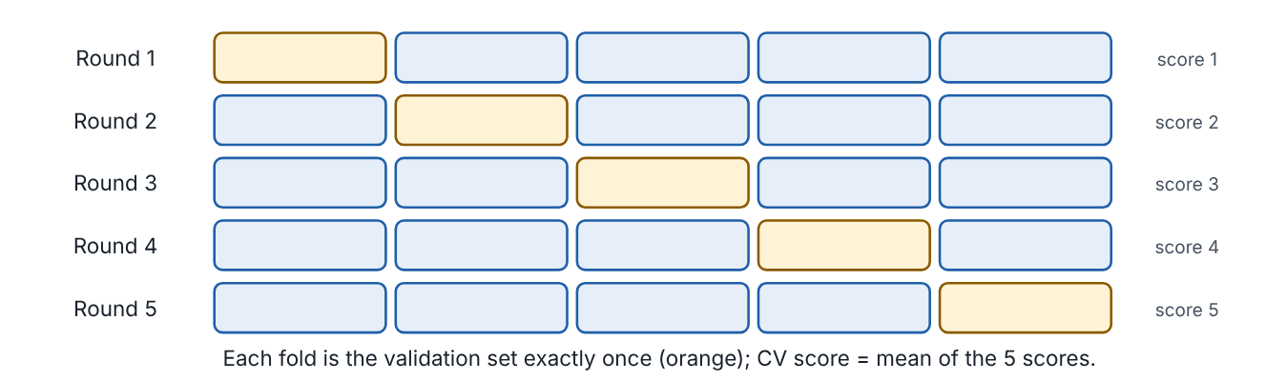
Reusing scarce data for validation
Lesson 3 · Cross-validation and learning curves · Intuition
When data are expensive, setting aside a large validation set hurts. k-fold cross-validation splits the data into k parts (folds); each fold takes a turn as validation while the rest train; the k scores are averaged. Learning curves plot validation error against training-set size to show whether more data would help.
5-fold cross-validation: each fold is the validation set exactly once.
Notes:
Reusing scarce data for validation. When data are expensive, setting aside a large validation set hurts. k-fold cross-validation splits the data into k parts (folds); each fold takes a turn as validation while the rest train; the k scores are averaged. Learning curves plot validation error against training-set size to show whether more data would help. Look at the figure. 5-fold cross-validation: each fold is the validation set exactly once. Five rows of five blocks; in each row a different block is highlighted orange as validation, the others blue for training. Each row yields a score; the CV score is their mean.

Slide 3
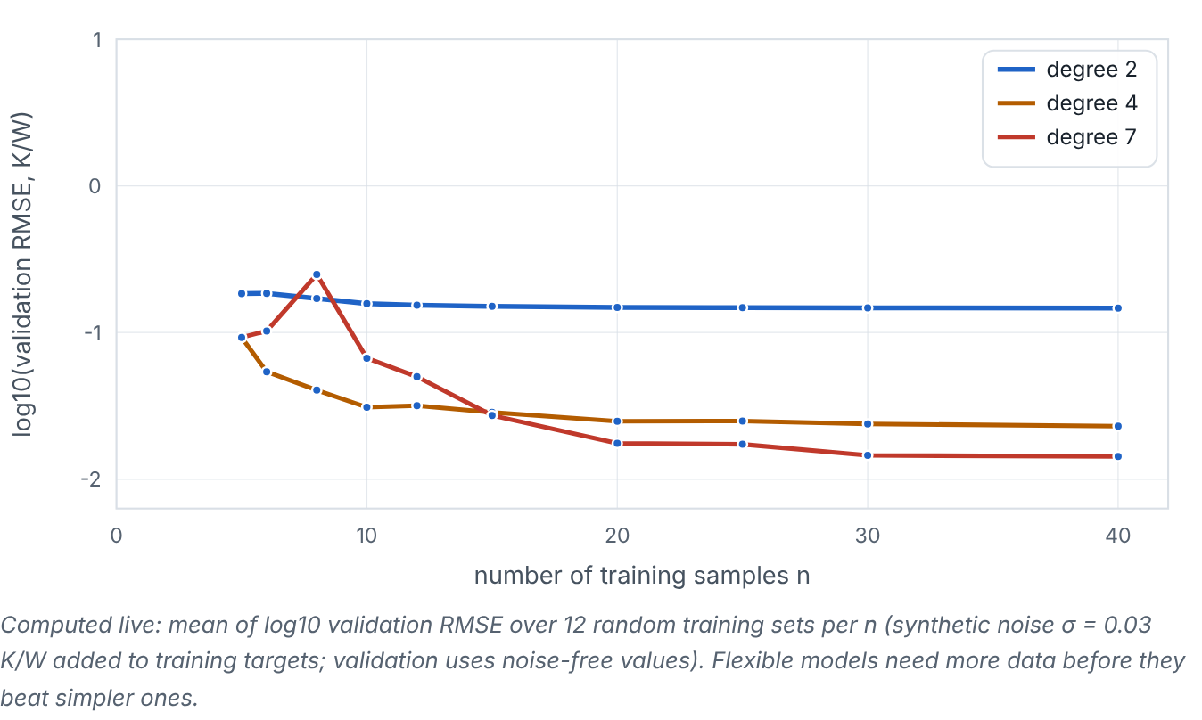
Reusing scarce data for validation
Lesson 3 · Cross-validation and learning curves · Figure
Learning curves (computed live): validation error versus number of training samples for three polynomial degrees.
Notes:
Here is another view. Learning curves (computed live): validation error versus number of training samples for three polynomial degrees. Three falling curves of log validation RMSE versus n. The degree-7 curve starts highest at small n and falls fastest; with enough data it beats degree 2, whose curve flattens at a higher error.

Slide 4
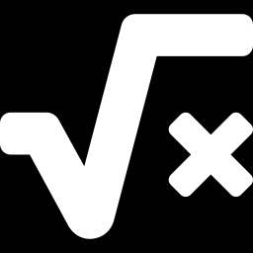
Reusing scarce data for validation
Lesson 3 · Cross-validation and learning curves · The mathematics
CV_{k} = (1)/(k) Σ_{j=1}^{k} RMSE_{j} (or mean of squared errors across folds)
k = n is leave-one-out CV. A model refit on each fold costs k fits — cheap for surrogates, since the expensive part (simulation) is already done.
Notes:
Now the mathematics. CV_k = (1)/(k) Σ_j_{=1}^k RMSE_j (or mean of squared errors across folds) k = n is leave-one-out CV. A model refit on each fold costs k fits — cheap for surrogates, since the expensive part (simulation) is already done.

Slide 5
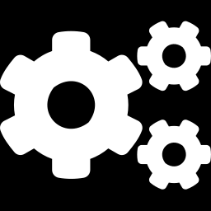
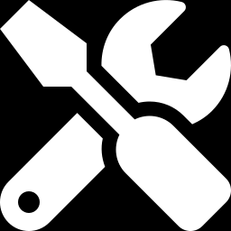
Reusing scarce data for validation
Lesson 3 · Cross-validation and learning curves · In engineering practice
Engineering application
Practical tip
With 30 CFD runs of a heat-exchanger design, 5-fold CV lets every run serve for both training and validation, comparing polynomial and GP surrogates without spending runs on a separate validation set.
Use 5- or 10-fold CV for model selection with small data; shuffle with a recorded seed — unless data are grouped (next lesson).
Notes:
Where does this matter in engineering? With 30 CFD runs of a heat-exchanger design, 5-fold CV lets every run serve for both training and validation, comparing polynomial and GP surrogates without spending runs on a separate validation set. A practical tip: Use 5- or 10-fold CV for model selection with small data; shuffle with a recorded seed — unless data are grouped (next lesson).

Slide 6

Pause and predict
Lesson 3 · Cross-validation and learning curves · Predict before you look
A learning curve for a GP has flattened at validation RMSE 0.002 K/W from n = 20 to n = 40. Will doubling the data again help much?
Write down your answer, then continue to the next slide.
Notes:
Time to predict. A learning curve for a GP has flattened at validation RMSE 0.002 K/W from n = 20 to n = 40. Will doubling the data again help much? Pause here and commit to an answer before moving on.

Slide 7
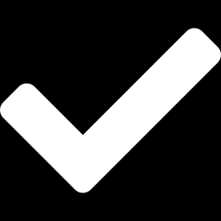
What happens, and why
Lesson 3 · Cross-validation and learning curves · Answer
Question: A learning curve for a GP has flattened at validation RMSE 0.002 K/W from n = 20 to n = 40. Will doubling the data again help much?
Probably little — the curve has plateaued. Improvement now needs a different model, different sampling (e.g., near the optimum), or better data, not just more of the same.
Notes:
Here is the answer. Probably little — the curve has plateaued. Improvement now needs a different model, different sampling (e.g., near the optimum), or better data, not just more of the same.

Slide 8
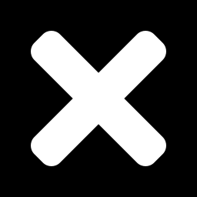
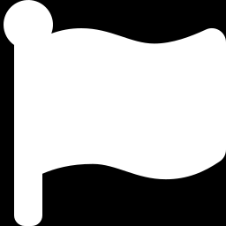
Reusing scarce data for validation
Lesson 3 · Cross-validation and learning curves · Common misconception
Misconception
What is actually true
Cross-validation removes the need for a final test set.
CV is used for selection; if you select using CV, a separate untouched test set (or a careful nested CV) still gives the unbiased final estimate.
Takeaway k-fold CV reuses data for validation; learning curves show whether more data would help.
Notes:
A common misconception is this: Cross-validation removes the need for a final test set. In fact: CV is used for selection; if you select using CV, a separate untouched test set (or a careful nested CV) still gives the unbiased final estimate. The takeaway: k-fold CV reuses data for validation; learning curves show whether more data would help.

Slide 9
Key takeaways from this lesson
Summary
1
Reusing scarce data for validation
k-fold CV reuses data for validation; learning curves show whether more data would help.
Notes:
To sum up this lesson. Reusing scarce data for validation: k-fold CV reuses data for validation; learning curves show whether more data would help.

Slide 10
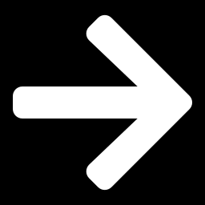
Data leakage, pipelines and group-aware splits
UP NEXT · LESSON 5.4
Next in Module 5: Lesson 4. Mark this lesson complete in the course before continuing.
Notes:
That completes Lesson 3 of Module 5: Cross-validation and learning curves. Next comes Lesson 4: Data leakage, pipelines and group-aware splits.

