Slide 1
Data leakage, pipelines and group-aware splits
MODULE 05 · LESSON 4 OF 5 · ≈ 12 MIN
5.4
Module 5: Generalization and trustworthy validation
Leakage: when the test answer sneaks into training
Splitting related observations by group
Notes:
Welcome to Module 5, Lesson 4 of the self-paced course Machine Learning Fundamentals for Surrogate-Based Engineering Optimization: Data leakage, pipelines and group-aware splits. This lesson belongs to the module Generalization and trustworthy validation and takes about 12 minutes. In this lesson: Leakage: when the test answer sneaks into training; Splitting related observations by group.

Slide 2
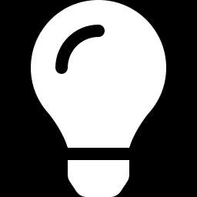
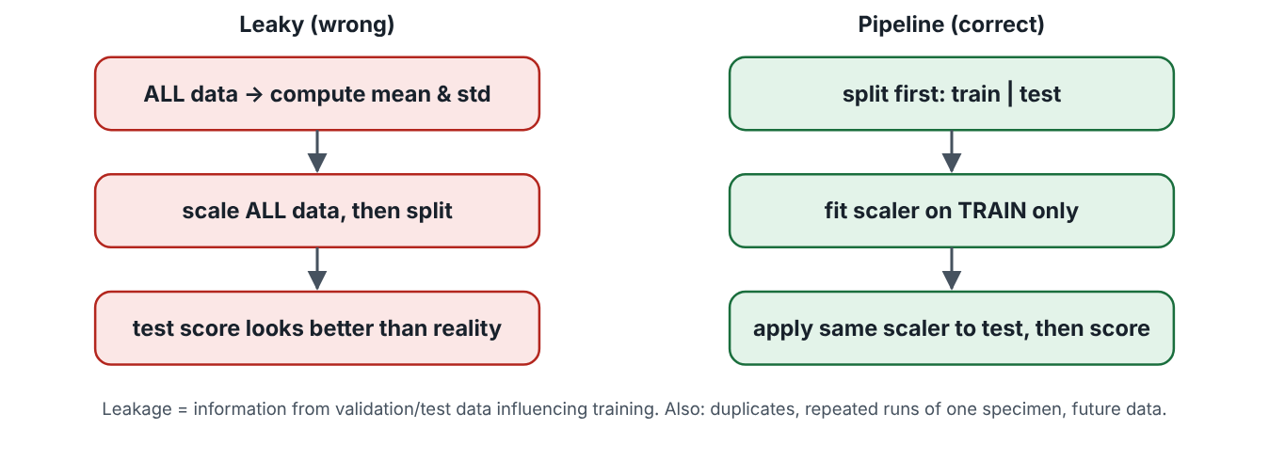
Leakage: when the test answer sneaks into training
Lesson 4 · Data leakage, pipelines and group-aware splits · Intuition
Data leakage means information from validation or test data influences training, making errors look smaller than they really are. Classic examples: scaling with statistics computed on all data before splitting; selecting features using all data; near-duplicate samples in both sets; using future measurements to predict the past.
Leaky preprocessing (left) versus a pipeline (right).
Notes:
Leakage: when the test answer sneaks into training. Data leakage means information from validation or test data influences training, making errors look smaller than they really are. Classic examples: scaling with statistics computed on all data before splitting; selecting features using all data; near-duplicate samples in both sets; using future measurements to predict the past. Look at the figure. Leaky preprocessing (left) versus a pipeline (right). Left column in red: compute mean and standard deviation on all data, scale everything, then split — test score looks better than reality. Right column in green: split first, fit scaler on training data only, apply the same scaler to test data, then score.

Slide 3
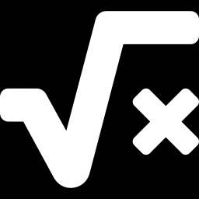
Leakage: when the test answer sneaks into training
Lesson 4 · Data leakage, pipelines and group-aware splits · The mathematics
A pipeline bundles preprocessing and model so that, inside each CV fold, every fitted quantity (means, standard deviations, polynomial feature scalings) is computed from that fold’s training part only:
from sklearn.pipeline import make_pipeline
from sklearn.preprocessing import StandardScaler, PolynomialFeatures
from sklearn.linear_model import LinearRegression
from sklearn.model_selection import cross_val_score
model = make_pipeline(StandardScaler(), PolynomialFeatures(3), LinearRegression())
scores = cross_val_score(model, X, y, cv=5, scoring="neg_root_mean_squared_error")
Notes:
Now the mathematics. A pipeline bundles preprocessing and model so that, inside each CV fold, every fitted quantity (means, standard deviations, polynomial feature scalings) is computed from that fold’s training part only: (The code listing is shown on the slide: from sklearn.pipeline import make_pipeline; from sklearn.preprocessing import StandardScaler, PolynomialFeatures; from sklearn.linear_model import LinearRegression; from sklearn.model_selection import cross_val_score; model = make_pipeline(StandardScaler(), PolynomialFeatures(3), LinearRegression()); scores = cross_val_score(model, X, y, cv=5, scoring="neg_root_mean_squared_error"))

Slide 4
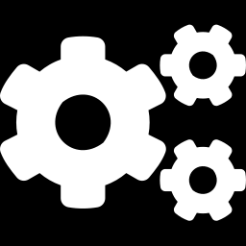
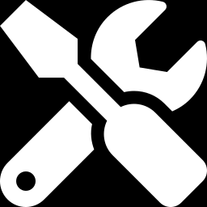
Leakage: when the test answer sneaks into training
Lesson 4 · Data leakage, pipelines and group-aware splits · In engineering practice
Engineering application
Practical tip
Scaling by fixed design-variable bounds (known before any data) cannot leak; scaling by data statistics can. With small datasets (20–40 runs), leakage effects are larger than many students expect.
Rule: anything “fitted” — scalers, feature selection, hyperparameter tuning — must be inside the cross-validation loop.
Notes:
Where does this matter in engineering? Scaling by fixed design-variable bounds (known before any data) cannot leak; scaling by data statistics can. With small datasets (20–40 runs), leakage effects are larger than many students expect. A practical tip: Rule: anything “fitted” — scalers, feature selection, hyperparameter tuning — must be inside the cross-validation loop.

Slide 5

Pause and predict
Lesson 4 · Data leakage, pipelines and group-aware splits · Predict before you look
You standardize all 40 runs, then do 5-fold CV. Is this leakage?
Write down your answer, then continue to the next slide.
Notes:
Time to predict. You standardize all 40 runs, then do 5-fold CV. Is this leakage? Pause here and commit to an answer before moving on.

Slide 6
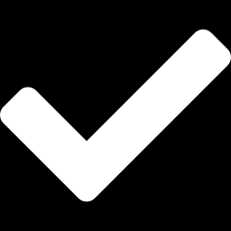
What happens, and why
Lesson 4 · Data leakage, pipelines and group-aware splits · Answer
Question: You standardize all 40 runs, then do 5-fold CV. Is this leakage?
Yes — mild but real: each fold’s validation data influenced the mean and standard deviation used in training. Put the scaler inside a pipeline.
Notes:
Here is the answer. Yes — mild but real: each fold’s validation data influenced the mean and standard deviation used in training. Put the scaler inside a pipeline.

Slide 7
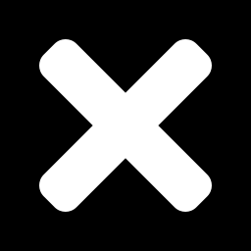
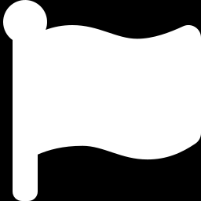
Leakage: when the test answer sneaks into training
Lesson 4 · Data leakage, pipelines and group-aware splits · Common misconception
Misconception
What is actually true
Leakage only matters for big-data applications.
It matters most for small datasets, where each point strongly affects fitted statistics and scores.
Takeaway Fit every preprocessing step on training data only; pipelines enforce this.
Notes:
A common misconception is this: Leakage only matters for big-data applications. In fact: It matters most for small datasets, where each point strongly affects fitted statistics and scores. The takeaway: Fit every preprocessing step on training data only; pipelines enforce this.

Slide 8
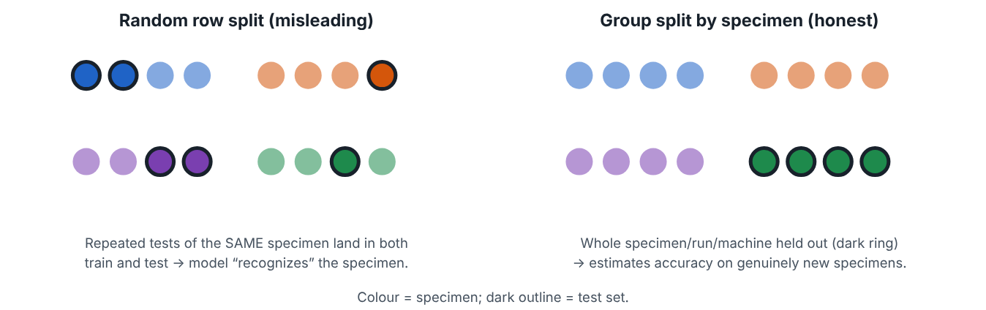
Splitting related observations by group
Lesson 4 · Data leakage, pipelines and group-aware splits · Intuition
Rows are often not independent: repeated tests on the same specimen, several time steps from one simulation run, measurements from one machine, or data ordered in time. Random row splitting puts near-identical rows in both training and test, so the model appears to generalize when it is really recognizing the group.
Random row split versus group split.
Notes:
Splitting related observations by group. Rows are often not independent: repeated tests on the same specimen, several time steps from one simulation run, measurements from one machine, or data ordered in time. Random row splitting puts near-identical rows in both training and test, so the model appears to generalize when it is really recognizing the group. Look at the figure. Random row split versus group split. Left: coloured dots for four specimens, with test points (dark outline) scattered among all specimens. Right: one entire specimen held out as the test group.

Slide 9
Splitting related observations by group
Lesson 4 · Data leakage, pipelines and group-aware splits · The mathematics
Group k-fold: partition the set of groups (not rows) into folds. In scikit-learn: GroupKFold(n_splits=5) with a groups array (specimen ID, run ID, machine ID). For time-ordered data, train on the past and test on the future (TimeSeriesSplit).
Notes:
Now the mathematics. Group k-fold: partition the set of groups (not rows) into folds. In scikit-learn: GroupKFold(n_splits=5) with a groups array (specimen ID, run ID, machine ID). For time-ordered data, train on the past and test on the future (TimeSeriesSplit).

Slide 10
Splitting related observations by group
Lesson 4 · Data leakage, pipelines and group-aware splits · In engineering practice
Engineering application
Practical tip
Fatigue tests: several strain-gauge readings per specimen → split by specimen. Transient CFD: 200 time steps per run → split by run. Machining: data from three lathes → hold out a whole lathe to check transfer to an unseen machine.
Ask: “What will be new when the model is used?” — a new design, specimen, machine, or time period — and split by that.
Notes:
Where does this matter in engineering? Fatigue tests: several strain-gauge readings per specimen → split by specimen. Transient CFD: 200 time steps per run → split by run. Machining: data from three lathes → hold out a whole lathe to check transfer to an unseen machine. A practical tip: Ask: “What will be new when the model is used?” — a new design, specimen, machine, or time period — and split by that.

Slide 11
Pause and predict
Lesson 4 · Data leakage, pipelines and group-aware splits · Predict before you look
A random split of 1 000 rows from 10 specimens gives test RMSE 2 MPa; a split by specimen gives 9 MPa. Which reflects performance on a new specimen?
Write down your answer, then continue to the next slide.
Notes:
Time to predict. A random split of 1 000 rows from 10 specimens gives test RMSE 2 MPa; a split by specimen gives 9 MPa. Which reflects performance on a new specimen? Pause here and commit to an answer before moving on.

Slide 12
What happens, and why
Lesson 4 · Data leakage, pipelines and group-aware splits · Answer
Question: A random split of 1 000 rows from 10 specimens gives test RMSE 2 MPa; a split by specimen gives 9 MPa. Which reflects performance on a new specimen?
The group split (9 MPa). The random split was inflated by within-specimen similarity.
Notes:
Here is the answer. The group split (9 MPa). The random split was inflated by within-specimen similarity.

Slide 13
Splitting related observations by group
Lesson 4 · Data leakage, pipelines and group-aware splits · Common misconception
Misconception
What is actually true
Random splitting is always the fair default.
It is fair only if rows are independent. Otherwise split by the unit you want to generalize to.
Takeaway Split by specimen/run/machine/time when rows are related; random row splits can be badly optimistic.
Notes:
A common misconception is this: Random splitting is always the fair default. In fact: It is fair only if rows are independent. Otherwise split by the unit you want to generalize to. The takeaway: Split by specimen/run/machine/time when rows are related; random row splits can be badly optimistic.

Slide 14
Key takeaways from this lesson
Summary
1
Leakage: when the test answer sneaks into training
Fit every preprocessing step on training data only; pipelines enforce this.
2
Splitting related observations by group
Split by specimen/run/machine/time when rows are related; random row splits can be badly optimistic.
Notes:
To sum up this lesson. Leakage: when the test answer sneaks into training: Fit every preprocessing step on training data only; pipelines enforce this. Splitting related observations by group: Split by specimen/run/machine/time when rows are related; random row splits can be badly optimistic.

Slide 15
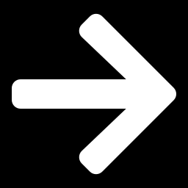
Why good average accuracy may be insufficient near an optimum
UP NEXT · LESSON 5.5
Next in Module 5: Lesson 5. Mark this lesson complete in the course before continuing.
Notes:
That completes Lesson 4 of Module 5: Data leakage, pipelines and group-aware splits. Next comes Lesson 5: Why good average accuracy may be insufficient near an optimum.

