Slide 1
Why good average accuracy may be insufficient near an optimum
MODULE 05 · LESSON 5 OF 5 · ≈ 8 MIN
5.5
Module 5: Generalization and trustworthy validation
Average accuracy vs accuracy where decisions are made
Notes:
Welcome to Module 5, Lesson 5 of the self-paced course Machine Learning Fundamentals for Surrogate-Based Engineering Optimization: Why good average accuracy may be insufficient near an optimum. This lesson belongs to the module Generalization and trustworthy validation and takes about 8 minutes. In this lesson: Average accuracy vs accuracy where decisions are made.

Slide 2
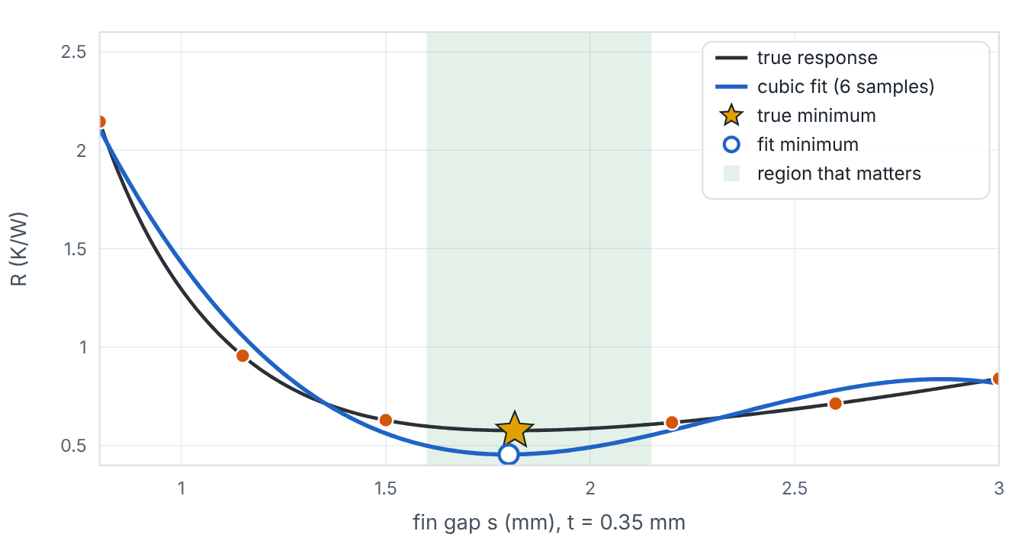

Average accuracy vs accuracy where decisions are made
Lesson 5 · Why good average accuracy may be insufficient near an optimum · Intuition
Validation metrics average over the whole design space. Optimization, however, cares about a small region — near the best designs — where differences between candidates may be tiny. A surrogate can have a fine global RMSE yet misplace the optimum or misjudge its value.
A cubic fit with acceptable global error places its minimum away from the true minimum on a 1-D slice.
Notes:
Average accuracy vs accuracy where decisions are made. Validation metrics average over the whole design space. Optimization, however, cares about a small region — near the best designs — where differences between candidates may be tiny. A surrogate can have a fine global RMSE yet misplace the optimum or misjudge its value. Look at the figure. A cubic fit with acceptable global error places its minimum away from the true minimum on a 1-D slice. Plot of true R versus fin gap at t = 0.35 mm, a cubic fit from six samples, the region near the optimum shaded green, the true minimum as a star and the fit’s minimum as a hollow circle. The readout compares global and local RMSE and the true R at the fitted minimum.

Slide 3

Average accuracy vs accuracy where decisions are made
Lesson 5 · Why good average accuracy may be insufficient near an optimum · The mathematics
Let x* minimize the true f and x̂* minimize the surrogate f̂. What matters is the verified gap
Δ = f(x̂*) − f(x*) ≥ 0
which depends on surrogate error near the optima, not on its average error elsewhere.
Notes:
Now the mathematics. Let x* minimize the true f and x̂* minimize the surrogate f̂. What matters is the verified gap Δ = f(x̂*) − f(x*) ≥ 0 which depends on surrogate error near the optima, not on its average error elsewhere.

Slide 4


Average accuracy vs accuracy where decisions are made
Lesson 5 · Why good average accuracy may be insufficient near an optimum · In engineering practice
Engineering application
Practical tip
In the heat sink, R ranges from about 0.57 to over 4 K/W across the bounds, but feasible designs near the optimum differ by only a few thousandths of a K/W. An error of 0.01 K/W can reorder those candidates.
Report errors separately for the region of good designs (e.g., best 20% of validation points) as well as globally — and verify candidates.
Notes:
Where does this matter in engineering? In the heat sink, R ranges from about 0.57 to over 4 K/W across the bounds, but feasible designs near the optimum differ by only a few thousandths of a K/W. An error of 0.01 K/W can reorder those candidates. A practical tip: Report errors separately for the region of good designs (e.g., best 20% of validation points) as well as globally — and verify candidates.

Slide 5

Pause and predict
Lesson 5 · Why good average accuracy may be insufficient near an optimum · Predict before you look
Surrogate A has global RMSE 0.02 K/W; surrogate B 0.04 K/W, but B is much more accurate within 0.2 mm of the optimum. Which is better for optimization?
Write down your answer, then continue to the next slide.
Notes:
Time to predict. Surrogate A has global RMSE 0.02 K/W; surrogate B 0.04 K/W, but B is much more accurate within 0.2 mm of the optimum. Which is better for optimization? Pause here and commit to an answer before moving on.

Slide 6

What happens, and why
Lesson 5 · Why good average accuracy may be insufficient near an optimum · Answer
Question: Surrogate A has global RMSE 0.02 K/W; surrogate B 0.04 K/W, but B is much more accurate within 0.2 mm of the optimum. Which is better for optimization?
Probably B. Optimization quality depends on accuracy where the optimizer will look. Always verify the candidate either way.
Notes:
Here is the answer. Probably B. Optimization quality depends on accuracy where the optimizer will look. Always verify the candidate either way.

Slide 7


Average accuracy vs accuracy where decisions are made
Lesson 5 · Why good average accuracy may be insufficient near an optimum · Common misconception
Misconception
What is actually true
If validation RMSE is small, the surrogate optimum is close to the true optimum.
Not necessarily; local errors and flat objectives can mislead. Verification with the original model (Module 11) is required.
Takeaway Good average accuracy ≠ good optimum; check local error and verify.
Notes:
A common misconception is this: If validation RMSE is small, the surrogate optimum is close to the true optimum. In fact: Not necessarily; local errors and flat objectives can mislead. Verification with the original model (Module 11) is required. The takeaway: Good average accuracy ≠ good optimum; check local error and verify.

Slide 8
Key takeaways from this lesson
Summary
1
Average accuracy vs accuracy where decisions are made
Good average accuracy ≠ good optimum; check local error and verify.
Notes:
To sum up this lesson. Average accuracy vs accuracy where decisions are made: Good average accuracy ≠ good optimum; check local error and verify.

Slide 9

Expensive models and their surrogates
UP NEXT · LESSON 6.1
That completes Module 5. Before moving on, review the Module 5 flashcards and take its quiz in the course (pass mark 70%). Next: Module 6, What engineering surrogates are.
Notes:
That completes Lesson 5 of Module 5: Why good average accuracy may be insufficient near an optimum. This was the last lesson of the module, so review the flashcards and take the Module 5 quiz in the course. Next comes Module 6, What engineering surrogates are, starting with Expensive models and their surrogates.

