Slide 1
Expensive models and their surrogates
MODULE 06 · LESSON 1 OF 4 · ≈ 10 MIN
6.1
Module 6: What engineering surrogates are
A fast approximation of a slow input–output relationship
Notes:
Welcome to Module 6, Lesson 1 of the self-paced course Machine Learning Fundamentals for Surrogate-Based Engineering Optimization: Expensive models and their surrogates. This lesson belongs to the module What engineering surrogates are and takes about 10 minutes. In this lesson: A fast approximation of a slow input–output relationship.

Slide 2

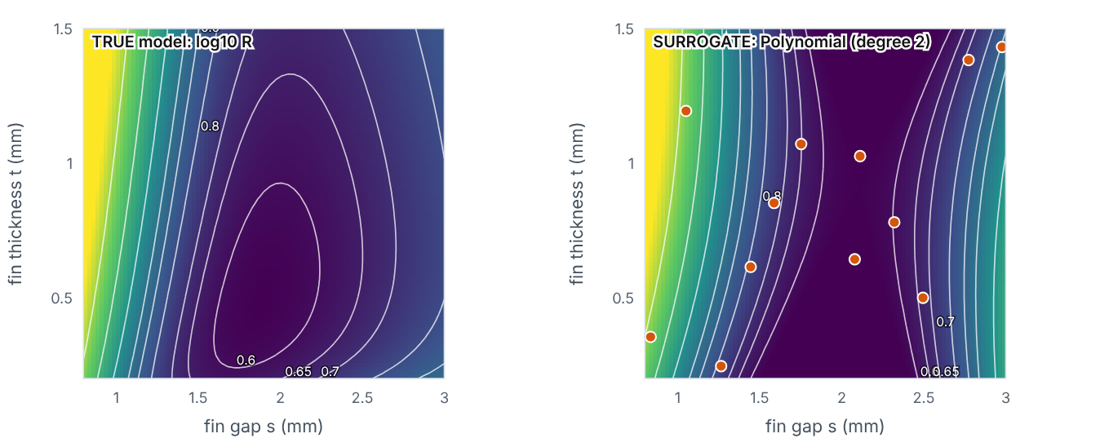
A fast approximation of a slow input–output relationship
Lesson 1 · Expensive models and their surrogates · Intuition
An expensive model — a CFD or FEA simulation, or a physical test — maps design variables to responses. A surrogate (also: metamodel, response surface, emulator) is a fitted function that imitates that mapping using a limited number of evaluated designs. It is not the simulator: it knows nothing beyond the samples and its own assumptions.
The true model (left) and a surrogate fitted to sampled designs (right). Change model family and sample size. (Interactive in the online course.)
Notes:
A fast approximation of a slow input–output relationship. An expensive model — a CFD or FEA simulation, or a physical test — maps design variables to responses. A surrogate (also: metamodel, response surface, emulator) is a fitted function that imitates that mapping using a limited number of evaluated designs. It is not the simulator: it knows nothing beyond the samples and its own assumptions. Look at the figure. The true model (left) and a surrogate fitted to sampled designs (right). Change model family and sample size. Two colour maps over fin gap and thickness. Left: true log thermal resistance. Right: the surrogate prediction with sample points; contour shapes resemble the true ones more closely as samples increase. The readout gives validation RMSE and maximum error.

Slide 3
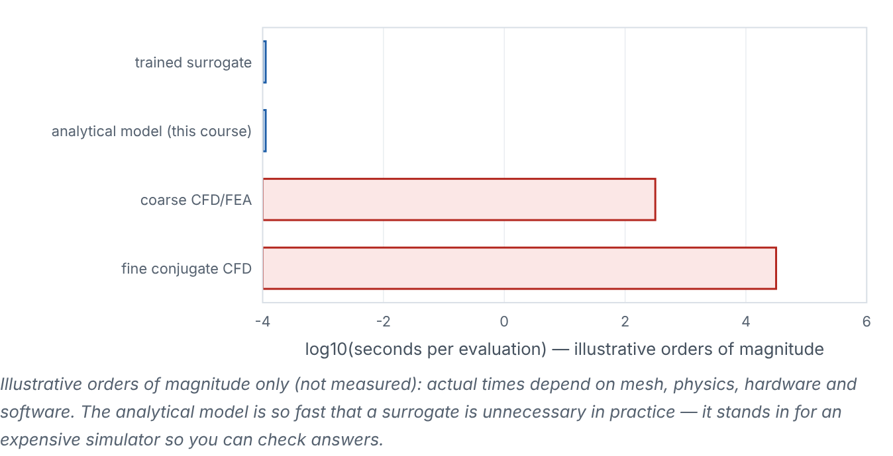
A fast approximation of a slow input–output relationship
Lesson 1 · Expensive models and their surrogates · Figure
Illustrative orders of magnitude of evaluation time.
Notes:
Here is another view. Illustrative orders of magnitude of evaluation time. Horizontal bars on a log time axis: trained surrogate and analytical model microseconds; coarse CFD/FEA minutes; fine conjugate CFD hours. Labelled as illustrative, not measured.

Slide 4

A fast approximation of a slow input–output relationship
Lesson 1 · Expensive models and their surrogates · The mathematics
y = f(x) (expensive) ≈ ŷ = f̂(x; θ) (cheap), fitted to 𝒟 = {(x_{i}, f(x_{i}))}_{i=1}^{n}
In this course f is the analytical heat-sink model, and surrogates are fitted to log₁₀R because the logarithm varies more smoothly across the space.
Notes:
Now the mathematics. y = f(x) (expensive) ≈ ŷ = f̂(x; θ) (cheap), fitted to 𝒟 = {(x_i, f(x_i))}_i_{=1}^n In this course f is the analytical heat-sink model, and surrogates are fitted to log₁₀R because the logarithm varies more smoothly across the space.

Slide 5


A fast approximation of a slow input–output relationship
Lesson 1 · Expensive models and their surrogates · In engineering practice
Engineering application
Practical tip
Heat exchangers: surrogate of effectiveness and pressure drop vs tube pitch and fin density from 3-D CFD. Structures: surrogate of peak stress vs rib dimensions from FEA. Fluid machinery: surrogate of pump efficiency vs blade angles.
Write down for every surrogate: inputs and ranges, fixed conditions, output transforms (e.g., log), training data source and size.
Notes:
Where does this matter in engineering? Heat exchangers: surrogate of effectiveness and pressure drop vs tube pitch and fin density from 3-D CFD. Structures: surrogate of peak stress vs rib dimensions from FEA. Fluid machinery: surrogate of pump efficiency vs blade angles. A practical tip: Write down for every surrogate: inputs and ranges, fixed conditions, output transforms (e.g., log), training data source and size.

Slide 6

Pause and predict
Lesson 1 · Expensive models and their surrogates · Predict before you look
A surrogate was trained on heat-sink CFD with Δp = 5 Pa. Can it predict performance at Δp = 10 Pa?
Write down your answer, then continue to the next slide.
Notes:
Time to predict. A surrogate was trained on heat-sink CFD with Δp = 5 Pa. Can it predict performance at Δp = 10 Pa? Pause here and commit to an answer before moving on.

Slide 7

What happens, and why
Lesson 1 · Expensive models and their surrogates · Answer
Question: A surrogate was trained on heat-sink CFD with Δp = 5 Pa. Can it predict performance at Δp = 10 Pa?
No. Δp was fixed during sampling; it is not an input of the surrogate. The surrogate only represents the conditions under which its data were generated.
Notes:
Here is the answer. No. Δp was fixed during sampling; it is not an input of the surrogate. The surrogate only represents the conditions under which its data were generated.

Slide 8


A fast approximation of a slow input–output relationship
Lesson 1 · Expensive models and their surrogates · Common misconception
Misconception
What is actually true
The surrogate is a faster version of the simulator.
It is an approximation fitted to some simulator outputs. Its errors, valid range and assumptions are its own.
Takeaway Surrogate = cheap regression model of an expensive model, valid only for its inputs, ranges and fixed conditions.
Notes:
A common misconception is this: The surrogate is a faster version of the simulator. In fact: It is an approximation fitted to some simulator outputs. Its errors, valid range and assumptions are its own. The takeaway: Surrogate = cheap regression model of an expensive model, valid only for its inputs, ranges and fixed conditions.

Slide 9
Key takeaways from this lesson
Summary
1
A fast approximation of a slow input–output relationship
Surrogate = cheap regression model of an expensive model, valid only for its inputs, ranges and fixed conditions.
Notes:
To sum up this lesson. A fast approximation of a slow input–output relationship: Surrogate = cheap regression model of an expensive model, valid only for its inputs, ranges and fixed conditions.

Slide 10

Design variables, response surfaces, objectives and constraints
UP NEXT · LESSON 6.2
Next in Module 6: Lesson 2. Mark this lesson complete in the course before continuing.
Notes:
That completes Lesson 1 of Module 6: Expensive models and their surrogates. Next comes Lesson 2: Design variables, response surfaces, objectives and constraints.

