Slide 1
Design variables, response surfaces, objectives and constraints
MODULE 06 · LESSON 2 OF 4 · ≈ 9 MIN
6.2
Module 6: What engineering surrogates are
Formulating the design problem
Notes:
Welcome to Module 6, Lesson 2 of the self-paced course Machine Learning Fundamentals for Surrogate-Based Engineering Optimization: Design variables, response surfaces, objectives and constraints. This lesson belongs to the module What engineering surrogates are and takes about 9 minutes. In this lesson: Formulating the design problem.

Slide 2
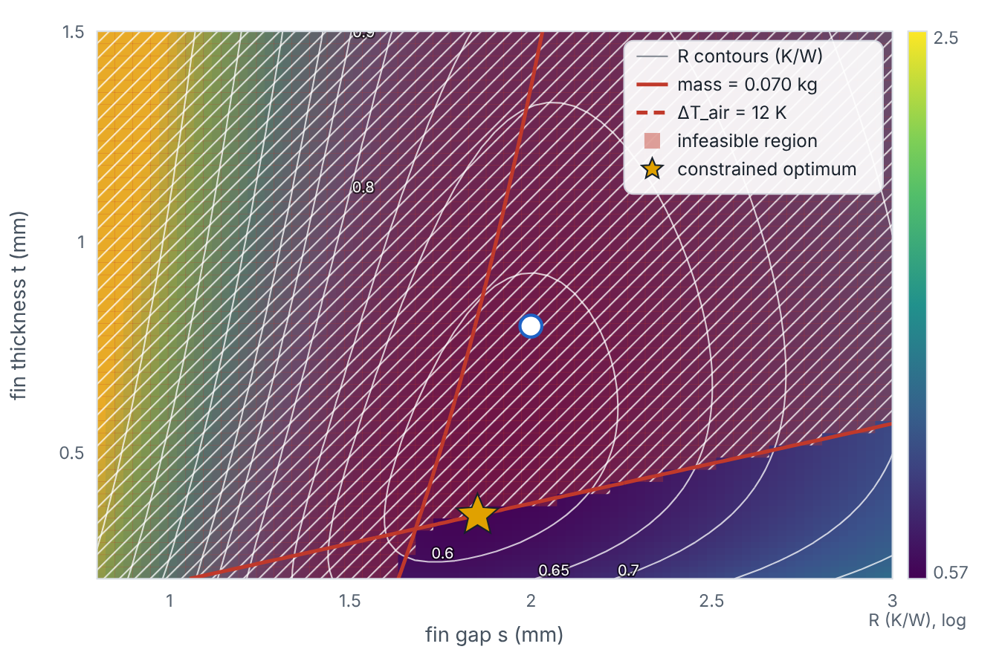

Formulating the design problem
Lesson 2 · Design variables, response surfaces, objectives and constraints · Intuition
Design variables are what you choose (here s, t), within bounds. The objective is what you minimize or maximize (here R). Constraints are requirements a design must satisfy (mass ≤ 0.070 kg; ΔT_{air} ≤ 12 K). Designs satisfying all constraints are feasible.
The heat-sink design space: objective contours, infeasible regions and the constrained optimum.
Notes:
Formulating the design problem. Design variables are what you choose (here s, t), within bounds. The objective is what you minimize or maximize (here R). Constraints are requirements a design must satisfy (mass ≤ 0.070 kg; ΔT_{air} ≤ 12 K). Designs satisfying all constraints are feasible. Look at the figure. The heat-sink design space: objective contours, infeasible regions and the constrained optimum. Colour map of R with contours. Red shading marks infeasible designs: thick fins or many fins violate the mass limit (solid red line), very small gaps violate the air-temperature limit (dashed red line). A star marks the constrained optimum on the mass-limit line near s = 1.85 mm, t = 0.35 mm.

Slide 3

Formulating the design problem
Lesson 2 · Design variables, response surfaces, objectives and constraints · The mathematics
min_{x} R(x) s.t. g₁(x) = m(x) − 0.070 kg ≤ 0, g₂(x) = ΔT_{air}(x) − 12 K ≤ 0, x_{L} ≤ x ≤ x_{U}
Symbol | Meaning | Unit
x = (s, t) | design vector | mm
x_{L}, x_{U} | bounds (0.8, 0.2) and (3.0, 1.5) | mm
g_{j}(x) ≤ 0 | inequality constraints written in standard form | kg, K
Notes:
Now the mathematics. min_x R(x) s.t. g_1(x) = m(x) − 0.070 kg ≤ 0, g_2(x) = ΔT_{air}(x) − 12 K ≤ 0, x_L ≤ x ≤ x_U x = (s, t) is the design vector, in mm. x_L, x_U is the bounds (0.8, 0.2) and (3.0, 1.5), in mm. g_j(x) ≤ 0 is the inequality constraints written in standard form, in kg, K.

Slide 4


Formulating the design problem
Lesson 2 · Design variables, response surfaces, objectives and constraints · In engineering practice
Engineering application
Practical tip
Constraints can be cheap (mass from geometry) or expensive (ΔT_{air} needs the flow solution). Model only the expensive ones with surrogates; compute cheap ones exactly. Structural example: minimize mass s.t. deflection ≤ limit (expensive, FEA) and plate thickness ≥ 2 mm (bound).
Write constraints as g(x) ≤ 0 with units, and normalize them (e.g., divide by the limit) when combining them in penalties.
Notes:
Where does this matter in engineering? Constraints can be cheap (mass from geometry) or expensive (ΔT_{air} needs the flow solution). Model only the expensive ones with surrogates; compute cheap ones exactly. Structural example: minimize mass s.t. deflection ≤ limit (expensive, FEA) and plate thickness ≥ 2 mm (bound). A practical tip: Write constraints as g(x) ≤ 0 with units, and normalize them (e.g., divide by the limit) when combining them in penalties.

Slide 5

Pause and predict
Lesson 2 · Design variables, response surfaces, objectives and constraints · Predict before you look
Why is the constrained optimum not at the unconstrained minimum of R?
Write down your answer, then continue to the next slide.
Notes:
Time to predict. Why is the constrained optimum not at the unconstrained minimum of R? Pause here and commit to an answer before moving on.

Slide 6

What happens, and why
Lesson 2 · Design variables, response surfaces, objectives and constraints · Answer
Question: Why is the constrained optimum not at the unconstrained minimum of R?
The unconstrained minimum (≈0.570 K/W at t ≈ 0.49 mm) weighs about 0.083 kg, violating the 0.070 kg limit; the best feasible design therefore lies on the mass-limit boundary with thinner fins.
Notes:
Here is the answer. The unconstrained minimum (≈0.570 K/W at t ≈ 0.49 mm) weighs about 0.083 kg, violating the 0.070 kg limit; the best feasible design therefore lies on the mass-limit boundary with thinner fins.

Slide 7


Formulating the design problem
Lesson 2 · Design variables, response surfaces, objectives and constraints · Common misconception
Misconception
What is actually true
Constraints are added after optimization by discarding infeasible results.
They must be part of the formulation; the optimizer needs to know them to search the feasible region effectively.
Takeaway Problem = variables + bounds + objective + constraints; model expensive responses, compute cheap ones exactly.
Notes:
A common misconception is this: Constraints are added after optimization by discarding infeasible results. In fact: They must be part of the formulation; the optimizer needs to know them to search the feasible region effectively. The takeaway: Problem = variables + bounds + objective + constraints; model expensive responses, compute cheap ones exactly.

Slide 8
Key takeaways from this lesson
Summary
1
Formulating the design problem
Problem = variables + bounds + objective + constraints; model expensive responses, compute cheap ones exactly.
Notes:
To sum up this lesson. Formulating the design problem: Problem = variables + bounds + objective + constraints; model expensive responses, compute cheap ones exactly.

Slide 9

Interpolation vs extrapolation; global vs local accuracy
UP NEXT · LESSON 6.3
Next in Module 6: Lesson 3. Mark this lesson complete in the course before continuing.
Notes:
That completes Lesson 2 of Module 6: Design variables, response surfaces, objectives and constraints. Next comes Lesson 3: Interpolation vs extrapolation; global vs local accuracy.

