Slide 1
Interpolation vs extrapolation; global vs local accuracy
MODULE 06 · LESSON 3 OF 4 · ≈ 10 MIN
6.3
Module 6: What engineering surrogates are
Where can you trust a surrogate?
Notes:
Welcome to Module 6, Lesson 3 of the self-paced course Machine Learning Fundamentals for Surrogate-Based Engineering Optimization: Interpolation vs extrapolation; global vs local accuracy. This lesson belongs to the module What engineering surrogates are and takes about 10 minutes. In this lesson: Where can you trust a surrogate?.

Slide 2
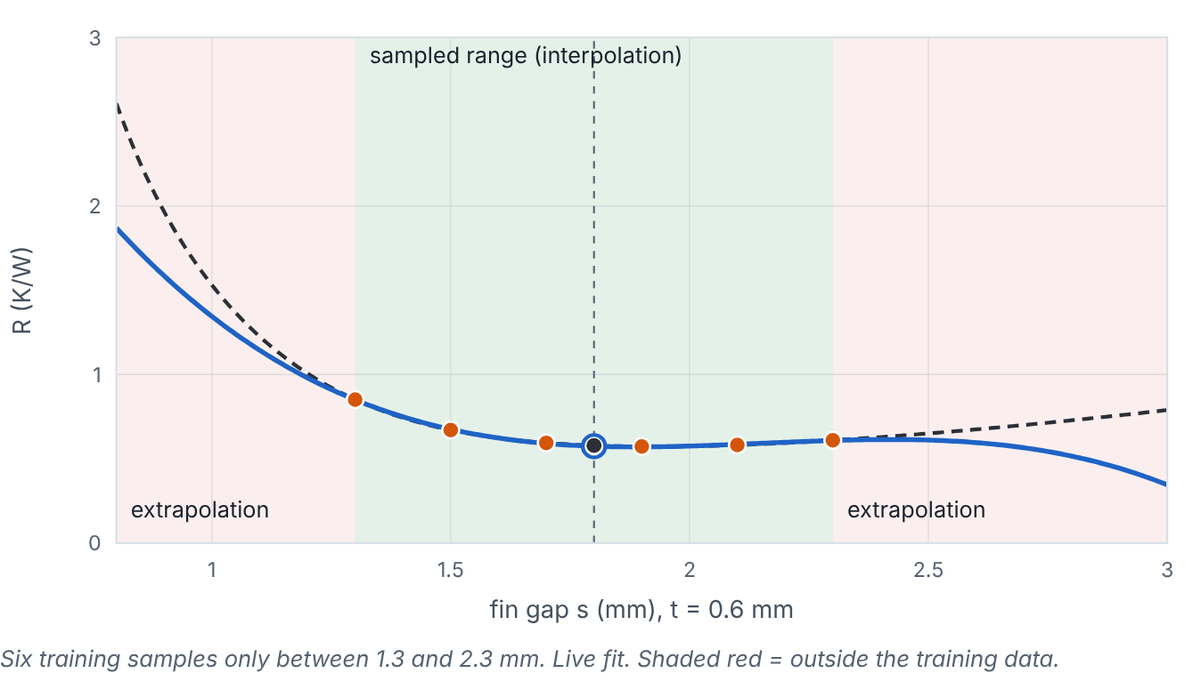

Where can you trust a surrogate?
Lesson 3 · Interpolation vs extrapolation; global vs local accuracy · Intuition
Interpolation: predicting inside the region covered by training samples. Extrapolation: predicting outside it. Surrogates are usually far less reliable when extrapolating, because nothing in the data constrains them there. Global accuracy is error averaged over the whole design space; local accuracy is error in a particular region (e.g., near the optimum).
Training data only cover 1.3–2.3 mm; move the prediction point into the extrapolation regions and compare models. (Interactive in the online course.)
Notes:
Where can you trust a surrogate?. Interpolation: predicting inside the region covered by training samples. Extrapolation: predicting outside it. Surrogates are usually far less reliable when extrapolating, because nothing in the data constrains them there. Global accuracy is error averaged over the whole design space; local accuracy is error in a particular region (e.g., near the optimum). Look at the figure. Training data only cover 1.3–2.3 mm; move the prediction point into the extrapolation regions and compare models. Plot of R versus fin gap with six training points in a green interpolation band; red-shaded extrapolation regions on both sides. A slider moves a query point; the readout labels it interpolation or extrapolation and gives prediction, truth and error. The GP option shows an uncertainty band that widens outside the data.

Slide 3

Where can you trust a surrogate?
Lesson 3 · Interpolation vs extrapolation; global vs local accuracy · The mathematics
In several dimensions, “inside” is subtler than “within the bounds of each variable”. A useful working definition is the convex hull of the samples; even inside the hull, large empty regions behave like local extrapolation. The fill distance (largest distance from any design to its nearest sample) measures how big those holes are (Module 7).
Notes:
Now the mathematics. In several dimensions, “inside” is subtler than “within the bounds of each variable”. A useful working definition is the convex hull of the samples; even inside the hull, large empty regions behave like local extrapolation. The fill distance (largest distance from any design to its nearest sample) measures how big those holes are (Module 7).

Slide 4


Where can you trust a surrogate?
Lesson 3 · Interpolation vs extrapolation; global vs local accuracy · In engineering practice
Engineering application
Practical tip
A machining roughness surrogate fitted for feeds 0.05–0.2 mm/rev should not be used at 0.4 mm/rev. In heat-sink optimization, an optimizer may push the design to a corner of the space where samples are sparse — local extrapolation.
Before trusting a prediction, check its distance to the nearest training sample and, if available, its predictive uncertainty.
Notes:
Where does this matter in engineering? A machining roughness surrogate fitted for feeds 0.05–0.2 mm/rev should not be used at 0.4 mm/rev. In heat-sink optimization, an optimizer may push the design to a corner of the space where samples are sparse — local extrapolation. A practical tip: Before trusting a prediction, check its distance to the nearest training sample and, if available, its predictive uncertainty.

Slide 5

Pause and predict
Lesson 3 · Interpolation vs extrapolation; global vs local accuracy · Predict before you look
A GP and a cubic polynomial agree closely at s = 1.8 mm but disagree strongly at s = 0.9 mm. What does the disagreement suggest?
Write down your answer, then continue to the next slide.
Notes:
Time to predict. A GP and a cubic polynomial agree closely at s = 1.8 mm but disagree strongly at s = 0.9 mm. What does the disagreement suggest? Pause here and commit to an answer before moving on.

Slide 6

What happens, and why
Lesson 3 · Interpolation vs extrapolation; global vs local accuracy · Answer
Question: A GP and a cubic polynomial agree closely at s = 1.8 mm but disagree strongly at s = 0.9 mm. What does the disagreement suggest?
That 0.9 mm is outside or far from the data, where each model is following its own assumptions. Disagreement between plausible models is a useful warning sign.
Notes:
Here is the answer. That 0.9 mm is outside or far from the data, where each model is following its own assumptions. Disagreement between plausible models is a useful warning sign.

Slide 7


Where can you trust a surrogate?
Lesson 3 · Interpolation vs extrapolation; global vs local accuracy · Common misconception
Misconception
What is actually true
If a point lies within the variable bounds, the surrogate is interpolating.
Samples may not cover all of the bounded box; corners and gaps can still be extrapolation in effect.
Takeaway Trust interpolation more than extrapolation; check local accuracy where decisions are made.
Notes:
A common misconception is this: If a point lies within the variable bounds, the surrogate is interpolating. In fact: Samples may not cover all of the bounded box; corners and gaps can still be extrapolation in effect. The takeaway: Trust interpolation more than extrapolation; check local accuracy where decisions are made.

Slide 8
Key takeaways from this lesson
Summary
1
Where can you trust a surrogate?
Trust interpolation more than extrapolation; check local accuracy where decisions are made.
Notes:
To sum up this lesson. Where can you trust a surrogate?: Trust interpolation more than extrapolation; check local accuracy where decisions are made.

Slide 9

The surrogate-assisted optimization workflow, and limitations
UP NEXT · LESSON 6.4
Next in Module 6: Lesson 4. Mark this lesson complete in the course before continuing.
Notes:
That completes Lesson 3 of Module 6: Interpolation vs extrapolation; global vs local accuracy. Next comes Lesson 4: The surrogate-assisted optimization workflow, and limitations.

