Slide 1
The surrogate-assisted optimization workflow, and limitations
MODULE 06 · LESSON 4 OF 4 · ≈ 9 MIN
6.4
Module 6: What engineering surrogates are
Fit → optimize → verify → update
Scientific limitations of simplified teaching models
Notes:
Welcome to Module 6, Lesson 4 of the self-paced course Machine Learning Fundamentals for Surrogate-Based Engineering Optimization: The surrogate-assisted optimization workflow, and limitations. This lesson belongs to the module What engineering surrogates are and takes about 9 minutes. In this lesson: Fit → optimize → verify → update; Scientific limitations of simplified teaching models.

Slide 2

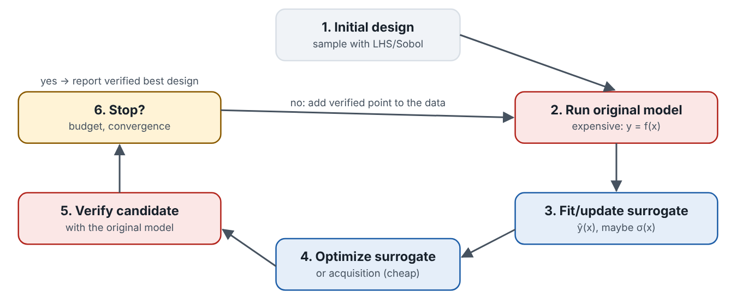
Fit → optimize → verify → update
Lesson 4 · The surrogate-assisted optimization workflow, and limitations · Intuition
The standard workflow: sample the design space; run the expensive model; fit a surrogate; optimize the cheap surrogate; verify the candidate with the expensive model; add the result to the data, refit, and repeat until a stopping rule is met. The verified results, not the predictions, are the evidence.
The sequential surrogate-based optimization loop.
Notes:
Fit → optimize → verify → update. The standard workflow: sample the design space; run the expensive model; fit a surrogate; optimize the cheap surrogate; verify the candidate with the expensive model; add the result to the data, refit, and repeat until a stopping rule is met. The verified results, not the predictions, are the evidence. Look at the figure. The sequential surrogate-based optimization loop. Cycle of six boxes: initial design sampling; run original model; fit or update surrogate; optimize surrogate or acquisition function; verify candidate with original model; stop or continue, adding the verified point to the data.

Slide 3

Fit → optimize → verify → update
Lesson 4 · The surrogate-assisted optimization workflow, and limitations · The mathematics
x_{new} = arg min_{x ∈ feasible} f̂(x), evaluate f(x_{new}), 𝒟 ← 𝒟 ∪ {(x_{new}, f(x_{new}))}
Notes:
Now the mathematics. x_{new} = arg min_x_{ ∈ feasible} f̂(x), evaluate f(x_{new}), 𝒟 ← 𝒟 ∪ {(x_{new}, f(x_{new}))}

Slide 4


Fit → optimize → verify → update
Lesson 4 · The surrogate-assisted optimization workflow, and limitations · In engineering practice
Engineering application
Practical tip
An aerodynamic duct study might start with 20 CFD runs, then add 1–3 verified candidates per iteration for 10 iterations: 30–50 CFD runs in total instead of thousands.
Budget verification runs from the start (e.g., 20–30% of the total evaluations).
Notes:
Where does this matter in engineering? An aerodynamic duct study might start with 20 CFD runs, then add 1–3 verified candidates per iteration for 10 iterations: 30–50 CFD runs in total instead of thousands. A practical tip: Budget verification runs from the start (e.g., 20–30% of the total evaluations).

Slide 5

Pause and predict
Lesson 4 · The surrogate-assisted optimization workflow, and limitations · Predict before you look
After optimizing a surrogate, its predicted optimum is R̂ = 0.560 K/W. The verified value is 0.585 K/W. Which value goes in your report as the design’s performance?
Write down your answer, then continue to the next slide.
Notes:
Time to predict. After optimizing a surrogate, its predicted optimum is R̂ = 0.560 K/W. The verified value is 0.585 K/W. Which value goes in your report as the design’s performance? Pause here and commit to an answer before moving on.

Slide 6

What happens, and why
Lesson 4 · The surrogate-assisted optimization workflow, and limitations · Answer
Question: After optimizing a surrogate, its predicted optimum is R̂ = 0.560 K/W. The verified value is 0.585 K/W. Which value goes in your report as the design’s performance?
The verified 0.585 K/W (with the prediction and its error reported too). The prediction is a hypothesis; the verification is evidence — about the model you verified with.
Notes:
Here is the answer. The verified 0.585 K/W (with the prediction and its error reported too). The prediction is a hypothesis; the verification is evidence — about the model you verified with.

Slide 7


Fit → optimize → verify → update
Lesson 4 · The surrogate-assisted optimization workflow, and limitations · Common misconception
Misconception
What is actually true
The surrogate’s optimum is the design’s performance.
It is a prediction. Verification with the original model is mandatory.
Takeaway Surrogate-based optimization alternates cheap prediction and expensive verification.
Notes:
A common misconception is this: The surrogate’s optimum is the design’s performance. In fact: It is a prediction. Verification with the original model is mandatory. The takeaway: Surrogate-based optimization alternates cheap prediction and expensive verification.

Slide 8
Scientific limitations of simplified teaching models
Lesson 4 · The surrogate-assisted optimization workflow, and limitations · Intuition
Our heat-sink model is a pedagogical model: physically reasonable, transparent and fast, but simplified (fully developed laminar flow, constant fan pressure, no bypass, continuous fin count). Results about it are results about the model, not about a real heat sink.
Notes:
Scientific limitations of simplified teaching models. Our heat-sink model is a pedagogical model: physically reasonable, transparent and fast, but simplified (fully developed laminar flow, constant fan pressure, no bypass, continuous fin count). Results about it are results about the model, not about a real heat sink.

Slide 9
Scientific limitations of simplified teaching models
Lesson 4 · The surrogate-assisted optimization workflow, and limitations · The mathematics
Three levels of error stack up in practice:
f̂(x) − y_{real} = [f̂(x) − f(x)] + [f(x) − y_{real}]
The first bracket is surrogate error (this course measures it); the second is model-form error of the simulator itself (requires experimental validation).
Notes:
Now the mathematics. Three levels of error stack up in practice: f̂(x) − y_{real} = [f̂(x) − f(x)] + [f(x) − y_{real}] The first bracket is surrogate error (this course measures it); the second is model-form error of the simulator itself (requires experimental validation).

Slide 10
Scientific limitations of simplified teaching models
Lesson 4 · The surrogate-assisted optimization workflow, and limitations · In engineering practice
Engineering application
Practical tip
A real heat-sink study would validate the CFD model against wind-tunnel measurements before trusting any surrogate built on it. In our model the thermal entrance length is comparable to the flow length at wider gaps, so the fully developed Nusselt number underestimates heat transfer there.
In reports, state clearly which model produced the “verified” values and what validation that model has.
Notes:
Where does this matter in engineering? A real heat-sink study would validate the CFD model against wind-tunnel measurements before trusting any surrogate built on it. In our model the thermal entrance length is comparable to the flow length at wider gaps, so the fully developed Nusselt number underestimates heat transfer there. A practical tip: In reports, state clearly which model produced the “verified” values and what validation that model has.

Slide 11
Pause and predict
Lesson 4 · The surrogate-assisted optimization workflow, and limitations · Predict before you look
A surrogate reproduces the analytical model to within 0.1%. Does this mean it predicts a real heat sink to within 0.1%?
Write down your answer, then continue to the next slide.
Notes:
Time to predict. A surrogate reproduces the analytical model to within 0.1%. Does this mean it predicts a real heat sink to within 0.1%? Pause here and commit to an answer before moving on.

Slide 12
What happens, and why
Lesson 4 · The surrogate-assisted optimization workflow, and limitations · Answer
Question: A surrogate reproduces the analytical model to within 0.1%. Does this mean it predicts a real heat sink to within 0.1%?
No. It means it reproduces the simplified model; the model’s own error relative to reality may be much larger.
Notes:
Here is the answer. No. It means it reproduces the simplified model; the model’s own error relative to reality may be much larger.

Slide 13
Scientific limitations of simplified teaching models
Lesson 4 · The surrogate-assisted optimization workflow, and limitations · Common misconception
Misconception
What is actually true
A very accurate surrogate makes the conclusions physically accurate.
It can be no more trustworthy than the model it imitates.
Takeaway Surrogate accuracy and physical accuracy are different claims; state both levels honestly.
Notes:
A common misconception is this: A very accurate surrogate makes the conclusions physically accurate. In fact: It can be no more trustworthy than the model it imitates. The takeaway: Surrogate accuracy and physical accuracy are different claims; state both levels honestly.

Slide 14
Key takeaways from this lesson
Summary
1
Fit → optimize → verify → update
Surrogate-based optimization alternates cheap prediction and expensive verification.
2
Scientific limitations of simplified teaching models
Surrogate accuracy and physical accuracy are different claims; state both levels honestly.
Notes:
To sum up this lesson. Fit → optimize → verify → update: Surrogate-based optimization alternates cheap prediction and expensive verification. Scientific limitations of simplified teaching models: Surrogate accuracy and physical accuracy are different claims; state both levels honestly.

Slide 15

Bounded design spaces, full factorial designs and the curse of dimensionality
UP NEXT · LESSON 7.1
That completes Module 6. Before moving on, review the Module 6 flashcards and take its quiz in the course (pass mark 70%). Next: Module 7, Sampling and design of experiments.
Notes:
That completes Lesson 4 of Module 6: The surrogate-assisted optimization workflow, and limitations. This was the last lesson of the module, so review the flashcards and take the Module 6 quiz in the course. Next comes Module 7, Sampling and design of experiments, starting with Bounded design spaces, full factorial designs and the curse of dimensionality.

