Slide 1
Bounded design spaces, full factorial designs and the curse of dimensionality
MODULE 07 · LESSON 1 OF 3 · ≈ 10 MIN
7.1
Module 7: Sampling and design of experiments
Grids grow explosively with dimension
Notes:
Welcome to Module 7, Lesson 1 of the self-paced course Machine Learning Fundamentals for Surrogate-Based Engineering Optimization: Bounded design spaces, full factorial designs and the curse of dimensionality. This lesson belongs to the module Sampling and design of experiments and takes about 10 minutes. In this lesson: Grids grow explosively with dimension.

Slide 2
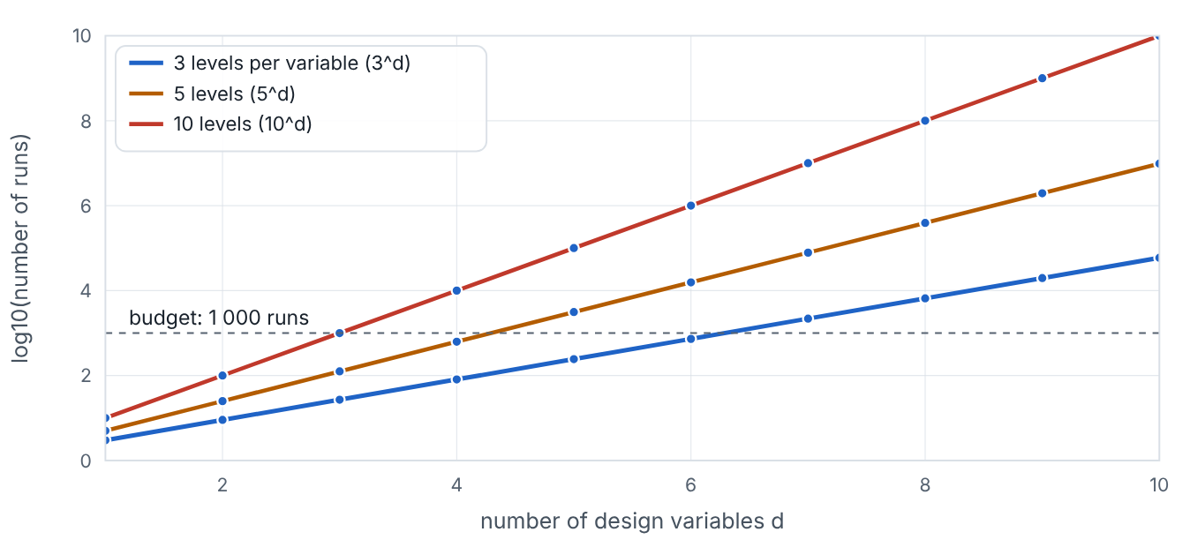

Grids grow explosively with dimension
Lesson 1 · Bounded design spaces, full factorial designs and the curse of dimensionality · Intuition
A bounded design space is a box: each variable has a lower and upper bound. The most obvious plan is a full-factorial grid: choose L levels per variable and run every combination. With 2 variables and 5 levels that is 25 runs — fine. With 8 variables it is 390 625 runs — impossible with CFD. This explosive growth is the curse of dimensionality.
Number of full-factorial runs (log scale) versus number of variables, for 3, 5 and 10 levels.
Notes:
Grids grow explosively with dimension. A bounded design space is a box: each variable has a lower and upper bound. The most obvious plan is a full-factorial grid: choose L levels per variable and run every combination. With 2 variables and 5 levels that is 25 runs — fine. With 8 variables it is 390 625 runs — impossible with CFD. This explosive growth is the curse of dimensionality. Look at the figure. Number of full-factorial runs (log scale) versus number of variables, for 3, 5 and 10 levels. Three straight lines on a log scale rising with dimension: 3^d, 5^d and 10^d runs. A horizontal line marks a budget of 1 000 runs, crossed at about d = 6, 4 and 3 respectively.

Slide 3

Grids grow explosively with dimension
Lesson 1 · Bounded design spaces, full factorial designs and the curse of dimensionality · The mathematics
N_{runs} = L^{d}, scaled coordinates z_{j} = (x_{j} − x_{j,L})/(x_{j,U} − x_{j,L}) ∈ [0, 1]
Symbol | Meaning | Unit
L | levels per variable | count
d | number of design variables | count
z_{j} | scaled j-th variable | —
Another face of the curse: to keep the same spacing h between samples in each direction, the number of samples grows like (1/h)^{d}.
Notes:
Now the mathematics. N_{runs} = L^d, scaled coordinates z_j = (x_j − x_j_{,L})/(x_j_{,U} − x_j_{,L}) ∈ [0, 1] L is the levels per variable, in count. d is the number of design variables, in count. z_j is the scaled j-th variable. Another face of the curse: to keep the same spacing h between samples in each direction, the number of samples grows like (1/h)^d.

Slide 4


Grids grow explosively with dimension
Lesson 1 · Bounded design spaces, full factorial designs and the curse of dimensionality · In engineering practice
Engineering application
Practical tip
A machining study with speed, feed and depth at 3 levels each needs 27 runs — practical. A turbine-blade study with 10 shape parameters at 3 levels needs 59 049 CFD runs — impractical; space-filling designs and dimension reduction are used instead.
Always sample in scaled coordinates [0, 1]^{d} and map back to physical units only for running the model.
Notes:
Where does this matter in engineering? A machining study with speed, feed and depth at 3 levels each needs 27 runs — practical. A turbine-blade study with 10 shape parameters at 3 levels needs 59 049 CFD runs — impractical; space-filling designs and dimension reduction are used instead. A practical tip: Always sample in scaled coordinates [0, 1]^d and map back to physical units only for running the model.

Slide 5

Pause and predict
Lesson 1 · Bounded design spaces, full factorial designs and the curse of dimensionality · Predict before you look
How many runs for a full factorial with 4 levels in each of 5 variables?
Write down your answer, then continue to the next slide.
Notes:
Time to predict. How many runs for a full factorial with 4 levels in each of 5 variables? Pause here and commit to an answer before moving on.

Slide 6

What happens, and why
Lesson 1 · Bounded design spaces, full factorial designs and the curse of dimensionality · Answer
Question: How many runs for a full factorial with 4 levels in each of 5 variables?
4⁵ = 1 024 runs.
Notes:
Here is the answer. 4⁵ = 1 024 runs.

Slide 7


Grids grow explosively with dimension
Lesson 1 · Bounded design spaces, full factorial designs and the curse of dimensionality · Common misconception
Misconception
What is actually true
A grid is always the most thorough design.
Grids waste runs: in each 1-D projection only L distinct values are tested, and the count explodes with d.
Takeaway Full factorial cost L^d grows exponentially with d — the curse of dimensionality.
Notes:
A common misconception is this: A grid is always the most thorough design. In fact: Grids waste runs: in each 1-D projection only L distinct values are tested, and the count explodes with d. The takeaway: Full factorial cost L^d grows exponentially with d — the curse of dimensionality.

Slide 8
Key takeaways from this lesson
Summary
1
Grids grow explosively with dimension
Full factorial cost L^d grows exponentially with d — the curse of dimensionality.
Notes:
To sum up this lesson. Grids grow explosively with dimension: Full factorial cost L^d grows exponentially with d — the curse of dimensionality.

Slide 9

Random, Latin hypercube and Sobol sampling
UP NEXT · LESSON 7.2
Next in Module 7: Lesson 2. Mark this lesson complete in the course before continuing.
Notes:
That completes Lesson 1 of Module 7: Bounded design spaces, full factorial designs and the curse of dimensionality. Next comes Lesson 2: Random, Latin hypercube and Sobol sampling.

