Slide 1
Random, Latin hypercube and Sobol sampling
MODULE 07 · LESSON 2 OF 3 · ≈ 12 MIN
7.2
Module 7: Sampling and design of experiments
Spreading points evenly with few runs
Notes:
Welcome to Module 7, Lesson 2 of the self-paced course Machine Learning Fundamentals for Surrogate-Based Engineering Optimization: Random, Latin hypercube and Sobol sampling. This lesson belongs to the module Sampling and design of experiments and takes about 12 minutes. In this lesson: Spreading points evenly with few runs.

Slide 2
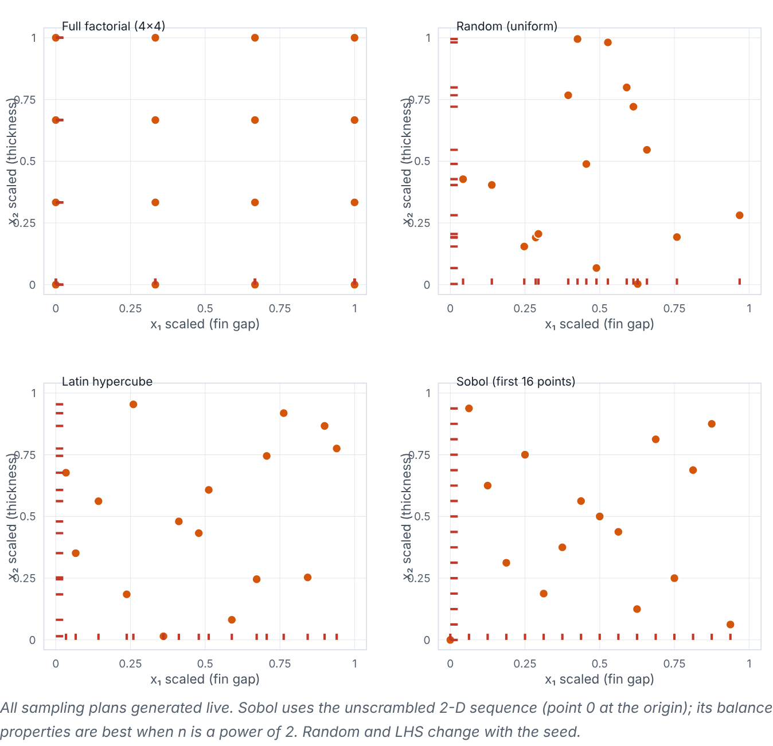

Spreading points evenly with few runs
Lesson 2 · Random, Latin hypercube and Sobol sampling · Intuition
Random (Monte Carlo) sampling draws each point independently and uniformly — simple, but points clump and leave holes. Latin hypercube sampling (LHS) divides each variable’s range into n equal strata and puts exactly one point in each stratum per variable — every 1-D projection is evenly covered. Sobol sequences are deterministic low-discrepancy sequences that fill space evenly and can be extended point by point (best balanced at n = 2^{m}).
Interactive comparison of full factorial, random, Latin hypercube and Sobol samples; red ticks show 1-D projections. (Interactive in the online course.)
Notes:
Spreading points evenly with few runs. Random (Monte Carlo) sampling draws each point independently and uniformly — simple, but points clump and leave holes. Latin hypercube sampling (LHS) divides each variable’s range into n equal strata and puts exactly one point in each stratum per variable — every 1-D projection is evenly covered. Sobol sequences are deterministic low-discrepancy sequences that fill space evenly and can be extended point by point (best balanced at n = 2^m). Look at the figure. Interactive comparison of full factorial, random, Latin hypercube and Sobol samples; red ticks show 1-D projections. Four square panels of points in the unit square. Factorial points form a grid with only a few distinct projection values. Random points clump with visible gaps. LHS points have exactly one tick per stratum on each axis. Sobol points look evenly spread. The readout lists minimum pairwise distance and fill distance for each.

Slide 3

Spreading points evenly with few runs
Lesson 2 · Random, Latin hypercube and Sobol sampling · The mathematics
LHS construction for n points in d dimensions:
z_{ij} = (π_{j}(i) + u_{ij})/(n), i = 0, …, n−1
Symbol | Meaning | Unit
π_{j} | a random permutation of 0…n−1, independent for each variable j | —
u_{ij} | uniform random number in [0, 1) (use 0.5 for stratum centres) | —
Space-filling measures: minimum pairwise distance (larger = less clumping; “maximin” designs maximize it) and fill distance (the largest distance from any point of the space to its nearest sample; smaller = no big holes).
Notes:
Now the mathematics. LHS construction for n points in d dimensions: z_{ij} = (π_j(i) + u_{ij})/(n), i = 0, …, n−1 π_j is the a random permutation of 0…n−1, independent for each variable j. u_{ij} is the uniform random number in [0, 1) (use 0.5 for stratum centres). Space-filling measures: minimum pairwise distance (larger = less clumping; “maximin” designs maximize it) and fill distance (the largest distance from any point of the space to its nearest sample; smaller = no big holes).

Slide 4


Spreading points evenly with few runs
Lesson 2 · Random, Latin hypercube and Sobol sampling · In engineering practice
Engineering application
Practical tip
Additive manufacturing: 16 coupons over (laser power, scan speed) via LHS test 16 distinct power levels and 16 distinct speeds, unlike a 4×4 grid with only 4 of each. In SciPy: qmc.LatinHypercube(d=2, seed=1).random(16) and qmc.Sobol(d=2, scramble=True, seed=1).random_base2(m=4).
For an initial surrogate design, a common rule of thumb is about 10 × d points (here ~20) — then add points sequentially where needed (Modules 11–12). Treat it as a starting point, not a law.
Notes:
Where does this matter in engineering? Additive manufacturing: 16 coupons over (laser power, scan speed) via LHS test 16 distinct power levels and 16 distinct speeds, unlike a 4×4 grid with only 4 of each. In SciPy: qmc.LatinHypercube(d=2, seed=1).random(16) and qmc.Sobol(d=2, scramble=True, seed=1).random_base2(m=4). A practical tip: For an initial surrogate design, a common rule of thumb is about 10 × d points (here ~20) — then add points sequentially where needed (Modules 11–12). Treat it as a starting point, not a law.

Slide 5

Pause and predict
Lesson 2 · Random, Latin hypercube and Sobol sampling · Predict before you look
With LHS of n = 10 points, how many points fall in the stratum 0.3 ≤ z₁ < 0.4?
Write down your answer, then continue to the next slide.
Notes:
Time to predict. With LHS of n = 10 points, how many points fall in the stratum 0.3 ≤ z₁ < 0.4? Pause here and commit to an answer before moving on.

Slide 6

What happens, and why
Lesson 2 · Random, Latin hypercube and Sobol sampling · Answer
Question: With LHS of n = 10 points, how many points fall in the stratum 0.3 ≤ z₁ < 0.4?
Exactly one — that is the defining property of LHS in every variable.
Notes:
Here is the answer. Exactly one — that is the defining property of LHS in every variable.

Slide 7


Spreading points evenly with few runs
Lesson 2 · Random, Latin hypercube and Sobol sampling · Common misconception
Misconception
What is actually true
LHS guarantees a good 2-D spread.
It guarantees even 1-D projections only; a bad permutation can still line points up diagonally. Optimized (maximin) LHS or several seeds help.
Takeaway LHS covers each variable evenly; Sobol fills space evenly and extends nicely; random is simplest but clumpy.
Notes:
A common misconception is this: LHS guarantees a good 2-D spread. In fact: It guarantees even 1-D projections only; a bad permutation can still line points up diagonally. Optimized (maximin) LHS or several seeds help. The takeaway: LHS covers each variable evenly; Sobol fills space evenly and extends nicely; random is simplest but clumpy.

Slide 8
Key takeaways from this lesson
Summary
1
Spreading points evenly with few runs
LHS covers each variable evenly; Sobol fills space evenly and extends nicely; random is simplest but clumpy.
Notes:
To sum up this lesson. Spreading points evenly with few runs: LHS covers each variable evenly; Sobol fills space evenly and extends nicely; random is simplest but clumpy.

Slide 9

Scaling, validation points and practical choices under a budget
UP NEXT · LESSON 7.3
Next in Module 7: Lesson 3. Mark this lesson complete in the course before continuing.
Notes:
That completes Lesson 2 of Module 7: Random, Latin hypercube and Sobol sampling. Next comes Lesson 3: Scaling, validation points and practical choices under a budget.

