Slide 1
Scaling, validation points and practical choices under a budget
MODULE 07 · LESSON 3 OF 3 · ≈ 10 MIN
7.3
Module 7: Sampling and design of experiments
Where errors land depends on where samples land
Notes:
Welcome to Module 7, Lesson 3 of the self-paced course Machine Learning Fundamentals for Surrogate-Based Engineering Optimization: Scaling, validation points and practical choices under a budget. This lesson belongs to the module Sampling and design of experiments and takes about 10 minutes. In this lesson: Where errors land depends on where samples land.

Slide 2
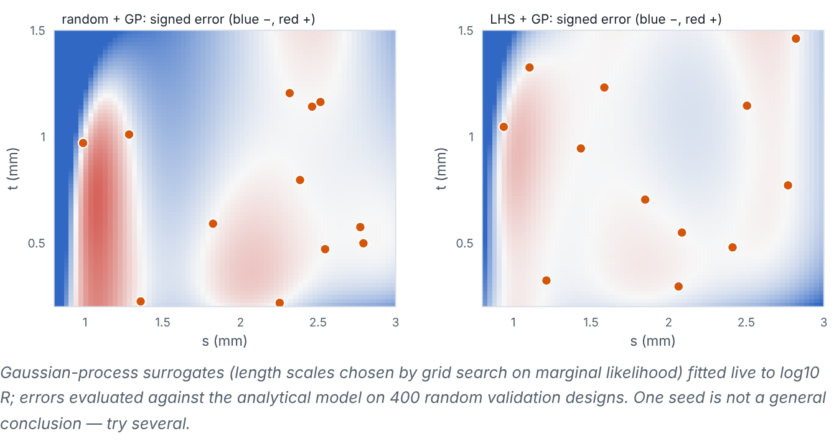

Where errors land depends on where samples land
Lesson 3 · Scaling, validation points and practical choices under a budget · Intuition
Surrogate error is usually small near samples and larger in holes and in steep regions. A good initial design spreads points; a good validation set is separate (not used for fitting) and also spread over the space. With a fixed budget, you trade initial samples, validation runs and later verification/infill runs.
GP surrogate error maps for random versus LHS designs of the same size. (Interactive in the online course.)
Notes:
Where errors land depends on where samples land. Surrogate error is usually small near samples and larger in holes and in steep regions. A good initial design spreads points; a good validation set is separate (not used for fitting) and also spread over the space. With a fixed budget, you trade initial samples, validation runs and later verification/infill runs. Look at the figure. GP surrogate error maps for random versus LHS designs of the same size. Two diverging colour maps of signed surrogate error (blue under-prediction, red over-prediction) over the design space with sample points. Errors concentrate in empty regions and near the steep small-gap edge; LHS usually shows smaller worst-case error, though not for every seed.

Slide 3

Where errors land depends on where samples land
Lesson 3 · Scaling, validation points and practical choices under a budget · The mathematics
A simple budget split for total budget B original-model runs:
B = n_{initial} + n_{validation} + n_{infill/verify}
If validation runs are too costly, use cross-validation on the initial design instead of a separate set, and rely on verification of candidates as extra validation near the optimum.
Notes:
Now the mathematics. A simple budget split for total budget B original-model runs: B = n_{initial} + n_{validation} + n_{infill/verify} If validation runs are too costly, use cross-validation on the initial design instead of a separate set, and rely on verification of candidates as extra validation near the optimum.

Slide 4


Where errors land depends on where samples land
Lesson 3 · Scaling, validation points and practical choices under a budget · In engineering practice
Engineering application
Practical tip
With B = 40 CFD runs for a two-variable heat-exchanger study: 20 LHS initial + 0 separate validation (5-fold CV instead) + 20 sequential infill/verification runs is a typical choice. In this course, the analytical model is cheap, so we often use large separate validation sets purely for teaching.
Record the sampler, seed, bounds and scaling in your notebook so the design can be regenerated exactly.
Notes:
Where does this matter in engineering? With B = 40 CFD runs for a two-variable heat-exchanger study: 20 LHS initial + 0 separate validation (5-fold CV instead) + 20 sequential infill/verification runs is a typical choice. In this course, the analytical model is cheap, so we often use large separate validation sets purely for teaching. A practical tip: Record the sampler, seed, bounds and scaling in your notebook so the design can be regenerated exactly.

Slide 5

Pause and predict
Lesson 3 · Scaling, validation points and practical choices under a budget · Predict before you look
Should validation points be chosen near the training points to check the surrogate carefully?
Write down your answer, then continue to the next slide.
Notes:
Time to predict. Should validation points be chosen near the training points to check the surrogate carefully? Pause here and commit to an answer before moving on.

Slide 6

What happens, and why
Lesson 3 · Scaling, validation points and practical choices under a budget · Answer
Question: Should validation points be chosen near the training points to check the surrogate carefully?
No — points next to training samples will look accurate by construction. Validation points should be spread over the region of interest, ideally independently sampled.
Notes:
Here is the answer. No — points next to training samples will look accurate by construction. Validation points should be spread over the region of interest, ideally independently sampled.

Slide 7


Where errors land depends on where samples land
Lesson 3 · Scaling, validation points and practical choices under a budget · Common misconception
Misconception
What is actually true
Including the validation points in training afterwards invalidates the whole study.
Once the validation is reported, refitting on all data for the final surrogate is common and sensible — but report the validation that was done before merging.
Takeaway Spread samples, keep validation separate (or use CV), and plan the budget for later infill and verification.
Notes:
A common misconception is this: Including the validation points in training afterwards invalidates the whole study. In fact: Once the validation is reported, refitting on all data for the final surrogate is common and sensible — but report the validation that was done before merging. The takeaway: Spread samples, keep validation separate (or use CV), and plan the budget for later infill and verification.

Slide 8
Key takeaways from this lesson
Summary
1
Where errors land depends on where samples land
Spread samples, keep validation separate (or use CV), and plan the budget for later infill and verification.
Notes:
To sum up this lesson. Where errors land depends on where samples land: Spread samples, keep validation separate (or use CV), and plan the budget for later infill and verification.

Slide 9

Polynomial response surfaces and radial basis functions
UP NEXT · LESSON 8.1
That completes Module 7. Before moving on, review the Module 7 flashcards and take its quiz in the course (pass mark 70%). Next: Module 8, Surrogate model families.
Notes:
That completes Lesson 3 of Module 7: Scaling, validation points and practical choices under a budget. This was the last lesson of the module, so review the flashcards and take the Module 7 quiz in the course. Next comes Module 8, Surrogate model families, starting with Polynomial response surfaces and radial basis functions.

