Slide 1
Polynomial response surfaces and radial basis functions
MODULE 08 · LESSON 1 OF 3 · ≈ 11 MIN
8.1
Module 8: Surrogate model families
Two classic surrogate families
Notes:
Welcome to Module 8, Lesson 1 of the self-paced course Machine Learning Fundamentals for Surrogate-Based Engineering Optimization: Polynomial response surfaces and radial basis functions. This lesson belongs to the module Surrogate model families and takes about 11 minutes. In this lesson: Two classic surrogate families.

Slide 2
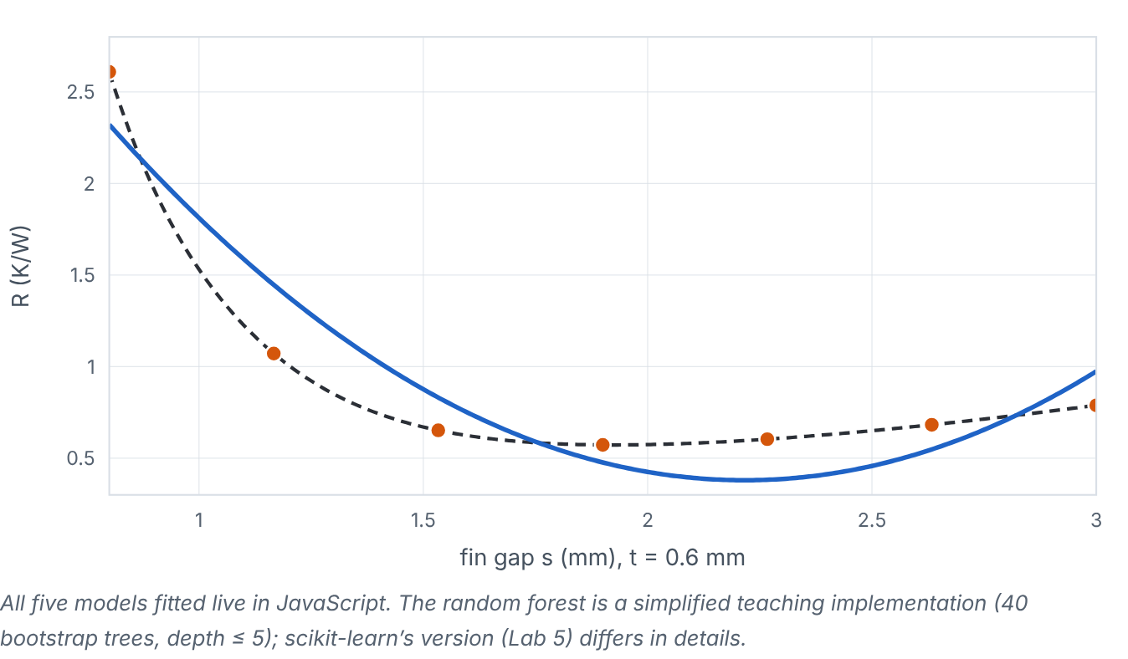

Two classic surrogate families
Lesson 1 · Polynomial response surfaces and radial basis functions · Intuition
A polynomial response surface fits a low-order polynomial (typically quadratic) by least squares: smooth, few parameters, easy to interpret, but cannot follow complicated shapes. A radial basis function (RBF) model places a “bump” function at each sample and combines them so that the surface passes exactly through all samples: flexible and accurate for smooth deterministic data, but no built-in uncertainty.
Five model families fitted to the same 1-D heat-sink samples. (Interactive in the online course.)
Notes:
Two classic surrogate families. A polynomial response surface fits a low-order polynomial (typically quadratic) by least squares: smooth, few parameters, easy to interpret, but cannot follow complicated shapes. A radial basis function (RBF) model places a “bump” function at each sample and combines them so that the surface passes exactly through all samples: flexible and accurate for smooth deterministic data, but no built-in uncertainty. Look at the figure. Five model families fitted to the same 1-D heat-sink samples. One-dimensional plot of R versus fin gap with equally spaced samples. A dropdown switches between quadratic and quartic polynomials, cubic RBF, Gaussian process (with uncertainty band) and a simplified random forest (stepped curve). The readout reports error against the true curve and a short characterization.

Slide 3

Two classic surrogate families
Lesson 1 · Polynomial response surfaces and radial basis functions · The mathematics
Quadratic response surface in d variables:
ŷ = β₀ + Σ_{j} β_{j}z_{j} + Σ_{j≤k} β_{jk}z_{j}z_{k}, number of terms = ((d+1)(d+2))/(2)
Cubic RBF with linear tail:
ŷ(z) = Σ_{i=1}^{n} w_{i} ‖z − z_{i}‖³ + c₀ + c^{T}z
The weights solve an (n + d + 1)-dimensional linear system that enforces ŷ(z_{i}) = y_{i}. A polynomial of total degree p in d variables has C(d+p, p) terms.
Notes:
Now the mathematics. Quadratic response surface in d variables: ŷ = β_0 + Σ_j β_jz_j + Σ_j_≤_k β_{jk}z_jz_k, number of terms = ((d+1)(d+2))/(2) Cubic RBF with linear tail: ŷ(z) = Σ_i_{=1}^n w_i ‖z − z_i‖^3 + c_0 + c^Tz The weights solve an (n + d + 1)-dimensional linear system that enforces ŷ(z_i) = y_i. A polynomial of total degree p in d variables has C(d+p, p) terms.

Slide 4


Two classic surrogate families
Lesson 1 · Polynomial response surfaces and radial basis functions · In engineering practice
Engineering application
Practical tip
Quadratic response surfaces are the long-standing workhorse of experimental design in manufacturing (e.g., roughness vs speed and feed) because they are robust with noisy data and give interpretable effects. RBFs are popular for deterministic CFD/FEA surrogates in aerospace and turbomachinery.
Start with a quadratic polynomial as a baseline surrogate; it tells you how much nonlinearity more flexible models must capture.
Notes:
Where does this matter in engineering? Quadratic response surfaces are the long-standing workhorse of experimental design in manufacturing (e.g., roughness vs speed and feed) because they are robust with noisy data and give interpretable effects. RBFs are popular for deterministic CFD/FEA surrogates in aerospace and turbomachinery. A practical tip: Start with a quadratic polynomial as a baseline surrogate; it tells you how much nonlinearity more flexible models must capture.

Slide 5

Pause and predict
Lesson 1 · Polynomial response surfaces and radial basis functions · Predict before you look
How many coefficients does a full quadratic in 3 variables have, and can you fit it to 8 samples?
Write down your answer, then continue to the next slide.
Notes:
Time to predict. How many coefficients does a full quadratic in 3 variables have, and can you fit it to 8 samples? Pause here and commit to an answer before moving on.

Slide 6

What happens, and why
Lesson 1 · Polynomial response surfaces and radial basis functions · Answer
Question: How many coefficients does a full quadratic in 3 variables have, and can you fit it to 8 samples?
(3+1)(3+2)/2 = 10 coefficients — more than 8 samples, so least squares is under-determined. You need at least 10, preferably 15–20.
Notes:
Here is the answer. (3+1)(3+2)/2 = 10 coefficients — more than 8 samples, so least squares is under-determined. You need at least 10, preferably 15–20.

Slide 7


Two classic surrogate families
Lesson 1 · Polynomial response surfaces and radial basis functions · Common misconception
Misconception
What is actually true
Interpolating models are always more accurate than regression models.
With noisy data, interpolation reproduces noise. Even with noise-free data, interpolants can oscillate between samples.
Takeaway Polynomials: smooth, few parameters, limited shape. RBFs: interpolate samples, flexible, no uncertainty.
Notes:
A common misconception is this: Interpolating models are always more accurate than regression models. In fact: With noisy data, interpolation reproduces noise. Even with noise-free data, interpolants can oscillate between samples. The takeaway: Polynomials: smooth, few parameters, limited shape. RBFs: interpolate samples, flexible, no uncertainty.

Slide 8
Key takeaways from this lesson
Summary
1
Two classic surrogate families
Polynomials: smooth, few parameters, limited shape. RBFs: interpolate samples, flexible, no uncertainty.
Notes:
To sum up this lesson. Two classic surrogate families: Polynomials: smooth, few parameters, limited shape. RBFs: interpolate samples, flexible, no uncertainty.

Slide 9

Trees, random forests and neural networks
UP NEXT · LESSON 8.2
Next in Module 8: Lesson 2. Mark this lesson complete in the course before continuing.
Notes:
That completes Lesson 1 of Module 8: Polynomial response surfaces and radial basis functions. Next comes Lesson 2: Trees, random forests and neural networks.

