Slide 1
Trees, random forests and neural networks
MODULE 08 · LESSON 2 OF 3 · ≈ 10 MIN
8.2
Module 8: Surrogate model families
Piecewise models and layered networks
Notes:
Welcome to Module 8, Lesson 2 of the self-paced course Machine Learning Fundamentals for Surrogate-Based Engineering Optimization: Trees, random forests and neural networks. This lesson belongs to the module Surrogate model families and takes about 10 minutes. In this lesson: Piecewise models and layered networks.

Slide 2

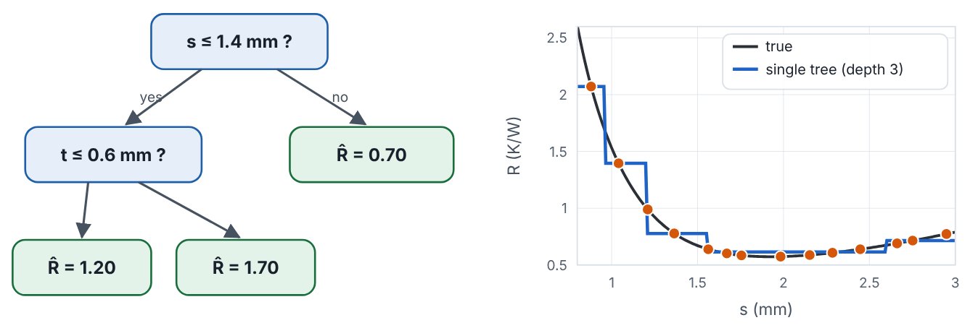
Piecewise models and layered networks
Lesson 2 · Trees, random forests and neural networks · Intuition
A regression tree splits the design space with yes/no questions (“is s ≤ 1.4 mm?”) and predicts a constant in each final region. A random forest averages many trees trained on bootstrap resamples, reducing variance. Forests handle many variables and mixed data well but produce piecewise-constant surfaces: not smooth, zero gradients almost everywhere, and flat beyond the data. A neural network composes many weighted sums and nonlinear activations; it can represent very complex functions but usually needs much more data and careful tuning.
Left: a small regression tree. Right: its piecewise-constant prediction versus the true smooth curve.
Notes:
Piecewise models and layered networks. A regression tree splits the design space with yes/no questions (“is s ≤ 1.4 mm?”) and predicts a constant in each final region. A random forest averages many trees trained on bootstrap resamples, reducing variance. Forests handle many variables and mixed data well but produce piecewise-constant surfaces: not smooth, zero gradients almost everywhere, and flat beyond the data. A neural network composes many weighted sums and nonlinear activations; it can represent very complex functions but usually needs much more data and careful tuning. Look at the figure. Left: a small regression tree. Right: its piecewise-constant prediction versus the true smooth curve. Left: tree diagram with splits on s and t leading to constant predictions. Right: plot of true R versus s with a staircase-shaped tree prediction.

Slide 3
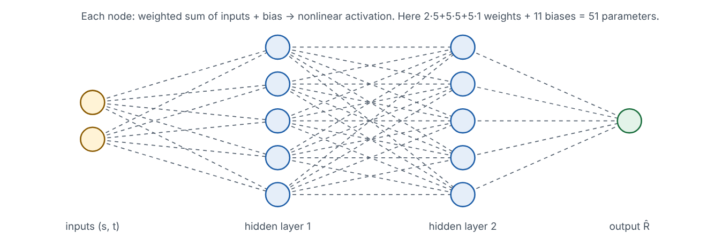
Piecewise models and layered networks
Lesson 2 · Trees, random forests and neural networks · Figure
A small feed-forward neural network with two inputs, two hidden layers of five nodes and one output.
Notes:
Here is another view. A small feed-forward neural network with two inputs, two hidden layers of five nodes and one output. Network diagram: two input nodes (s, t), two hidden layers of five nodes each, one output node, all connected; caption counts 51 trainable parameters.

Slide 4

Piecewise models and layered networks
Lesson 2 · Trees, random forests and neural networks · The mathematics
Forest prediction: ŷ(x) = (1/B) Σ_{b} T_{b}(x), averaging B trees. One hidden layer of a network: h = σ(Wx + b), with σ an activation such as tanh or ReLU. Parameter count for layer sizes (2, 5, 5, 1): 2·5 + 5·5 + 5·1 weights + 5 + 5 + 1 biases = 51.
Notes:
Now the mathematics. Forest prediction: ŷ(x) = (1/B) Σ_b T_b(x), averaging B trees. One hidden layer of a network: h = σ(Wx + b), with σ an activation such as tanh or ReLU. Parameter count for layer sizes (2, 5, 5, 1): 2·5 + 5·5 + 5·1 weights + 5 + 5 + 1 biases = 51.

Slide 5


Piecewise models and layered networks
Lesson 2 · Trees, random forests and neural networks · In engineering practice
Engineering application
Practical tip
Forests are effective for process data with many categorical settings (machine, tool type) and noise, e.g., predicting tool wear. Neural networks shine with large datasets — thousands of CFD fields — or images. For 20–50 expensive simulations of a smooth response, GPs, RBFs or polynomials are usually better choices.
Count parameters versus samples: a 51-parameter network fitted to 20 runs is heavily under-determined without strong regularization.
Notes:
Where does this matter in engineering? Forests are effective for process data with many categorical settings (machine, tool type) and noise, e.g., predicting tool wear. Neural networks shine with large datasets — thousands of CFD fields — or images. For 20–50 expensive simulations of a smooth response, GPs, RBFs or polynomials are usually better choices. A practical tip: Count parameters versus samples: a 51-parameter network fitted to 20 runs is heavily under-determined without strong regularization.

Slide 6

Pause and predict
Lesson 2 · Trees, random forests and neural networks · Predict before you look
Why is a random forest awkward as a surrogate for gradient-based optimization?
Write down your answer, then continue to the next slide.
Notes:
Time to predict. Why is a random forest awkward as a surrogate for gradient-based optimization? Pause here and commit to an answer before moving on.

Slide 7

What happens, and why
Lesson 2 · Trees, random forests and neural networks · Answer
Question: Why is a random forest awkward as a surrogate for gradient-based optimization?
Its prediction is piecewise constant, so gradients are zero almost everywhere and undefined at split boundaries; gradient-based optimizers have no direction to follow.
Notes:
Here is the answer. Its prediction is piecewise constant, so gradients are zero almost everywhere and undefined at split boundaries; gradient-based optimizers have no direction to follow.

Slide 8


Piecewise models and layered networks
Lesson 2 · Trees, random forests and neural networks · Common misconception
Misconception
What is actually true
Deep learning is the state of the art, so it must be best for surrogates.
With small data, simpler models often generalize better. Complexity must be justified by validation evidence.
Takeaway Forests: robust, many variables, but non-smooth. Networks: flexible but data-hungry. Choose by data size and smoothness needs.
Notes:
A common misconception is this: Deep learning is the state of the art, so it must be best for surrogates. In fact: With small data, simpler models often generalize better. Complexity must be justified by validation evidence. The takeaway: Forests: robust, many variables, but non-smooth. Networks: flexible but data-hungry. Choose by data size and smoothness needs.

Slide 9
Key takeaways from this lesson
Summary
1
Piecewise models and layered networks
Forests: robust, many variables, but non-smooth. Networks: flexible but data-hungry. Choose by data size and smoothness needs.
Notes:
To sum up this lesson. Piecewise models and layered networks: Forests: robust, many variables, but non-smooth. Networks: flexible but data-hungry. Choose by data size and smoothness needs.

Slide 10

Gaussian processes, comparison table and a worked comparison
UP NEXT · LESSON 8.3
Next in Module 8: Lesson 3. Mark this lesson complete in the course before continuing.
Notes:
That completes Lesson 2 of Module 8: Trees, random forests and neural networks. Next comes Lesson 3: Gaussian processes, comparison table and a worked comparison.

