Slide 1
Gaussian processes, comparison table and a worked comparison
MODULE 08 · LESSON 3 OF 3 · ≈ 14 MIN
8.3
Module 8: Surrogate model families
Choosing a surrogate family
Notes:
Welcome to Module 8, Lesson 3 of the self-paced course Machine Learning Fundamentals for Surrogate-Based Engineering Optimization: Gaussian processes, comparison table and a worked comparison. This lesson belongs to the module Surrogate model families and takes about 14 minutes. In this lesson: Choosing a surrogate family.

Slide 2
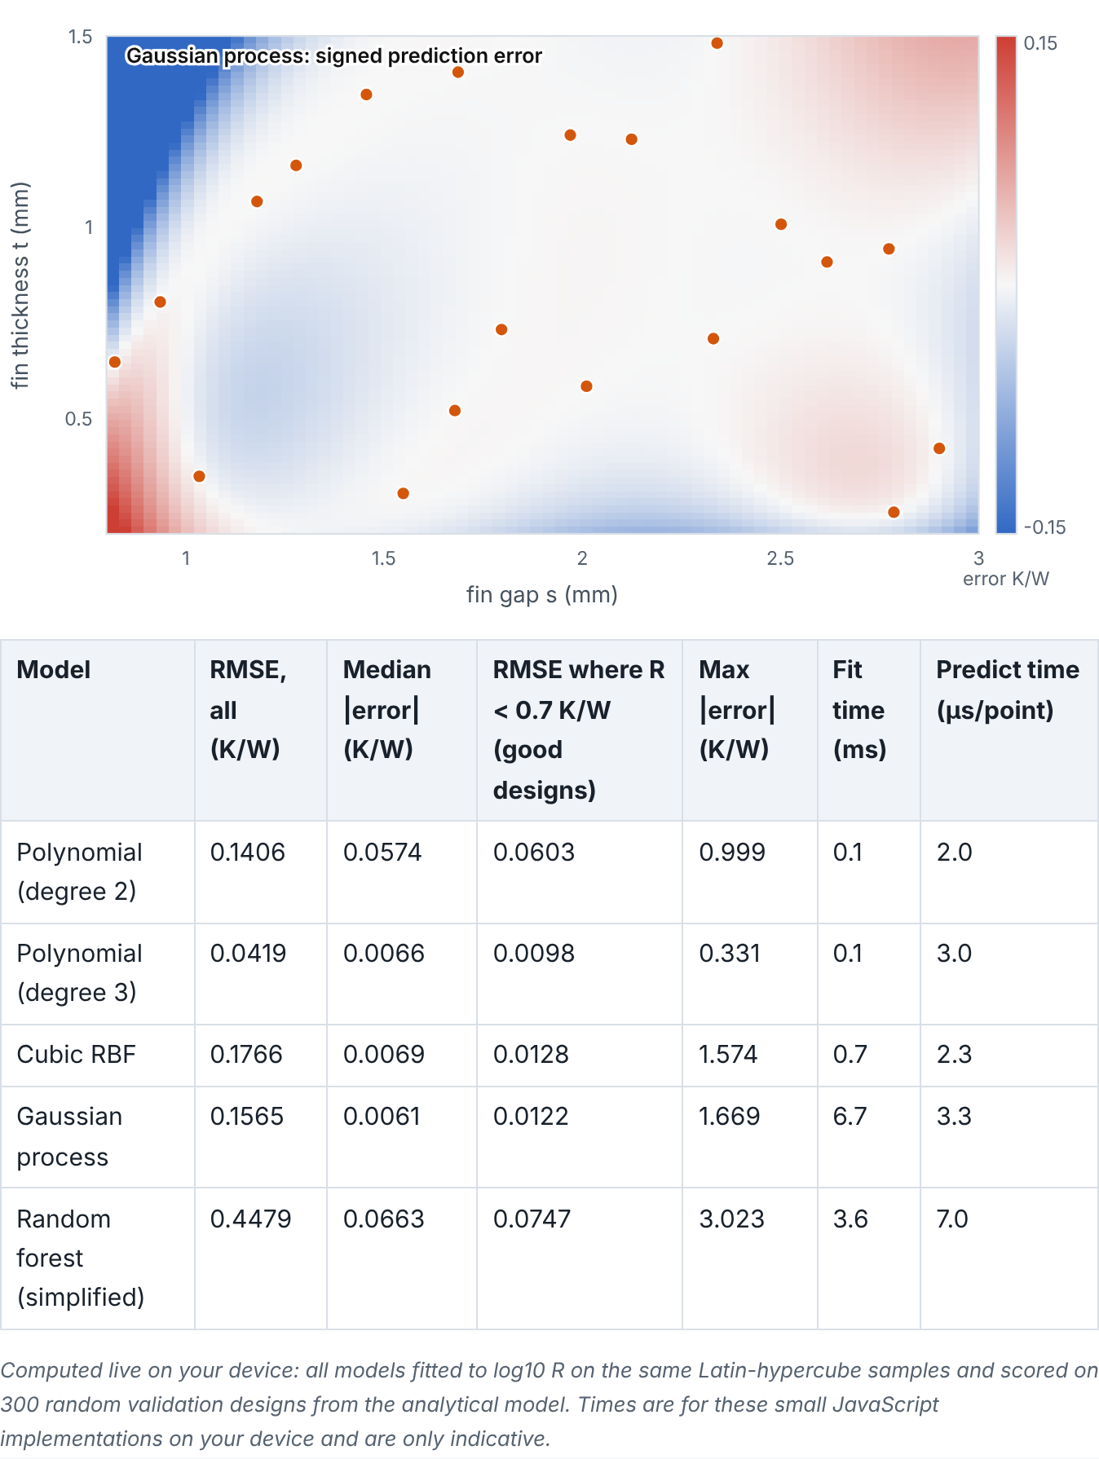

Choosing a surrogate family
Lesson 3 · Gaussian processes, comparison table and a worked comparison · Intuition
A Gaussian process (GP) treats the unknown function as random with a specified correlation structure: nearby designs have similar outputs. It interpolates noise-free data, is smooth, and gives a predictive uncertainty (Module 9). Its cost grows as n³, which is negligible for tens or hundreds of samples. No model wins everywhere; compare candidates on the same data with the same validation.
Worked comparison (computed live): five families trained on the same Latin-hypercube samples of the heat sink, scored on 300 validation designs with three error measures.
Notes:
Choosing a surrogate family. A Gaussian process (GP) treats the unknown function as random with a specified correlation structure: nearby designs have similar outputs. It interpolates noise-free data, is smooth, and gives a predictive uncertainty (Module 9). Its cost grows as n³, which is negligible for tens or hundreds of samples. No model wins everywhere; compare candidates on the same data with the same validation. Look at the figure. Worked comparison (computed live): five families trained on the same Latin-hypercube samples of the heat sink, scored on 300 validation designs with three error measures. A table lists, for quadratic and cubic polynomials, cubic RBF, Gaussian process and simplified random forest: RMSE over all validation designs, median absolute error, RMSE among good designs (R below 0.7 K/W), maximum error, fit time and prediction time. A diverging error map shows where the selected model errs; the largest errors sit in the steep corner of small gaps and thick fins.

Slide 3
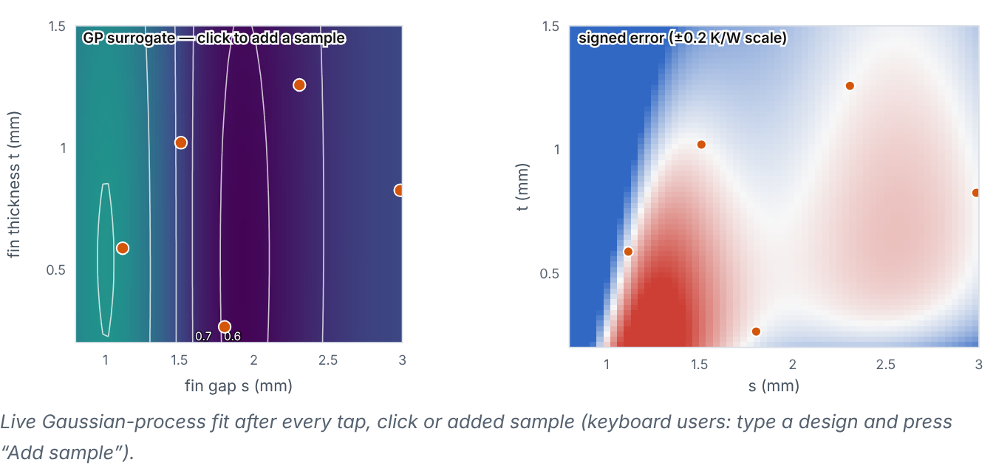
Choosing a surrogate family
Lesson 3 · Gaussian processes, comparison table and a worked comparison · Figure
You can add samples and watch the GP surrogate and its error map change. (Interactive in the online course.)
Notes:
Here is another view. You can add samples and watch the GP surrogate and its error map change. Left: GP surrogate map with sample points; clicking adds a sample. Right: signed error map. Errors shrink where samples are added.

Slide 4

Choosing a surrogate family
Lesson 3 · Gaussian processes, comparison table and a worked comparison · The mathematics
Fair comparison protocol: same training samples, same validation data, same output transform (log₁₀R here), metrics in engineering units back-transformed (R̂ = 10^{prediction}), and report both accuracy and cost (fit + prediction time, number of expensive runs).
Notes:
Now the mathematics. Fair comparison protocol: same training samples, same validation data, same output transform (log₁₀R here), metrics in engineering units back-transformed (R̂ = 10^{prediction}), and report both accuracy and cost (fit + prediction time, number of expensive runs).

Slide 5

Choosing a surrogate family
Lesson 3 · Gaussian processes, comparison table and a worked comparison · Reference table
General guidance from common practice, not universal rules.
Family | Data needed (smooth, d ≈ 2–10) | Fit cost | Smooth / differentiable | Uncertainty | Typical use
Polynomial (quadratic) | ≥ (d+1)(d+2)/2, ideally 1.5–2× | very low | yes | only via statistics of residuals | baseline; noisy experiments; interpretable effects
RBF interpolant | 10–20 per dimension | low (solve n×n) | yes (cubic: twice differentiable) | no | deterministic simulators
Random forest | moderate–large | low–moderate | no (piecewise constant) | rough (tree spread) | many variables, categorical, noisy data
Gaussian process | 10–20 per dimension | O(n³), fine to ~10³ | yes (SE kernel: infinitely) | yes (model-based) | expensive simulators, Bayesian optimization
Neural network | large (hundreds–thousands+) | moderate–high, tuning-heavy | yes with smooth activations | not by default | large datasets, fields, images
Notes:
Here is a reference table. General guidance from common practice, not universal rules. Polynomial (quadratic), Data needed (smooth, d ≈ 2–10): ≥ (d+1)(d+2)/2, ideally 1.5–2×, Fit cost: very low, Smooth / differentiable: yes, Uncertainty: only via statistics of residuals, Typical use: baseline; noisy experiments; interpretable effects. RBF interpolant, Data needed (smooth, d ≈ 2–10): 10–20 per dimension, Fit cost: low (solve n×n), Smooth / differentiable: yes (cubic: twice differentiable), Uncertainty: no, Typical use: deterministic simulators. Random forest, Data needed (smooth, d ≈ 2–10): moderate–large, Fit cost: low–moderate, Smooth / differentiable: no (piecewise constant), Uncertainty: rough (tree spread), Typical use: many variables, categorical, noisy data. Gaussian process, Data needed (smooth, d ≈ 2–10): 10–20 per dimension, Fit cost: O(n³), fine to ~10³, Smooth / differentiable: yes (SE kernel: infinitely), Uncertainty: yes (model-based), Typical use: expensive simulators, Bayesian optimization. Neural network, Data needed (smooth, d ≈ 2–10): large (hundreds–thousands+), Fit cost: moderate–high, tuning-heavy, Smooth / differentiable: yes with smooth activations, Uncertainty: not by default, Typical use: large datasets, fields, images.

Slide 6


Choosing a surrogate family
Lesson 3 · Gaussian processes, comparison table and a worked comparison · In engineering practice
Engineering application
Practical tip
What the demo typically shows with 20 LHS samples (author’s check over 10 seeds): the cubic polynomial often has the lowest overall RMSE (≈0.05 K/W), because overall RMSE is dominated by a few validation points in the steep corner (small gaps, thick fins) where R reaches 2–4 K/W; the GP and cubic RBF have the smallest median errors (≈0.006 K/W) and are usually most accurate among good designs; the quadratic is limited by its shape; the forest is worst on every measure. Lesson: the metric and the region you evaluate decide the ranking — for optimization, accuracy among good designs matters most. Lab 5 shows the same pattern with scikit-learn.
Keep a quadratic polynomial and a GP in every comparison: one robust baseline and one flexible, uncertainty-aware model.
Notes:
Where does this matter in engineering? What the demo typically shows with 20 LHS samples (author’s check over 10 seeds): the cubic polynomial often has the lowest overall RMSE (≈0.05 K/W), because overall RMSE is dominated by a few validation points in the steep corner (small gaps, thick fins) where R reaches 2–4 K/W; the GP and cubic RBF have the smallest median errors (≈0.006 K/W) and are usually most accurate among good designs; the quadratic is limited by its shape; the forest is worst on every measure. Lesson: the metric and the region you evaluate decide the ranking — for optimization, accuracy among good designs matters most. Lab 5 shows the same pattern with scikit-learn. A practical tip: Keep a quadratic polynomial and a GP in every comparison: one robust baseline and one flexible, uncertainty-aware model.

Slide 7

Pause and predict
Lesson 3 · Gaussian processes, comparison table and a worked comparison · Predict before you look
Going from 20 to 30 samples roughly halves the GP’s typical error in the demo. What do 10 extra samples cost in a real CFD study, and in GP fitting?
Write down your answer, then continue to the next slide.
Notes:
Time to predict. Going from 20 to 30 samples roughly halves the GP’s typical error in the demo. What do 10 extra samples cost in a real CFD study, and in GP fitting? Pause here and commit to an answer before moving on.

Slide 8

What happens, and why
Lesson 3 · Gaussian processes, comparison table and a worked comparison · Answer
Question: Going from 20 to 30 samples roughly halves the GP’s typical error in the demo. What do 10 extra samples cost in a real CFD study, and in GP fitting?
In CFD: 10 more expensive runs (hours each). GP fitting cost rises by about (30/20)³ ≈ 3.4× (n³ scaling) but remains milliseconds — negligible compared with the simulations.
Notes:
Here is the answer. In CFD: 10 more expensive runs (hours each). GP fitting cost rises by about (30/20)³ ≈ 3.4× (n³ scaling) but remains milliseconds — negligible compared with the simulations.

Slide 9


Choosing a surrogate family
Lesson 3 · Gaussian processes, comparison table and a worked comparison · Common misconception
Misconception
What is actually true
The model with lowest training error is best.
Interpolating models have zero training error by construction. Compare on validation data.
Takeaway Choose by validation accuracy where it matters, smoothness needs, uncertainty needs and data size — not by fashion.
Notes:
A common misconception is this: The model with lowest training error is best. In fact: Interpolating models have zero training error by construction. Compare on validation data. The takeaway: Choose by validation accuracy where it matters, smoothness needs, uncertainty needs and data size — not by fashion.

Slide 10
Key takeaways from this lesson
Summary
1
Choosing a surrogate family
Choose by validation accuracy where it matters, smoothness needs, uncertainty needs and data size — not by fashion.
Notes:
To sum up this lesson. Choosing a surrogate family: Choose by validation accuracy where it matters, smoothness needs, uncertainty needs and data size — not by fashion.

Slide 11

Mean prediction and predictive uncertainty
UP NEXT · LESSON 9.1
That completes Module 8. Before moving on, review the Module 8 flashcards and take its quiz in the course (pass mark 70%). Next: Module 9, Gaussian processes and uncertainty.
Notes:
That completes Lesson 3 of Module 8: Gaussian processes, comparison table and a worked comparison. This was the last lesson of the module, so review the flashcards and take the Module 8 quiz in the course. Next comes Module 9, Gaussian processes and uncertainty, starting with Mean prediction and predictive uncertainty.

