Slide 1
Kernels, length scales and scaling
MODULE 09 · LESSON 2 OF 3 · ≈ 10 MIN
9.2
Module 9: Gaussian processes and uncertainty
How the kernel encodes “nearby means similar”
Notes:
Welcome to Module 9, Lesson 2 of the self-paced course Machine Learning Fundamentals for Surrogate-Based Engineering Optimization: Kernels, length scales and scaling. This lesson belongs to the module Gaussian processes and uncertainty and takes about 10 minutes. In this lesson: How the kernel encodes “nearby means similar”.

Slide 2

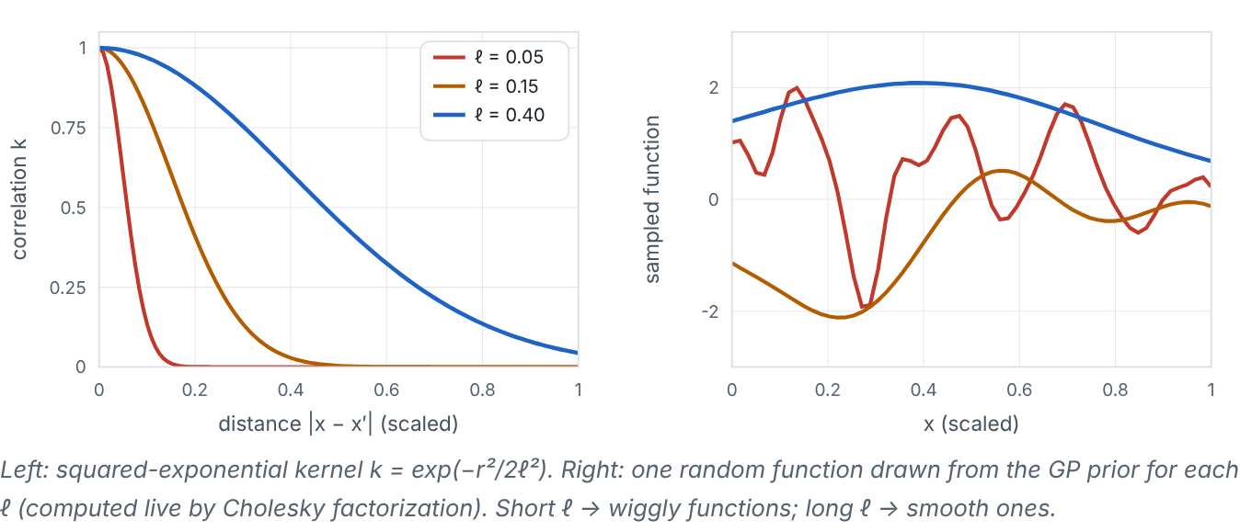
How the kernel encodes “nearby means similar”
Lesson 2 · Kernels, length scales and scaling · Intuition
The kernel (covariance function) states how strongly outputs at two inputs are correlated. The squared-exponential (SE, also RBF) kernel says correlation decays smoothly with distance. The length scale ℓ sets how far “nearby” extends: short ℓ → wiggly functions and fast-growing uncertainty between samples; long ℓ → smooth functions and confident interpolation.
Left: kernel correlation versus distance for three length scales. Right: random functions drawn from the GP prior with those length scales.
Notes:
How the kernel encodes “nearby means similar”. The kernel (covariance function) states how strongly outputs at two inputs are correlated. The squared-exponential (SE, also RBF) kernel says correlation decays smoothly with distance. The length scale ℓ sets how far “nearby” extends: short ℓ → wiggly functions and fast-growing uncertainty between samples; long ℓ → smooth functions and confident interpolation. Look at the figure. Left: kernel correlation versus distance for three length scales. Right: random functions drawn from the GP prior with those length scales. Left: three bell-shaped decay curves, narrow for ℓ = 0.05, wider for 0.15 and 0.40. Right: three random curves — very wiggly for ℓ = 0.05, moderately smooth for 0.15, gently varying for 0.40.

Slide 3

How the kernel encodes “nearby means similar”
Lesson 2 · Kernels, length scales and scaling · The mathematics
k(x, x′) = σ_{f}² exp( − 1/2 Σ_{j} ((x_{j} − x′_{j})²)/(ℓ_{j}²) )
Symbol | Meaning | Unit
σ_{f}² | signal variance: typical squared deviation of f from its mean | (units of y)²
ℓ_{j} | length scale for variable j (anisotropic if different per variable) | units of x_{j} (scaled units here)
Hyperparameters (σ_{f}, ℓ_{j}, σ_{n}) are usually chosen by maximizing the marginal likelihood; this page uses a simple grid search over ℓ (disclosed in each demo). Because ℓ is measured in input units, scaling inputs to [0, 1] makes one default sensible for all variables; otherwise a single ℓ is meaningless when units differ.
Notes:
Now the mathematics. k(x, x′) = σ_f^2 exp( − 1/2 Σ_j ((x_j − x′_j)^2)/(ℓ_j^2) ) σ_f² is the signal variance: typical squared deviation of f from its mean, in (units of y)². ℓ_j is the length scale for variable j (anisotropic if different per variable), in units of x_j (scaled units here). Hyperparameters (σ_f, ℓ_j, σ_n) are usually chosen by maximizing the marginal likelihood; this page uses a simple grid search over ℓ (disclosed in each demo). Because ℓ is measured in input units, scaling inputs to [0, 1] makes one default sensible for all variables; otherwise a single ℓ is meaningless when units differ.

Slide 4


How the kernel encodes “nearby means similar”
Lesson 2 · Kernels, length scales and scaling · In engineering practice
Engineering application
Practical tip
For the heat sink, fitted length scales in scaled units are typically around 0.2–0.5 in both directions. A process with a sharp transition (e.g., onset of laminar–turbulent transition, or AM keyhole porosity) breaks the SE assumption of uniform smoothness; special kernels or input transformations are then needed.
Use anisotropic length scales (one per variable) on scaled inputs; inspect the fitted values — a very large ℓ suggests the variable barely matters.
Notes:
Where does this matter in engineering? For the heat sink, fitted length scales in scaled units are typically around 0.2–0.5 in both directions. A process with a sharp transition (e.g., onset of laminar–turbulent transition, or AM keyhole porosity) breaks the SE assumption of uniform smoothness; special kernels or input transformations are then needed. A practical tip: Use anisotropic length scales (one per variable) on scaled inputs; inspect the fitted values — a very large ℓ suggests the variable barely matters.

Slide 5

Pause and predict
Lesson 2 · Kernels, length scales and scaling · Predict before you look
You set ℓ = 0.03 (scaled) with 6 samples over [0, 1]. What will the GP mean look like between samples?
Write down your answer, then continue to the next slide.
Notes:
Time to predict. You set ℓ = 0.03 (scaled) with 6 samples over [0, 1]. What will the GP mean look like between samples? Pause here and commit to an answer before moving on.

Slide 6

What happens, and why
Lesson 2 · Kernels, length scales and scaling · Answer
Question: You set ℓ = 0.03 (scaled) with 6 samples over [0, 1]. What will the GP mean look like between samples?
It will quickly revert to the overall mean between samples (spiky “bumps” at the data) and the uncertainty band will be wide almost everywhere — the length scale is far shorter than the sample spacing.
Notes:
Here is the answer. It will quickly revert to the overall mean between samples (spiky “bumps” at the data) and the uncertainty band will be wide almost everywhere — the length scale is far shorter than the sample spacing.

Slide 7


How the kernel encodes “nearby means similar”
Lesson 2 · Kernels, length scales and scaling · Common misconception
Misconception
What is actually true
The kernel choice is a minor detail.
The kernel is the GP’s core assumption about the function; it controls both predictions and uncertainty.
Takeaway Kernel + length scale = assumed smoothness; scale inputs so length scales are comparable.
Notes:
A common misconception is this: The kernel choice is a minor detail. In fact: The kernel is the GP’s core assumption about the function; it controls both predictions and uncertainty. The takeaway: Kernel + length scale = assumed smoothness; scale inputs so length scales are comparable.

Slide 8
Key takeaways from this lesson
Summary
1
How the kernel encodes “nearby means similar”
Kernel + length scale = assumed smoothness; scale inputs so length scales are comparable.
Notes:
To sum up this lesson. How the kernel encodes “nearby means similar”: Kernel + length scale = assumed smoothness; scale inputs so length scales are comparable.

Slide 9

Noise versus limited knowledge, and a numerical example
UP NEXT · LESSON 9.3
Next in Module 9: Lesson 3. Mark this lesson complete in the course before continuing.
Notes:
That completes Lesson 2 of Module 9: Kernels, length scales and scaling. Next comes Lesson 3: Noise versus limited knowledge, and a numerical example.

