Slide 1
Noise versus limited knowledge, and a numerical example
MODULE 09 · LESSON 3 OF 3 · ≈ 12 MIN
9.3
Module 9: Gaussian processes and uncertainty
Two sources of uncertainty
Notes:
Welcome to Module 9, Lesson 3 of the self-paced course Machine Learning Fundamentals for Surrogate-Based Engineering Optimization: Noise versus limited knowledge, and a numerical example. This lesson belongs to the module Gaussian processes and uncertainty and takes about 12 minutes. In this lesson: Two sources of uncertainty.

Slide 2

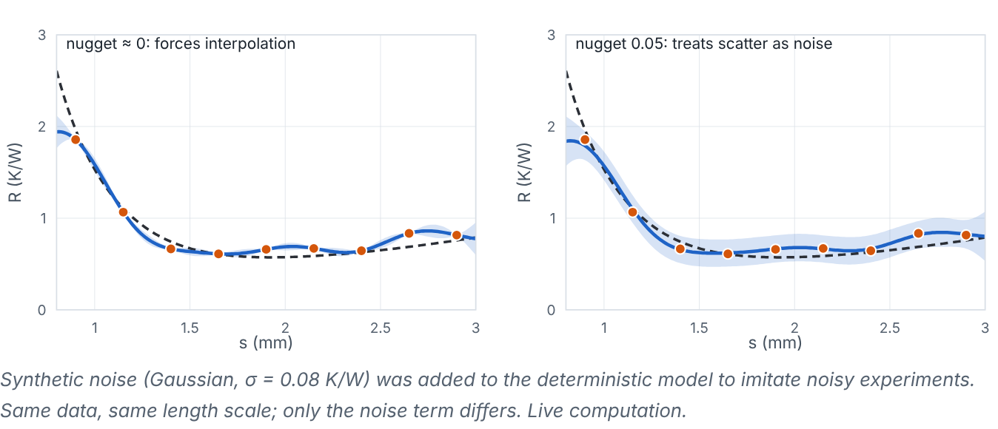
Two sources of uncertainty
Lesson 3 · Noise versus limited knowledge, and a numerical example · Intuition
Aleatory uncertainty (observation noise): repeat the experiment and you get a different value. Epistemic uncertainty (limited knowledge): you have not observed the function there yet; more samples reduce it. Deterministic simulators have (essentially) no noise, so GP uncertainty is epistemic. Experiments have both. The nugget term σ_{n}² lets the GP stop chasing noise.
The same noisy data fitted with a near-zero nugget (forced interpolation) and with a noise term.
Notes:
Two sources of uncertainty. Aleatory uncertainty (observation noise): repeat the experiment and you get a different value. Epistemic uncertainty (limited knowledge): you have not observed the function there yet; more samples reduce it. Deterministic simulators have (essentially) no noise, so GP uncertainty is epistemic. Experiments have both. The nugget term σ_n² lets the GP stop chasing noise. Look at the figure. The same noisy data fitted with a near-zero nugget (forced interpolation) and with a noise term. Two panels. Left: the GP mean passes through every noisy point, wiggling, with a narrow band at the points. Right: with a noise term, the mean is smoother and closer to the true curve and the band does not pinch to zero at the data.

Slide 3

Two sources of uncertainty
Lesson 3 · Noise versus limited knowledge, and a numerical example · The mathematics (1/2)
Worked example (noise-free, zero prior mean, σ_{f} = 1, ℓ = 0.5). Observations: y(0) = 1, y(1) = 0. Predict at x* = 0.5.
Kernel between the observations: k(0,1) = exp(−1²/(2·0.5²)) = e⁻² = 0.1353. So K = [[1, 0.1353], [0.1353, 1]].
Kernel to the query: k(0, 0.5) = k(1, 0.5) = exp(−0.25/0.5) = e^{−0.5} = 0.6065.
α = K⁻¹y: det = 1 − 0.1353² = 0.9817; α = (1/det)·[1, −0.1353] = [1.0187, -0.1379].
Mean: μ(0.5) = 0.6065 × (1.0187 + (-0.1379)) = 0.5342.
Variance: σ² = 1 − k*^{T}K⁻¹k* = 1 − 2 × 0.6065² × (1 − 0.1353)/det = 0.3519, so σ = 0.5933.
Notes:
Now the mathematics. Worked example (noise-free, zero prior mean, σ_f = 1, ℓ = 0.5). Observations: y(0) = 1, y(1) = 0. Predict at x* = 0.5. 1. Kernel between the observations: k(0,1) = exp(−1²/(2·0.5²)) = e^{−2} = 0.1353. So K = [[1, 0.1353], [0.1353, 1]].
2. Kernel to the query: k(0, 0.5) = k(1, 0.5) = exp(−0.25/0.5) = e^{−0.5} = 0.6065.
3. α = K^{−1}y: det = 1 − 0.1353² = 0.9817; α = (1/det)·[1, −0.1353] = [1.0187, -0.1379].
4. Mean: μ(0.5) = 0.6065 × (1.0187 + (-0.1379)) = 0.5342.
5. Variance: σ² = 1 − k_*^TK^{−1}k_* = 1 − 2 × 0.6065² × (1 − 0.1353)/det = 0.3519, so σ = 0.5933.

Slide 4
Two sources of uncertainty
Lesson 3 · Noise versus limited knowledge, and a numerical example · The mathematics (2/2)
Interpretation: the GP mean is a covariance-weighted combination of the observations, μ(x*) = w^{T}y with weights w = K⁻¹k* = [0.5342, 0.5342]. By symmetry both observations get the same weight, but the weights are not required to sum to 1 (here they sum to 1.068), so the prediction is not an arithmetic average: μ(0.5) = 0.5342, slightly above 0.5. The weights depend on how strongly the query correlates with each observation (k*) and how the observations correlate with each other (K). Far from all data the weights shrink towards 0 and μ returns to the prior mean. The uncertainty here is substantial because ℓ is comparable to the spacing.
Notes:
Continuing. Interpretation: the GP mean is a covariance-weighted combination of the observations, μ(x*) = w^Ty with weights w = K^{−1}k_* = [0.5342, 0.5342]. By symmetry both observations get the same weight, but the weights are not required to sum to 1 (here they sum to 1.068), so the prediction is not an arithmetic average: μ(0.5) = 0.5342, slightly above 0.5. The weights depend on how strongly the query correlates with each observation (k_*) and how the observations correlate with each other (K). Far from all data the weights shrink towards 0 and μ returns to the prior mean. The uncertainty here is substantial because ℓ is comparable to the spacing.

Slide 5


Two sources of uncertainty
Lesson 3 · Noise versus limited knowledge, and a numerical example · In engineering practice
Engineering application
Practical tip
Noisy experiments (AM porosity, machining roughness): include a noise term and estimate it, ideally checked against repeat tests. Deterministic CFD: use a tiny nugget for numerical stability only — but note that CFD can show small “numerical noise” from meshing and convergence, which a small fitted nugget can absorb.
Report which uncertainty the GP represents (epistemic only, or including noise) and how hyperparameters were chosen. Uncertainty bands are model-dependent and are not guarantees.
Notes:
Where does this matter in engineering? Noisy experiments (AM porosity, machining roughness): include a noise term and estimate it, ideally checked against repeat tests. Deterministic CFD: use a tiny nugget for numerical stability only — but note that CFD can show small “numerical noise” from meshing and convergence, which a small fitted nugget can absorb. A practical tip: Report which uncertainty the GP represents (epistemic only, or including noise) and how hyperparameters were chosen. Uncertainty bands are model-dependent and are not guarantees.

Slide 6

Pause and predict
Lesson 3 · Noise versus limited knowledge, and a numerical example · Predict before you look
Single observation y(0) = 2 with zero prior mean, σ_{f} = 1, ℓ = 1, no noise. What is μ(1)?
Write down your answer, then continue to the next slide.
Notes:
Time to predict. Single observation y(0) = 2 with zero prior mean, σ_f = 1, ℓ = 1, no noise. What is μ(1)? Pause here and commit to an answer before moving on.

Slide 7

What happens, and why
Lesson 3 · Noise versus limited knowledge, and a numerical example · Answer
Question: Single observation y(0) = 2 with zero prior mean, σf = 1, ℓ = 1, no noise. What is μ(1)?
μ(1) = k(1,0)·y/k(0,0) = e^{−0.5} × 2 ≈ 1.213. The prediction decays toward the prior mean 0 with distance.
Notes:
Here is the answer. μ(1) = k(1,0)·y/k(0,0) = e^{−0.5} × 2 ≈ 1.213. The prediction decays toward the prior mean 0 with distance.

Slide 8


Two sources of uncertainty
Lesson 3 · Noise versus limited knowledge, and a numerical example · Common misconception
Misconception
What is actually true
A wider uncertainty band means the simulator is noisier there.
For deterministic simulators, the band reflects lack of data and model assumptions, not noise.
Takeaway Noise (aleatory) vs limited data (epistemic); GP bands reflect assumptions — verify and calibrate.
Notes:
A common misconception is this: A wider uncertainty band means the simulator is noisier there. In fact: For deterministic simulators, the band reflects lack of data and model assumptions, not noise. The takeaway: Noise (aleatory) vs limited data (epistemic); GP bands reflect assumptions — verify and calibrate.

Slide 9
Key takeaways from this lesson
Summary
1
Two sources of uncertainty
Noise (aleatory) vs limited data (epistemic); GP bands reflect assumptions — verify and calibrate.
Notes:
To sum up this lesson. Two sources of uncertainty: Noise (aleatory) vs limited data (epistemic); GP bands reflect assumptions — verify and calibrate.

Slide 10

Objectives, bounds, constraints; minimization and maximization
UP NEXT · LESSON 10.1
That completes Module 9. Before moving on, review the Module 9 flashcards and take its quiz in the course (pass mark 70%). Next: Module 10, Optimization foundations.
Notes:
That completes Lesson 3 of Module 9: Noise versus limited knowledge, and a numerical example. This was the last lesson of the module, so review the flashcards and take the Module 9 quiz in the course. Next comes Module 10, Optimization foundations, starting with Objectives, bounds, constraints; minimization and maximization.

