Slide 1

Computer Program: Instructions of human for performing specific task using computer.

Slide 2
Programming Language: A programming language is a computer language. It is developed by some set of rules for communicating with computer.
Like: C, C++ and etc.

Slide 3
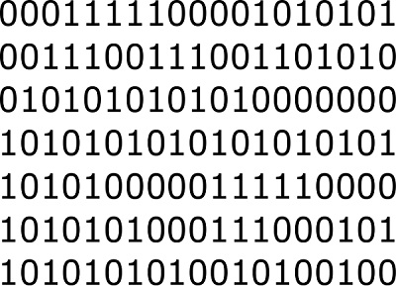
Machine Language:
Machine(our computer) understands only 0 or 1
Machine code

Slide 4
“C” language to “Machine Code”
Source code
Compiler
Machine code

Slide 5
Introduction

Slide 6
Overview of C Programming Language

Slide 7
Content of today’s learning of C:
C program structure
Data Type
I/O Function
Conditional Statement
Looping
Array
Strings
User Define Function
Recursions

Slide 8
Lets go CodeBlocks program: for Basic Structure N.B: every statement should end with semicolon(;)

Slide 9
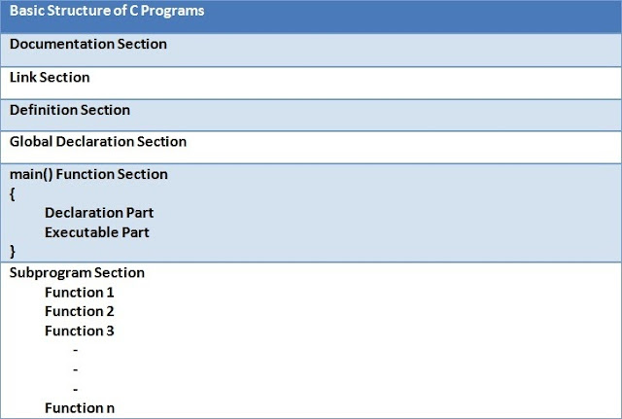
Structure of a C program:

Slide 10
Lets go CodeBlocks program: for data type.

Slide 11
Data Type:
1.Integer (int)
2. Float (float)
3.Double (double)
4.Character (char)

Slide 12
Lets go CodeBlocks program: for I/O

Slide 13
I/O functions:
Input: scanf()
Output: printf()

Slide 14
Lets go CodeBlocks program: for conditions

Slide 15
Conditional statement:
if(condition)
statement;
else
statement;

Slide 16
Lets go CodeBlocks
Example: “looping” program.

Slide 17
Loop:
1. for loop
structure:
for(initial value; condition; increase/decrease)
{
………..
}

Slide 18
2.While loop:
Structure:
while(condition) {
……
…….
increment/decrement;
}

Slide 19
Lets go CodeBlocks
Example: “Array” program.

Slide 20
Array:
An array is a data structure that can store same type of data in sequentially.
declaration:
data type array_name[element size];
int A[100];
int A[n];

Slide 21
