Slide 1
What is Docker
By Dr. Soheil Tehrani
https://www.linkedin.com/in/soheiltehrani/

Slide 2


What is Docker?

Slide 3
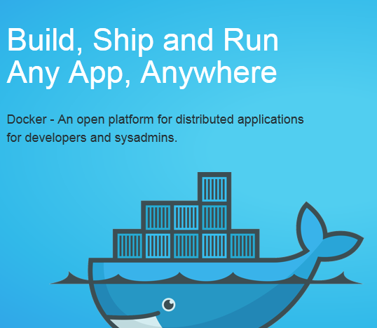
What is Docker?
Isn’t a programming language.
Isn’t a framework for building software.
Docker is a tool that helps solve common problems like
installing, removing, upgrading distributing, trusting, and managing software.
Docker is a platform that allows you to “build, ship, and run any app, anywhere.”

Slide 4
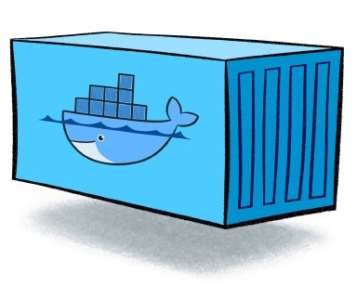
What is Container?
A container is a standard unit of software that packages up code and all its dependencies so the application runs quickly and reliably from one computing environment to another.
Benefits Of Container:
• Self-contained: Dev/prod parity (The twelve-factor app) • Scalable • Portable: portability across machines and cloud providers • DevOps • Version controlled • Reusable • Security

Slide 5
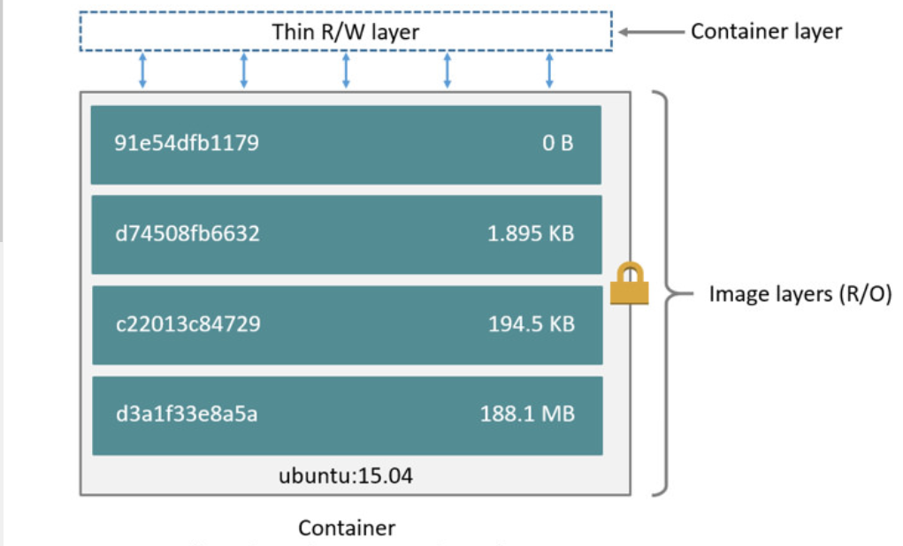
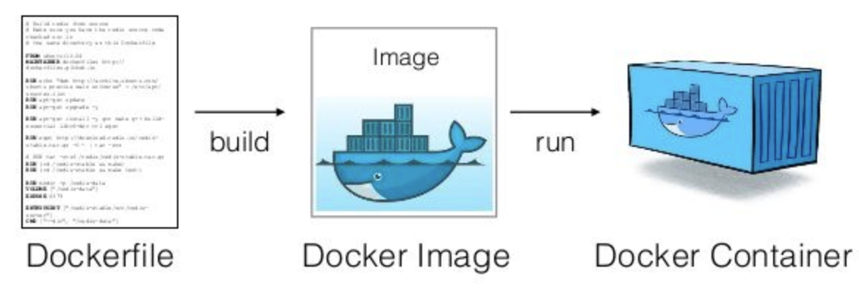
What is Image?
A Docker image is built up from a series of layers. Each layer represents an instruction in the image’s Dockerfile. Each layer except the very last one is read-only.

Slide 6
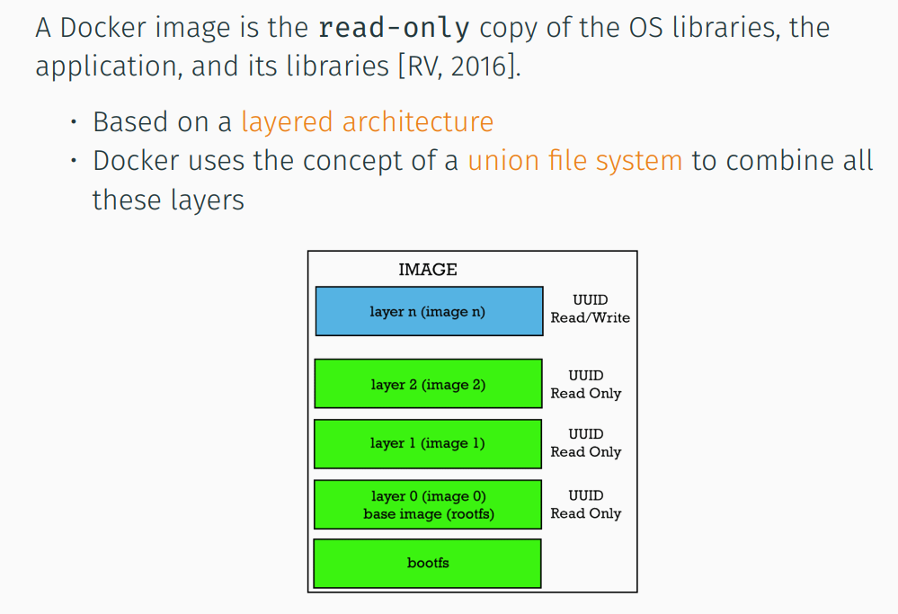
What is Image?

Slide 7
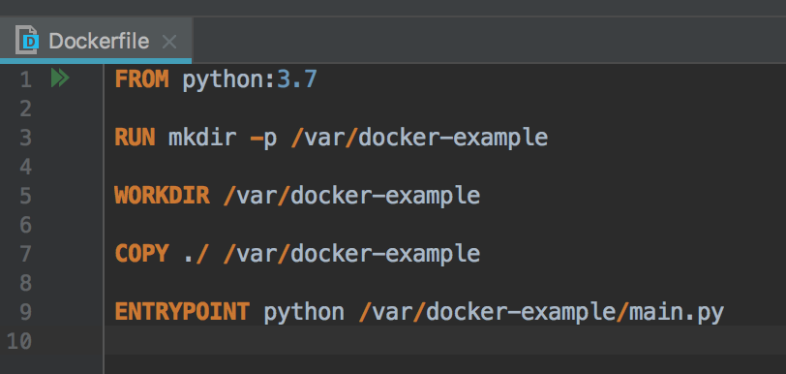
What is Dockerfile?
A Dockerfile is a text document that contains all the commands a user could call on the command line to assemble an image. Using docker build users can create an automated build that executes several command-line instructions in succession.
A Dockerfile is a build or scripting file that contains instructions to build a Docker image.
Programming languages used: Go (programming language)

Slide 8

Docker History

Slide 9
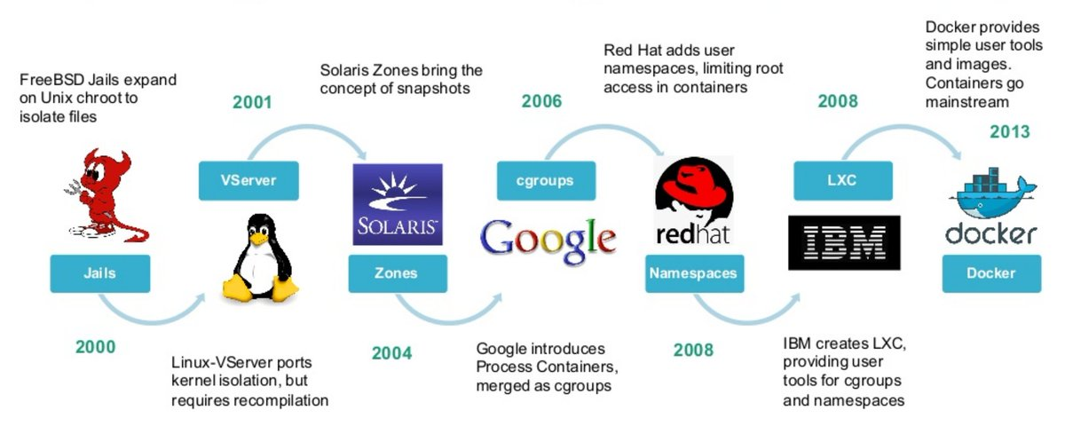
Docker History

Slide 10
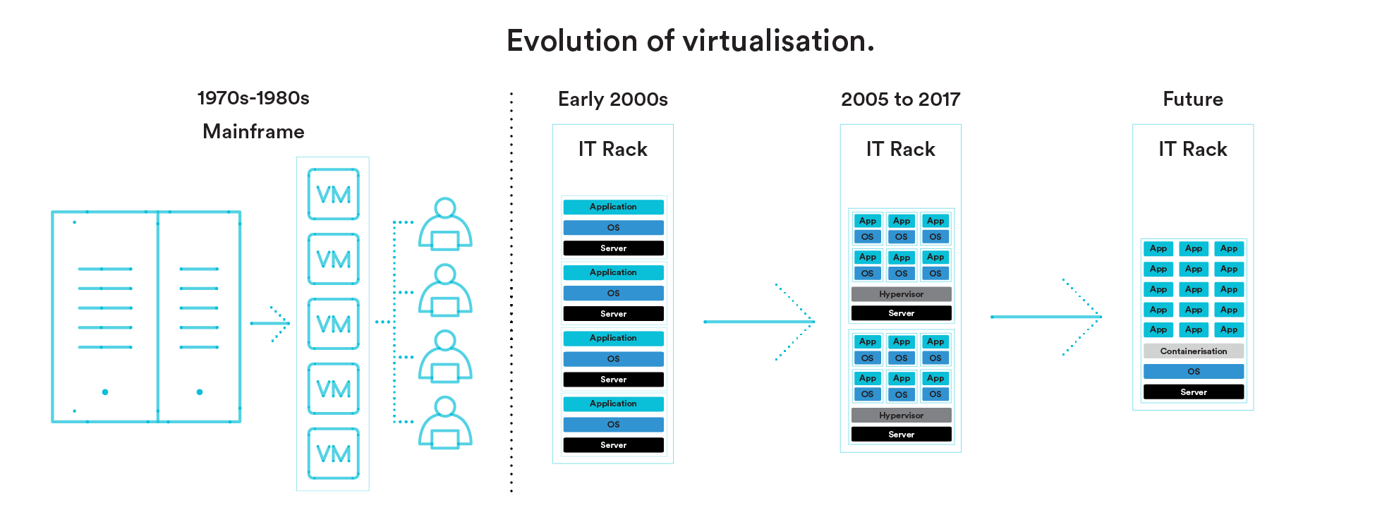
Docker History

Slide 11
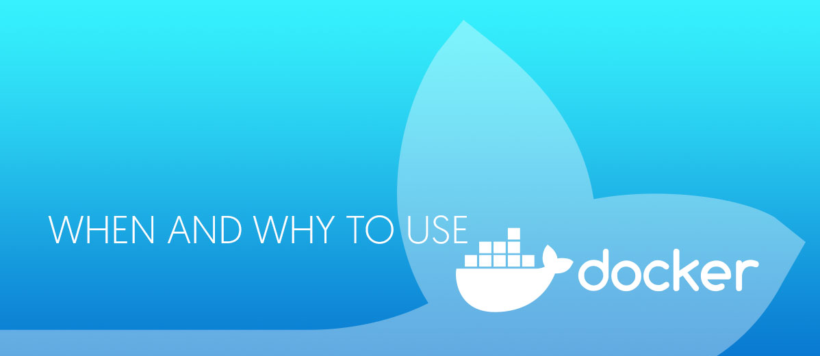
Why Docker ?

Slide 12
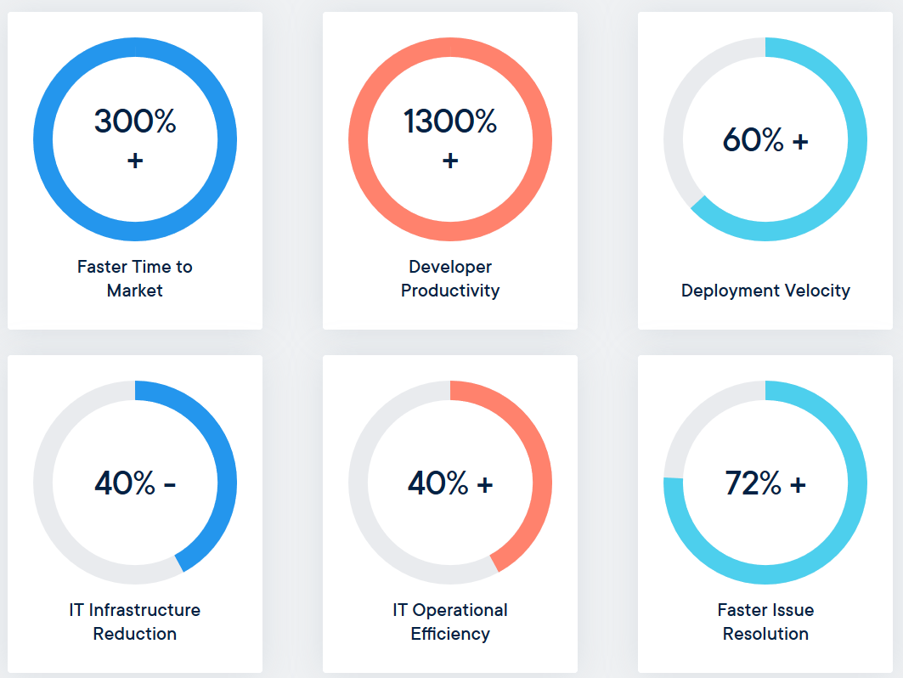
Why Docker?

Slide 13
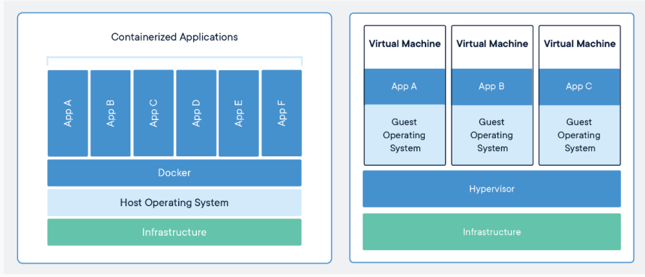
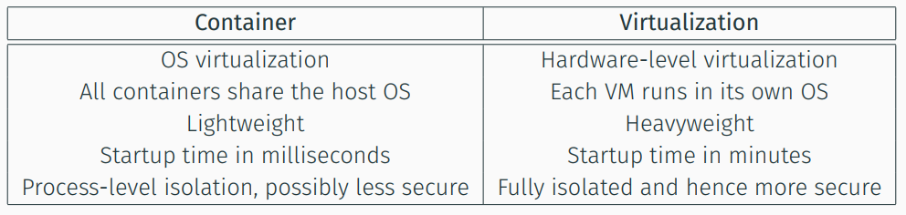
Dockerization vs Virtualization

Slide 14
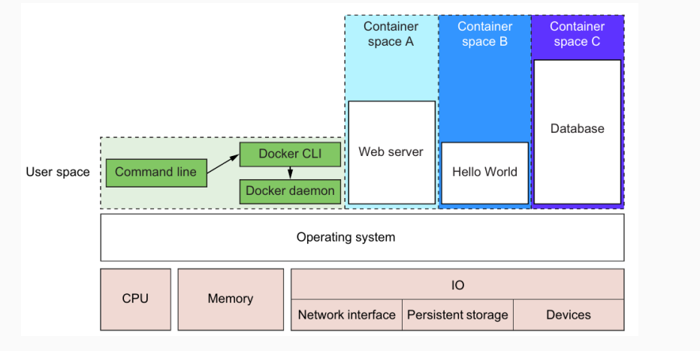
Running software in containers for isolation

Slide 15
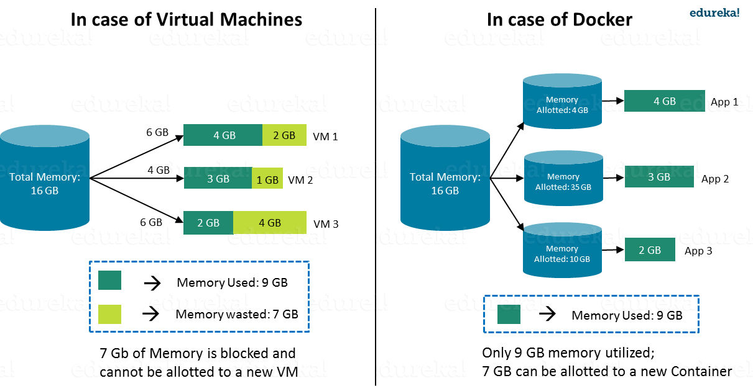
Why Docker?

Slide 16
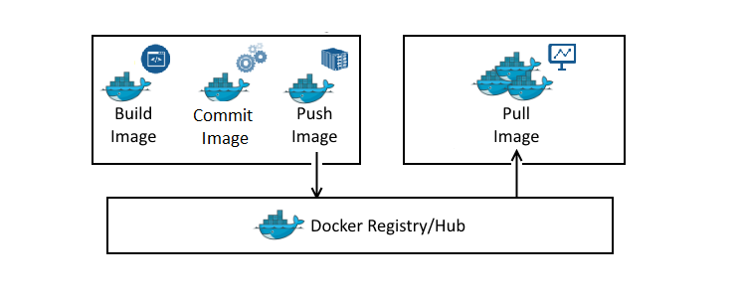

What is Docker Registry?
The Docker registry is a central place where Docker images are published and downloaded from.
• https://hub.docker.com
• Docker private registry

Slide 17
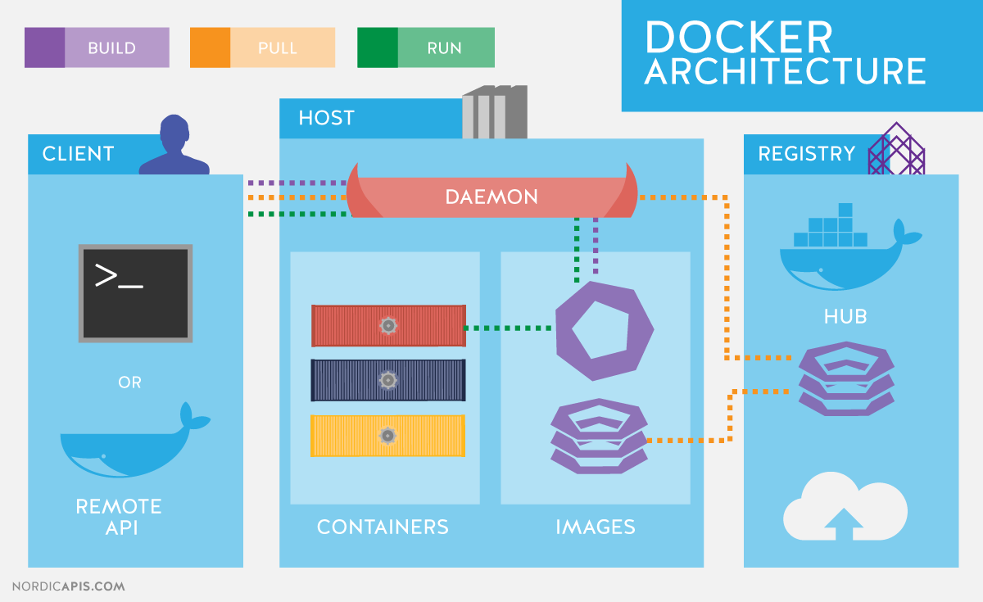
Docker Components

Slide 18
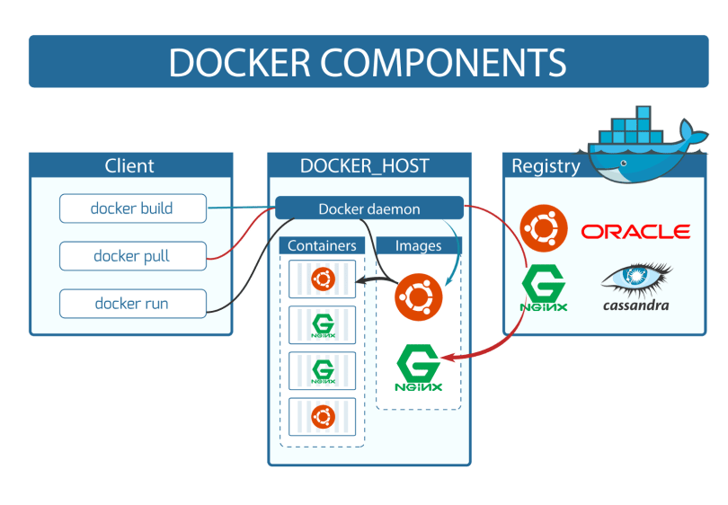
What are Docker Components?

Slide 19
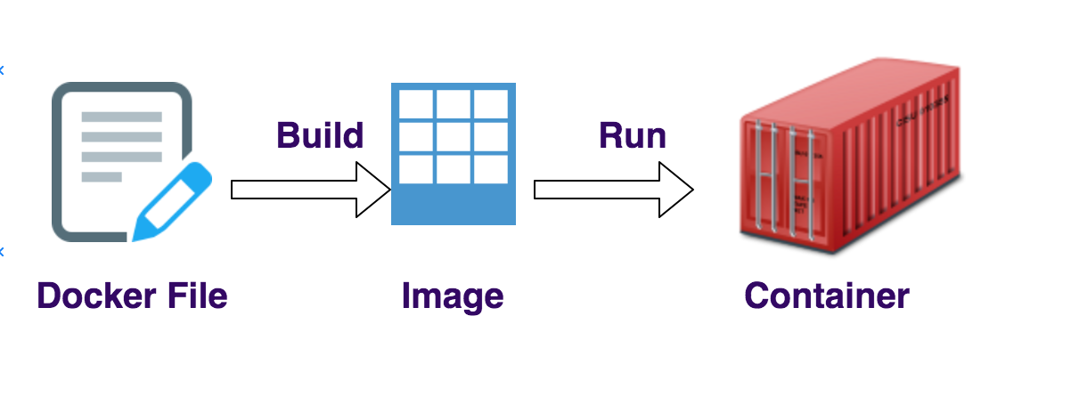
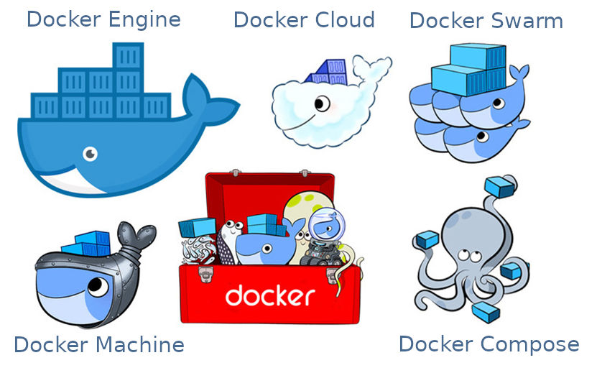
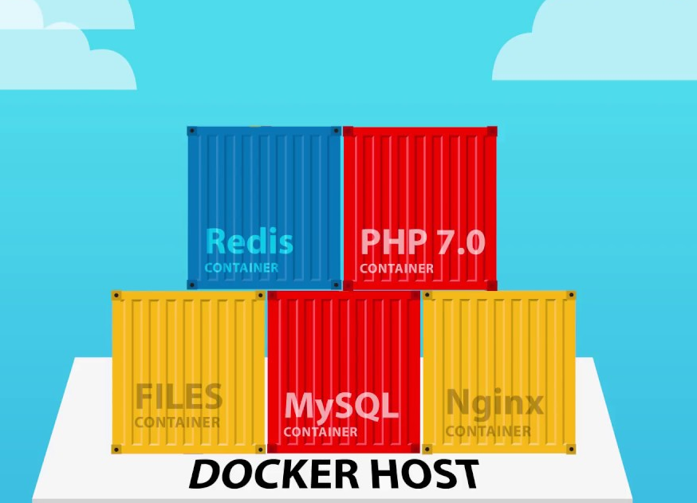
Docker in a Nutshell

Slide 20
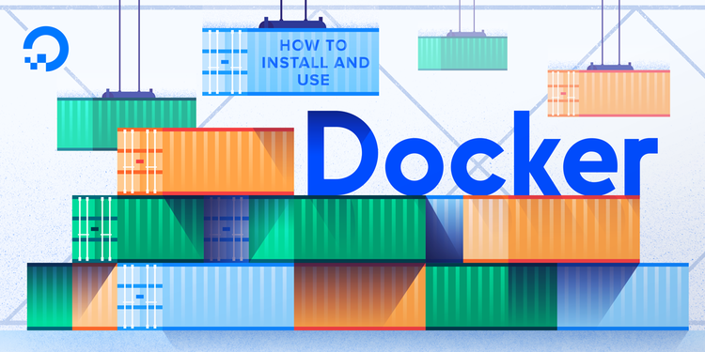
How to Use Docker?

Slide 21
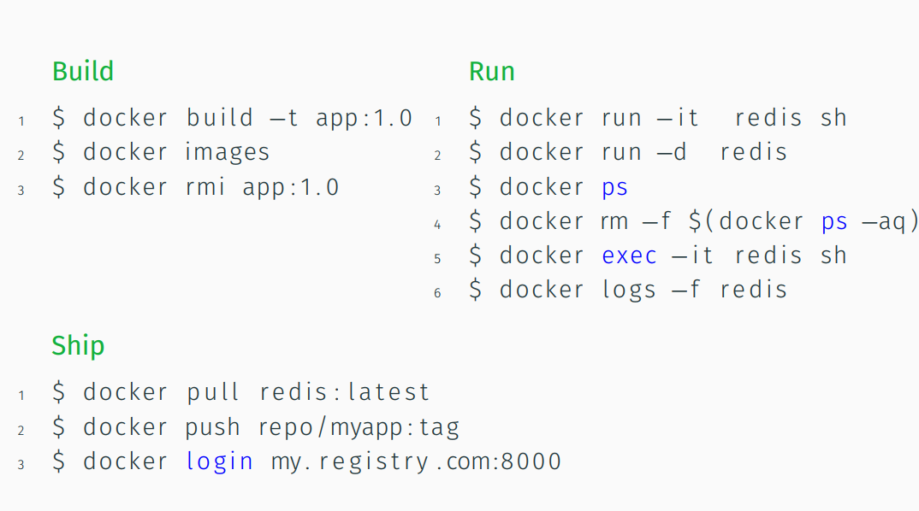
Docker Commands

