Slide 1
Android Mobile Applications
Week 9 – Custom Views

Slide 2
Corresponding Text
Android Programming, 527– 537

Slide 3
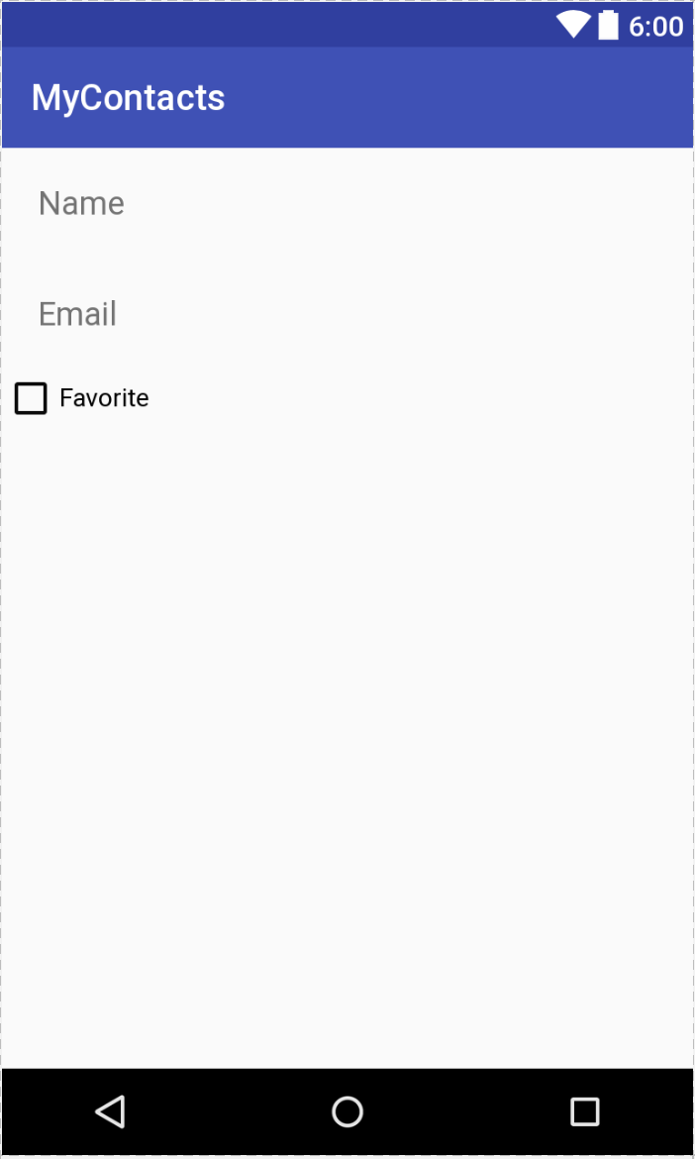
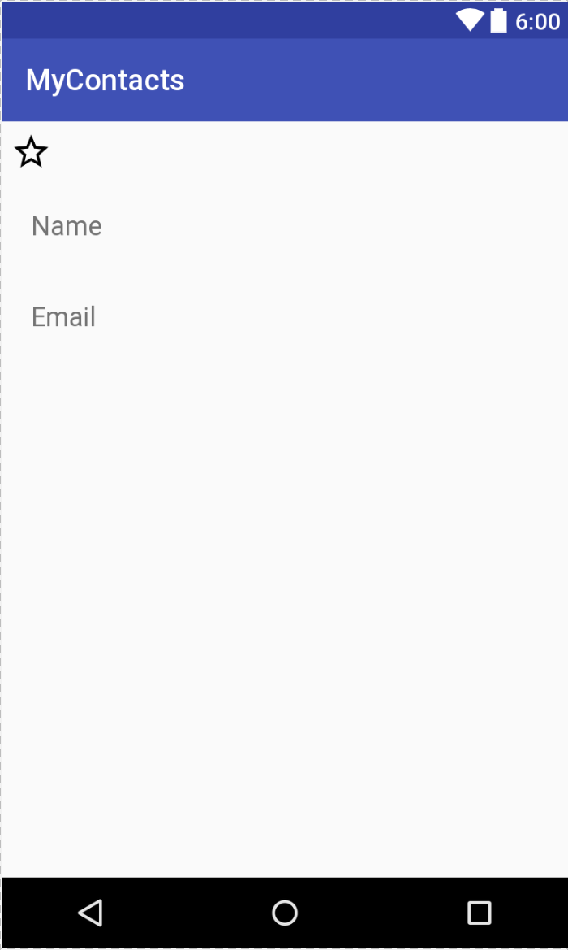
Standard Widgets/Views
Custom Widget/View

Slide 4
Custom Views – Two Types
Simple – no child views, usually responsible for custom rendering
Composite – composed of other objects, delegates rendering to children

Slide 5
Custom Views - Steps
Create subclass of android.view.View or one of its subclasses
Override constructors
Constructor(Context context)
Constructor(Context context, AttributeSet attrs)
Add custom functionality
onDraw(Canvas canvas)
onMeasure(int width, int height)

Slide 6
onDraw(Canvas canvas)
onDraw() method is responsible for rendering the view
A Canvas instance is the object on which we will draw
Use a Paint instance to draw on the canvas
Can use Bitmap to draw resources on a canvas

Slide 7
onMeasure(int widthSpec, int heightSpec)
Used to provide hosting layout with width and height information related to drawing
Must call setMeasuredDimension()
Two parameters contain both layout and size information; use MeasureSpec to extract both
Three MeasureSpec modes:
MeasureSpec.EXACTLY: widget must use the specified size
MeasureSpec.AT_MOST: widget can use not more than the specified size
MeasureSpec.UNSPECIFIED: no size specified

Slide 8
Changing State
Add an OnClickListener using setOnClickListener()
OnClickListener should call invalidate() to redraw the widget
Custom view should allow an additional listener to be set, this should be used in the OnClickListener
Custom Listener should implement a custom interface defined in the custom view class that specifies the appropriate method to call.

