Slide 1
Mobile App Development Lec5: Saving data
Ekarat Rattagan, PhD
1
Notes:
<number>

Slide 2
Outline
Saving data as Key-Value Sets
Saving data in Files
Saving data in SQL Databases
1

Slide 3
Outline
Saving data as Key-Value Sets
Saving data in Files
Saving data in SQL Databases
1

Slide 4
Saving Key-Value Sets
If you have a relatively small collection of key-values that you'd like to save.
Scenarios why we need to save data, e.g.,
To check the first time use
To check the latest version
To save geographical location
To save session
To save app’s setting
1

Slide 5
Saving Key-Value Sets
If you have a relatively small collection of key-values that you'd like to save, you should use the SharedPreferences APIs.
A SharedPreferences object points to a file containing key-value pairs and provides simple methods to read and write them. Each SharedPreferences file is managed by the framework and can be private or shared.
1

Slide 6
Get a Handle to a SharedPreferences
You can create a new shared preference file or access an existing one by calling one of two methods:
getSharedPreferences() — Use this if you need multiple shared preference files identified by name, which you specify with the first parameter. You can call this from any Context in your app.
getPreferences() — Use this from an Activity if you need to use only one shared preference file for the activity. Because this retrieves a default shared preference file that belongs to the activity, you don't need to supply a name.
1

Slide 7
Create SharedPreferences’ objects
For example:
Context context = getActivity();
SharedPreferences sharedPref = context.getSharedPreferences(
getString(R.string.preference_file_key), Context.MODE_PRIVATE);
If you need just one shared preference file for your activity
SharedPreferences sharedPref = getActivity().getPreferences(Context.MODE_PRIVATE);
1

Slide 8
Write to Shared Preferences
To write to a shared preferences file,
create a SharedPreferences.Editor by calling edit() on your SharedPreferences.
Pass the keys and values you want to write with methods such as putInt() and putString().
Then call commit() to save the changes.
1

Slide 9
Write to Shared Preferences
Example:
int newHighScore;
SharedPreferences sharedPref = getActivity().getPreferences
(Context.MODE_PRIVATE);
SharedPreferences.Editor editor = sharedPref.edit();
editor.putInt(“highScore”, newHighScore);
editor.commit();
1

Slide 10
Read from Shared Preferences
To retrieve values from a shared preferences file
call methods such as getInt() and getString(),
providing the key for the value you want, and optionally a default value to return if the key isn't present.
1

Slide 11
Read from Shared Preferences
Example,
SharedPreferences sharedPref = getActivity().
getPreferences(Context.MODE_PRIVATE);
int defaultValue = 0;
long highScore = sharedPref.getInt(“highScore”, defaultValue);
1

Slide 12
Delete Shared Preferences
1. Remove one key
Editor editor = shared.edit();
editor.remove(getString(R.string.saved_high_score));
editor.commit();
2. Remove all data
Editor editor = shared.edit();
editor.clear();
editor.commit();
1

Slide 13
Case study 1 (Simple)
public class SharedPreferencesDemo extends Activity {
private static final String MY_PREFS = "my_prefs";
@Override
public void onCreate(Bundle savedInstanceState) {
super.onCreate(savedInstanceState);
setContentView(R.layout.main);
SharedPreferences shared = getApplicationContext().getSharedPreferences
(MY_PREFS, Context.MODE_PRIVATE);
1

Slide 14
Case study 1
// Write
Editor editor = shared.edit();
editor.putString("stringKey", “Ekarat");
editor.putBoolean("booleanKey", true);
editor.commit();
//Read
String stringValue = shared.getString("stringKey", "not found!");
boolean booleanValue = shared.getBoolean("booleanKey, false);
Toast.makeText(this.getApplicationContext(), "name = "+value1+",boolean="+value2,
Toast.LENGTH_LONG).show();
} }
1

Slide 15
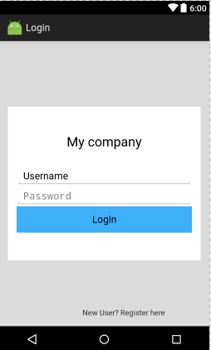
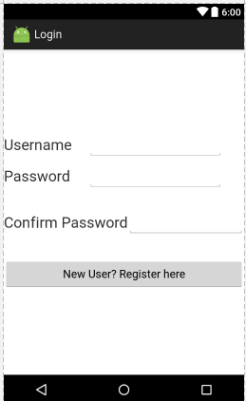
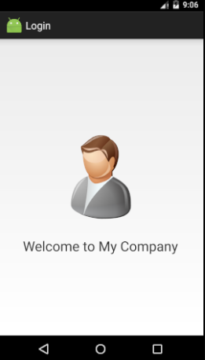
Case study 2: (Login process)
Column 1
Column 2
Column 3
Login UI
Register UI
Main UI
1

Slide 16
Preference (Setting)
Represents the basic Preference UI building block displayed by a PreferenceActivity in the form of a ListView. Associates with a SharedPreferences to store/retrieve the preference data.
Specifying a preference hierarchy in XML, each element can point to a subclass of Preference, similar to the view hierarchy and layouts.
1

Slide 17
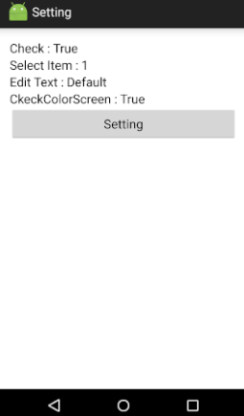
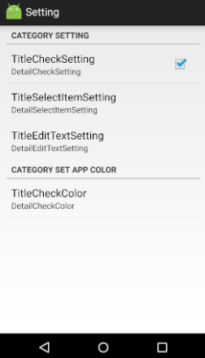
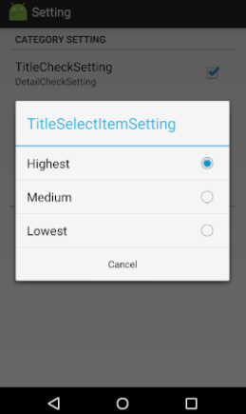
Case study 3: (Setting)
1

Slide 18
Exercise
1. Create a setting to allow users to change the background colors of your apps.
1

Slide 19
Resource
https://developer.android.com/training/basics/data-storage/shared-preferences.html
https://devahoy.com/posts/android-login-activity-with-sharedpreferences/
http://www.androidcode.in.th/2012/?p=228
<number>

