Slide 1
Modern Related Technology on Mobile Devices
Lec4: Intent
Ekarat Rattagan, PhD
Notes:
1

Slide 2
Intents
An Android application could include any number of activities.
• An activity uses the setContentView(...) method to expose a
single UI from which a number of actions could be performed.
• Activities are independent of each other; however they usually
cooperate exchanging data and actions.
• Typically, one of the activities is designated as the first one (main) that
should be presented to the user when the application is launched.
• Moving from one activity to another is accomplished by asking the
current activity to execute an intent.
2

Slide 3
Intents
- An asynchronous message.
Bind individual components to each other at runtime.
Think of them as the messengers that request an action from other components, whether the component belongs to your app or another.
2

Slide 4
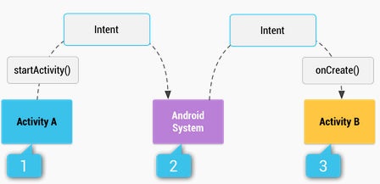
Intents
Figure 1. Illustration of how an implicit intent is delivered through the system to start another activity:
[1] Activity A creates an Intent with an action description and passes it to startActivity().
[2] The Android System searches all apps for an intent filter that matches the intent. When a
match is found,
[3] the system starts the matching activity (Activity B) by invoking itsonCreate() method and
passing it the Intent.
3

Slide 5
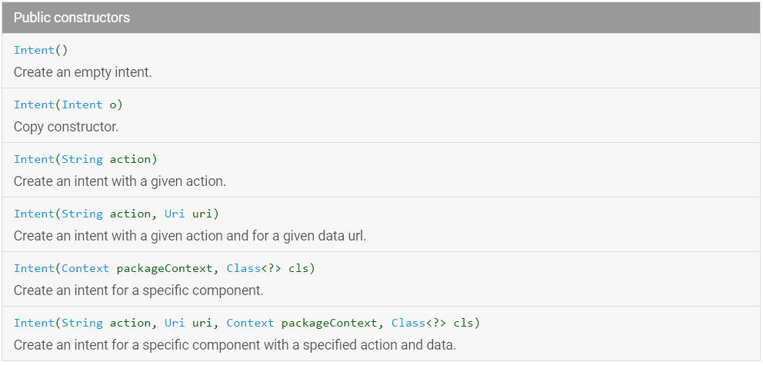
Intents
4

Slide 6
Type of Intents
Implicit intents
Do not directly specify the Android components which should be called,
e.g., Intent int1 = new Intent(Intent.ACTION_VIEW,
Uri.parse("http://www.google.com"));
startActivity(int1);
Explicit intents
Specify the Android component to be called, e.g., Activity B and A,
e.g., Intent intent = new Intent(this,ActivityB.class);
startActivity(intent);
5

Slide 7
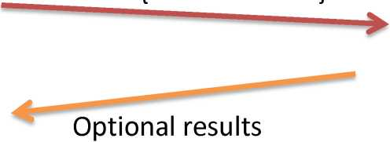
Action/Data
The main arguments of an Intent are:
1. Action The built-in action to be performed, such
as ACTION_VIEW, ACTION_EDIT, ACTION_MAIN, etc.
2. Data The primary data to operate on, such as a phone
number to be called (expressed as a Uri).
Intent: { action + data }
Activity-2
Activity-1
5

Slide 8
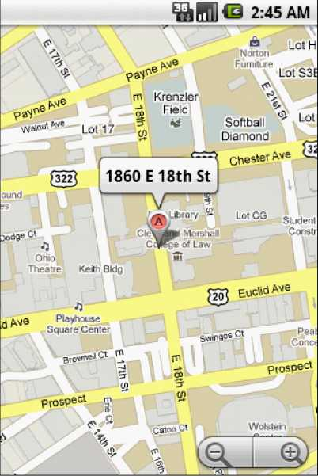
Intents
Example 1 : Using Standard Actions
Geo Mapping an Address
Provide a geoCode expression holding a street
address (or place, such as 'golden gate ca' )
Replace spaces with '+'.
String geoCode = "geo:0,0?q=18 60+east+18th+street+cleveland+oh";
Intent intent = new Intent(Intent.ACTION VIEW, Uri. parse(geoCode));
startActivity(intent);
Modify the Manifest adding the following requests:
<uses-permission android:name="android.permission.ACCESS_COARSE_LOCATION" />
<uses-permission android:name="android.permission.INTERNET" />
25

Slide 9
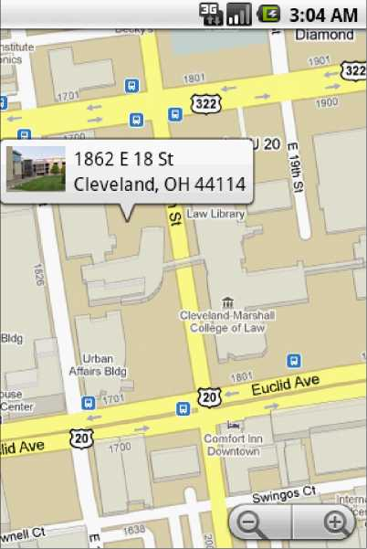
Intents
Example 2 : Using Standard Actions
Geo Mapping Coordinates (latitude, longitude)
Provide a geoCode holding latitude and
longitude (also an addittional zoom '?z=xx' with
xx in range 1..23)
String geoCode =
"geo:41.5020952,-81.6789717";
Intent intent = new Intent(Intent.ACTION VIEW,
Uri. parse(geoCode));
startActivity(intent);
Modify the Manifest adding the following requests:
<uses-permission android:name="android.permission.ACCESS_COARSE_LOCATION" />
<uses-permission android:name="android.permission.INTERNET" />
26
Notes:
1

Slide 10
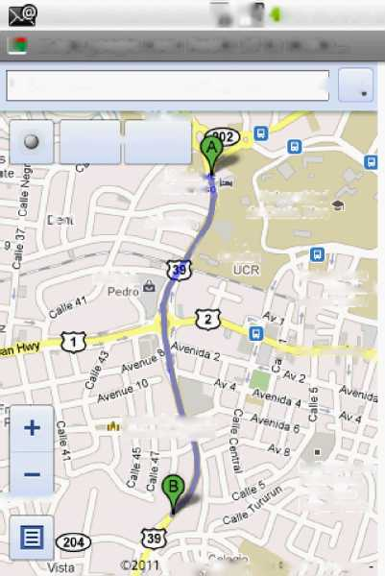
Intents
Examples 3
// Getting driving directions: how to go from loaction A to location B?
Intent intent = new Intent(android.content.Intent.ACTION_VIEW,
Uri.parse("http://maps.google.com/maps?saddr=9.938083,-84.054430&daddr=9.926392,-84.055964"));
startActivity(intent);
a fin-Cl 9:35 AM
n maps.google.com: Route 39 to Route...
5,-84.054430 to: 9.926392,-84.055964 Q.
BAC-Sac
Menu n Layers
Hotel A
del Pfl'ais
Umversi dad
j. i ■
Aloireda
m Ccsta Rica
f t
tandia
Mall San
Cnlefliti Jose
Joaquin ^
iVbngas.Cairo
^ Pan America^ ^
Iglesia de MKMra
Sefiofa de F%ma
Institute Sobfe
Alrototemo
v Farmaoe
Depart encia
OSscsrouir
Googje^^ ^ta D2011 Googie
27

Slide 11
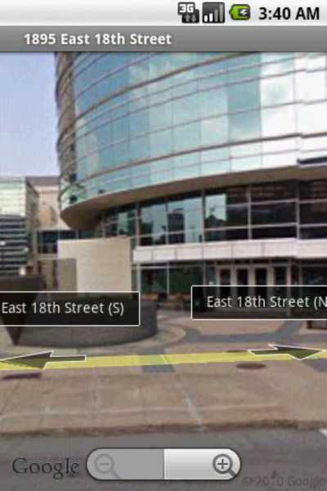
Intents
Example 4 : Using Standard Actions
Geo Mapping - Google StreetView
geoCode Uri structure:
google.streetview:cbll=lat,lng&cbp=1,yaw,,pitch,zoom&mz=mapZoom
Reference: http://developer.android.com/guide/appendix/g-app-intents.html
String
geoCode =
ii
google.streetview:cbll=41.5020952,-81.6789717&cbp=1,270,,45,1&mz=1";
Intent intent = new Intent(Intent.ACTION_VIEW, Uri.parse(geoCode));
startActivity(intent);
Modify the Manifest adding the following requests:
<uses-permission android:name="android.permission.ACCESS_COARSE_LOCATION" />
<uses-permission android:name="android.permission.INTERNET" />
29

Slide 12
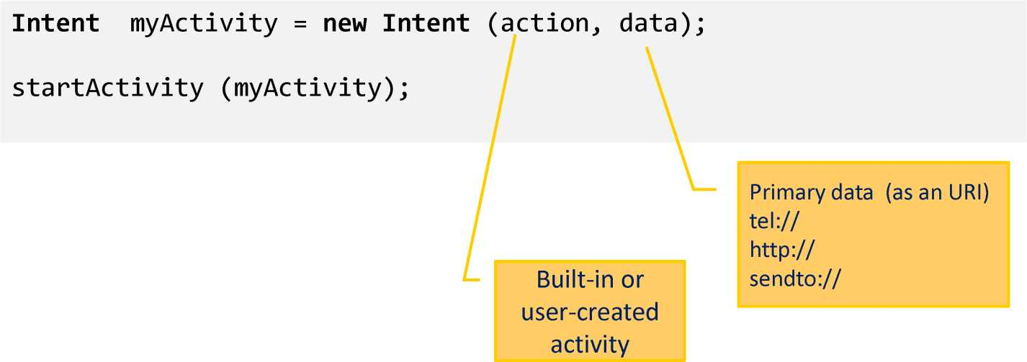
Action/Data
6

Slide 13
Action/Data
Examples of action/data pairs are:
ACTION_DIAL tel:123
Display the phone dialer with the given number filled in.
ACTION_VIEW http://www.google.com
Show Google page in a browser view. Note how the VIEW action does what is considered the most reasonable thing for a particular URI.
ACTION_EDIT content://contacts/people/2
Edit information about the person whose identifier is ”2”.
ACTION_VIEW content://contacts/people/2
Used to start an activity to display 2-nd person.
ACTION_VIEW content://contacts/ people/
Display a list of people, which the user can browse through. Selecting a particular person to view would result in a new intent
7

Slide 14
Action/Data
Built-in Standard Actions
List of standard actions that Intents can use for launching activities (usually through startActivity(Intent).
ACTION_MAIN | ACTION_ANSWER
ACTION_VIEW | ACTION_INSERT
ACTION_ATTACH_DATA | ACTION_DELETE
ACTION_EDIT | ACTION_RUN
ACTION_PICK | ACTION_SYNC
ACTION_CHOOSER | ACTION_PICK_ACTIVITY
ACTION_GET_CONTENT | ACTION_SEARCH
ACTION_DIAL | ACTION_WEB_SEARCH
ACTION_CALL ACTION_SEND ACTION_SENDTO | ACTION_FACTORY_TEST
8

Slide 15
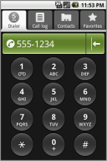
Intents
Example 5
Display the phone dialer with the given number filled in.
Intent myActivity2 = new Intent (Intent.ACTION_DIAL,
Uri.parse( "tel:555-1234"));
startActivity(myActivity2);
9

Slide 16
Send values between Activities
Intents - Secondary Attributes
In addition to the primary action/data attributes, there are a number of secondary attributes that you can also include with an intent, such as:
putExtra: Send data between activities
Activity 1 (Sender)
Activity 2 (Receiver)
Intent intent = new Intent(AdultTeeth.this, MainScreen.class);
intent.putExtra("int_value", int_variable);
startActivity(intent);
Intent intent = getIntent();
int temp = intent.getIntExtra("int_value", 0);
10

Slide 17
Send values between Activities
Data type of extra
• boolean
• boolean[]
• byte
• byte[]
• char
• char[]
• CharSequence
• CharSequence[]
• double
• double[]
• float
• float[]
• int
• int[]
• long
• long[]
• short
• short[]
• String
• String[]
• ArrayList<CharSequence>
• ArrayList<String>
• ArrayList<Integer>
• Parcelable
• Serializable
Exercise 1 Implement Intent sends values app
10

Slide 18

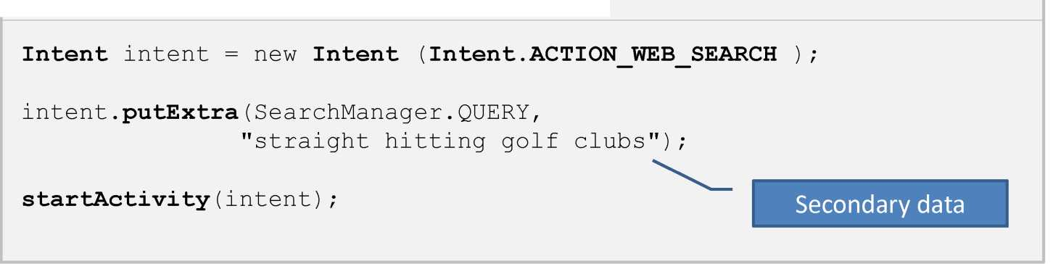
Intents - Secondary Attributes
Not only defined variables, but also built-in variables
Example 6 : Doing a Google search looking for golf clubs
10

Slide 19
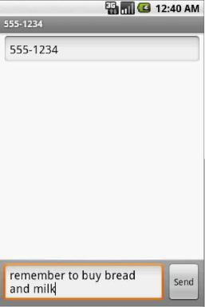
Intents
Not only defined variables, but also built-in variables
Example 7 : Sending a text message (using extra attributes)
Intent intent = new Intent(Intent.ACTION_SENDTO,
Uri.parse("sms:5551234"));
intent.putExtra("sms_body", "are we playing golf next Saturday?”);
startActivity(intent);
11

Slide 20

Intents
Not only defined variables, but also built-in variables
- Set type
Example 8 : Showing Pictures (using extra attributes)
Intent myIntent = new Intent();
myIntent.setType("image/pictures/*");
myIntent.setAction(Intent.ACTION_GET_CONTENT);
startActivity(myIntent);
12

Slide 21
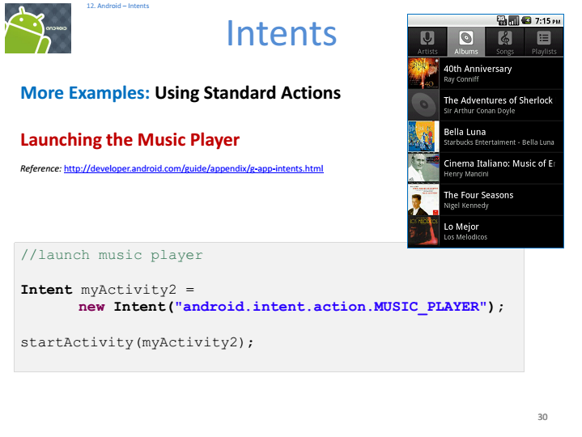

Slide 22
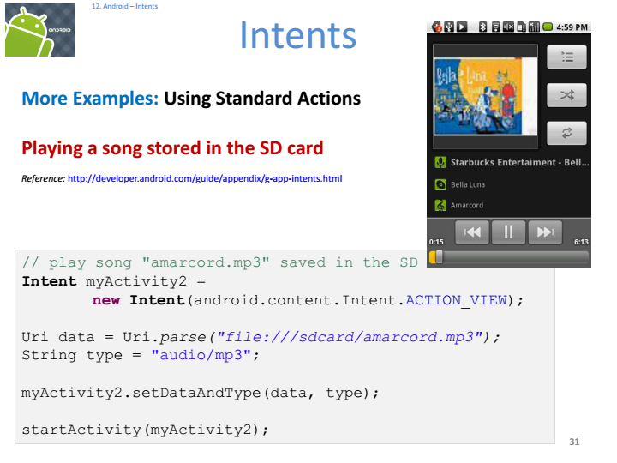

Slide 23
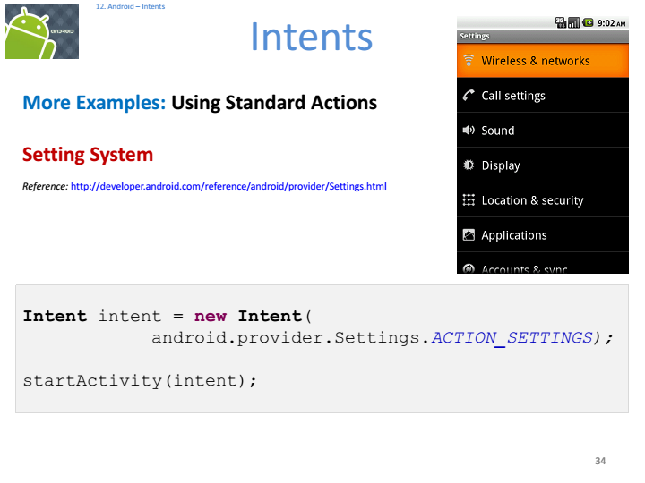

Slide 24
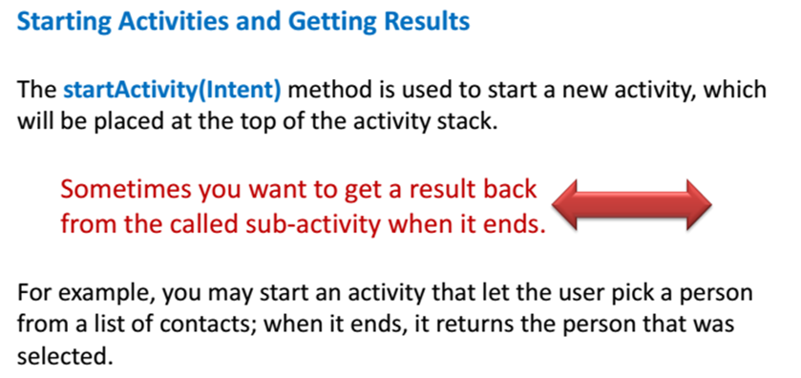
Intents with getting results

Slide 25
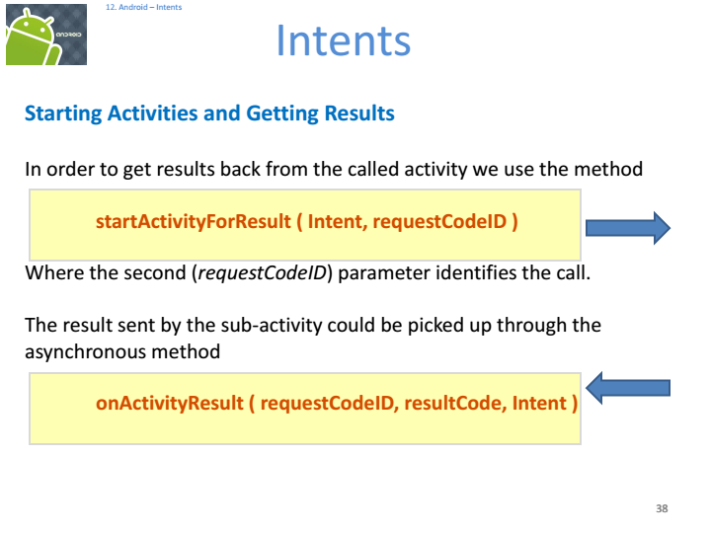

Slide 26
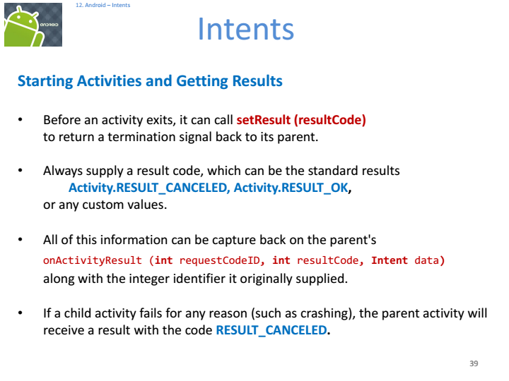

Slide 27
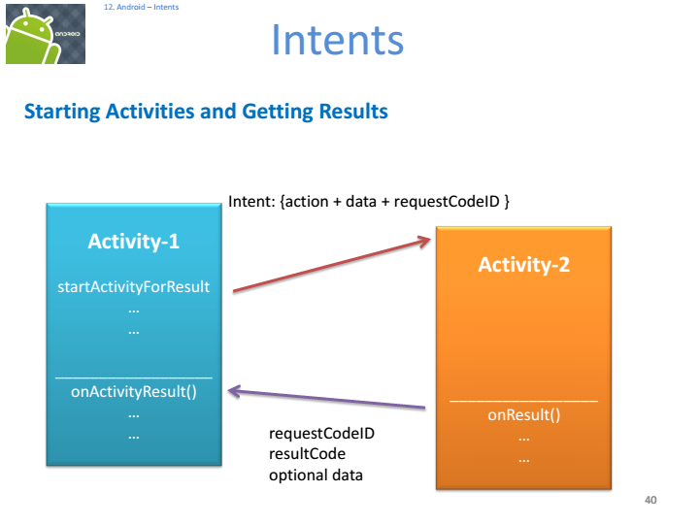

Slide 28
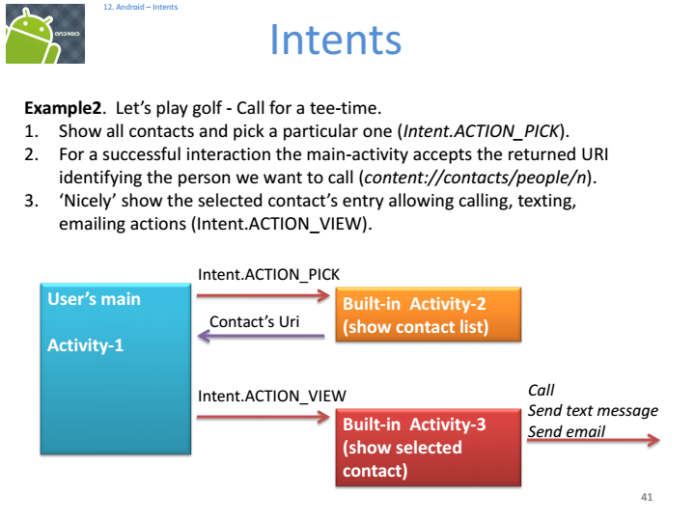

Slide 29
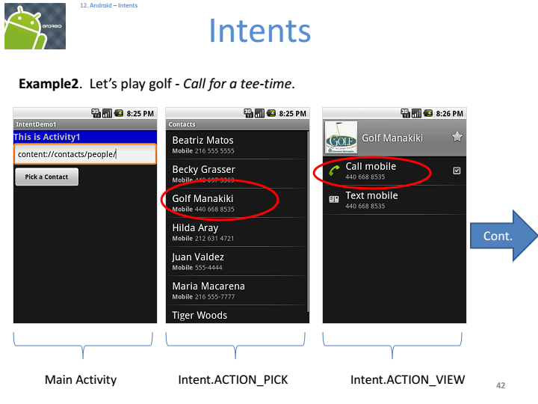

Slide 30
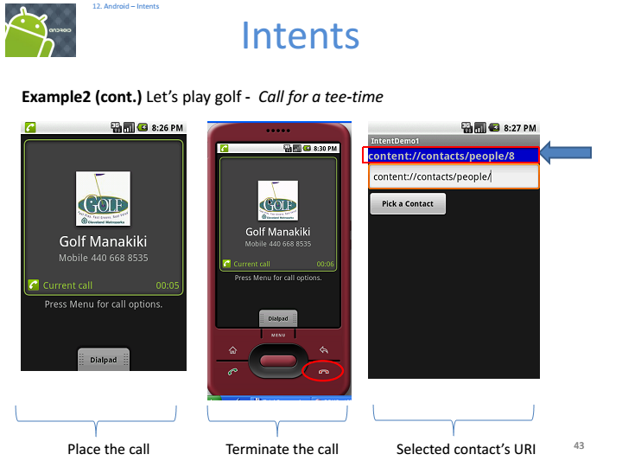

Slide 31
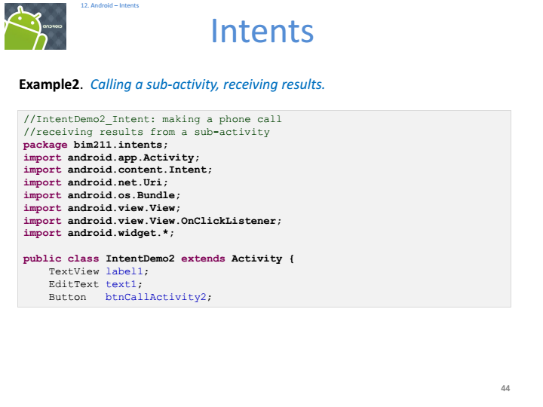

Slide 32
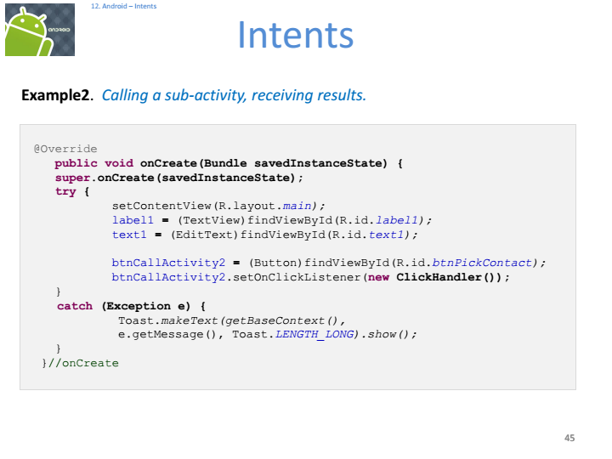

Slide 33
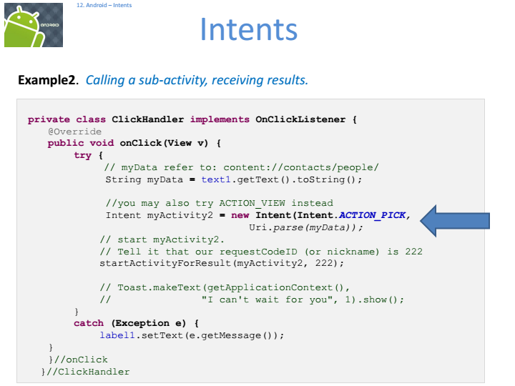

Slide 34
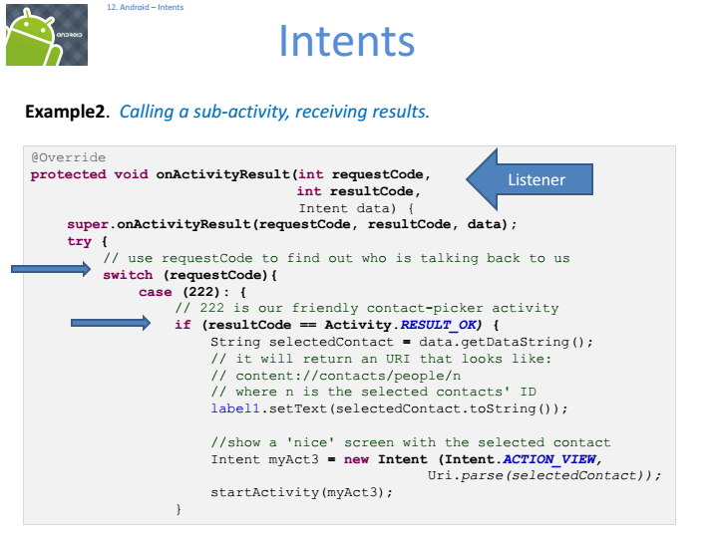

Slide 35
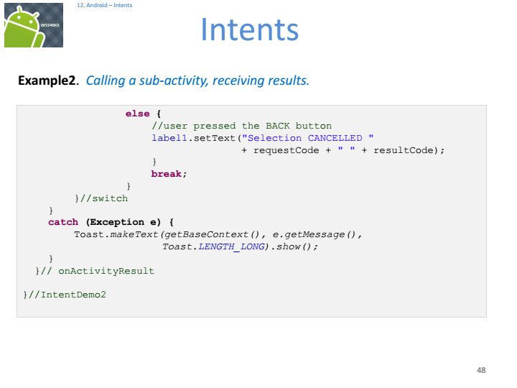

Slide 36
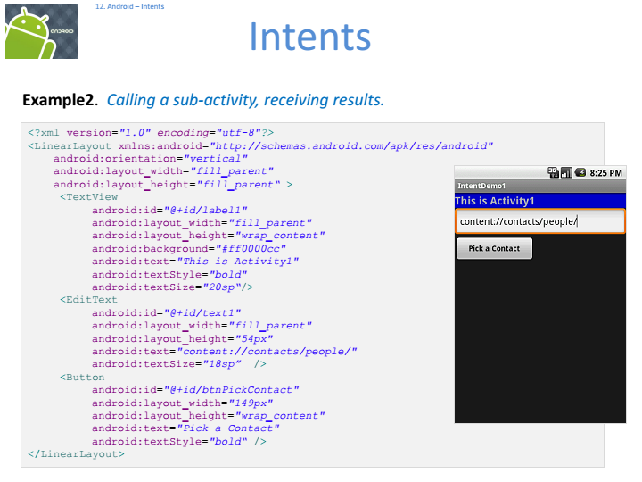

Slide 37
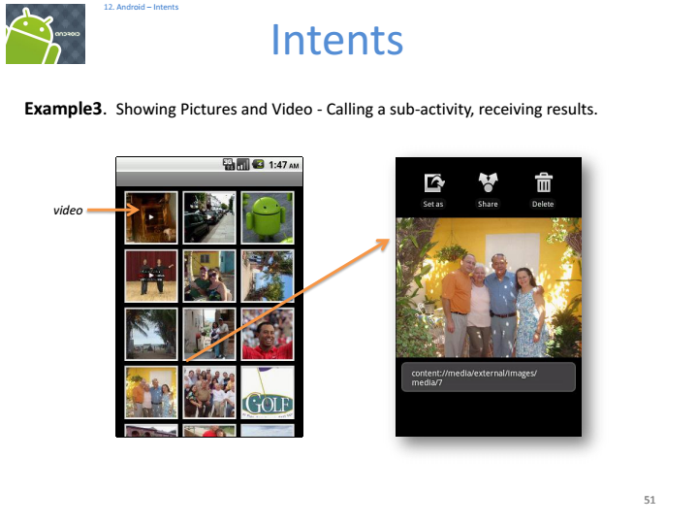

Slide 38
