Slide 1
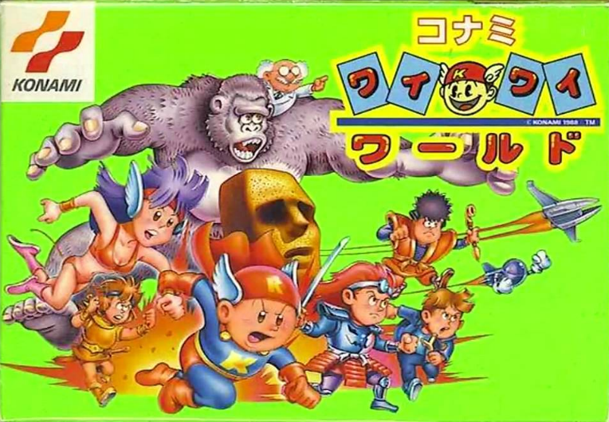
ITEC-1304 (Multimedia Systems and Applications) Lec 1: Introduction
Ekarat Rattagan, Ph.D.
https://i.ytimg.com/vi/cENdkI71A7I/maxresdefault.jpg
Some slides info from Andrea Resmini.

Slide 2
Biography
Name: Ekarat Rattagan (เอกรัฐ รัฐกาญจน์)
Education: Ph.D. (Electrical Engineering and Computer Science)
Research:
Mobile embedded systems
Game technology
Published:
“Calibrating Parameters and Formulas for Process-level Energy Consumption Profiling in Smartphones”, Journal of Network and Computer Application, 2014.
“Semi-online Power Estimation For Smartphone Hardware Components”, IEEE International Symposium on Industrial Embedded System(SIES), Siegen, Germany, June 8-10, 2015.
“Symbolic Regression and Clustering for Power Consumption Estimation on Smartphone Hardware Subsystem”, Taiwan patent, 2015.
Line id: ajpok
E-mail: ekarat@mutacth.com

Slide 3
Biography (Cont.)
More details of me
Linkedin: https://th.linkedin.com/in/ekarat-rattagan-478210100
ResearchGate: https://www.researchgate.net/profile/Ekarat_Rattagan
Dblp: http://dblp.uni-trier.de/pers/hd/r/Rattagan:Ekarat

Slide 4
Course outlines
1. Introduction to game development (Unity)
2. 2D game I (Scene structure, sprite, component, C#)
3 2D game II (Prefab, C#)
4 2D game III (Animation, Create a simple game like shooting spaceship) (quiz1)
5 2D game IV (Animation cont., Multiple scene, scores)
6 GUI I
7 GUI II
8 Audio
Midterm
9 Project I (A complete of 2D simple game)
10 2D game VI (Puzzle game design I, Algorithm I)
11 2D game II (Puzzle game design II, Algorithm II)
12 2D game III (Paticle effects) (quiz2)
13 3D game IV (Network multi-players)
14 3D game V (Connected to remoted database)
15 Project II (A complete of 2D multiple players game)
Final

Slide 5
Course outlines
Midterm: 20%
Final: 30%
Attend: 10%
Project: 30%
Quiz 1&2: 10%

Slide 6
1. Why learn game development

Slide 7
1. Why learn game development
1.1 Fun & challenge
1.2 Core of multimedia technology
1.3 Can be your future careers

Slide 8
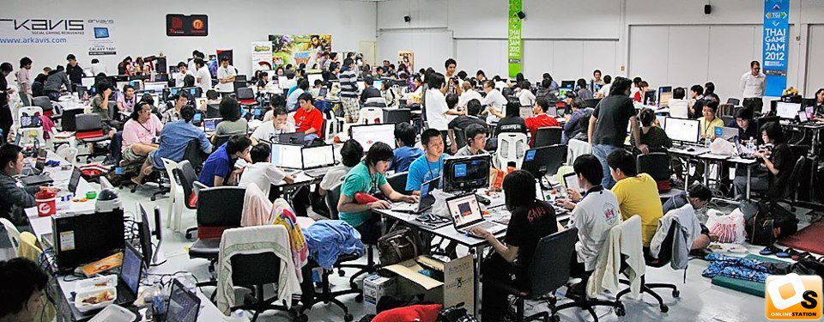
1.1 Fun & challenge
Global Game Jam 2015 มหกรรมการรวมตัวสร้างเกมกว่า 78 ประเทศเข้าร่วมสร้างเกมกว่า 5000 เกม ภายในเวลา 48 ชั่วโมง!

Slide 9
1.2 Core of multimedia technology
Graphics
Animation
Real-time Interaction
Sound
Movie
Other areas, e.g., Script writing, psychology, etc.

Slide 10
1.2 Core of multimedia technology (Cont.)
Case study
https://madewith.unity.com/stories/candle-the-adventure-of-creating-an-adventure
https://blogs.unity3d.com/2015/06/22/making-of-the-blacksmith-animation-camera-effects-audiovideo/
https://www.platinumgames.com/official-blog/games/nier-automata/

Slide 11

1.3 Can be your future careers

Slide 12
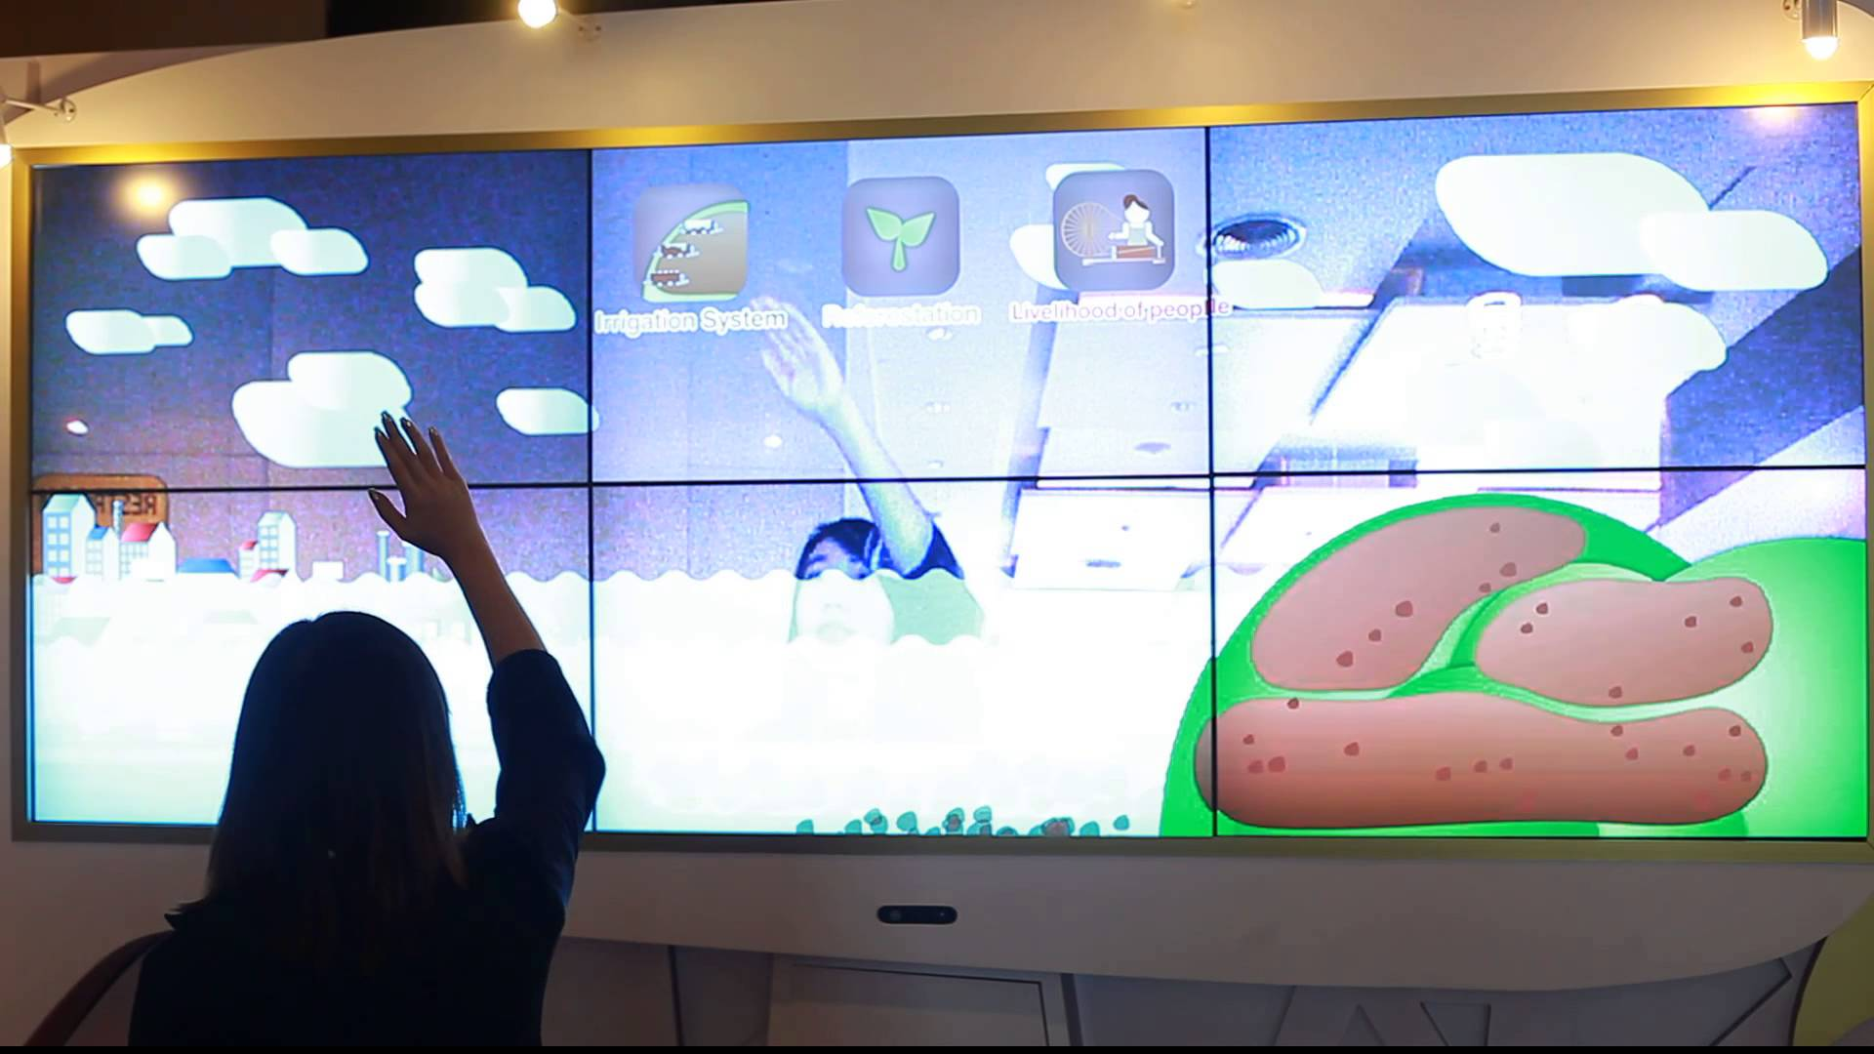

1.3 Can be your future careers
Advertising: Interactive wall
Real estate: interior walk-in

Slide 13
2. Definitions of Games

Slide 14
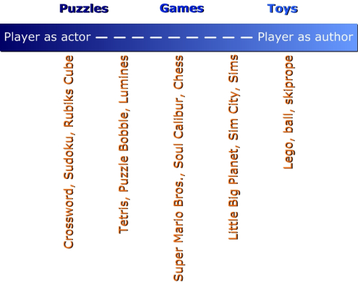
2.1 Puzzles, Games, Toys
Game designer Tj'ièn elaborates:
Puzzles
Only one answer.
Is confined to finding the answer to the puzzle like a riddle.
Examples, jigsaw, Sudoku, Rubik's cube, Tower of Hanoi.
Toys
Is completely free in the way the player handles them.
No hard rules that tell the player what to do or how to do it.
The player creates its own experience.
Games
The middle between toys and puzzles.
Allow for more freedom than puzzles and are more confined than toys.
Games are puzzle-toys

Slide 15
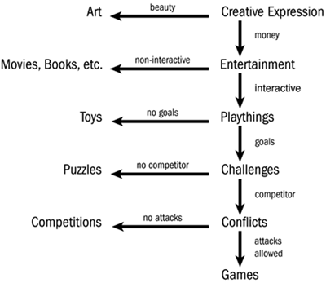
2.1 Puzzles, Games, Toys
Definition of game (by Chris Crawford)

Slide 16
2.1 Puzzles, Games, Toys
Paul Z definition (Determine by ending condition)
Toy: give up
Puzzle: win OR give up
Game: win OR lose OR give up before completion

Slide 17
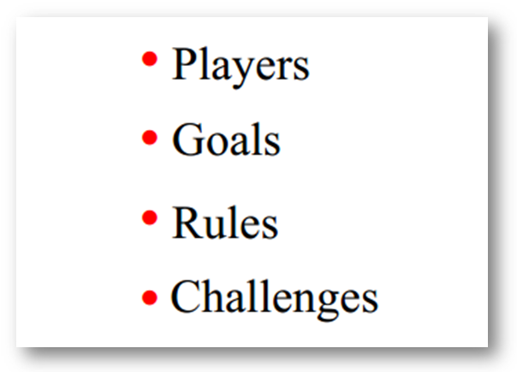
2.1 Definitions of Games
Adams: Fundamentals of Game Design A game is a form of interactive entertainment where players must overcome challenges, by taking actions that are governed by rules, in order to meet a victory condition.
Salen & Zimmerman: Rules of Play A game is a system in which players engage in artificial conflict, defined by rules, that results in a quantifiable outcome.

Slide 18
Game elements
Players
How do human affect the game ?
Goals
What is the player trying to do ?
Rules
How can the player achieve the goal ? (GamePlay)
Challenges
What obstacles block the goal ?

Slide 19
3. Is this a Game?

Slide 20
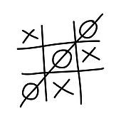
3. Is this a Game?
OX game

Slide 21
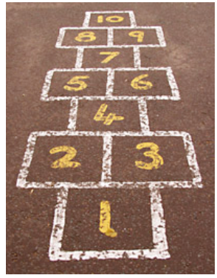
3. Is this a Game?
Hopscotch

Slide 22
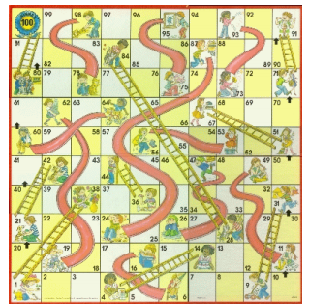
3. Is this a Game?
Snakes and ladders

Slide 23
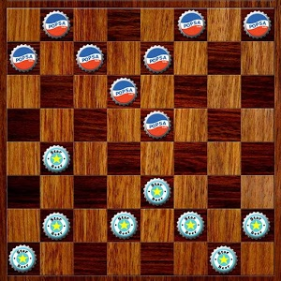
3. Is this a Game?
Checkers

Slide 24
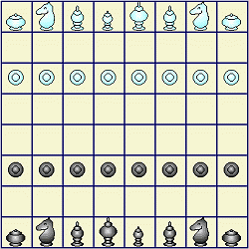
3. Is this a Game?
Thai chess

Slide 25
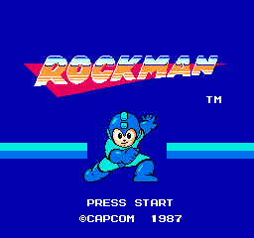
3. Is this a Game?
Rockman
https://www.youtube.com/watch?v=njXrYd0ehNU

Slide 26
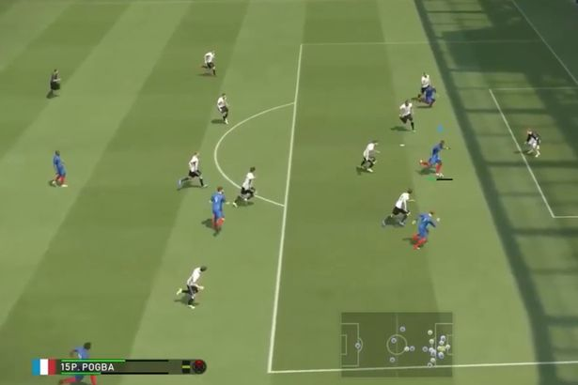
3. Is this a Game?
PES 2017

Slide 27
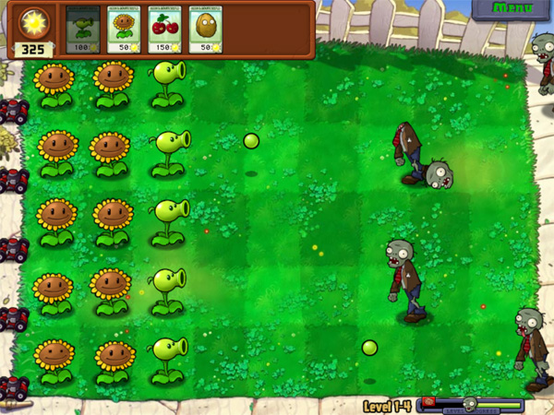
3. Is this a Game?
Plants VS Zombies

Slide 28
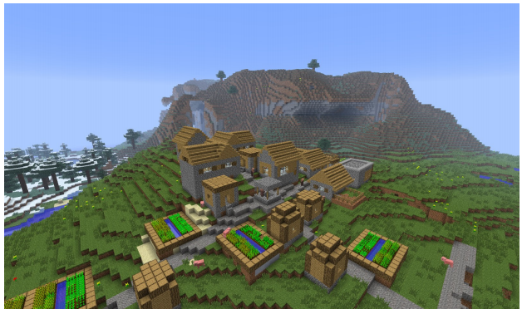
3. What is a Game?
Minecraft

Slide 29
4. Conclusion
Why learn game development?
Definitions of games
Is this a game?

Slide 30
Homework I
Write the game elements’ report of your one favorite game.
1 page A4
Submit as an electronic file (No print as a hard copy)
Due date 1 week
Some free web-based game
http://www.kongregate.com/

