Slide 1
Modern Related Technology on Mobile Devices Lec 8: Thread I
Ekarat Rattagan, PhD

Slide 2
Outline
Process & Thread
Notes:
Planing
File
Compress
En/Decrypt
2. Constraint layout
3. App Mix between 1 & 2.

Slide 3
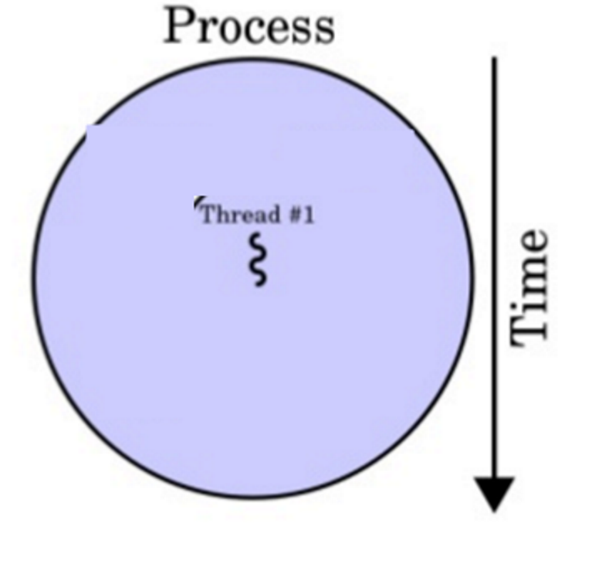
Process & Thread
When an application component, <activity>, <service>, <receiver>, and <provider>, starts and the application does not have any other components running, the Android system starts a new Linux process for the application with a single thread of execution.
By default, all components of the same application run in the same process and thread (called the "main" thread).
Notes:
Planing
File
Compress
En/Decrypt
2. Constraint layout
3. App Mix between 1 & 2.

Slide 4
Threads
The main thread is very important because it is in charge of dispatching events to the appropriate user interface widgets, including drawing events.
It is also the thread in which your application interacts with components from the Android UI toolkit. As such, the main thread is also sometimes called the “UI thread.”
Notes:
Planing
File
Compress
En/Decrypt
2. Constraint layout
3. App Mix between 1 & 2.

Slide 5
Threads
The system does not create a separate thread for each instance of a component.
All components that run in the same process are instantiated in the UI thread, and system calls to each component are dispatched from that thread.
Consequently, methods that respond to system callbacks (such as onKeyDown() to report user actions or a lifecycle callback method) always run in the UI thread of the process.
Notes:
Planing
File
Compress
En/Decrypt
2. Constraint layout
3. App Mix between 1 & 2.

Slide 6
Threads
When your app performs intensive work in response to user interaction, this single thread model can yield poor performance.
Specifically, if everything is happening in the UI thread, performing long operations such as network access or database queries will block the whole UI. When the thread is blocked, no events can be dispatched, including drawing events.
Even worse, if the UI thread is blocked for about 5 seconds the user is presented with the infamous "application not responding" (ANR) dialog.
Notes:
Planing
File
Compress
En/Decrypt
2. Constraint layout
3. App Mix between 1 & 2.

Slide 7
Threads
Additionally, the Android UI toolkit is not thread-safe. So, you must not manipulate your UI from a worker thread—you must do all manipulation to your user interface from the UI thread. Thus, there are simply two rules to Android's single thread model:
Do not block the UI thread
Do not access the Android UI toolkit from outside the UI thread
Notes:
Planing
File
Compress
En/Decrypt
2. Constraint layout
3. App Mix between 1 & 2.

Slide 8
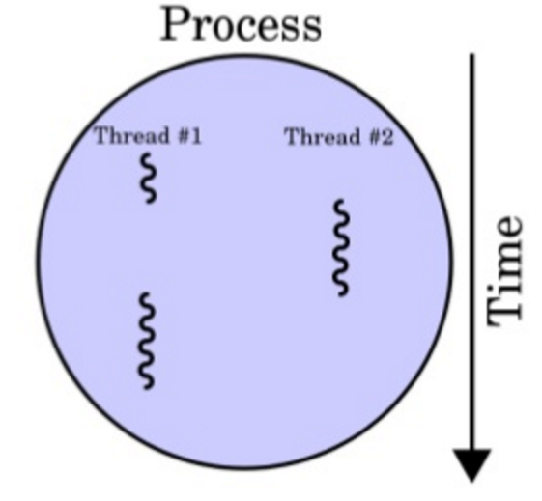
Worker threads
Because of the single threaded model described above, it's vital to the responsiveness of your application's UI that you do not block the UI thread. If you have operations to perform that are not instantaneous, you should make sure to do them in separate threads ("background" or "worker" threads).
Notes:
Planing
File
Compress
En/Decrypt
2. Constraint layout
3. App Mix between 1 & 2.

Slide 9
Worker threads
To fix this problem, Android offers several ways to access the UI thread from other threads. Here is a list of methods that can help:
Activity.runOnUiThread (Runnable)
View.post (Runnable)
View.postDelayed (Runnable, long)
Example:
public void onClick(View v) { new Thread(new Runnable() { public void run() { // a potentially time consuming task final Bitmap bitmap = processBitMap("image.png"); mImageView.post(new Runnable() { public void run() { mImageView.setImageBitmap(bitmap); } }); } }).start();
Notes:
Planing
File
Compress
En/Decrypt
2. Constraint layout
3. App Mix between 1 & 2.

Slide 10
AsyncTask
AsyncTask enables proper and easy use of the UI thread.
This class allows you to perform background operations and publish results on the UI thread without having to manipulate threads and/or handlers.
Notes:
Planing
File
Compress
En/Decrypt
2. Constraint layout
3. App Mix between 1 & 2.

Slide 11
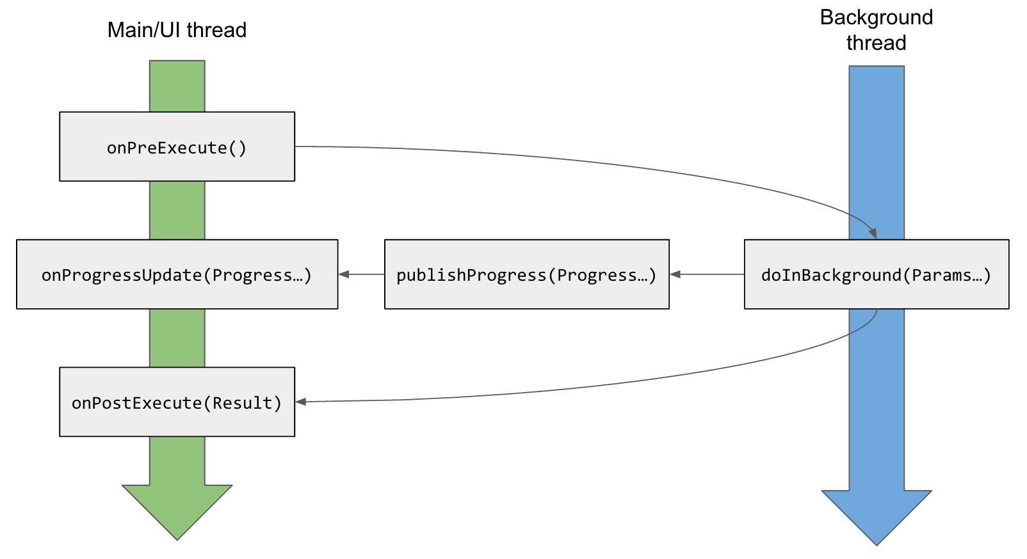
AsyncTask
An asynchronous task is defined by 3 generic types, called
Params
Progress
Result
And 4 steps, called
onPreExecute,
doInBackground,
onProgressUpdate
onPostExecute.
Notes:
Planing
File
Compress
En/Decrypt
2. Constraint layout
3. App Mix between 1 & 2.

Slide 12
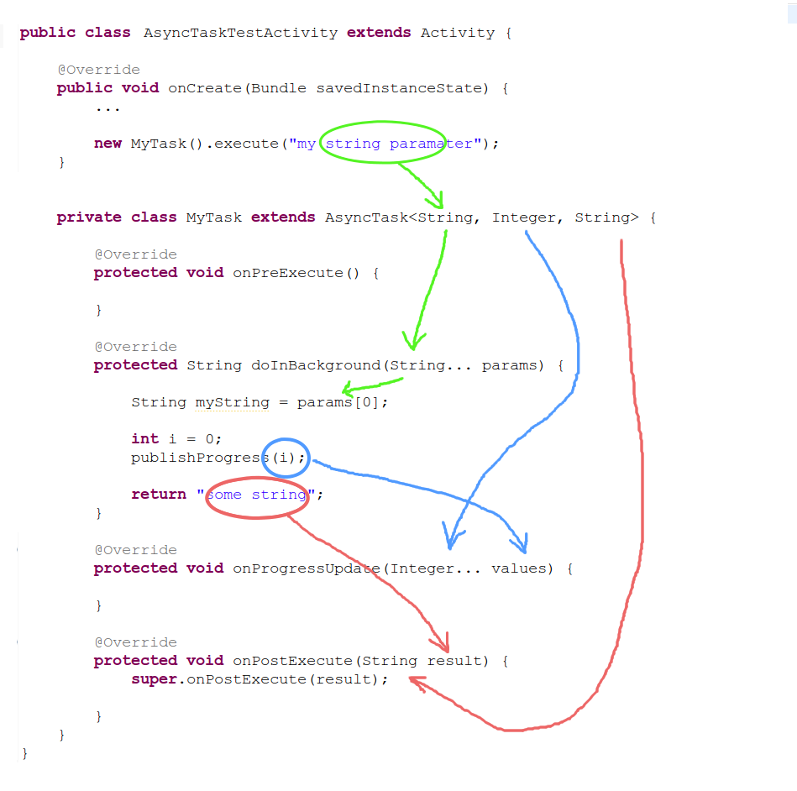
AsyncTask
Notes:
Planing
File
Compress
En/Decrypt
2. Constraint layout
3. App Mix between 1 & 2.

Slide 13
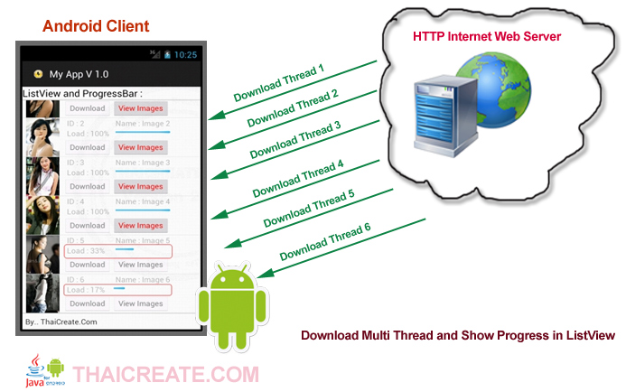
Thread application
http://resource.thaicreate.com/upload/tutorial/android-progressbar-listview-download-file-00.jpg?v=1001
Notes:
Executor
ThreadPoolExecutor
FutureTask

