Slide 1
Mobile App Development Lec1: Introduction
Ekarat Rattagan, PhD

Slide 2
Outline
1 Introduction and application fundamental
2 Layout and GUI widget I
3 Layout and GUI widget II
4 Activity
5 Intents + Preference
6 Saving data & files
Saving database
Midterm
8 Concurrent I
9 Concurrent II
10 Multimedia I
11 Multimedia II
12 Networking I
13 Networking II
14 Jason
Case study
Final
Project

Slide 3
Outline
กลางภาค 30%
ปลายภาค 30%
Project 30%
เข้าเรียน 10%
Quiz (option) 10%

Slide 4
Biography
Name: Ekarat Rattagan (เอกรัฐ รัฐกาญจน์)
Education: Ph.D. (Electrical Engineering and Computer Science), NCTU, Taiwan.
Research:
Mobile system and app technology
Video game technology
Published:
“Calibrating Parameters and Formulas for Process-level Energy Consumption Profiling in Smartphones”, Journal of Network and Computer Application, 2014.
“Semi-online Power Estimation For Smartphone Hardware Components”, IEEE International Symposium on Industrial Embedded System(SIES), Siegen, Germany, June 8-10, 2015.
“Symbolic Regression and Clustering for Power Consumption Estimation on Smartphone Hardware Subsystem”, Taiwan patent, 2015.
“Wi-Fi Usage Monitoring and Power Management Policy for Smartphone Background Applications”, Management and Innovation Technology International Conference (MITicon), Bang-Saen, Thailand, 12-14 October 2016.
Tel: 094-450-4027
Line id: ajpok
E-mail: pokekarat@gmail.com

Slide 5
Biography (Cont.)
More channels
Linkedin: https://th.linkedin.com/in/ekarat-rattagan-478210100
ResearchGate: https://www.researchgate.net/profile/Ekarat_Rattagan
Dblp: http://dblp.uni-trier.de/pers/hd/r/Rattagan:Ekarat

Slide 6
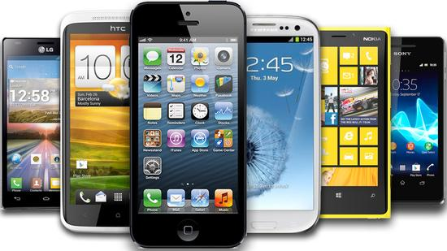
Smartphones

Slide 7
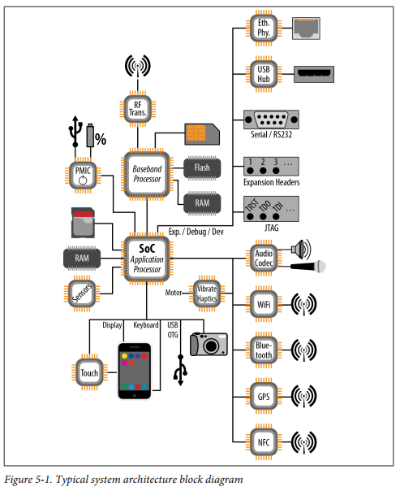
Smartphone HW components
Embedded Android book
Notes:
PMIC: power management integrated circuits
RF Transmitter/Transceiver
Flash memory is an electronic non-volatile computer storage medium (erased and reprogram)
USB OTG: Mobile devices can act as a host http://droidsans.com/usb-otg-with-android
NFC: Near Field Communication, a set of communication protocols that enable two electronic devices, one of which is usually a portable device such as a smartphone, to establish communication by bringing them within 4 cm (2 in) of each other.
JTAG: IEEE 1149.1, on-chip instrumentation
RS232: telecommunication standard
Expansion Headers: http://beagleboard.org/static/images/cape-headers.png

Slide 8
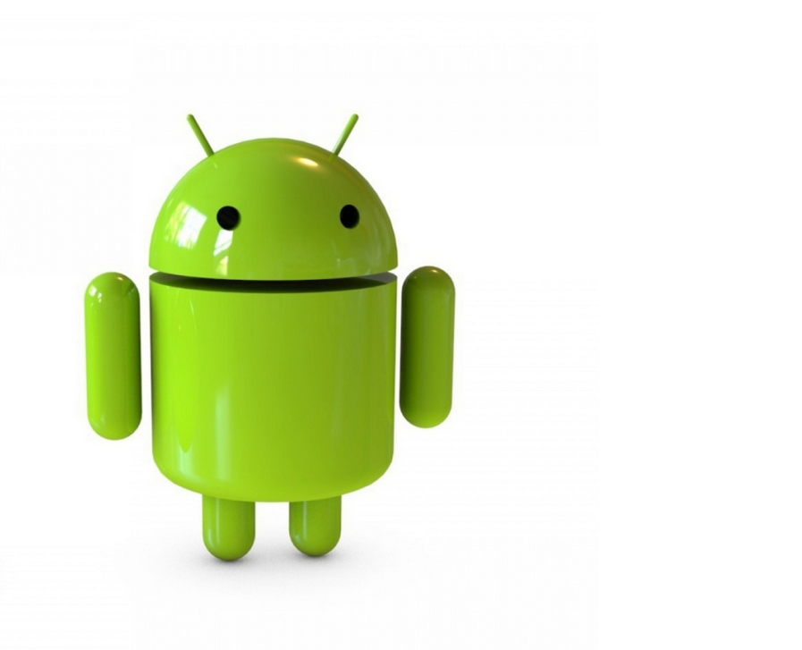

What is Android?
Mobile operating system
Google purchased from Android, Inc. in 2005.
Runs on phones, tablets, watches, TVs
2 million apps published in Play Store (Feb. 2016) [statista].
http://www.thaiware.com/
http://www.mobipicker.com/

Slide 9
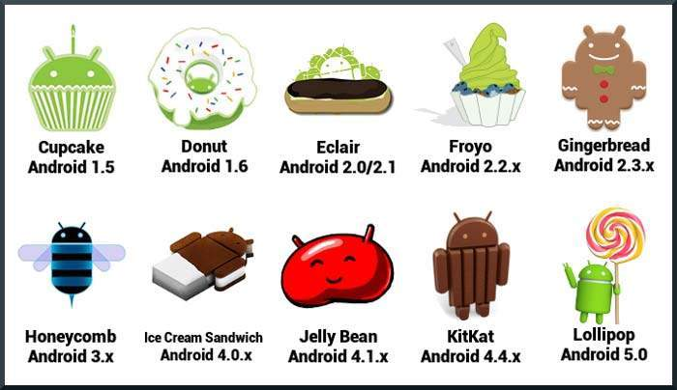
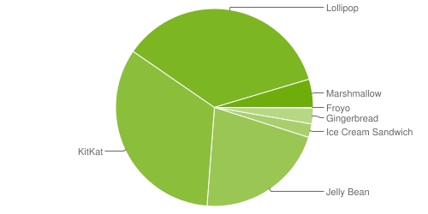
Android version history & distribution
Tutorialspoint.com
April 4, 2016.

Slide 10
Android platform
Based on Java and Linux.
Open source codes
Easier to customize, license, etc.
software stack for mobile devices:
Operating system, middleware & key applications
Use Android SDK to create applications
Libraries & development tools
Lots of documentation
http://developer.android.com/

Slide 11
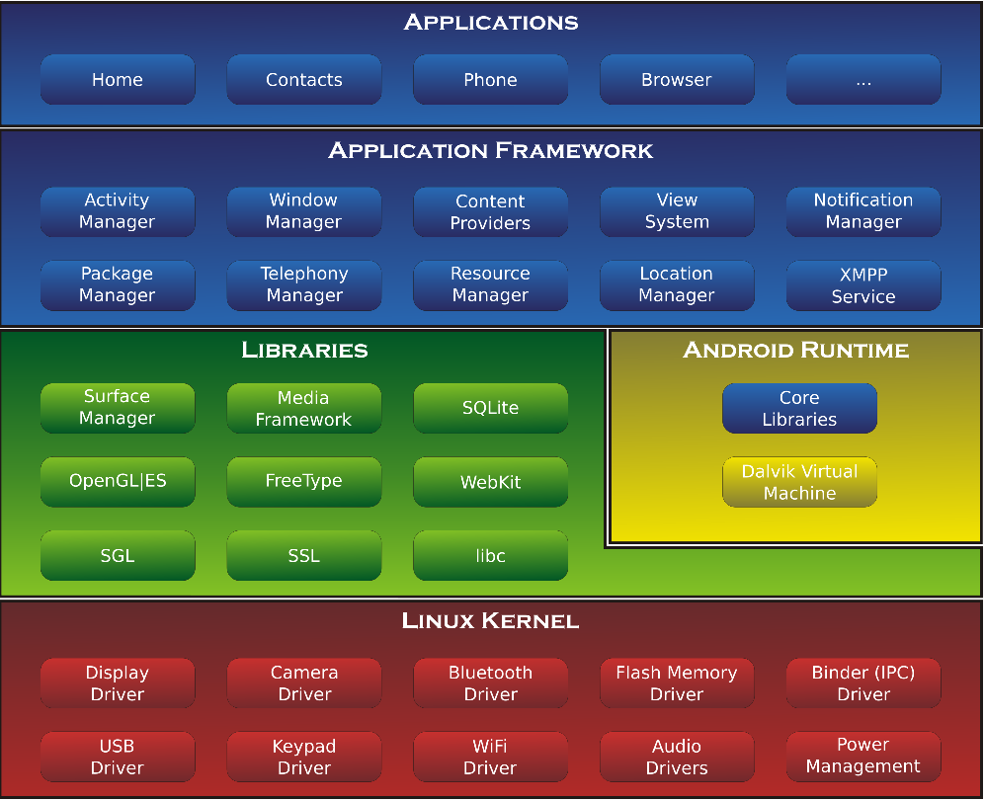
The Android Architecture
More IT, CS
More EE, CE
http://developer.android.com/guide/basics/what--‐is--‐android.html

Slide 12
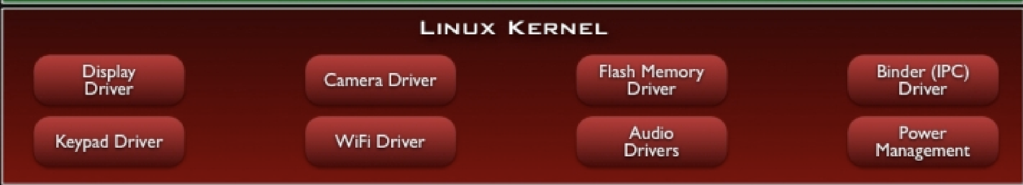
Linux Kernel Layer
Abstraction layer between HW & SW
Memory & process management
Network stack
Device driver model
Notes:
Why linux kernel
• Great memory and process management
• Permissions-based security model
• Proven driver model
• Support for shared libraries
• Itʼs already open source!

Slide 13
Library layer
http://developer.android.com/guide/basics/what--‐is--‐android.html

Slide 14
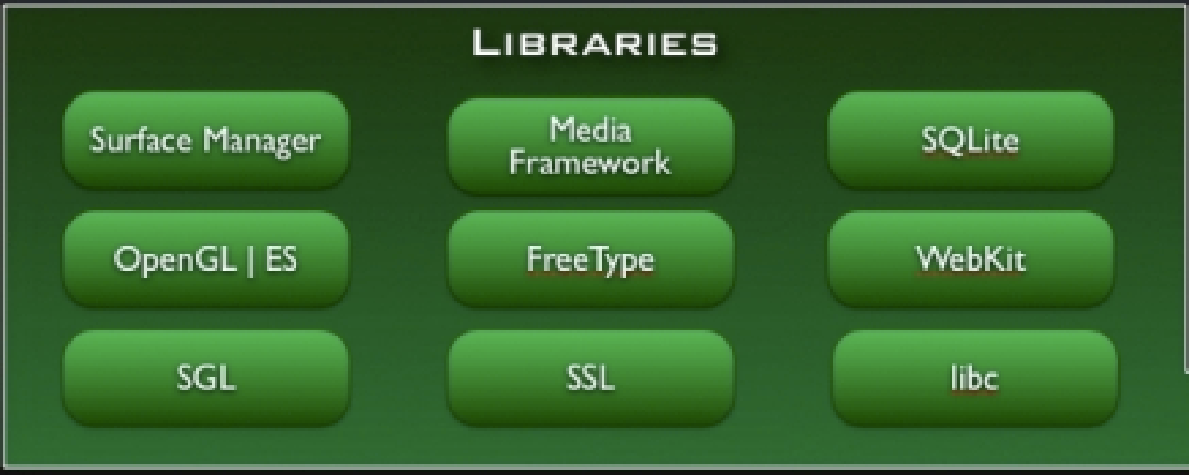
Library layer: Native Libraries
C/C++ libraries
System C library
bionic libc
Surface Manager
Display management
Media Framework
Audio/video
Webkit
Web browser engine
OpenGL ES, SGL
Graphics engines
SQLite
Relational database engine
SSL
Secure Socket Layer
Notes:
Bionic is the standard C library (including libc, libdl, libm, and libpthread) developed by Google for its Android operating system
• License: we want to keep GPL out of user-space
• Size: will load in each process, so it needs to be small
• Fast: limited CPU power means we need to be fast
SSL: a common building block for encrypted communications between clients and servers

Slide 15
Library layer: Android Runtime
http://developer.android.com/guide/basics/what--‐is--‐android.html

Slide 16
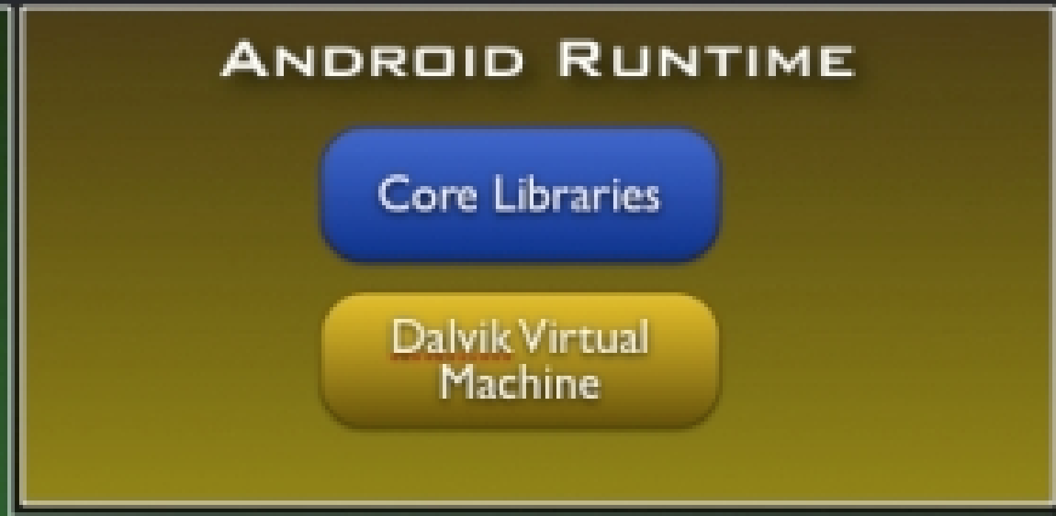
Library layer: Android Runtime
Support services for executing applications
Core libraries
Dalvik Virtual Machine (DVM)

Slide 17
Library layer: Android Runtime - Core Libraries
Core libraries
Doesn’t include all standard Java SDK classes
Android.*
Java.*, javax.*
Junit.*
Org.apache.*, org.json.*, org.xml.*

Slide 18
Library layer: Android Runtime - DVM(1/7)
DVM designed to run on a handheld device
Slow CPU
Little RAM
Limited battery life
Notes:
Android does not offer swap space for memory, but it does use paging and memory-mapping to manage memory.
This means that any memory you modify—whether by allocating new objects or touching mmapped pages—remains resident in RAM and cannot be paged out. So the only way to completely release memory from your app is to release object references you may be holding, making the memory available to the garbage collector. That is with one exception: any files mmapped in without modification, such as code, can be paged out of RAM if the system wants to use that memory elsewhere.

Slide 19
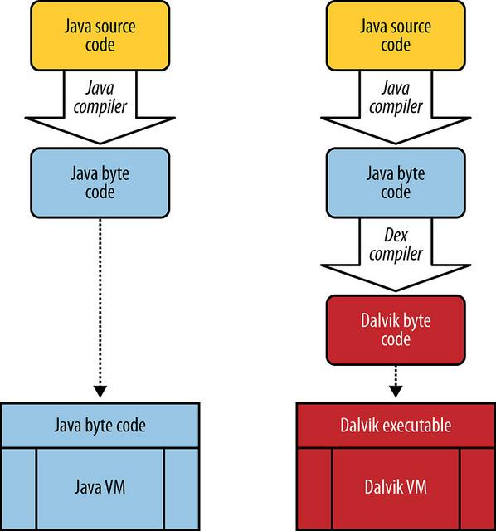
Library layer: Android Runtime - DVM(2/7)
Apps typically wrote in Java
Do not run in a standard Java virtual
machine
dx program transforms java classes
into .dex formatted bytecodes
Bytecodes executed in DVM
Applications typically run in their own
processes, inside their own instance of
the DVM.

Slide 20
Library layer: Android Runtime - DVM(3/7)
Memory
One .dex file for multiple classes
Modified garbage collection to improve memory sharing
CPU
Optimization applied at installation time
Register-based, rather than stack-based
Notes:
https://www.usenix.org/legacy/events/vee05/full_papers/p153-yunhe.pdf
https://markfaction.wordpress.com/2012/07/15/stack-based-vs-register-based-virtual-machine-architecture-and-the-dalvik-vm/

Slide 21
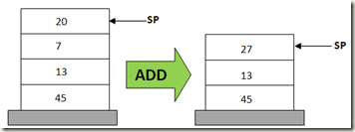
Library layer: Android Runtime - DVM(4/7)
Stack-based
POP 20
POP 7
ADD 20, 7, result
PUSH result
Notes:
A stack based virtual machine implements the general features described as needed by a virtual machine in the points above, but the memory structure where the operands are stored is a stack data structure. Operations are carried out by popping data from the stack, processing them and pushing in back the results in LIFO (Last in First Out) fashion. In a stack based virtual machine, the operation of adding two numbers would usually be carried out in the following manner (where 20, 7, and ‘result’ are the operands):

Slide 22
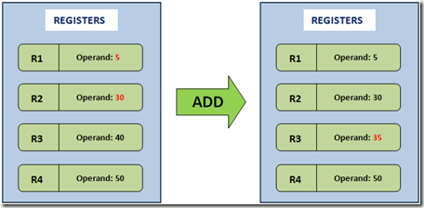
Library layer: Android Runtime - DVM(5/7)
Register-based
ADD R1, R2, R3;
# Add contents of R1 and R2, store result in R3
Notes:
In the register based implementation of a virtual machine, the data structure where the operands are stored is based on the registers of the CPU. There is no PUSH or POP operations here, but the instructions need to contain the addresses (the registers) of the operands. That is, the operands for the instructions are explicitly addressed in the instruction, unlike the stack based model where we had a stack pointer to point to the operand. For example, if an addition operation is to be carried out in a register based virtual machine, the instruction would more or less be as follows:
ADD R1, R2, R3 ; # Add contents of R1 and R2, store result in R3
As I mentioned earlier, there is no POP or PUSH operations, so the instruction for adding is just one line. But unlike the stack, we need to explicitly mention the addresses of the operands as R1, R2, and R3. The advantage here is that the overhead of pushing to and popping from a stack is non-existent, and instructions in a register based VM execute faster within the instruction dispatch loop.

Slide 23
Library layer: Android Runtime - DVM(6/7)
Why register-based
Expected benefits over stack-based VMs
Avoids slow instruction dispatch
Avoids unnecessary memory accesses
More efficient instruction stream

Slide 24
Library layer: Android Runtime - DVM(7/7)
Example
public static long sumArray (int[ ] arr)
{
long sum = 0;
for(int i:arr)
{
sum += i;
}
return sum;
}

Slide 25
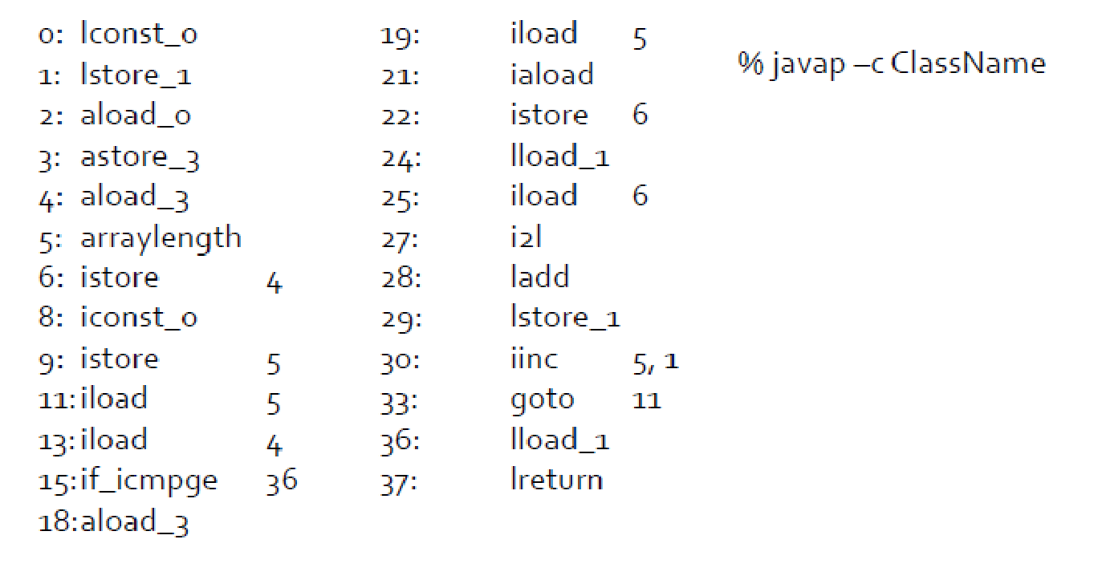
Java Bytecode (Stack-based)

Slide 26
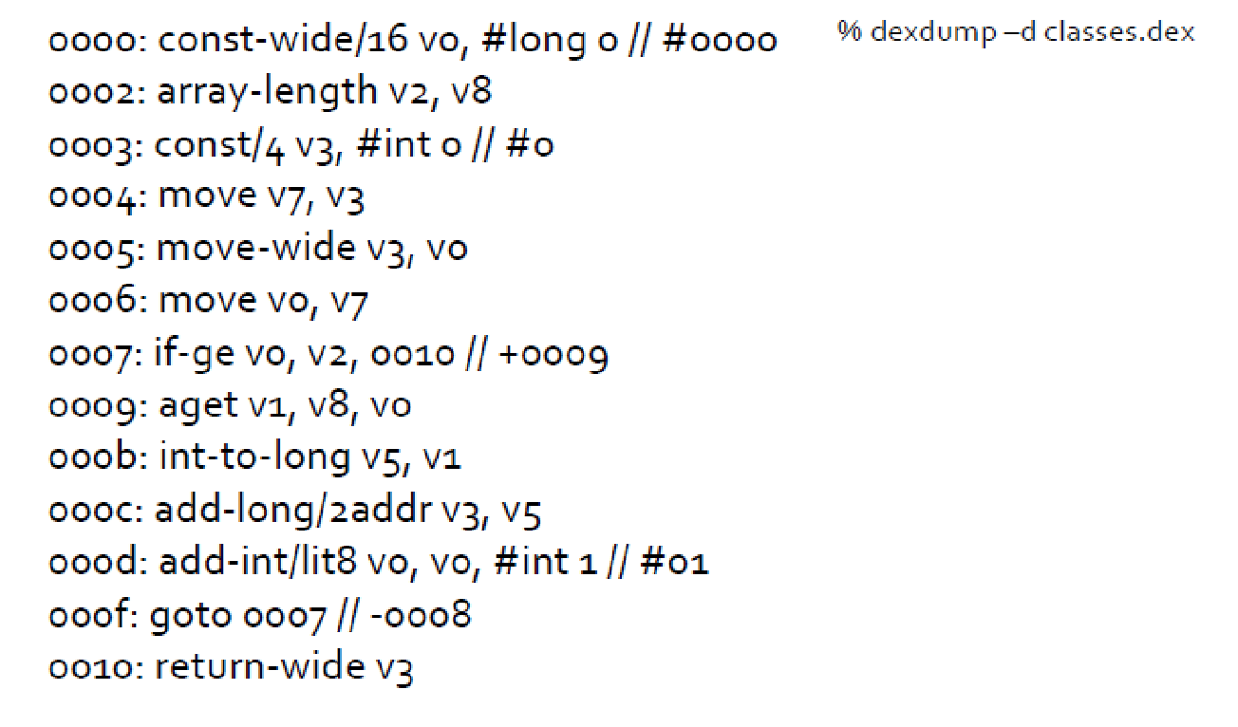
Dex Bytecode (Register-based)

Slide 27
Register-based vs Stack-based VMs
30% fewer instructions
35% fewer code units
35% more bytes in the instruction stream

Slide 28
Application Framework Layer
http://developer.android.com/guide/basics/what--‐is--‐android.html

Slide 29
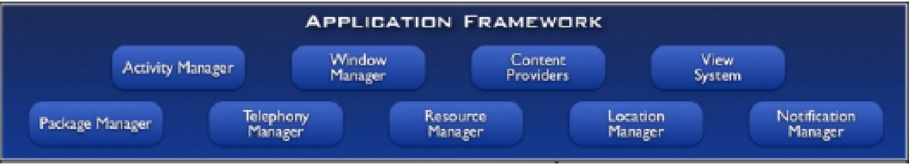
Application Framework Layer
Window Manager
Manages top-level window’s look & behavior
View system
Lists, grids, buttons, etc.
Content providers
Inter-application data sharing
Activity manager
Application lifecycle

Slide 30
Application Layer
http://developer.android.com/guide/basics/what--‐is--‐android.html

Slide 31
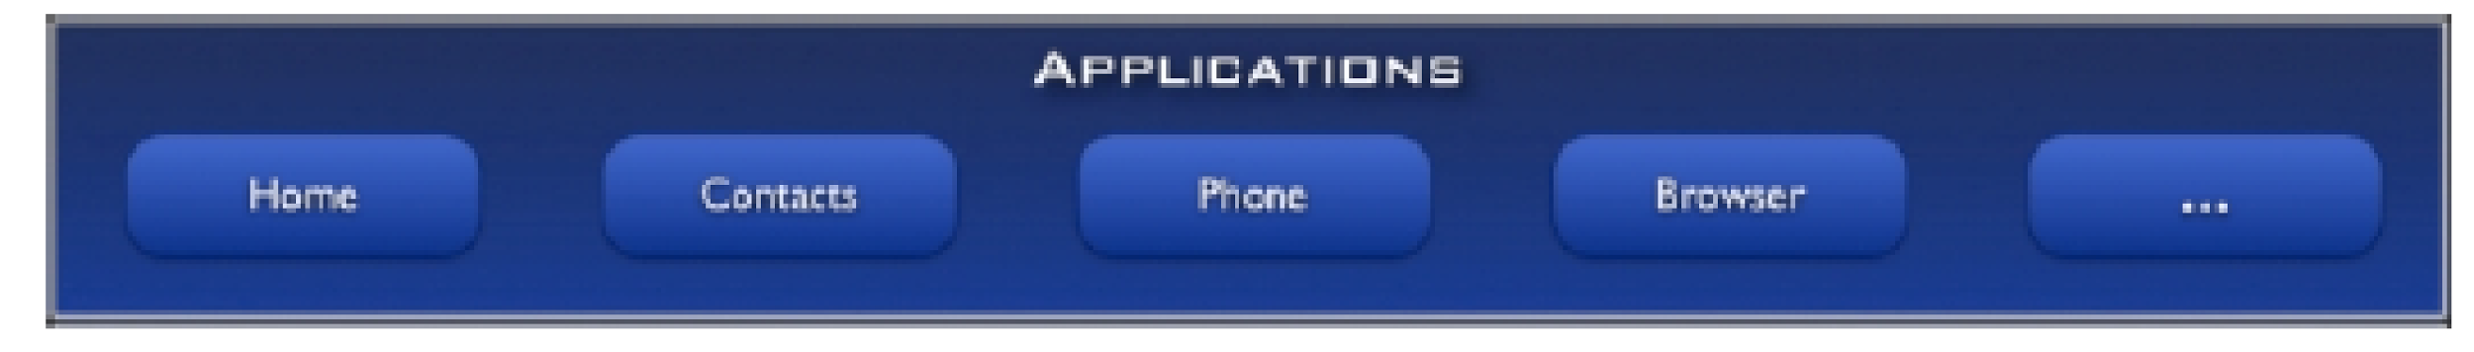
Application Layer
Standard apps
Home – main screen
Contacts - contacts database
Phone-dial phone numbers
Browser-view web pages
Email
Installed apps (Google Play)

Slide 32
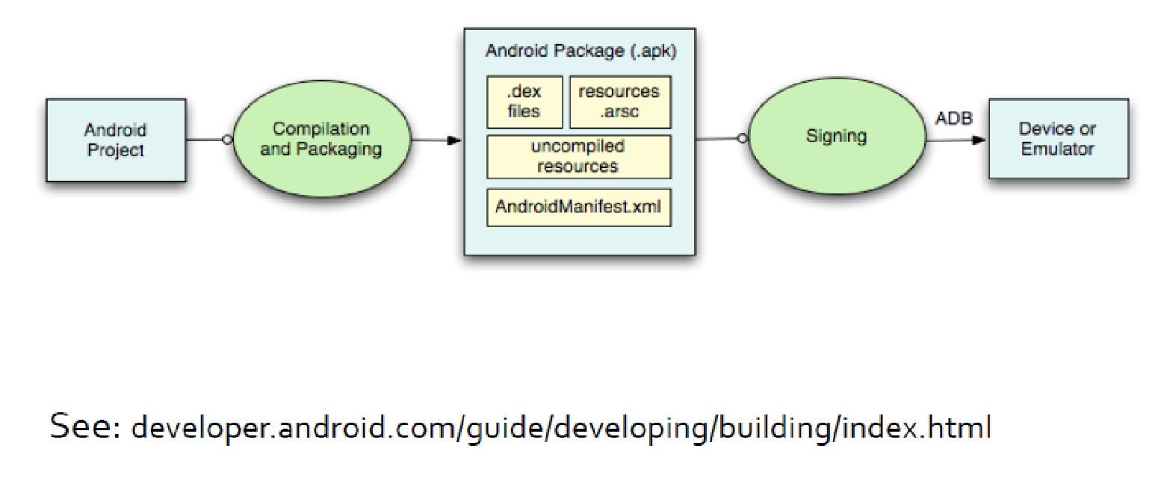
Building an App
Notes:
Decompile APK to show all files inside.
contains all of the resource names, identifiers, and values (for resources that come from separate file, their value is the path to that file in the .apk), in a format that can easily mmapped and parsed on the device at runtime.
Android requires that all apps be digitally signed with a certificate before they can be installed. Android uses this certificate to identify the author of an app, and the certificate does not need to be signed by a certificate authority.
The manifest file presents essential information about your app to the Android system, information the system must have before it can run any of the app's code. Among other things, the manifest does the following:
It names the Java package for the application. The package name serves as a unique identifier for the application.
It describes the components of the application — the activities, services, broadcast receivers, and content providers that the application is composed of. It names the classes that implement each of the components and publishes their capabilities (for example, which Intent messages they can handle). These declarations let the Android system know what the components are and under what conditions they can be launched.
It determines which processes will host application components.
It declares which permissions the application must have in order to access protected parts of the API and interact with other applications.
It also declares the permissions that others are required to have in order to interact with the application's components.
It lists the Instrumentation classes that provide profiling and other information as the application is running. These declarations are present in the manifest only while the application is being developed and tested; they're removed before the application is published.
It declares the minimum level of the Android API that the application requires.
It lists the libraries that the application must be linked against.

Slide 33
Running an App
By default, each app
Assigned a unique Linux user ID
Executes in its own Linux process
By default, each process runs its own DVM
Notes:
Show figure app, dalvik, etc.

Slide 34
Application Components
Main component classes include
Activities
Services
Broadcast receivers
Content providers

Slide 35
1. Activity
Primary class for interacting with users
Usually implements a focused task
E.g., calculator

Slide 36
2. Service
Runs in the background to perform long running or remote operations
Does not have a visual user interface
E.g., Music player

Slide 37
3. Broadcast Receiver
Component that listens for broadcast announcements (events)
Does not have a visual user interface
E.g., Messaging (SMS receipt)

Slide 38
4. Content Providers
Store & retrieve data across apps
Uses database-style interface
E.g., contacts

Slide 39
Conclusion
Smartphone HW & SW
Android architecture
Android app components

