Slide 1
Mobile App Development Lec2: User Interface (UI)
Ekarat Rattagan, PhD

Slide 2
Outline (1/2)
Layouts
Input Controls
Toasts
Input Events

Slide 3
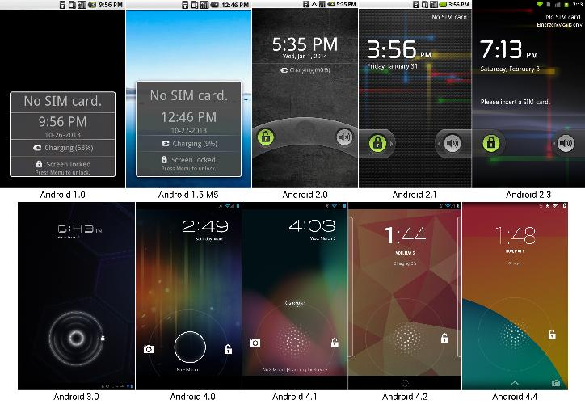
Outline (2/2)

Slide 4
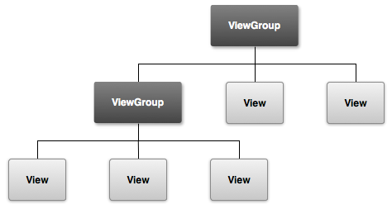
User Interface (UI)
Everything that the user can see and interact with
All UI elements are built using
View and ViewGroup

Slide 5


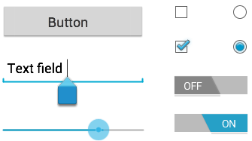
User Interface (UI)
1. Layout models, e.g., a linear or relative layout
2. Input controls, e.g., buttons and text fields

Slide 6
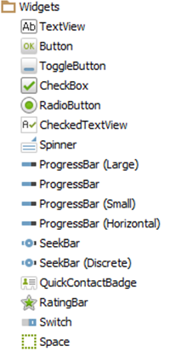
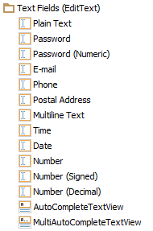
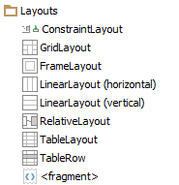
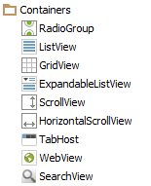
User Interface (UI)
More in Android studio

Slide 7
1. Layout models
Visual structure for a user interface
Two ways of creation
1. Declare UI elements in XML
Using Android's XML vocabulary
2. Instantiate layout elements at runtime
Create View and ViewGroup objects programmatically.

Slide 8
1. Layout models
public void onCreate(Bundle savedInstanceState) { super.onCreate(savedInstanceState); setContentView(R.layout.main_layout); }
Declare UI elements in XML
<?xml version="1.0" encoding="utf-8"?>
<LinearLayout xmlns:android="http://schemas.android.com/apk/res/android"
android:layout_width="match_parent"
android:layout_height="match_parent"
android:orientation="vertical" >
<TextView android:id="@+id/text"
android:layout_width="wrap_content"
android:layout_height="wrap_content"
android:text="Hello, I am a TextView" />
<Button android:id="@+id/button"
android:layout_width="wrap_content"
android:layout_height="wrap_content"
android:text="Hello, I am a Button" />
</LinearLayout>
Notes:
UTF-8 is a character encoding capable of encoding all possible characters 8 bits

Slide 9
1. Layout models
Type of layouts
1.1 Linear
1.2 Relative
1.3 Absolute
1.4 Constraint

Slide 10
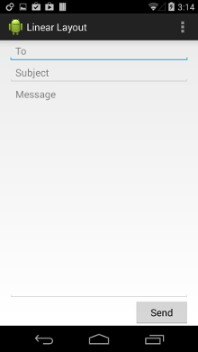
1.1 Linear Layout
A view group that aligns all children in a single direction, vertically or horizontally.
<LinearLayout
xmlns:android="http://schemas.android.com/apk/res/android"
android:layout_width="match_parent"
android:layout_height="match_parent"
android:orientation="vertical" >

Slide 11
1.2 Relative Layout (1/3)
A view group that displays child views in relative positions.
Relative to sibling elements, e.g., left-of or below another view
Relative to the parent

Slide 12
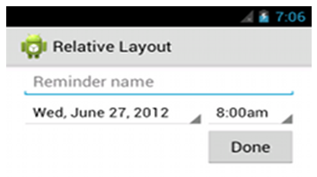
1.2 Relative Layout (2/3)
<RelativeLayout xmlns:android="http://schemas.android.com/apk/
res/android"
android:layout_width="match_parent"
android:layout_height="match_parent"
android:paddingLeft="16dp"
android:paddingRight="16dp" >
<EditText
android:id="@+id/name"
android:layout_width="match_parent"
android:layout_height="wrap_content"
android:hint="@string/reminder" />
<Spinner
android:id="@+id/dates"
android:layout_width="0dp"
android:layout_height="wrap_content"
android:layout_below="@id/name"
android:layout_alignParentLeft="true"
android:layout_toLeftOf="@+id/times" />
<Spinner
android:id="@id/times"
android:layout_width="96dp"
android:layout_height="wrap_content"
android:layout_below="@id/name"
android:layout_alignParentRight="true" />
<Button
android:layout_width="96dp"
android:layout_height="wrap_content"
android:layout_below="@id/times"
android:layout_alignParentRight="true"
android:text="@string/done" />
</RelativeLayout>
android:layout_alignParentTop
If "true", makes the top edge of this view match the top edge of the parent.
android:layout_centerVertical
If "true", centers this child vertically within its parent.
android:layout_below
Positions the top edge of this view below the view specified with a resource ID.
android:layout_toRightOf
Positions the left edge of this view to the right of the view specified with a resource ID.

Slide 13
1.2 Relative Layout (3/3)
A very powerful utility for designing a user interface
Can eliminate nested view groups and keep your layout hierarchy flat
Improves performance.
If several nested LinearLayout groups, replace with a single RelativeLayout.

Slide 14
1.3 Absolute Layout
Enables you to specify the exact location of its children
<AbsoluteLayout
android:layout_width=”fill_parent”
android:layout_height=”fill_parent”
xmlns:android=”http://schemas.android.com/apk/res/android” >
<Button
android:layout_width=”188dp”
android:layout_height=”wrap_content”
android:text=”Button”
android:layout_x=”126px”
android:layout_y=”361px” />
</AbsoluteLayout>
More about dp, https://www.captechconsulting.com/blogs/understanding-density-independence-in-android

Slide 15
2. Input controls
Control Type | Description | Related Classes
2.1 Button | A push-button that can be pressed, or clicked, by the user to perform an action. | Button
2.2 Text field | An editable text field. You can use the AutoCompleteTextView widget to create a text entry widget that provides auto-complete suggestions | EditText, AutoCompleteTextView
2.3 Checkbox | An on/off switch that can be toggled by the user. You should use checkboxes when presenting users with a group of selectable options that are not mutually exclusive. | CheckBox
2.4 Radio button | Similar to checkboxes, except that only one option can be selected in the group. | RadioGroup RadioButton
2.5 Toggle button | An on/off button with a light indicator. | ToggleButton
2.6 Spinner | A drop-down list that allows users to select one value from a set. | Spinner
2.7 Pickers | A dialog for users to select a single value for a set by using up/down buttons or via a swipe gesture. Use a DatePickercode> widget to enter the values for the date (month, day, year) or a TimePicker widget to enter the values for a time (hour, minute, AM/PM), which will be formatted automatically for the user's locale. | DatePicker,TimePicker

Slide 16

2.1 Button
A button consists of text and/or an icon that communicates what action occurs when the user touches it.
With text, using the Button class:
<Button android:layout_width="wrap_content" android:layout_height="wrap_content" android:text="@string/button_text" ... />
With an icon, using the ImageButton class:
<ImageButton android:layout_width="wrap_content" android:layout_height="wrap_content" android:src="@drawable/button_icon" ... />
With text and an icon, using the Button class with the android:drawableLeft attribute:
<Button android:layout_width="wrap_content" android:layout_height="wrap_content" android:text="@string/button_text" android:drawableLeft="@drawable/button_icon" ... />

Slide 17
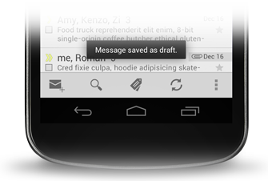
Toast
A simple feedback about an operation in a small popup
Context context = getApplicationContext(); CharSequence text = "Hello toast!"; int duration = Toast.LENGTH_SHORT; Toast toast = Toast.makeText(context, text, duration); toast.show();

Slide 18
2.1 Button (click events)
1. Add XML attribute: android:onClick attribute
<?xml version="1.0" encoding="utf-8"?> <Button xmlns:android="http://schemas.android.com/apk/res/android" android:id="@+id/button_send" android:layout_width="wrap_content" android:layout_height="wrap_content" android:text="@string/button_send" android:onClick="sendMessage" />
/** Called when the user touches the button */ public void sendMessage(View view)
{ // Do something in response to button click }

Slide 19
2.1 Button (click events)
2. Using an OnClickListener
Button button = (Button) findViewById(R.id.button_send); button.setOnClickListener(new View.OnClickListener() { public void onClick(View v) { // Do something in response to button click } });

Slide 20

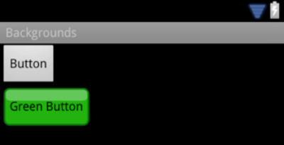
2.1 More Button Styling
Borderless button
Custom background
[Right click] Drawable > New > Drawable resource file
<Button android:id="@+id/button_send" android:layout_width="wrap_content" android:layout_height="wrap_content" android:text="@string/button_send" android:onClick="sendMessage" style="?android:attr/borderlessButtonStyle" />
<Button android:id="@+id/button_send" android:layout_width="wrap_content" android:layout_height="wrap_content" android:text="@string/button_send" android:onClick="sendMessage" android:background="@drawable/button_custom" />
<?xml version="1.0" encoding="utf-8"?> <selector xmlns:android="http://schemas.android.com/apk/res/android"> <item android:drawable="@color/colorAccent" android:state_pressed="true" /> <item android:drawable="@color/colorPrimary" android:state_focused="true" /> <item android:drawable="@color/colorPrimaryDark" /> </selector>
Notes:
https://developer.android.com/guide/topics/graphics/2d-graphics.html#nine-patch
http://www.creativebloq.com/android/user-interface-design-android-apps-11112874
<?xml version="1.0" encoding="utf-8"?>
<selector xmlns:android="http://schemas.android.com/apk/res/android">
<item android:state_pressed="true" android:color="#227EC9" ></item>
<item android:state_selected="true" android:color="#227EC9"></item>
<item android:state_enabled="false" android:color="#ADADAD"></item>
<item android:color="#2E2E2E"/>
</selector>

Slide 21
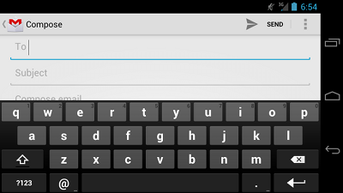
2.2 Text Fields
Allow the user to type text into an app
Single and Multiple line
Touching a text field
Place the cursor
Automatically displays the keyboard
Notes:
https://developer.android.com/guide/topics/graphics/2d-graphics.html#nine-patch
http://www.creativebloq.com/android/user-interface-design-android-apps-11112874
<?xml version="1.0" encoding="utf-8"?> <selector xmlns:android="http://schemas.android.com/apk/res/android"> <item android:state_pressed="true" android:color="#227EC9" ></item> <item android:state_selected="true" android:color="#227EC9"></item> <item android:state_enabled="false" android:color="#ADADAD"></item> <item android:color="#2E2E2E"/> </selector>

Slide 22
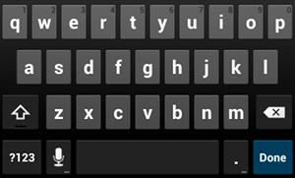
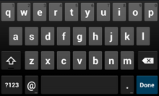
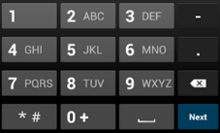
2.2 Text Fields
Keyboard Type
"text"
Normal text keyboard.
"textEmailAddress"
Normal text keyboard with the @ character.
"textUri"
Normal text keyboard with the / character.
"number"
Basic number keypad.
"phone"
Phone-style keypad
<EditText android:id="@+id/email_address" android:layout_width="fill_parent" android:layout_height="wrap_content" android:hint="@string/email_hint" android:inputType="textEmailAddress" />
Figure 1. The default text input type.
Figure 2. The textEmailAddress input type.
Figure 3. The phone input type.
Notes:
https://developer.android.com/guide/topics/graphics/2d-graphics.html#nine-patch
http://www.creativebloq.com/android/user-interface-design-android-apps-11112874
<?xml version="1.0" encoding="utf-8"?> <selector xmlns:android="http://schemas.android.com/apk/res/android"> <item android:state_pressed="true" android:color="#227EC9" ></item> <item android:state_selected="true" android:color="#227EC9"></item> <item android:state_enabled="false" android:color="#ADADAD"></item> <item android:color="#2E2E2E"/> </selector>

Slide 23
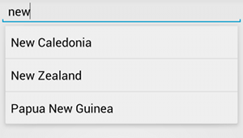
2.2 Text Fields
Auto-complete suggestions
<?xml version="1.0" encoding="utf-8"?> <AutoCompleteTextView xmlns:android=
"http://schemas.android.com/apk/res/android" android:id="@+id/autocomplete_country" android:layout_width="fill_parent" android:layout_height="wrap_content" />
<?xml version="1.0" encoding="utf-8"?> <resources> <string-array name="countries_array"> <item>Afghanistan</item> <item>Albania</item> <item>Algeria</item> <item>American Samoa</item> <item>Andorra</item> <item>Angola</item> <item>Anguilla</item> <item>Antarctica</item> ... </string-array> </resources>
// Get a reference to the AutoCompleteTextView in the layout AutoCompleteTextView textView = (AutoCompleteTextView) findViewById(R.id.autocomplete_country); // Get the string array String[] countries = getResources().getStringArray(R.array.countries_array); // Create the adapter and set it to the AutoCompleteTextView ArrayAdapter<String> adapter = new ArrayAdapter<String>(this, android.R.layout.simple_list_item_1, countries); textView.setAdapter(adapter);
Notes:
https://developer.android.com/guide/topics/graphics/2d-graphics.html#nine-patch
http://www.creativebloq.com/android/user-interface-design-android-apps-11112874
<?xml version="1.0" encoding="utf-8"?> <selector xmlns:android="http://schemas.android.com/apk/res/android"> <item android:state_pressed="true" android:color="#227EC9" ></item> <item android:state_selected="true" android:color="#227EC9"></item> <item android:state_enabled="false" android:color="#ADADAD"></item> <item android:color="#2E2E2E"/> </selector>

Slide 24
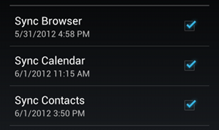
2.3 Checkboxes
Allow the user to select one or more options from a set
Present in a vertical list
<?xml version="1.0" encoding="utf-8"?> <LinearLayout xmlns:android="http://schemas.android.com/apk/res/android" android:orientation="vertical" android:layout_width="fill_parent" android:layout_height="fill_parent"> <CheckBox android:id="@+id/checkbox_meat" android:layout_width="wrap_content" android:layout_height="wrap_content" android:text="@string/meat" android:onClick="onCheckboxClicked"/> <CheckBox android:id="@+id/checkbox_cheese" android:layout_width="wrap_content" android:layout_height="wrap_content" android:text="@string/cheese" android:onClick="onCheckboxClicked"/> </LinearLayout>
Notes:
https://developer.android.com/guide/topics/graphics/2d-graphics.html#nine-patch
http://www.creativebloq.com/android/user-interface-design-android-apps-11112874
<?xml version="1.0" encoding="utf-8"?> <selector xmlns:android="http://schemas.android.com/apk/res/android"> <item android:state_pressed="true" android:color="#227EC9" ></item> <item android:state_selected="true" android:color="#227EC9"></item> <item android:state_enabled="false" android:color="#ADADAD"></item> <item android:color="#2E2E2E"/> </selector>

Slide 25
2.3 Checkboxes
Source code example
public void onCheckboxClicked(View view) { // Is the view now checked? boolean checked = ((CheckBox) view).isChecked(); // Check which checkbox was clicked switch(view.getId()) { case R.id.checkbox_meat: if (checked) // Put some meat on the sandwich else // Remove the meat break; case R.id.checkbox_cheese: if (checked) // Cheese me else // I'm lactose intolerant break; // TODO: Veggie sandwich } }
Notes:
https://developer.android.com/guide/topics/graphics/2d-graphics.html#nine-patch
http://www.creativebloq.com/android/user-interface-design-android-apps-11112874
<?xml version="1.0" encoding="utf-8"?> <selector xmlns:android="http://schemas.android.com/apk/res/android"> <item android:state_pressed="true" android:color="#227EC9" ></item> <item android:state_selected="true" android:color="#227EC9"></item> <item android:state_enabled="false" android:color="#ADADAD"></item> <item android:color="#2E2E2E"/> </selector>

Slide 26

2.4 Radio Buttons
Allow the user to select one option from a set.
Mutually exclusive
<?xml version="1.0" encoding="utf-8"?> <RadioGroup xmlns:android="http://schemas.android.com/apk/res/android" android:layout_width="fill_parent" android:layout_height="wrap_content" android:orientation="vertical"> <RadioButton android:id="@+id/radio_pirates" android:layout_width="wrap_content" android:layout_height="wrap_content" android:text="@string/pirates" android:onClick="onRadioButtonClicked"/> <RadioButton android:id="@+id/radio_ninjas" android:layout_width="wrap_content" android:layout_height="wrap_content" android:text="@string/ninjas" android:onClick="onRadioButtonClicked"/> </RadioGroup>
Notes:
https://developer.android.com/guide/topics/graphics/2d-graphics.html#nine-patch
http://www.creativebloq.com/android/user-interface-design-android-apps-11112874
<?xml version="1.0" encoding="utf-8"?> <selector xmlns:android="http://schemas.android.com/apk/res/android"> <item android:state_pressed="true" android:color="#227EC9" ></item> <item android:state_selected="true" android:color="#227EC9"></item> <item android:state_enabled="false" android:color="#ADADAD"></item> <item android:color="#2E2E2E"/> </selector>

Slide 27
2.4 Radio Buttons
Source code example
public void onRadioButtonClicked(View view) { // Is the button now checked? boolean checked = ((RadioButton) view).isChecked(); // Check which radio button was clicked switch(view.getId()) { case R.id.radio_pirates: if (checked) // Pirates are the best break; case R.id.radio_ninjas: if (checked) // Ninjas rule break; } }
Notes:
https://developer.android.com/guide/topics/graphics/2d-graphics.html#nine-patch
http://www.creativebloq.com/android/user-interface-design-android-apps-11112874
<?xml version="1.0" encoding="utf-8"?> <selector xmlns:android="http://schemas.android.com/apk/res/android"> <item android:state_pressed="true" android:color="#227EC9" ></item> <item android:state_selected="true" android:color="#227EC9"></item> <item android:state_enabled="false" android:color="#ADADAD"></item> <item android:color="#2E2E2E"/> </selector>

Slide 28

2.5 Toggle Buttons
Allows the user to change a setting between two states
Android 4.0+
ToggleButton toggle = (ToggleButton) findViewById(R.id.togglebutton); toggle.setOnCheckedChangeListener(new CompoundButton.OnCheckedChangeListener() { public void onCheckedChanged(CompoundButton buttonView, boolean isChecked) { if (isChecked) { // The toggle is enabled } else { // The toggle is disabled } } });
Notes:
https://developer.android.com/guide/topics/graphics/2d-graphics.html#nine-patch
http://www.creativebloq.com/android/user-interface-design-android-apps-11112874
<?xml version="1.0" encoding="utf-8"?> <selector xmlns:android="http://schemas.android.com/apk/res/android"> <item android:state_pressed="true" android:color="#227EC9" ></item> <item android:state_selected="true" android:color="#227EC9"></item> <item android:state_enabled="false" android:color="#ADADAD"></item> <item android:color="#2E2E2E"/> </selector>

Slide 29
2.6 Spinners
Provide a quick way to select one value from a set
Displays a dropdown menu
<?xml version="1.0" encoding="utf-8"?> <resources> <string-array name="planets_array"> <item>Mercury</item> <item>Venus</item> <item>Earth</item> <item>Mars</item> <item>Jupiter</item> <item>Saturn</item> <item>Uranus</item> <item>Neptune</item> </string-array> </resources>
<Spinner android:id="@+id/planets_spinner" android:layout_width="fill_parent" android:layout_height="wrap_content" />
Notes:
https://developer.android.com/guide/topics/graphics/2d-graphics.html#nine-patch
http://www.creativebloq.com/android/user-interface-design-android-apps-11112874
<?xml version="1.0" encoding="utf-8"?> <selector xmlns:android="http://schemas.android.com/apk/res/android"> <item android:state_pressed="true" android:color="#227EC9" ></item> <item android:state_selected="true" android:color="#227EC9"></item> <item android:state_enabled="false" android:color="#ADADAD"></item> <item android:color="#2E2E2E"/> </selector>

Slide 30
2.6 Spinners
Source code example
Spinner spinner = (Spinner) findViewById(R.id.spinner); ArrayAdapter<CharSequence> adapter = ArrayAdapter.createFromResource(this, R.array.planets_array, android.R.layout.simple_spinner_item); adapter.setDropDownViewResource(android.R.layout.simple_spinner_dropdown_item); spinner.setAdapter(adapter);
public class SpinnerActivity extends Activity implements OnItemSelectedListener { ... public void onItemSelected(AdapterView<?> parent, View view, int pos, long id) { // An item was selected. You can retrieve the selected item using // parent.getItemAtPosition(pos) } public void onNothingSelected(AdapterView<?> parent) { // Another interface callback } }
Notes:
https://developer.android.com/guide/topics/graphics/2d-graphics.html#nine-patch
http://www.creativebloq.com/android/user-interface-design-android-apps-11112874
<?xml version="1.0" encoding="utf-8"?> <selector xmlns:android="http://schemas.android.com/apk/res/android"> <item android:state_pressed="true" android:color="#227EC9" ></item> <item android:state_selected="true" android:color="#227EC9"></item> <item android:state_enabled="false" android:color="#ADADAD"></item> <item android:color="#2E2E2E"/> </selector>

Slide 31
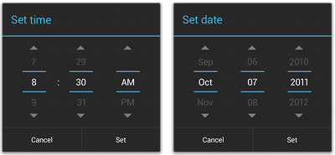
2.7 Pickers
Provides controls for selecting each part of the
Time (hour, minute, AM/PM) or Date (month, day, year)
Ensure that your users can pick a time or date that is valid, formatted correctly, and adjusted to the user's locale
Notes:
https://developer.android.com/guide/topics/graphics/2d-graphics.html#nine-patch
http://www.creativebloq.com/android/user-interface-design-android-apps-11112874
<?xml version="1.0" encoding="utf-8"?> <selector xmlns:android="http://schemas.android.com/apk/res/android"> <item android:state_pressed="true" android:color="#227EC9" ></item> <item android:state_selected="true" android:color="#227EC9"></item> <item android:state_enabled="false" android:color="#ADADAD"></item> <item android:color="#2E2E2E"/> </selector>

Slide 32
2.7 Pickers
Extending DialogFragment for a time picker
public static class TimePickerFragment extends DialogFragment implements TimePickerDialog.OnTimeSetListener { @Override public Dialog onCreateDialog(Bundle savedInstanceState) { // Use the current time as the default values for the picker final Calendar c = Calendar.getInstance(); int hour = c.get(Calendar.HOUR_OF_DAY); int minute = c.get(Calendar.MINUTE); // Create a new instance of TimePickerDialog and return it return new TimePickerDialog(getActivity(), this, hour, minute, DateFormat.is24HourFormat(getActivity())); } public void onTimeSet(TimePicker view, int hourOfDay, int minute) { // Do something with the time chosen by the user } }
public void showTimePickerDialog(View v) { DialogFragment newFragment = new TimePickerFragment(); newFragment.show(getSupportFragmentManager(), "timePicker"); }
Notes:
https://developer.android.com/guide/topics/graphics/2d-graphics.html#nine-patch
http://www.creativebloq.com/android/user-interface-design-android-apps-11112874
<?xml version="1.0" encoding="utf-8"?> <selector xmlns:android="http://schemas.android.com/apk/res/android"> <item android:state_pressed="true" android:color="#227EC9" ></item> <item android:state_selected="true" android:color="#227EC9"></item> <item android:state_enabled="false" android:color="#ADADAD"></item> <item android:color="#2E2E2E"/> </selector>

Slide 33
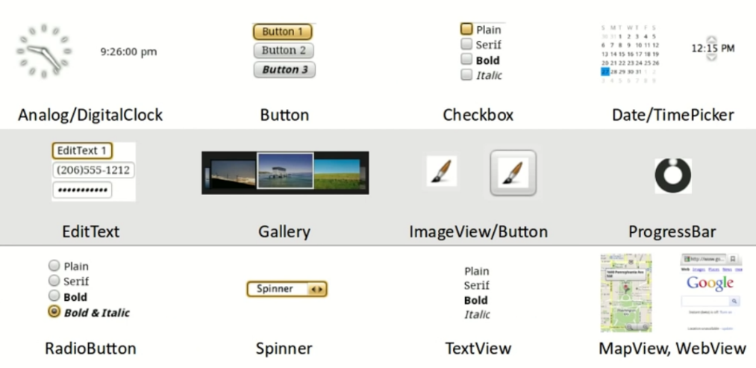
Android widgets
CS 193A, Stanford University

Slide 34


Input Events
Many views, so use Event Listener
An interface in the View class that contains a single callback method.
Android framework call the registered view when it is triggered.
onTouchEvent()

Slide 35
Input Events
Many views, so use Event Listener
An interface in the View class that contains a single callback method.
Android framework call the registered view when it is triggered.
Callback methods
onClick()
onLongClick()
Hold down for one second
onFocusChange()
onKey()
onTouch()

Slide 36
Input Events
Registered example
1st option 2nd option
// Create an anonymous implementation of OnClickListener private OnClickListener mCorkyListener = new OnClickListener() { public void onClick(View v) { // do something when the button is clicked } }; protected void onCreate(Bundle savedValues) { ... // Capture our button from layout Button button = (Button)findViewById(R.id.corky); // Register the onClick listener with the implementation above button.setOnClickListener(mCorkyListener); ... }
public class ExampleActivity extends Activity implements
OnClickListener { protected void onCreate(Bundle savedValues) { ... Button button = (Button)findViewById(R.id.corky); button.setOnClickListener(this); } // Implement the OnClickListener callback public void onClick(View v) { // do something when the button is clicked } ... }

Slide 37
Conclusion
What you have learned
Layout
UI elements
Input events
Toasts

Slide 38
Resource
http://unitid.nl/androidpatterns/uap_category/getting-input
https://developer.android.com/guide/topics/ui/overview.html
Library
https://github.com/codepath/android_guides/wiki/Must-Have-Libraries
https://github.com/square/leakcanary
https://github.com/code-troopers/android-betterpickers
https://github.com/wasabeef/awesome-android-ui
https://infinum.co/the-capsized-eight/articles/top-5-android-libraries-every-android-developer-should-know-about
http://blog.teamtreehouse.com/android-libraries-use-every-project
https://github.com/ddanny/achartengine
Notes:
https://www.youtube.com/watch?v=TkPiXRNee7A

