Slide 1
Mobile App Development Lec 7: Saving data (Database)
Ekarat Rattagan, PhD

Slide 2
Outline
Saving Key-Value Sets
Saving Files
Saving Data in SQL Databases
Notes:
Planing
File
Compress
En/Decrypt
2. Constraint layout
3. App Mix between 1 & 2.

Slide 3
SQL Databases
Ideal for repeating or structured data, such as contact information.
SQLite
A relational DBMS contained in a C programming library.
Embedded into the end program.
Android.database.sqlite
Notes:
Planing
File
Compress
En/Decrypt
2. Constraint layout
3. App Mix between 1 & 2.

Slide 4
DBMS
Schema: a formal declaration of how the DB is organized, such as table, relation, etc.
Table name: Contacts
Field | Type | Key
id | INT | PRIMARY
name | TEXT
phone_number | TEXT
Notes:
Planing
File
Compress
En/Decrypt
2. Constraint layout
3. App Mix between 1 & 2.

Slide 5
Example 1 (Contact DB).
Writing Contact.java Class
public class Contact { public int _id; public String _name; public String _phone_number;
public Contact(){}
public Contact(String name, String _phone_number)
{ this._name = name; this._phone_number = _phone_number; }
public Contact(int id, String name, String _phone_number)
{ this._id = id; this._name = name; this._phone_number = _phone_number; } }
Notes:
Planing
File
Compress
En/Decrypt
2. Constraint layout
3. App Mix between 1 & 2.

Slide 6
Example 1.
Use SQLiteOpenHelper class to handle the DB operations
import android.content.Context; import android.database.sqlite.SQLiteDatabase; import android.database.sqlite.SQLiteOpenHelper; import android.provider.ContactsContract; public class DatabaseHandler extends SQLiteOpenHelper { private static final String DATABASE_NAME = "contactsManager"; private static final int DATABASE_VERSION = 1; private static final String TABLE_CONTACTS = "contacts"; // Contacts Table Columns names private static final String KEY_ID = "id"; private static final String KEY_NAME = "name"; private static final String KEY_PH_NO = "phone_number"; public DatabaseHandler(Context context){ super(context,DATABASE_NAME, null, DATABASE_VERSION); }
Notes:
Planing
File
Compress
En/Decrypt
2. Constraint layout
3. App Mix between 1 & 2.

Slide 7
Example 1.
Use SQLiteOpenHelper class to handle the DB operations
// Creating Tables @Override public void onCreate(SQLiteDatabase db) { String CREATE_CONTACTS_TABLE = "CREATE TABLE " + TABLE_CONTACTS + "(" + KEY_ID + " INTEGER PRIMARY KEY," + KEY_NAME + " TEXT," + KEY_PH_NO + " TEXT" + ")"; db.execSQL(CREATE_CONTACTS_TABLE); } // Upgrading database @Override public void onUpgrade(SQLiteDatabase db, int oldVersion, int newVersion) { // Drop older table if existed db.execSQL("DROP TABLE IF EXISTS " + TABLE_CONTACTS); // Create tables again onCreate(db); } }
Notes:
Planing
File
Compress
En/Decrypt
2. Constraint layout
3. App Mix between 1 & 2.

Slide 8
CRUD operations
Use SQLiteOpenHelper class to handle the DB operations
// Adding new contact public void addContact(Contact contact) {} // Getting single contact public Contact getContact(int id) {} // Getting All Contacts public List<Contact> getAllContacts() {} // Getting contacts Count public int getContactsCount() {} // Updating single contact public int updateContact(Contact contact) {} // Deleting single contact public void deleteContact(Contact contact) {}
Notes:
Planing
File
Compress
En/Decrypt
2. Constraint layout
3. App Mix between 1 & 2.

Slide 9
CRUD (Insert)
Long insert (String table, String nullColumnHack, ContentValues values)
// Adding new contact public void addContact(Contact contact) {
SQLiteDatabase db = this.getWritableDatabase();
ContentValues values = new ContentValues(); values.put(KEY_NAME, contact._name); values.put(KEY_PH_NO,contact._phone_number); long insert = db.insert(TABLE_CONTACTS, null, values); db.close(); }
Notes:
Planing
File
Compress
En/Decrypt
2. Constraint layout
3. App Mix between 1 & 2.

Slide 10
CRUD (Select)
Select (query)
// Getting single contact public Contact getContact(int id) { SQLiteDatabase db = this.getReadableDatabase(); Cursor cursor = db.query(
TABLE_CONTACTS , new String[]{KEY_ID, KEY_NAME, KEY_PH_NO} , KEY_ID + "=?" , new String[]{String.valueOf(id)} , null , null , null , null); if (cursor != null) cursor.moveToFirst(); Contact contact = new Contact(Integer.parseInt(cursor.getString(0)), cursor.getString(1), cursor.getString(2)); // return contact return contact; }
Cursor query (
String table,
String [] columns,
String selection,
String [] selectionArgs,
String groupBy,
String having,
String orderBy,
String limit
)
Notes:
Planing
File
Compress
En/Decrypt
2. Constraint layout
3. App Mix between 1 & 2.

Slide 11
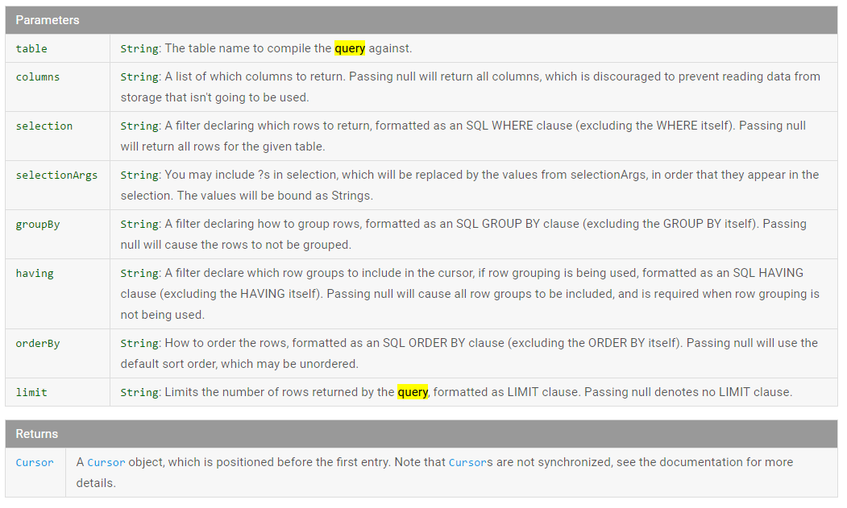
CRUD (Select)
Notes:
Planing
File
Compress
En/Decrypt
2. Constraint layout
3. App Mix between 1 & 2.

Slide 12
CRUD (Select)
public List<Contact> getAllContacts() { List<Contact> contactList = new ArrayList<Contact>(); String selectQuery = "SELECT * FROM " + TABLE_CONTACTS; SQLiteDatabase db = this.getWritableDatabase(); Cursor cursor = db.rawQuery(selectQuery, null); // looping through all rows and adding to list if (cursor.moveToFirst()) { do { Contact contact = new Contact(); contact._id = Integer.parseInt(cursor.getString(0)); contact._name = cursor.getString(1); contact._phone_number = cursor.getString(2); contactList.add(contact); } while (cursor.moveToNext()); } // return contact list return contactList; }
Notes:
Planing
File
Compress
En/Decrypt
2. Constraint layout
3. App Mix between 1 & 2.

Slide 13
CRUD (Update)
// Updating single contact public int updateContact(Contact contact)
{ SQLiteDatabase db = this.getWritableDatabase(); ContentValues values = new ContentValues(); values.put(KEY_NAME, contact._name); values.put(KEY_PH_NO, contact._phone_number); // updating row return db.update(
TABLE_CONTACTS,
values,
KEY_ID + " = ?", new String[] { String.valueOf(contact._id) }
); }
Notes:
Planing
File
Compress
En/Decrypt
2. Constraint layout
3. App Mix between 1 & 2.

Slide 14
CRUD (Delete)
// Deleting single contact public void deleteContact(Contact contact)
{ SQLiteDatabase db = this.getWritableDatabase();
db.delete(
TABLE_CONTACTS,
KEY_ID + " = ?", new String[] { String.valueOf(contact._id) }
);
db.close(); }
Notes:
Planing
File
Compress
En/Decrypt
2. Constraint layout
3. App Mix between 1 & 2.

Slide 15
CRUD (Delete)
// Deleting single contact public void deleteContact(Contact contact)
{ SQLiteDatabase db = this.getWritableDatabase();
db.delete(
TABLE_CONTACTS,
KEY_ID + " = ?", new String[] { String.valueOf(contact._id) }
);
db.close(); }
Notes:
Planing
File
Compress
En/Decrypt
2. Constraint layout
3. App Mix between 1 & 2.

Slide 16
MainActivity.java
@Override protected void onCreate(Bundle savedInstanceState) { super.onCreate(savedInstanceState); setContentView(R.layout.activity_main); DatabaseHandler db = new DatabaseHandler(this); db.addContact(new Contact("Ekarat","0899999999")); List<Contact> contacts = db.getAllContacts(); }
Notes:
Planing
File
Compress
En/Decrypt
2. Constraint layout
3. App Mix between 1 & 2.

Slide 17
Exercise 1
1.1 Implement the Contact app and use debug to check the result.
1.2 Update the name and phone of the 2nd row.
1.3 Delete the first row.
1.4 Add a new column “salary”.
Notes:
Planing
File
Compress
En/Decrypt
2. Constraint layout
3. App Mix between 1 & 2.

Slide 18
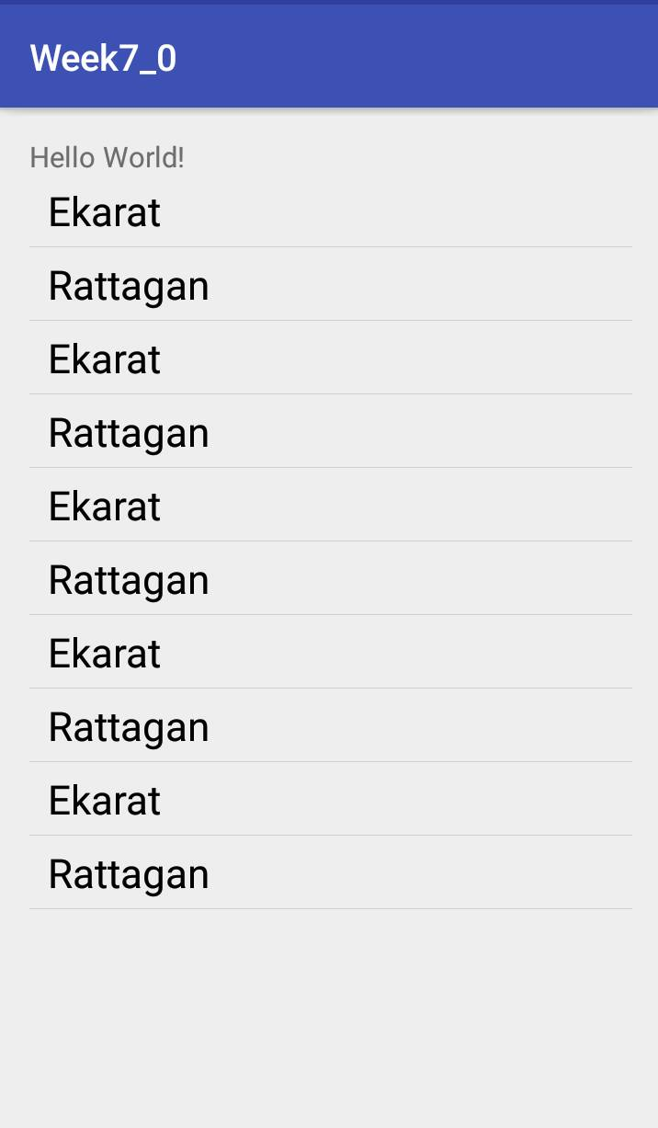
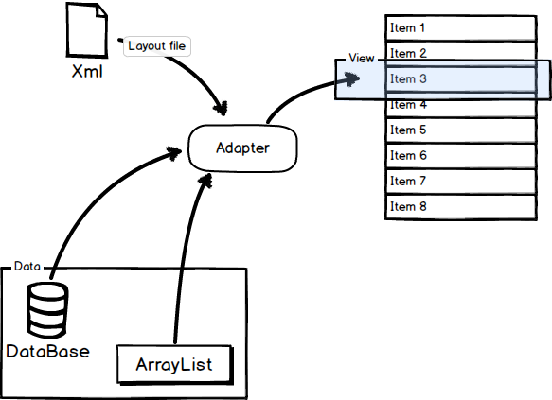
ListView
Show the results of DB in ListView
http://neohsu.github.io/images/SVG/0-talk-about-listview-and-adapter-on-android.png
Notes:
Planing
File
Compress
En/Decrypt
2. Constraint layout
3. App Mix between 1 & 2.

Slide 19
ListView
1. Create a ListView in activity_main.xml
<?xml version="1.0" encoding="utf-8"?> <RelativeLayout xmlns:android=http://schemas.android.com/apk/res/android
……> <TextView android:layout_width="wrap_content" android:layout_height="wrap_content" android:text="Hello World!" android:id="@+id/textView" /> <ListView android:layout_marginTop="20dp" android:id="@+id/listView1" android:layout_width="match_parent" android:layout_height="match_parent" android:layout_alignParentBottom="true" android:layout_alignParentStart="true" />
</RelativeLayout>
Notes:
Planing
File
Compress
En/Decrypt
2. Constraint layout
3. App Mix between 1 & 2.

Slide 20
ListView
2. Create a CustomAdapter class
import android.content.Context; import android.view.LayoutInflater; import android.view.View; import android.view.ViewGroup; import android.widget.BaseAdapter; import android.widget.TextView; public class CustomAdapter extends BaseAdapter { Context mContext; String[] strName; public CustomAdapter(Context context, String[] strName){ mContext = context; this.strName = strName; }
Notes:
Planing
File
Compress
En/Decrypt
2. Constraint layout
3. App Mix between 1 & 2.

Slide 21
ListView
2. Create a CustomAdapter class
@Override public int getCount() { return strName.length; } @Override public Object getItem(int i) { return null; } @Override public long getItemId(int i) { return 0; }
Notes:
Planing
File
Compress
En/Decrypt
2. Constraint layout
3. App Mix between 1 & 2.

Slide 22
ListView
2. Create a CustomAdapter class
@Override public View getView(int position, View view, ViewGroup parent)
{
LayoutInflater mInflater = (LayoutInflater)mContext.getSystemService
(Context.LAYOUT_INFLATER_SERVICE); if(view == null) view = mInflater.inflate(R.layout.listview_row, parent, false); TextView textView = (TextView)view.findViewById(R.id.textView1); textView.setText(strName[position]); return view; } }
Notes:
Planing
File
Compress
En/Decrypt
2. Constraint layout
3. App Mix between 1 & 2.

Slide 23
ListView
3. Inside MainActivity.java
db.addContact(new Contact("Ekarat","0899999999")); db.addContact(new Contact("Rattagan","011111111")); List<Contact> contacts = db.getAllContacts(); String[] datas = new String[contacts.size()]; for(int i=0; i<datas.length; i++)
{ datas[i]= contacts.get(i)._name; } CustomAdapter adapter = new CustomAdapter(getApplicationContext(),datas); ListView listView = (ListView)findViewById(R.id.listView1); listView.setAdapter(adapter);
Notes:
Planing
File
Compress
En/Decrypt
2. Constraint layout
3. App Mix between 1 & 2.

Slide 24
Exercise 2
2.1 Click each row to delete it (Snackbar shows success).
Notes:
Planing
File
Compress
En/Decrypt
2. Constraint layout
3. App Mix between 1 & 2.

