Slide 1


CLOUDROUTING
Project Objective
Creating a server-client system integrated with ORTEC Cloud geocoding and routing services which enables a courier driver to easily deliver and pickup packages in a time-economical way
Technologies Used
C#, ASP.NET Core, Xamarin (Forms), AngularJS 2, Microsoft SQL Server
Project Authors
Dragos George Feleaga and Radu Mazilu, with help from Serghei Radjabov and the ORTEC supervisor team

Slide 2

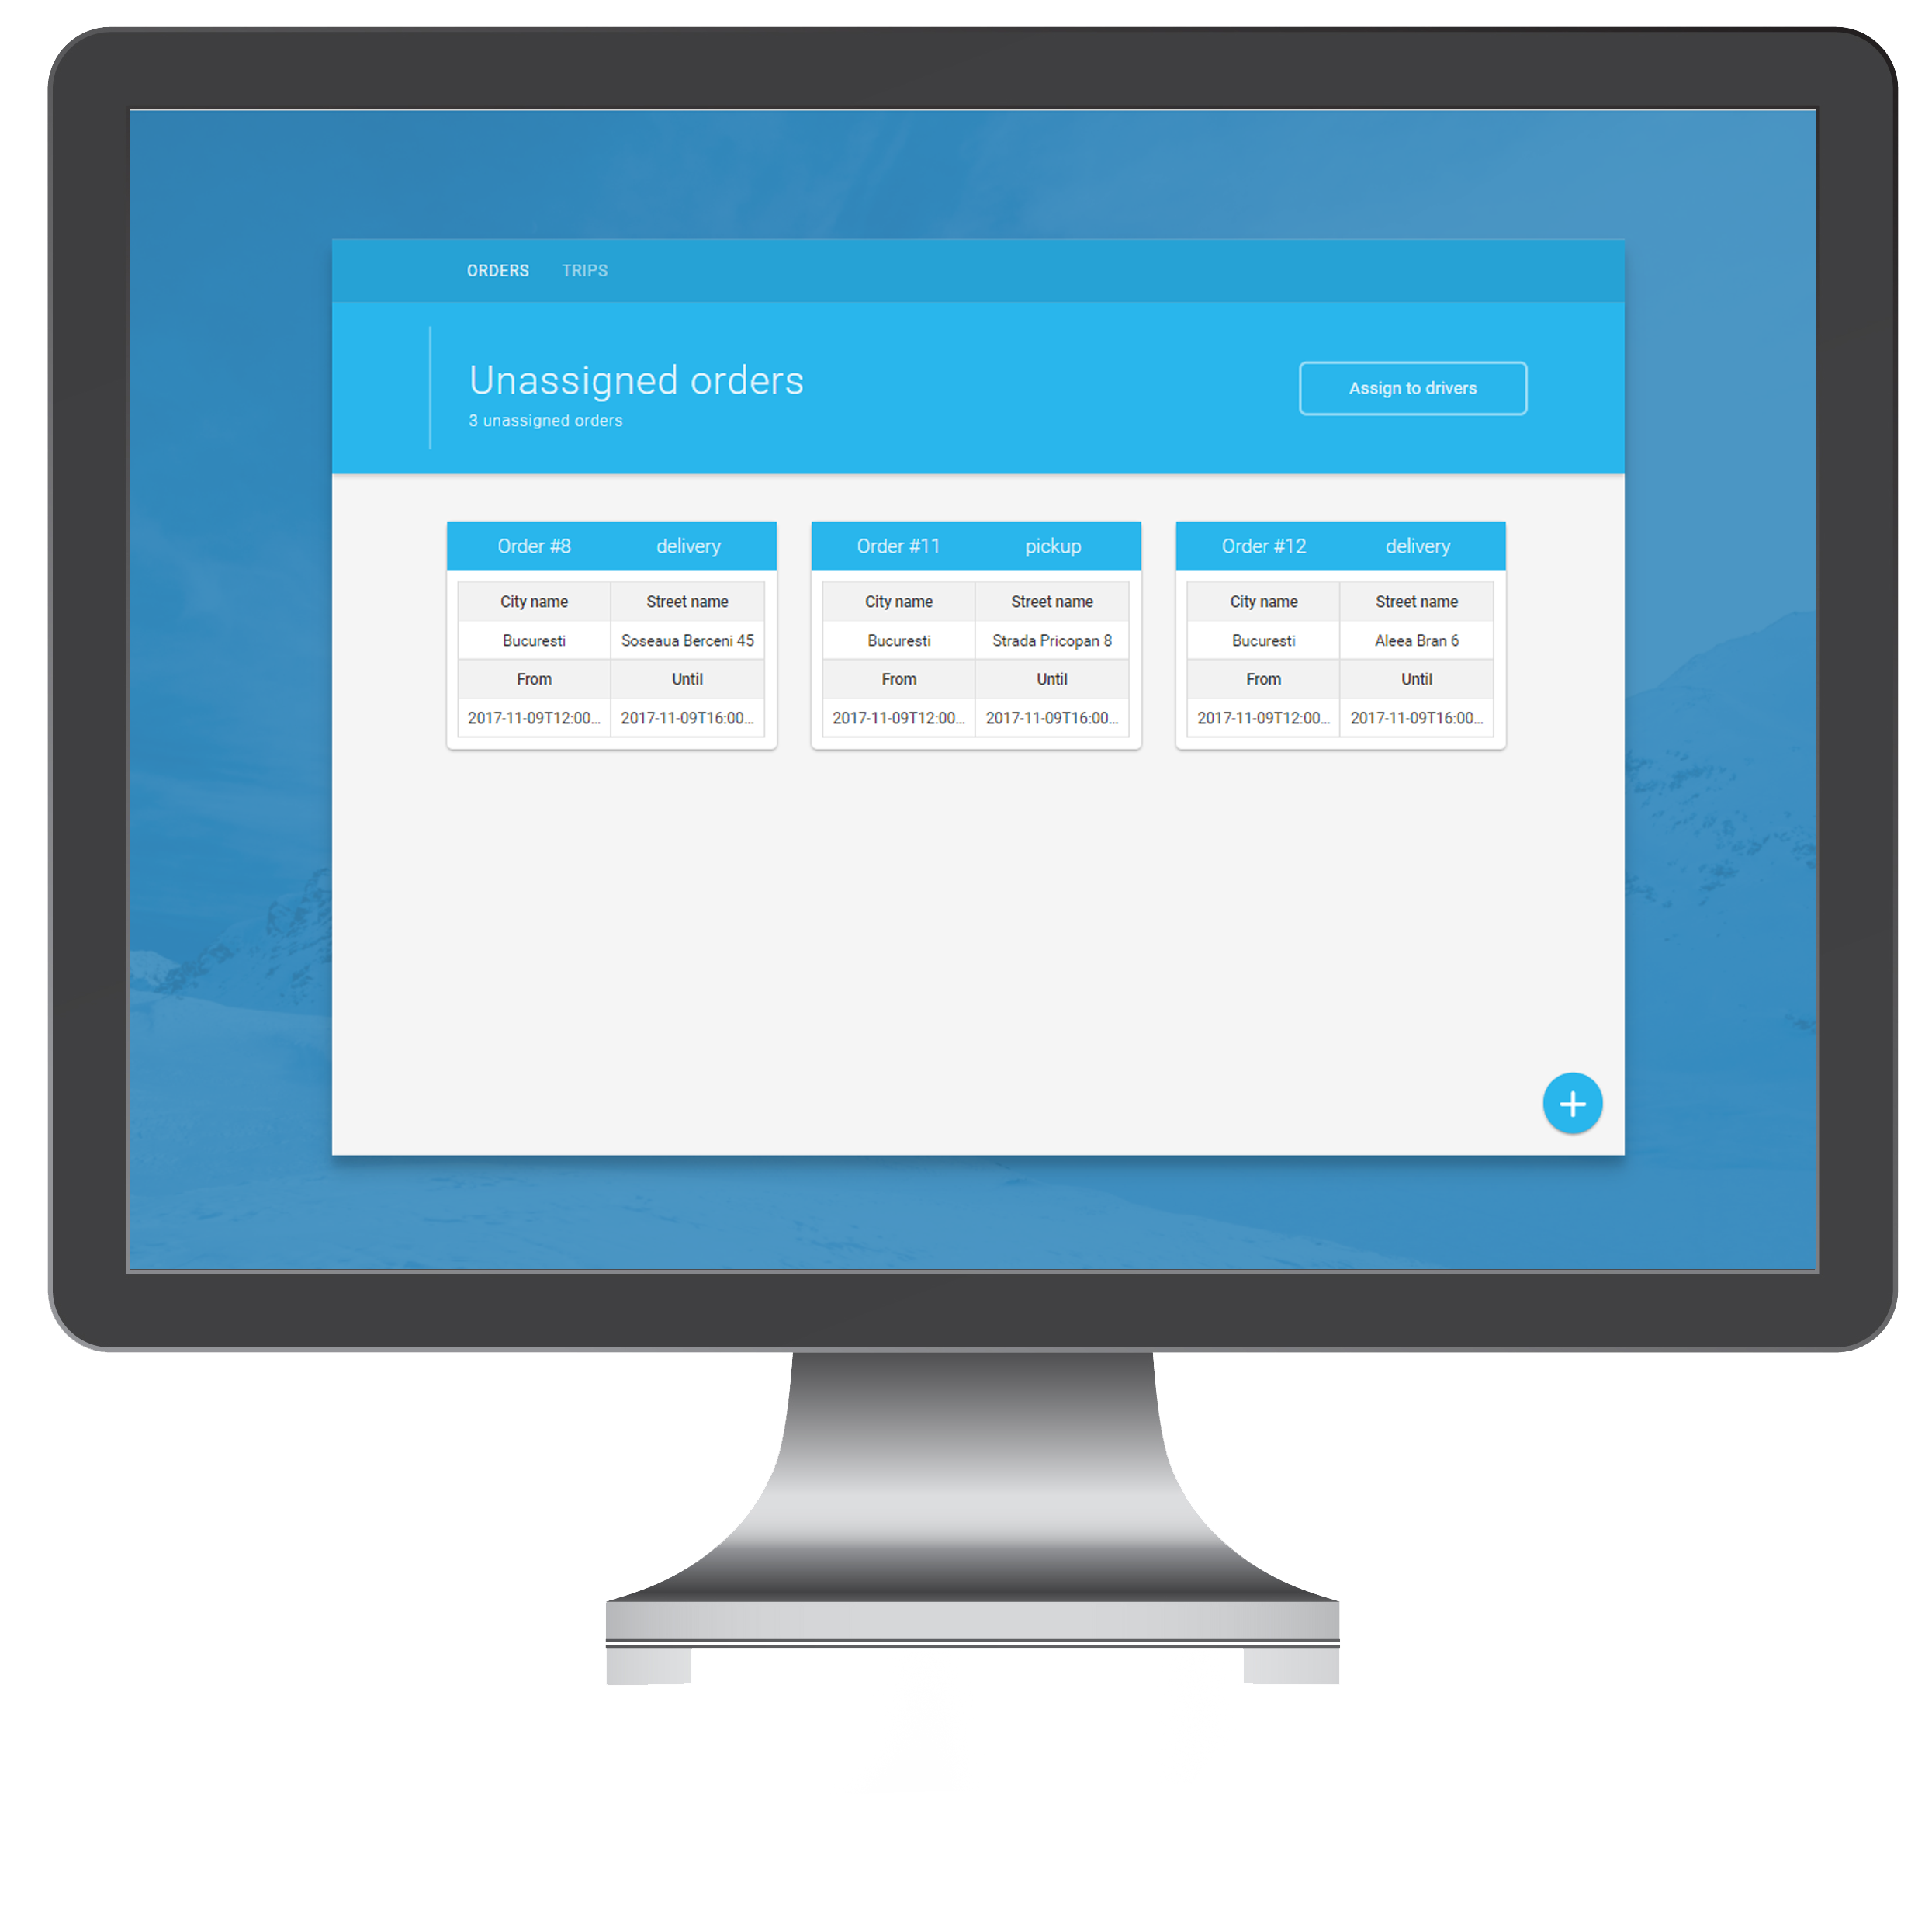
CLOUDROUTING
Web Portal
Request
Response
SERVER
Made with HTML, CSS, and JavaScript(AngularJS)
Enables the portal manager to upload orders, assign them to specific drivers and view the drivers' trips.
Provides the implementation of Google Maps for order visualization
Simple and attractive design

Slide 3
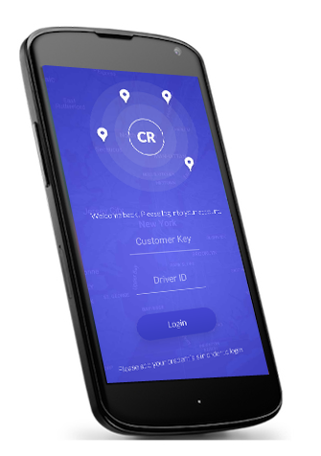
CLOUDROUTING
Mobile Application
Request
Response
SERVER
Made with Xamarin Forms
Enables the driver to view information about their account, trips and assigned orders, as well as plan new routes based on their orders
Provides the implementation of Google Maps for better route visualization
Clean and intuitive design

Slide 4
CLOUDROUTING
Challenges
Xamarin Forms lacks thorough documentation
We needed to use an older version of the Google Maps API
Integrating the cloud routing API required a lot of documentation and testing
Had difficulties with hosting the database and server on Azure

Slide 5
CLOUDROUTING
Conclusions
The project was more than enough for us to learn the required technologies
Even though Xamarin Forms is a good UI Toolkit, it is not designed for pixel perfect applications

