Slide 1
MLOps Pipeline for Tourism Package Prediction
Done by Mazin Alahmadi
August 29, 2026
Notes:
[Sources]
- prompt.extracted.txt: assignment context and presentation audience.
- criteria rubrics.extracted.txt: required MLOps evidence areas.
- User instruction: cover name spelling confirmed as Mazin Alahmadi.

Slide 2
Contents / Agenda
• Executive summary
• Business overview and solution approach
• Data registration and preparation
• Customer insights from tourism data
• Model building, tracking, and performance
• Deployment and automated GitHub workflow
• Output evidence, recommendations, and appendix
Notes:
[Sources]
- prompt.extracted.txt: visible deck should focus on business analysis, not code.
- criteria rubrics.extracted.txt: agenda mirrors scoring categories.

Slide 3
Executive Summary
• The tourism campaign has a 19.3% package-purchase rate, so better targeting can materially improve sales productivity.
• A completed MLOps pipeline now registers data, cleans and splits it, trains a tuned XGBoost model, and publishes a Hugging Face prediction app.
• The best local model achieved 91.3% test accuracy, 76.4% precision, 79.4% recall, and 77.8% F1 at the selected threshold.
• Business recommendation: prioritize high-probability customers first, then monitor conversion lift through the automated workflow.
Notes:
[Sources]
- tourism_project/reports/business_summary.json: 4,011 customers, 774 buyers, 19.3% conversion.
- tourism_project/reports/metrics.json: local test metrics from the trained model.
- tourism_project/model_building/train.py: model training and threshold selection.

Slide 4
Business Overview and Solution Approach
• Business problem: sales teams need to focus outreach on customers most likely to purchase a tourism package.
• Decision lens: rank prospects before calling so high-fit customers receive faster and better-timed follow-up.
• Solution: convert customer attributes into a purchase-probability score using a reproducible, deployment-ready ML workflow.
• Operating model: GitHub controls source code, Hugging Face stores data/model/app assets, and GitHub Actions runs the pipeline end to end.
Notes:
[Sources]
- prompt.extracted.txt: prepare business overview, solution approach, insights, recommendations, and benefits.
- criteria rubrics.extracted.txt: GitHub, Hugging Face, deployment, and workflow requirements.

Slide 5
Data Registration
• Master project folder: tourism_project with data, model_building, deployment, hosting, reports, and models subfolders.
• Raw data asset: tourism_project/data/tourism.csv, documented with a dataset README for governance.
• Hugging Face dataset target: mazin903/tourism
• Registration script creates or reuses the dataset repo and uploads the raw dataset files.
• Benefit: the workflow has a single governed data source instead of manual file movement.
Notes:
[Sources]
- tourism_project/model_building/data_register.py: dataset repository creation and raw data upload.
- tourism_project/data/README.md: dataset card content.
- criteria rubrics.extracted.txt: Data Registration scoring requirements.

Slide 6
Data Preparation
• Loaded the tourism dataset from Hugging Face when credentials are available, with local fallback for development.
• Removed generated index/customer ID fields, removed duplicates, and standardized inconsistent categorical values.
• Imputed missing numeric values with medians and categorical values with modes.
• Created a stratified 80/20 split: 3,208 training rows and 803 testing rows.
• Saved cleaned, train, and test files locally and prepared automatic upload back to the dataset repo.
Notes:
[Sources]
- tourism_project/model_building/prep.py: data loading, cleaning, splitting, and processed upload logic.
- tourism_project/data/processed/*.csv: generated cleaned, train, and test files.
- criteria rubrics.extracted.txt: Data Preparation scoring requirements.

Slide 7
Customer Insights That Drive Targeting
• Base purchase rate: 19.3%, confirming the need for selective campaign prioritization.
• Passport holders convert at 35.9% versus 12.4% for non-passport customers.
• Basic package prospects convert at 30.1%, the strongest product segment in the dataset.
• Single customers convert at 30.9%, more than double married and divorced segments.
• Recommendation: combine model scores with these high-conversion segments for call-list prioritization.
Notes:
[Sources]
- tourism_project/reports/business_summary.json: base conversion and summarized takeaways.
- tourism_project/reports/conversion_by_Passport.csv: passport segment conversion.
- tourism_project/reports/conversion_by_ProductPitched.csv: product segment conversion.
- tourism_project/reports/conversion_by_MaritalStatus.csv: marital-status segment conversion.

Slide 8
Model Building with Experimentation Tracking
• Model choice: XGBoost classifier with preprocessing for numeric and categorical fields.
• Class imbalance handled with scale_pos_weight so minority buyers are not ignored.
• Grid search evaluated 48 parameter/run combinations using F1 as the selection metric.
• MLflow logs parameters, metrics, artifacts, model path, and threshold analysis for comparison.
• Best model is packaged for Hugging Face Model Hub target: mazin903/tourism-package-model
Notes:
[Sources]
- tourism_project/model_building/train.py: preprocessing, XGBoost training, grid search, MLflow logging, and model packaging.
- tourism_project/reports/metrics.json: model performance.
- tourism_project/model_building/model_card.md: Model Hub documentation.

Slide 9
Model Performance and Decision Threshold
• Selected threshold: 0.50, chosen for the best local F1 with a balanced precision/recall tradeoff.
• Test performance: 91.3% accuracy, 76.4% precision, 79.4% recall, 77.8% F1.
• Business meaning: most predicted buyers are actionable, while recall still captures nearly four out of five actual buyers.
• Top signals: Passport, Basic package, Single marital status, Executive designation, and CityTier.
• Operational use: score prospects, prioritize top-probability leads, and monitor uplift after deployment.
Notes:
[Sources]
- tourism_project/reports/threshold_analysis.csv: threshold comparison table.
- tourism_project/reports/metrics.json: selected-threshold test metrics.
- tourism_project/reports/feature_importance.csv: top model drivers.

Slide 10
Model Deployment
• Deployment surface: Streamlit Community Cloud app, with Hugging Face hosting script and Space files retained for portability.
• The app loads the registered model artifact from Hugging Face Model Hub.
• User inputs are converted into the same feature schema used during model training.
• Output: purchase probability, decision threshold, and a business-friendly follow-up recommendation.
• Accepted deployment path: Streamlit app launched directly from the GitHub repository.
Notes:
[Sources]
- tourism_project/deployment/app.py: Streamlit scoring app and model download logic.
- tourism_project/deployment/Dockerfile: container configuration.
- tourism_project/hosting/hosting.py: Hugging Face Space upload script.
- User-provided Great Learning support response: Streamlit Community Cloud deployment is acceptable and HF subscription is optional.
- Streamlit Docs: https://docs.streamlit.io/deploy/streamlit-community-cloud/deploy-your-app/deploy
- Hugging Face Docs: https://huggingface.co/docs/hub/spaces-sdks-static
- criteria rubrics.extracted.txt: Deployment scoring requirements.

Slide 11
Automated GitHub Actions Workflow
• Trigger: push to main or manual workflow dispatch.
• Pipeline steps: install dependencies, register dataset, clean/split data, generate analysis, train/register model, and deploy app.
• Secrets and variables separate credentials from source code: HF_TOKEN, HF_USERNAME, dataset repo, model repo, and Space repo.
• Generated processed data and reports are committed back to main with skip-ci protection.
• Benefit: one repeatable workflow replaces manual notebook-only execution.
Notes:
[Sources]
- .github/workflows/pipeline.yml: GitHub Actions pipeline definition.
- .env.example: required environment variables.
- criteria rubrics.extracted.txt: GitHub Actions scoring requirements.

Slide 12
Output Evaluation Evidence
• GitHub repository: https://github.com/mazin903/MLOps-pipeline-on-GitHub
• Hugging Face dataset: https://huggingface.co/datasets/mazin903/tourism
• Hugging Face model: https://huggingface.co/mazin903/tourism-package-model
• Streamlit app deployment: Streamlit Community Cloud, using the GitHub repository and Hugging Face model.
• Hugging Face prediction app backup: https://huggingface.co/spaces/mazin903/tourism-package-prediction
• Screenshots to capture after first account run: repo folder structure, green GitHub Actions workflow, Hugging Face dataset/model pages, and prediction app result.
Notes:
[Sources]
- criteria rubrics.extracted.txt: Output Evaluation requires links and screenshots.
- README.md: local run, Colab run, account setup, and repository structure.
- User-provided GitHub repository and Hugging Face username.
- User-provided Great Learning support response: Streamlit Community Cloud deployment details are acceptable.

Slide 13
Notes:
[Sources]
- Source slide 10 preserved as the appendix divider.

Slide 14
Dataset Overview and Registration Details
• Source file: tourism.csv with customer demographics, interaction history, product pitch attributes, and purchase outcome.
• Target variable: ProdTaken, where 1 means the customer purchased the package and 0 means they did not.
• Model features include age, income, city tier, follow-ups, satisfaction, passport, car ownership, occupation, package pitched, and designation.
• Processed outputs: cleaned_tourism.csv, Xtrain.csv, Xtest.csv, ytrain.csv, and ytest.csv.
• Registration plan: raw and processed files are uploaded to the Hugging Face dataset repo for reproducible downstream steps.
Notes:
[Sources]
- tourism_project/config.py: feature lists and target variable.
- tourism_project/data/README.md: dataset documentation.
- tourism_project/model_building/prep.py: generated processed outputs.

Slide 15
Experimentation Tracking Details
• Algorithm: XGBoost classifier selected from the assignment-approved model family.
• Tuning grid: n_estimators 100/200, max_depth 3/5, learning_rate 0.05/0.10, reg_lambda 1.0/5.0, colsample values 0.8.
• Best parameters: n_estimators 200, max_depth 5, learning_rate 0.10, reg_lambda 1.0.
• Tracked artifacts: metrics, classification report, threshold analysis, feature importance, and joblib model bundle.
• Model Hub registration stores the trained model and model card for deployment reuse.
Notes:
[Sources]
- tourism_project/model_building/train.py: approved algorithm, tuning grid, MLflow logging, and model hub upload.
- tourism_project/reports/metrics.json: evaluation metrics.
- tourism_project/reports/feature_importance.csv: feature importance outputs.

Slide 16
GitHub Actions Workflow Details
• Repository-ready workflow: .github/workflows/pipeline.yml.
• Step 1: install Python dependencies and validate the project environment.
• Step 2: register raw data, prepare train/test assets, and generate business summary tables.
• Step 3: train the model, log results, and upload the best bundle to Hugging Face Model Hub.
• Step 4: push deployment files to Hugging Face Spaces and commit generated reports back to main.
Notes:
[Sources]
- .github/workflows/pipeline.yml: CI/CD implementation.
- tourism_project/hosting/hosting.py: deployment upload.
- criteria rubrics.extracted.txt: workflow evidence and automatic push-back requirements.

Slide 17
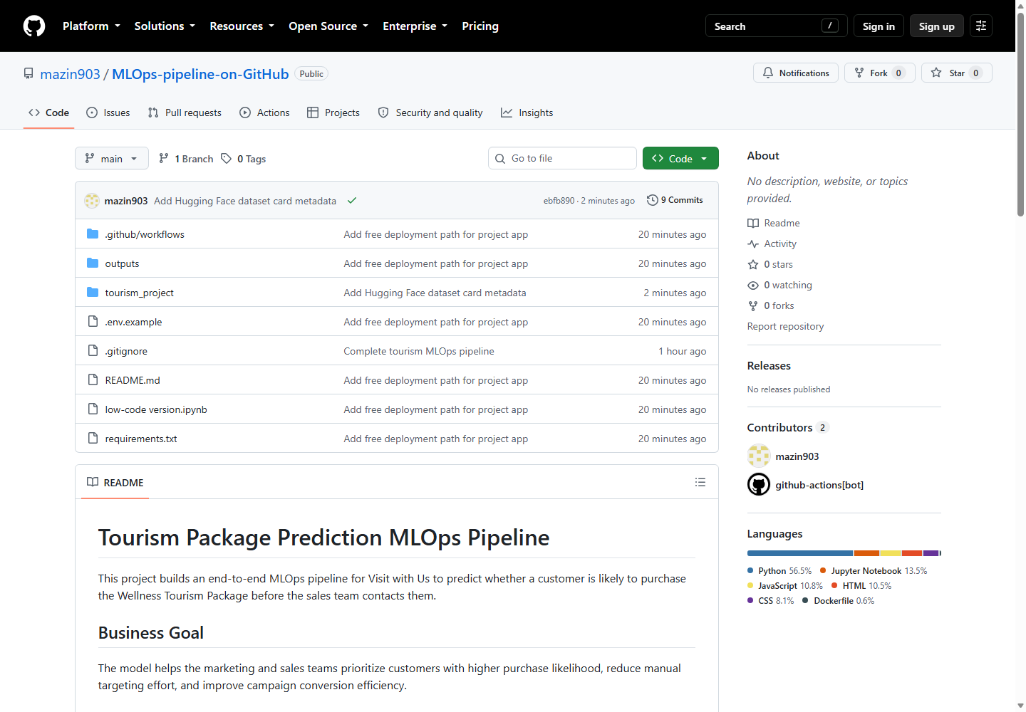
Evidence: GitHub Repository
Repository structure and project files: github.com/mazin903/MLOps-pipeline-on-GitHub
Notes:
[Sources]
- Screenshot file: outputs/screenshots/github-repo.png
- Evidence added to support the rubric output-evaluation requirement.

Slide 18
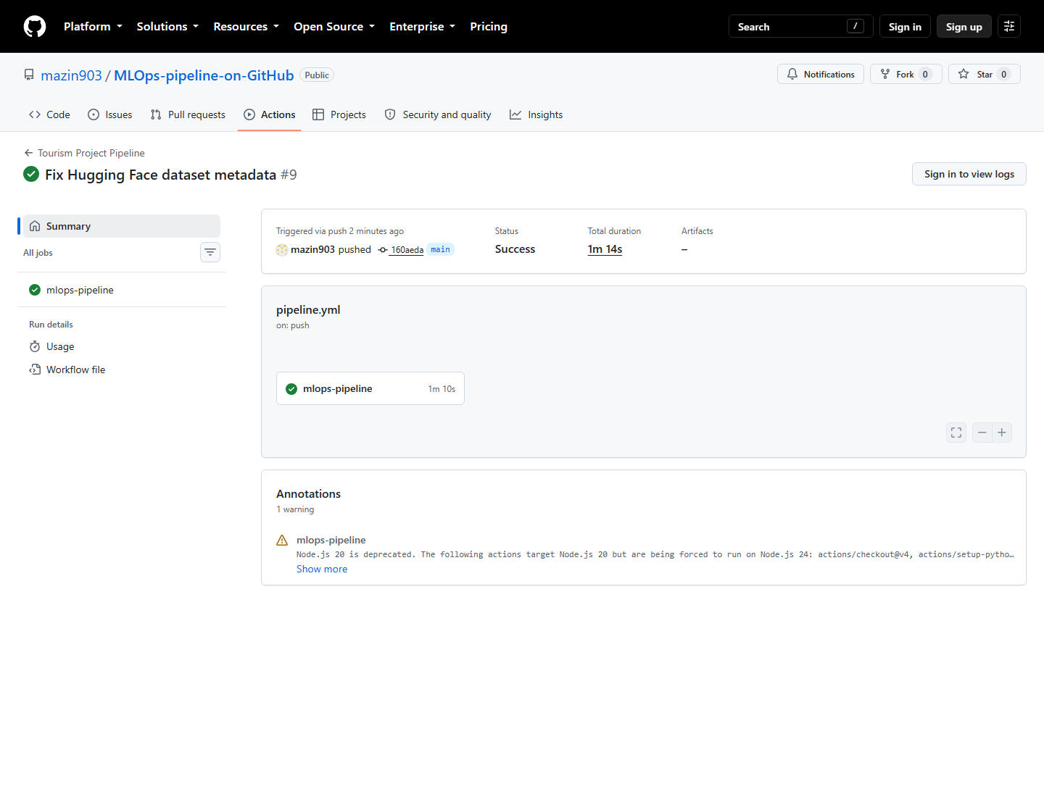
Evidence: GitHub Actions Workflow
Latest pipeline run #9 on commit 160aeda completed successfully on August 29, 2026.
Notes:
[Sources]
- Screenshot file: outputs/screenshots/github-actions-final.png
- Evidence added to support the rubric output-evaluation requirement.

Slide 19
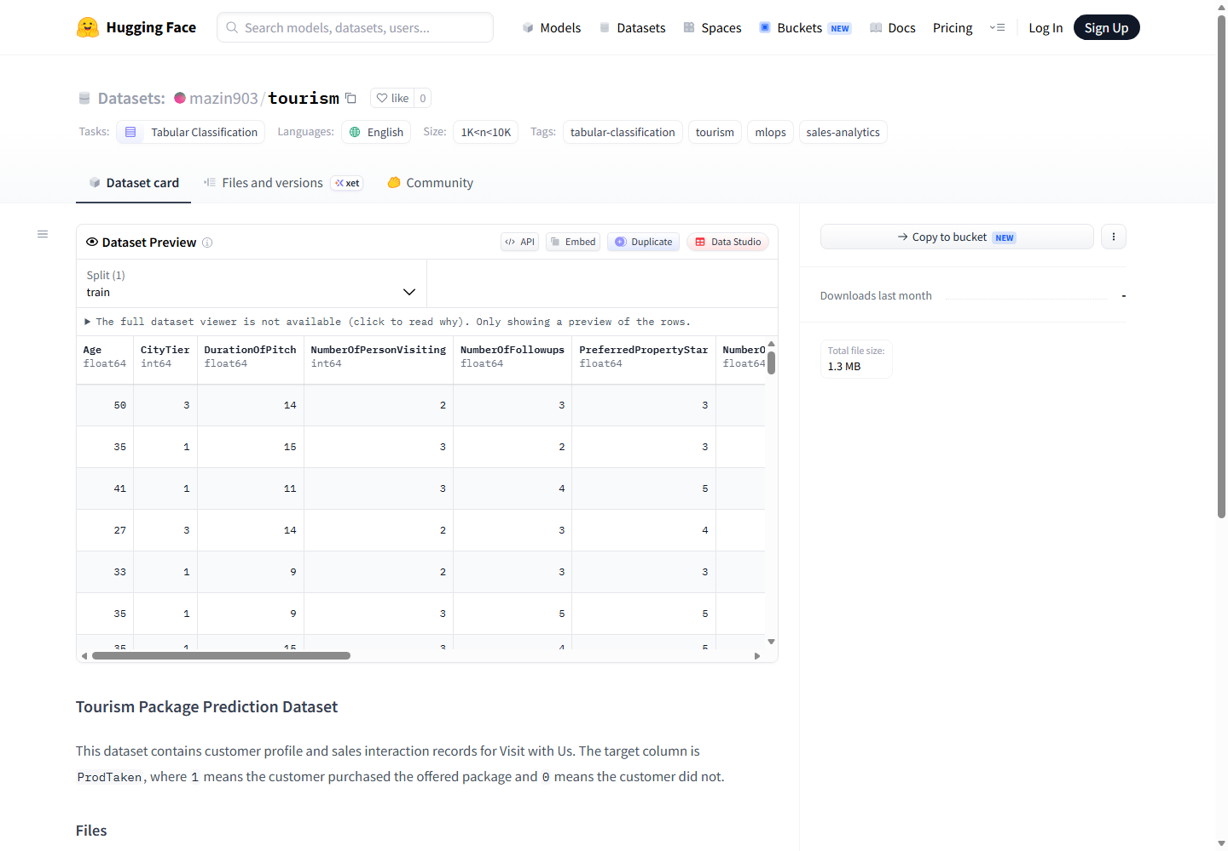
Evidence: Hugging Face Dataset
Registered dataset repository: huggingface.co/datasets/mazin903/tourism
Notes:
[Sources]
- Screenshot file: outputs/screenshots/hf-dataset-final.png
- Evidence added to support the rubric output-evaluation requirement.

Slide 20
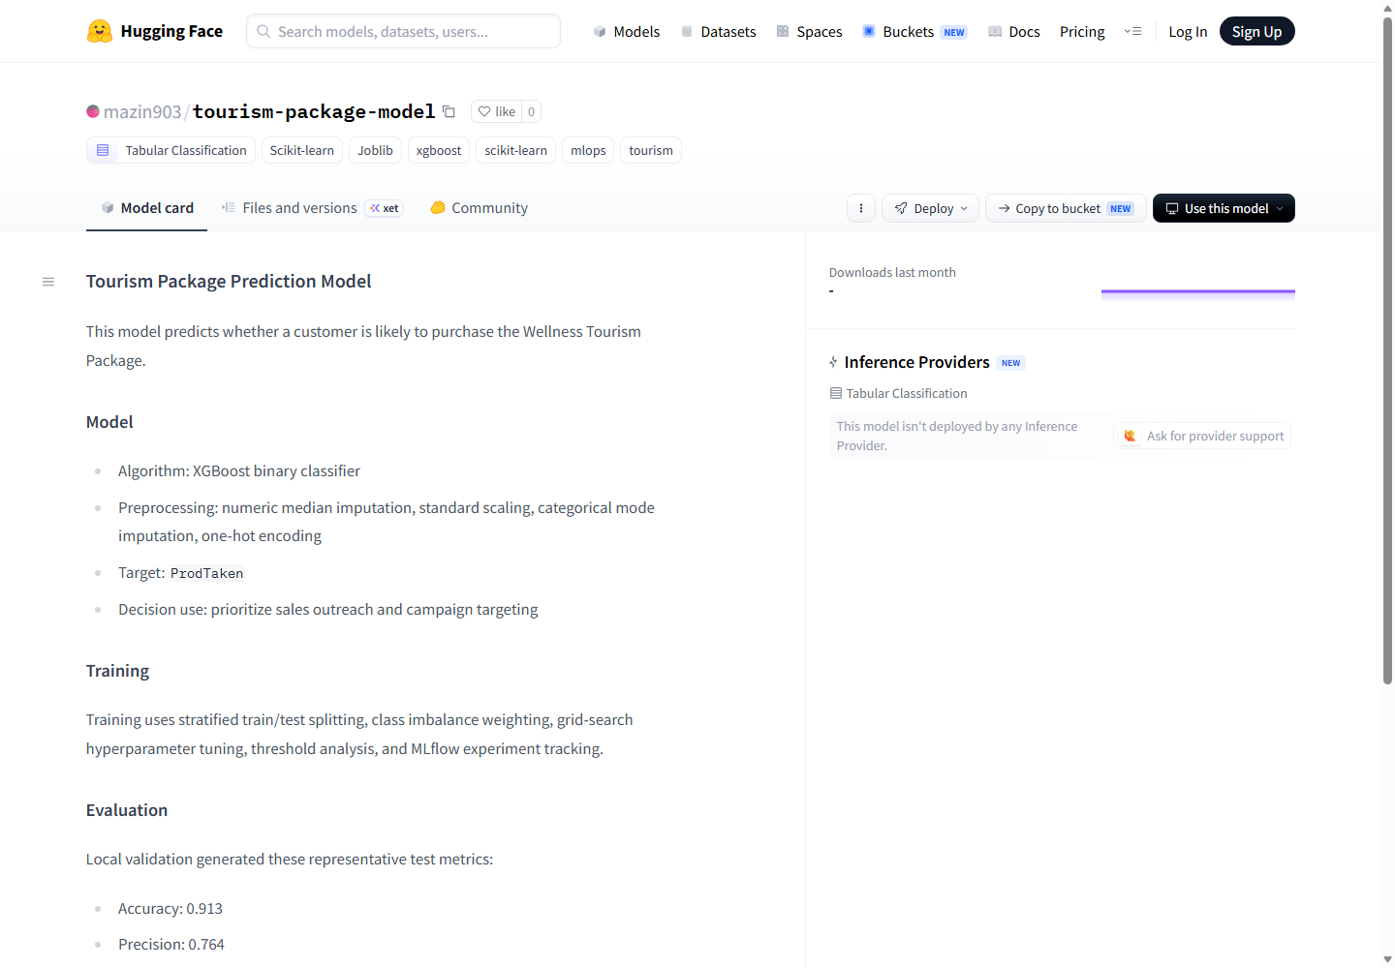
Evidence: Hugging Face Model Hub
Registered model artifact repository: huggingface.co/mazin903/tourism-package-model
Notes:
[Sources]
- Screenshot file: outputs/screenshots/hf-model.png
- Evidence added to support the rubric output-evaluation requirement.

Slide 21
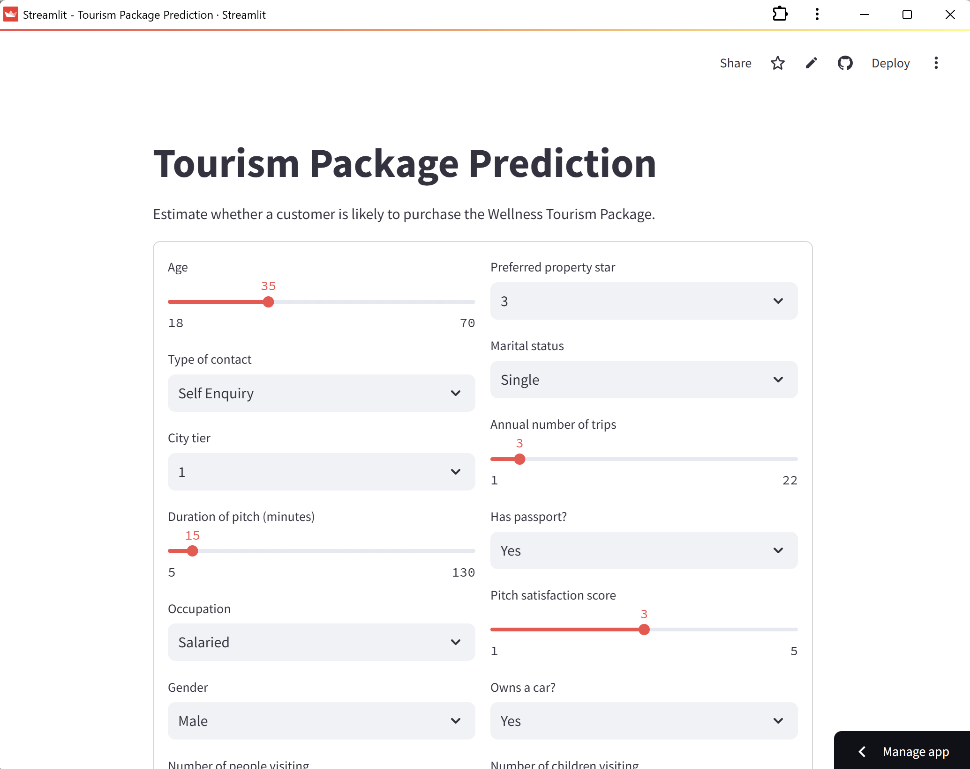
Evidence: Streamlit Community Cloud App
Primary accepted app deployment: tourism-package-prediction-mazin903.streamlit.app
Notes:
[Sources]
- Screenshot file: outputs/screenshots/streamlit-cloud-user.png
- Evidence added to support the rubric output-evaluation requirement.

Slide 22
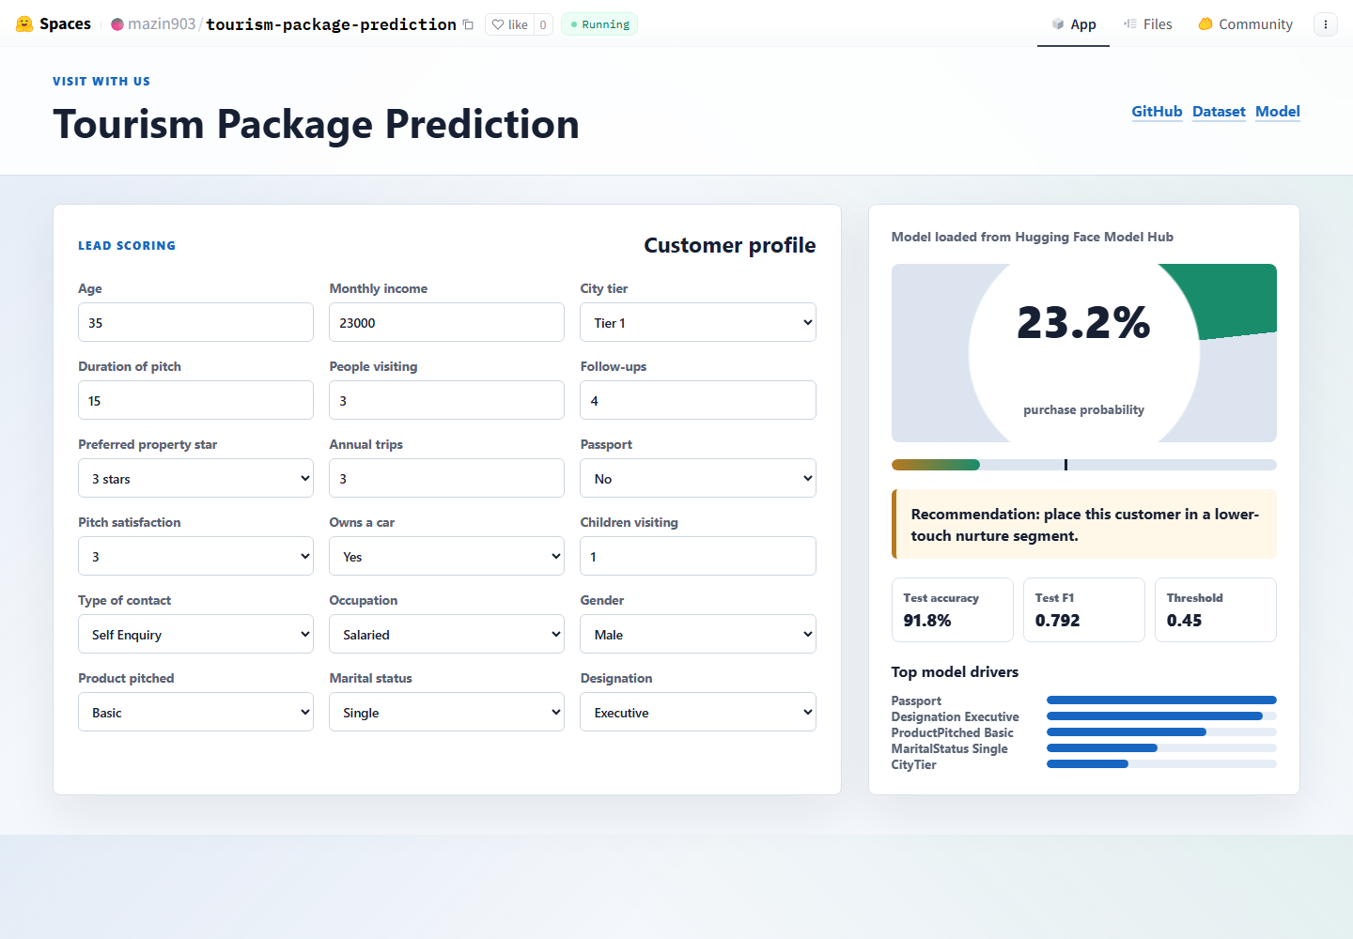
Evidence: Hugging Face Static Space Backup
Free hosted prediction-app backup: huggingface.co/spaces/mazin903/tourism-package-prediction
Notes:
[Sources]
- Screenshot file: outputs/screenshots/hf-space.png
- Evidence added to support the rubric output-evaluation requirement.

