Slide 1
FOOD POINT APP
A ORDERING FOOD APP FROM ULK RESTAURANTS
DESIGNER ::
HASSAAN ATIF MUSTAFA

Slide 2


Project overview
The product :
FOOD POINT is an online food ordering app designed to help you avoid long queues.
The app allows users to order their meals from ULK restaurants and cafés, and It will reach you at your location Users can pay directly through the app.
Project duration:
17 October 2025- 21 October 2025
FOOD POINT

Slide 3
Project overview
The problem :
The goal :
People often face the problem of long waiting lines when ordering or picking up their food from ULK restaurants.
FOOD POINT aims to provide a smooth and fast food ordering experience, saving time by reducing waiting and crowding.

Slide 4
Project overview
My role :
Responsibilites :
Creating Low and High fidelity prototypes, Accounting for accessibilities, and iterating on designs.
UX Designer, UI Designer

Slide 5
User research : pain points
TIME
Queues
People have to spent like 10 - 20 minutes in queues to get their order.
Long gueues sometimes leads to canceling the order and sometimes leads to miss the lectures.

Slide 6
paper wireframes
Starting
Digital wireframes
the
Low-fidelity prototype
design
Usability studies

Slide 7
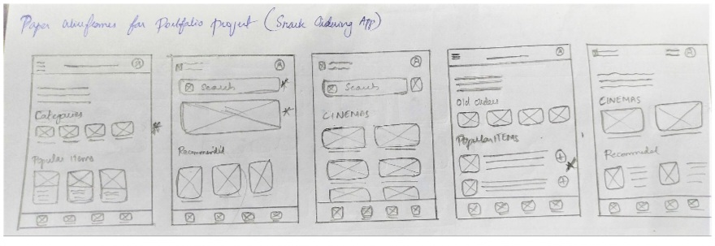
Paper wireframes
Each Screen of the app on paper ensured that the elements that made to digital wireframes would be well suited to address user pain points. For home screen, I prioritize easy and quick ordering process to help users.

Slide 8
Digital wireframes
Proceeding towards digital wireframes i want to ensure the findings and feedbacks from the user research were covered.
Users can easily choose theire favourites food from the popular menu section.
Users can easily search for theire food .

Slide 9
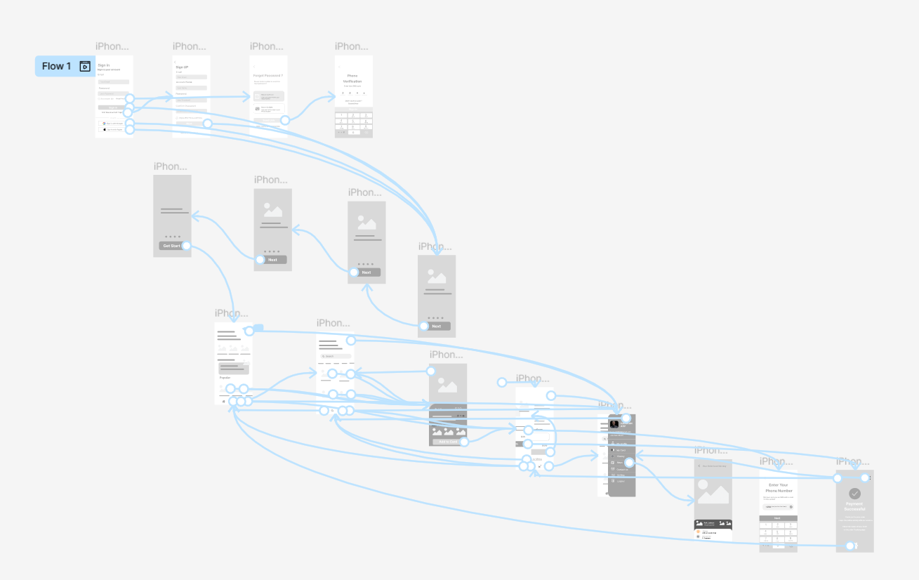
Low-fidelity prototype
The low-fidelity prototype
connected to the primary flow of
the app.
https://www.figma.com/design/l7HGfpZmaFZqakvc3X7SW1/Untitled?node-id=86-919&t=xXg4ikGmqAhe7sLp-1
View Prototype :

Slide 10
Key Mokups
High - fidelity prototype

Slide 11
Key Mockups

Slide 12
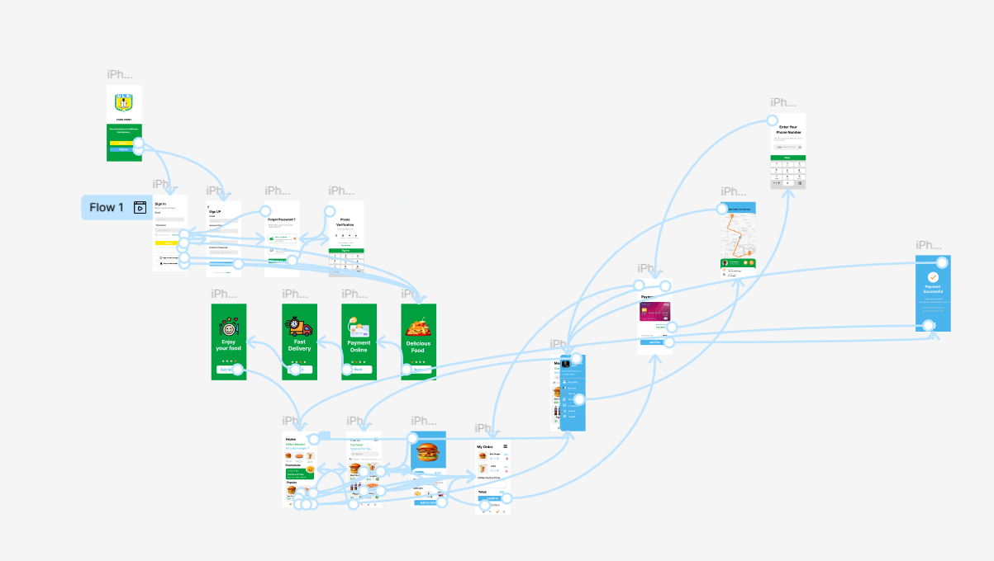
High-fidelity prototype
The final high fidelity
prototype presented with a
main user flow contains
adding snacks, scheduling
on-seat delivery and the
tracking process.
View Prototype :
https://www.figma.com/design/l7HGfpZmaFZqakvc3X7SW1/Untitled?node-id=0-1&t=erCvLkMEcfIcCuTx-1

Slide 13
see you

