Slide 1
Regime-Aware
Mean Reversion Strategy
Quantitative Crypto Spot Trading System | BTC ETH SOL BNB XRP
5 Years
5 Crypto
V2 vs V3
Walk-Forward
Backtest Period
Assets
Strategy Versions
Validation
March 2021 – March 2026 | $100K Initial Capital | Long-Only

Slide 2
OVERVIEW
Full-Pipeline Quantitative Research
From raw data exploration through statistically validated trading signals
01
02
03
04
Exploratory Analysis
Signal Engineering
Backtesting
Validation
Return distributions, correlation structure, regime detection, tail risk, PCA
OU-process regime scoring, Z-score entries, RSI confirmation, trend filter
Event-driven engine, multi-layer entries, correlation-aware sizing, circuit breakers
Walk-forward OOS testing, bootstrap Sharpe CIs, regime dependence tests
Tools: Python | pandas, numpy, scipy, statsmodels, matplotlib, seaborn, sklearn | Custom event-driven backtester

Slide 3
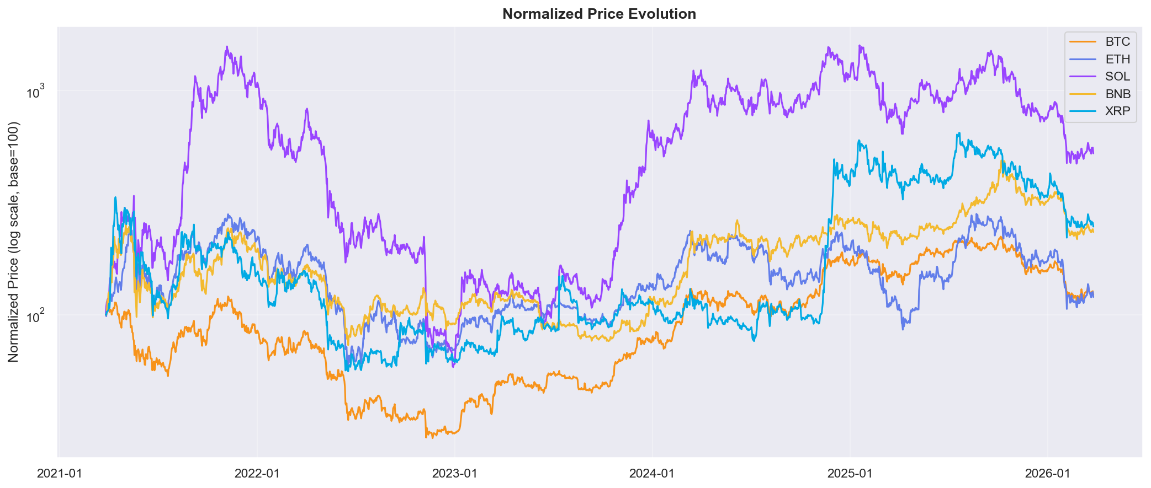
EDA
Market Understanding: 5-Year Price Evolution
All assets normalized to base 100 on log scale — reveals relative performance across different price magnitudes
Data: Yahoo Finance OHLCV daily bars | Period: March 2021 – March 2026 | Cached locally for reproducibility

Slide 4
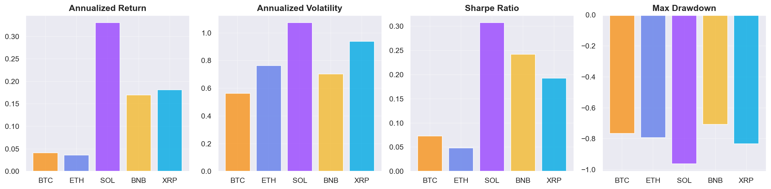
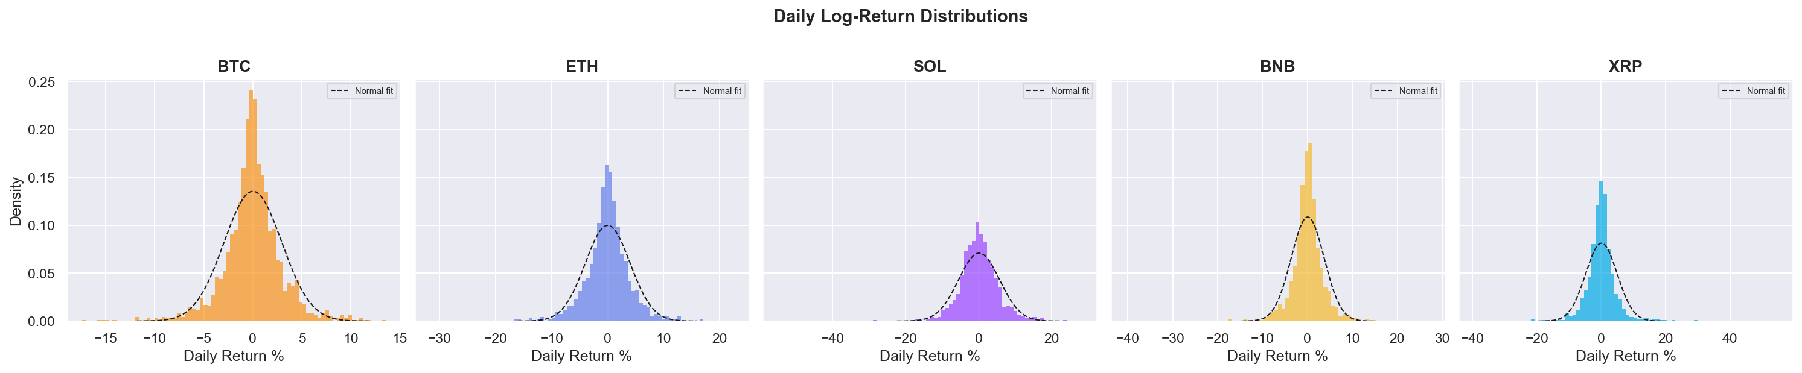
EDA
Return Properties & Distributional Analysis
Fat tails and non-normality justify ATR-based position sizing over fixed percentage models
All assets reject normality at p < 0.001 (Jarque-Bera, Shapiro-Wilk) | Excess kurtosis confirms heavy tails

Slide 5
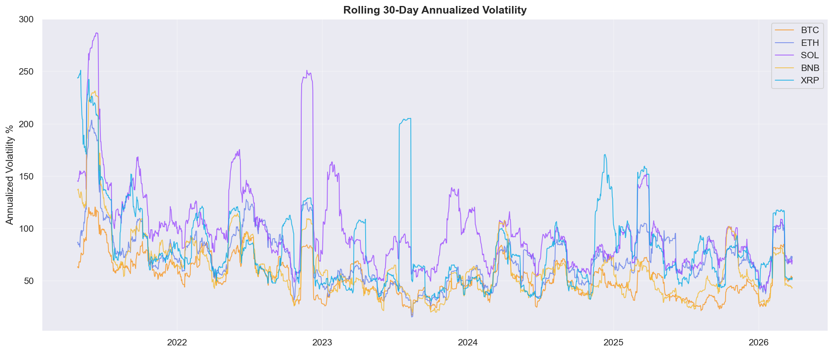
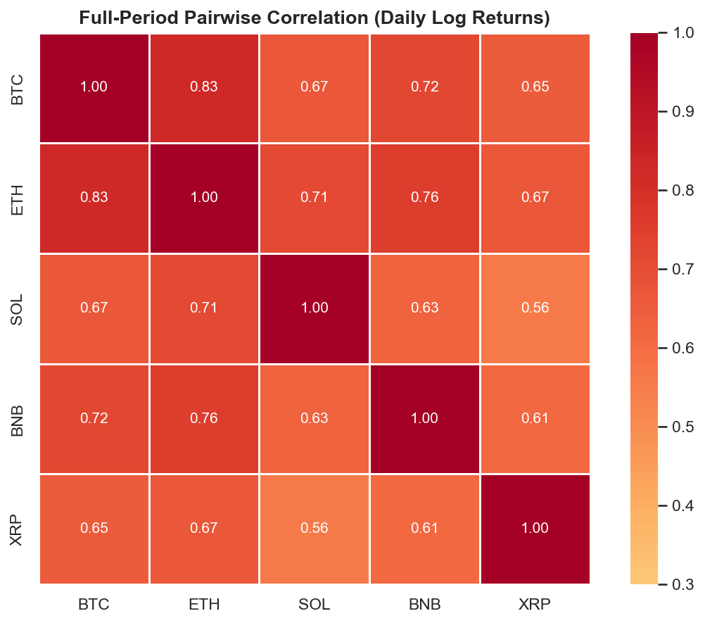
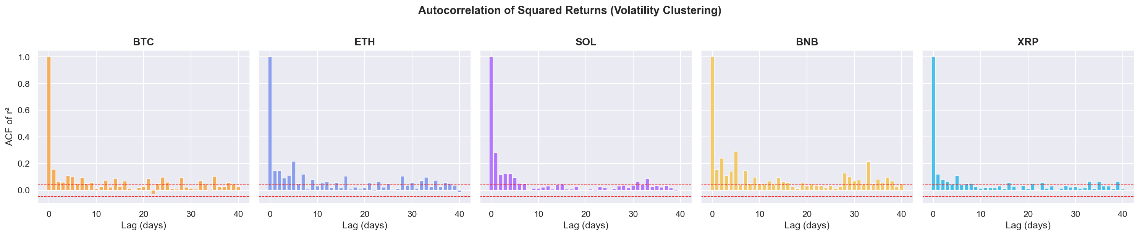
EDA
Volatility Clustering & Correlation Structure
Persistent vol regimes + unstable correlations motivate adaptive regime detection and cluster-capping
Significant ACF in r² confirms GARCH-like clustering | BTC-ETH correlation fluctuates 0.5–0.95 | Cluster threshold: ρ ≥ 0.90

Slide 6
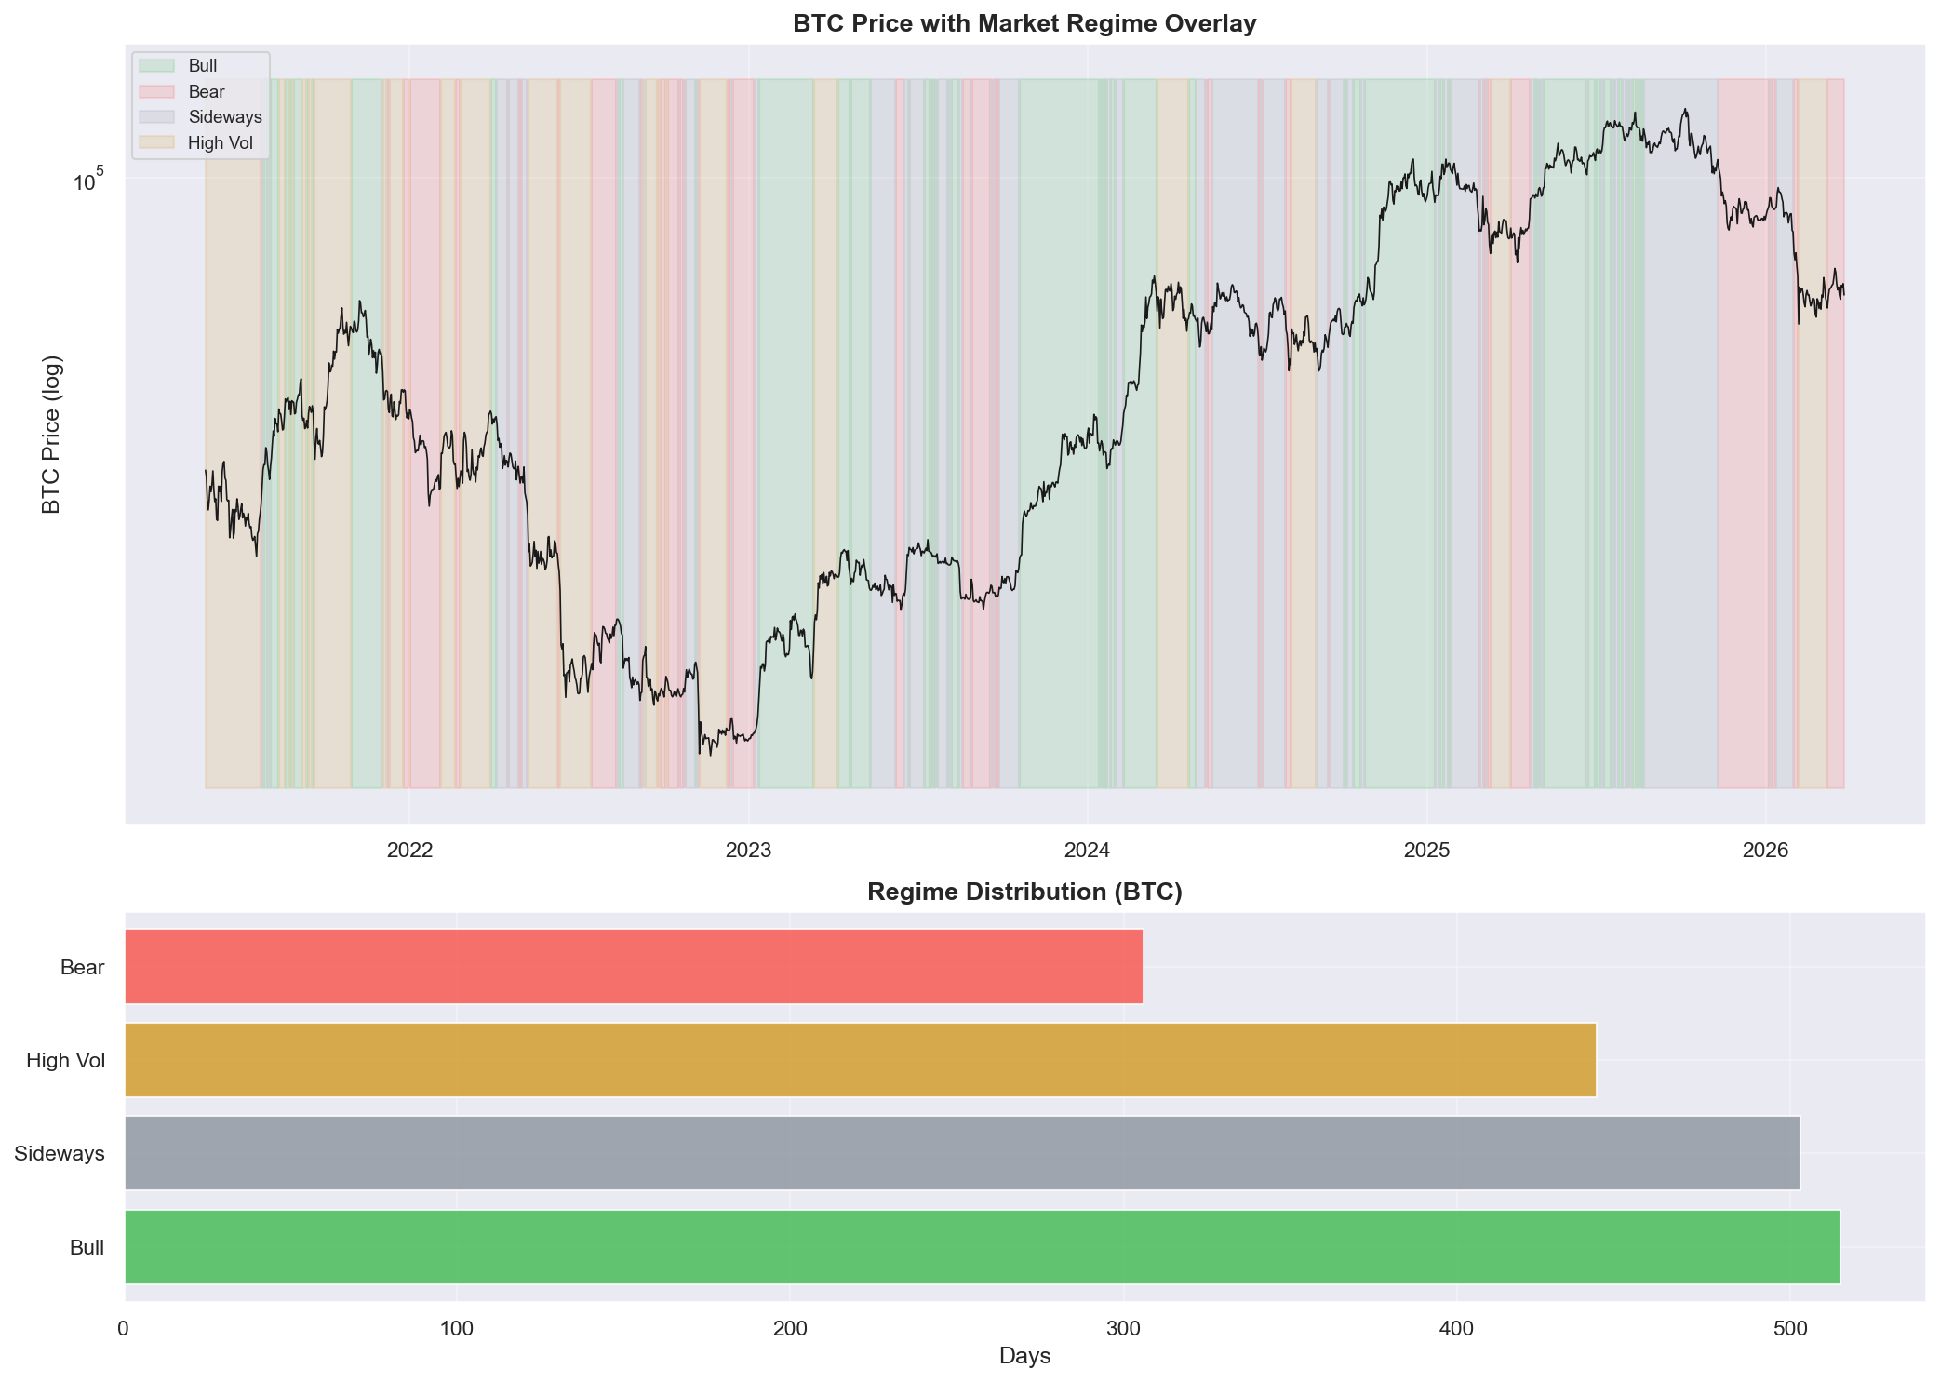
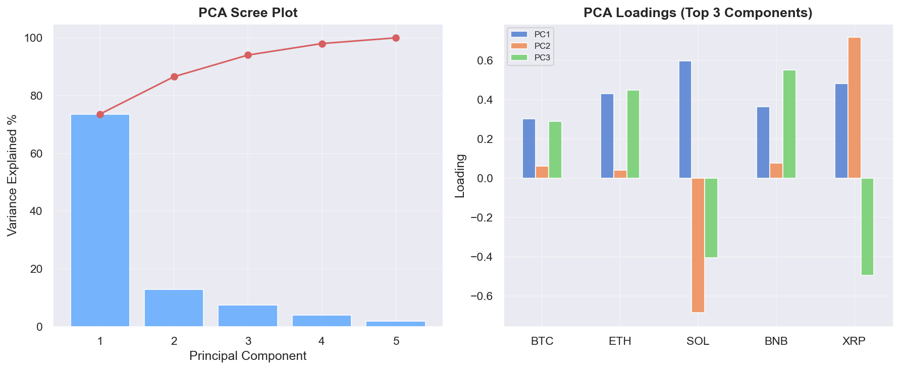
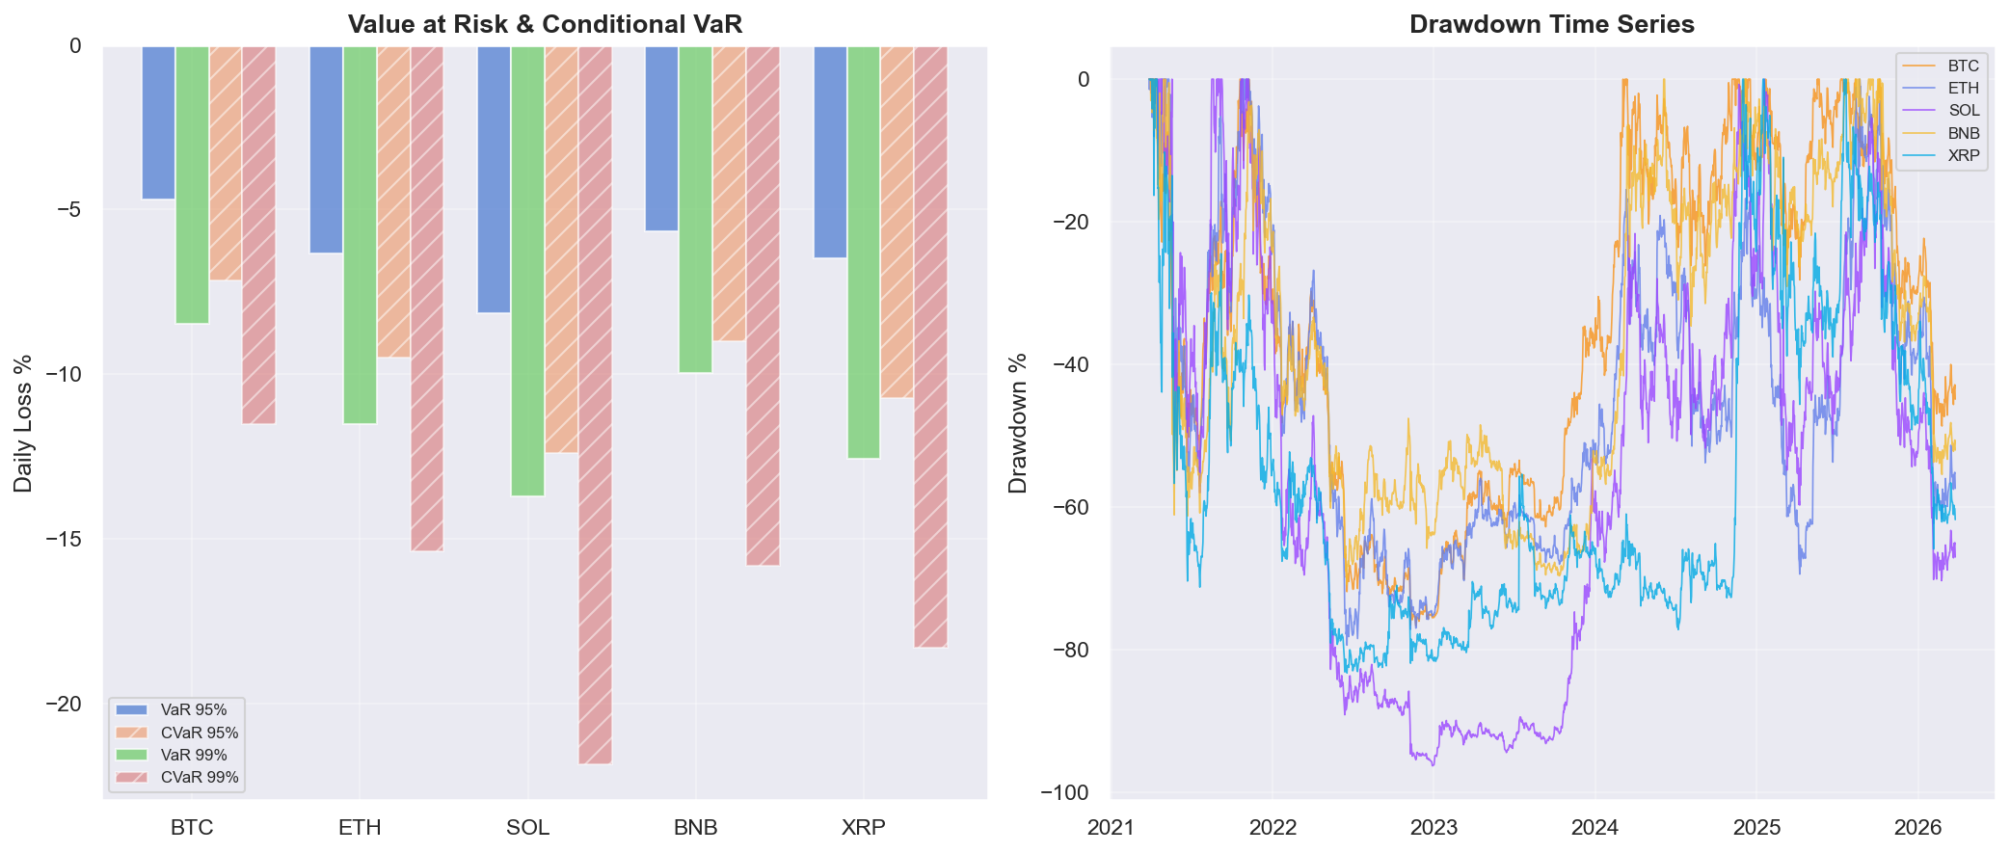
EDA
Market Regimes & Factor Structure
PC1 explains ~75%+ of variance — a single crypto market factor dominates, limiting diversification
Regime detection: rolling 60-day return + 30-day volatility | VaR/CVaR at 95% and 99% confidence levels

Slide 7
STRATEGY
Signal Architecture: V3 Multi-Layer System
Ornstein-Uhlenbeck regime scoring × Z-score mean reversion × correlation clustering
Signal Generation
Regime Detection
Risk Management
Z = (ln(P) − EMA) / σ
3 entry levels: Z=1.8, 2.0, 2.5
RSI confirmation on weak signals
200-day EMA trend filter
ATR-based stop-loss (2.8×)
Rolling AR(1) → OU calibration
θ = −ln(1+b), T½ = ln2/θ
Score = 0.4×halflife + 0.3×R² + 0.3×pval
Continuous sizing: 0.15× → 1.4×
Hard floor at score < 0.1
ATR position sizing: risk/ATR×k
Max 18% per layer, 38% total
DD breaker: −50% at 15% DD
Correlation cluster cap: 35%
Max 15 concurrent positions
V3 improvements over V2: continuous regime scaling (vs binary), multi-layer entries, correlation-aware allocation, RSI confirmation

Slide 8
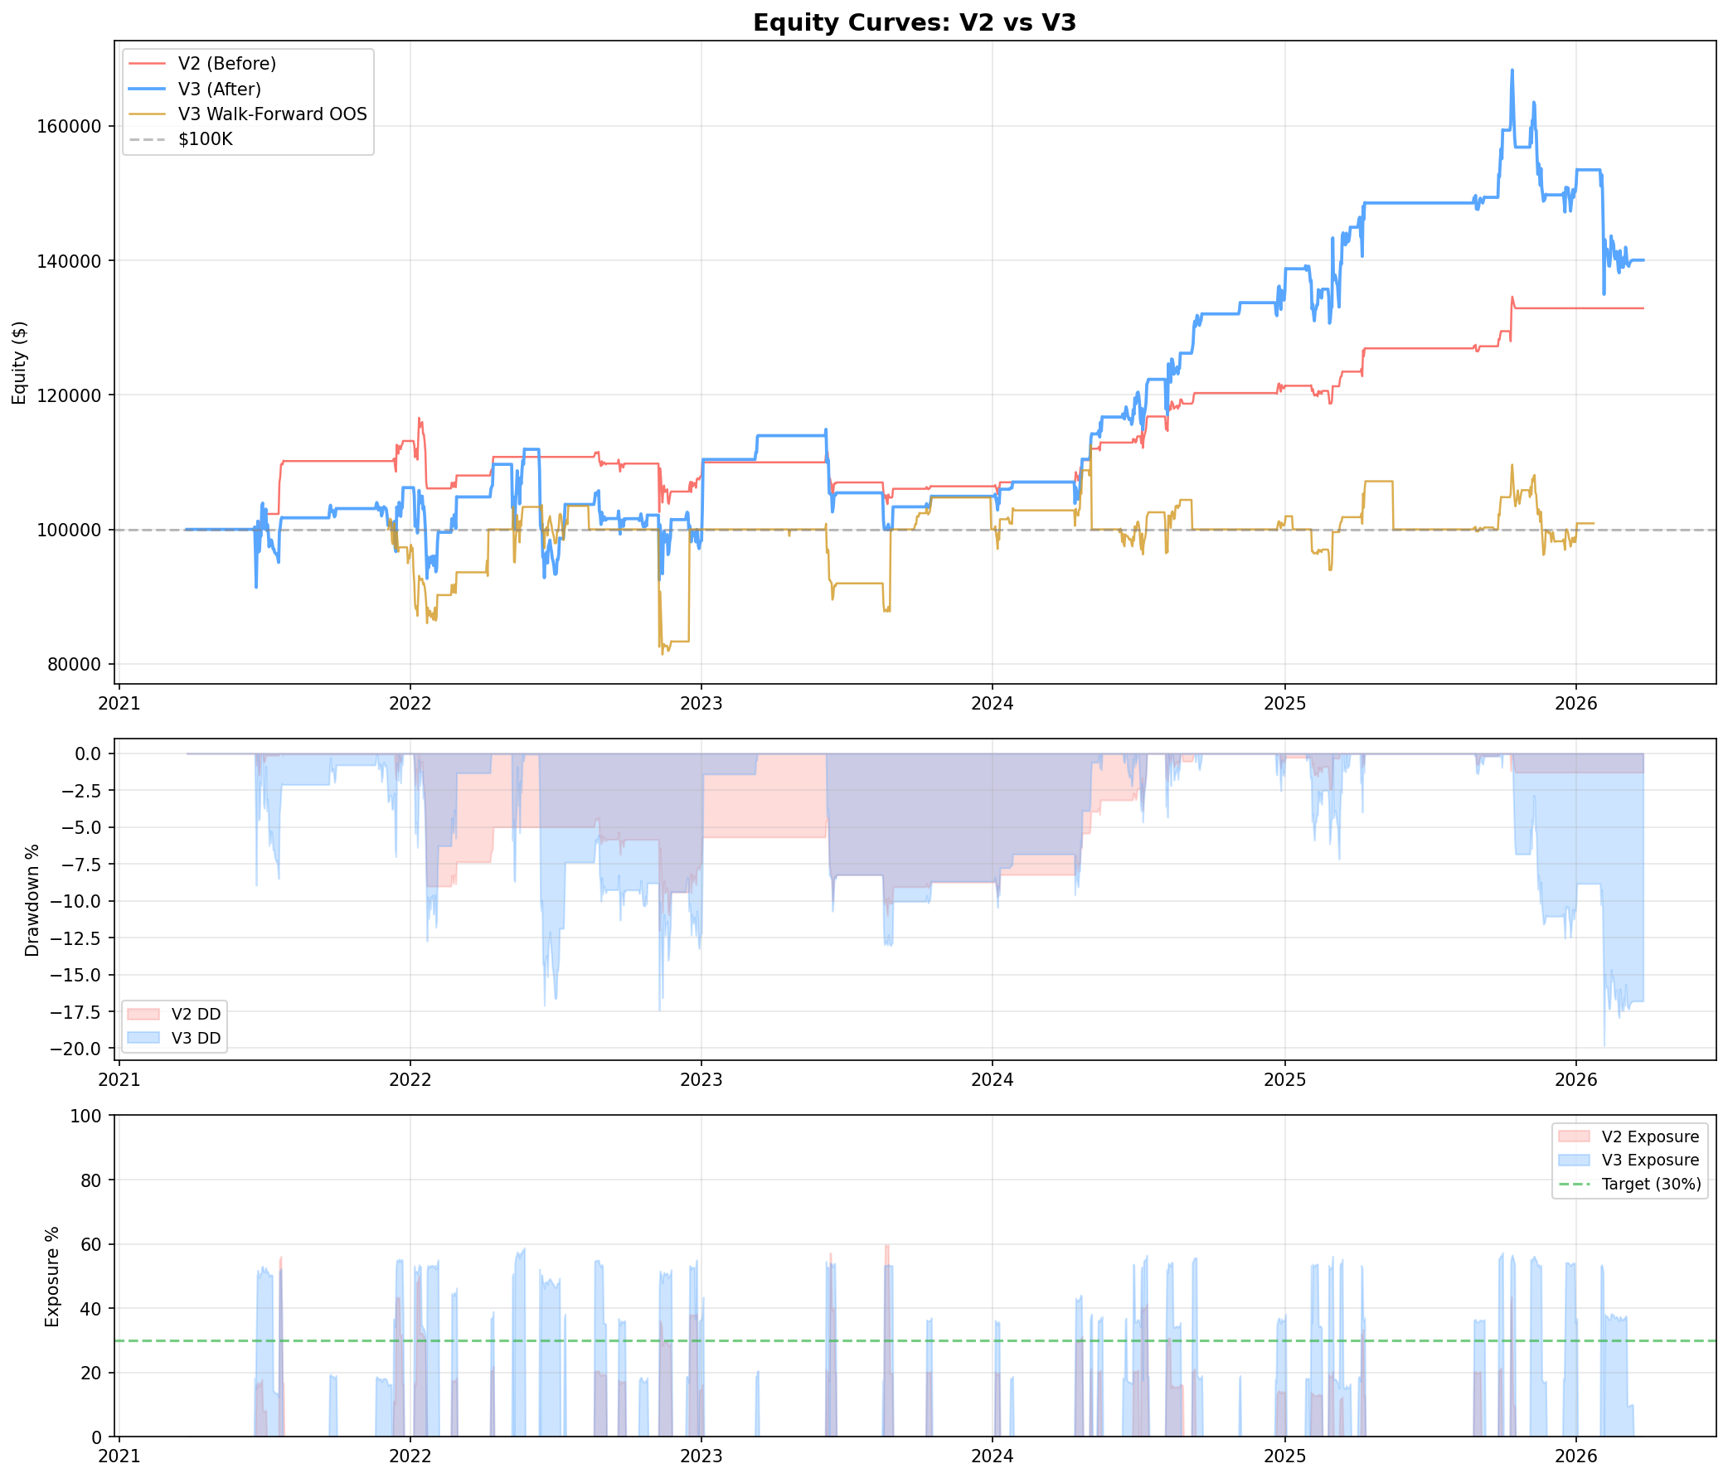
RESULTS
Before & After: V2 vs V3 Equity Curves
V3 (blue) achieves higher returns with better capital utilization — walk-forward OOS in gold
Red = V2 baseline (single entry, binary regime) | Blue = V3 (multi-layer, continuous regime, correlation-aware) | Gold = Walk-forward OOS

Slide 9
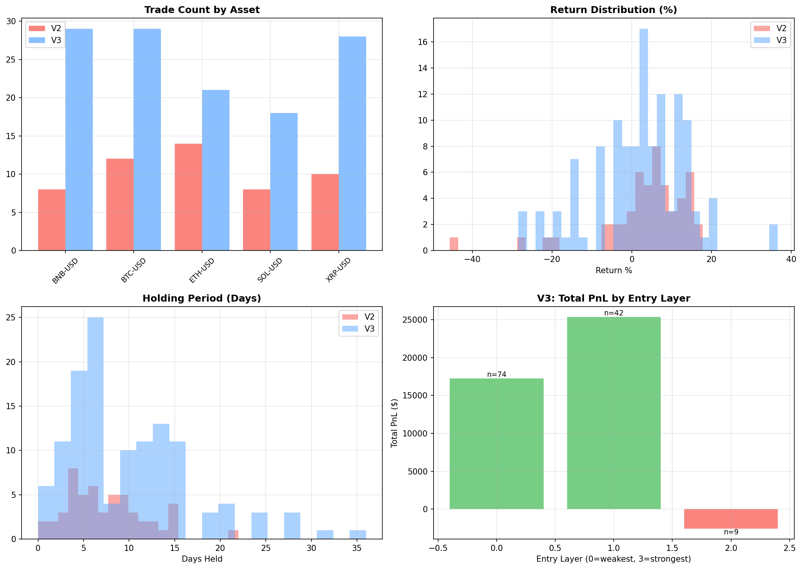
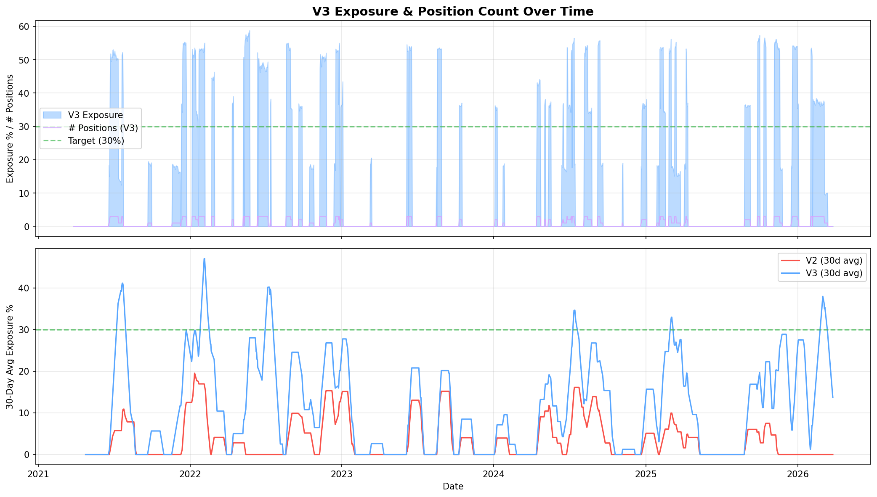
RESULTS
Trade Distribution & Capital Utilization
V3 generates significantly more trades across all assets with tighter holding periods
V3 multi-layer system: trades per asset, return distribution, holding period, PnL by entry layer | Exposure target: 30%

Slide 10
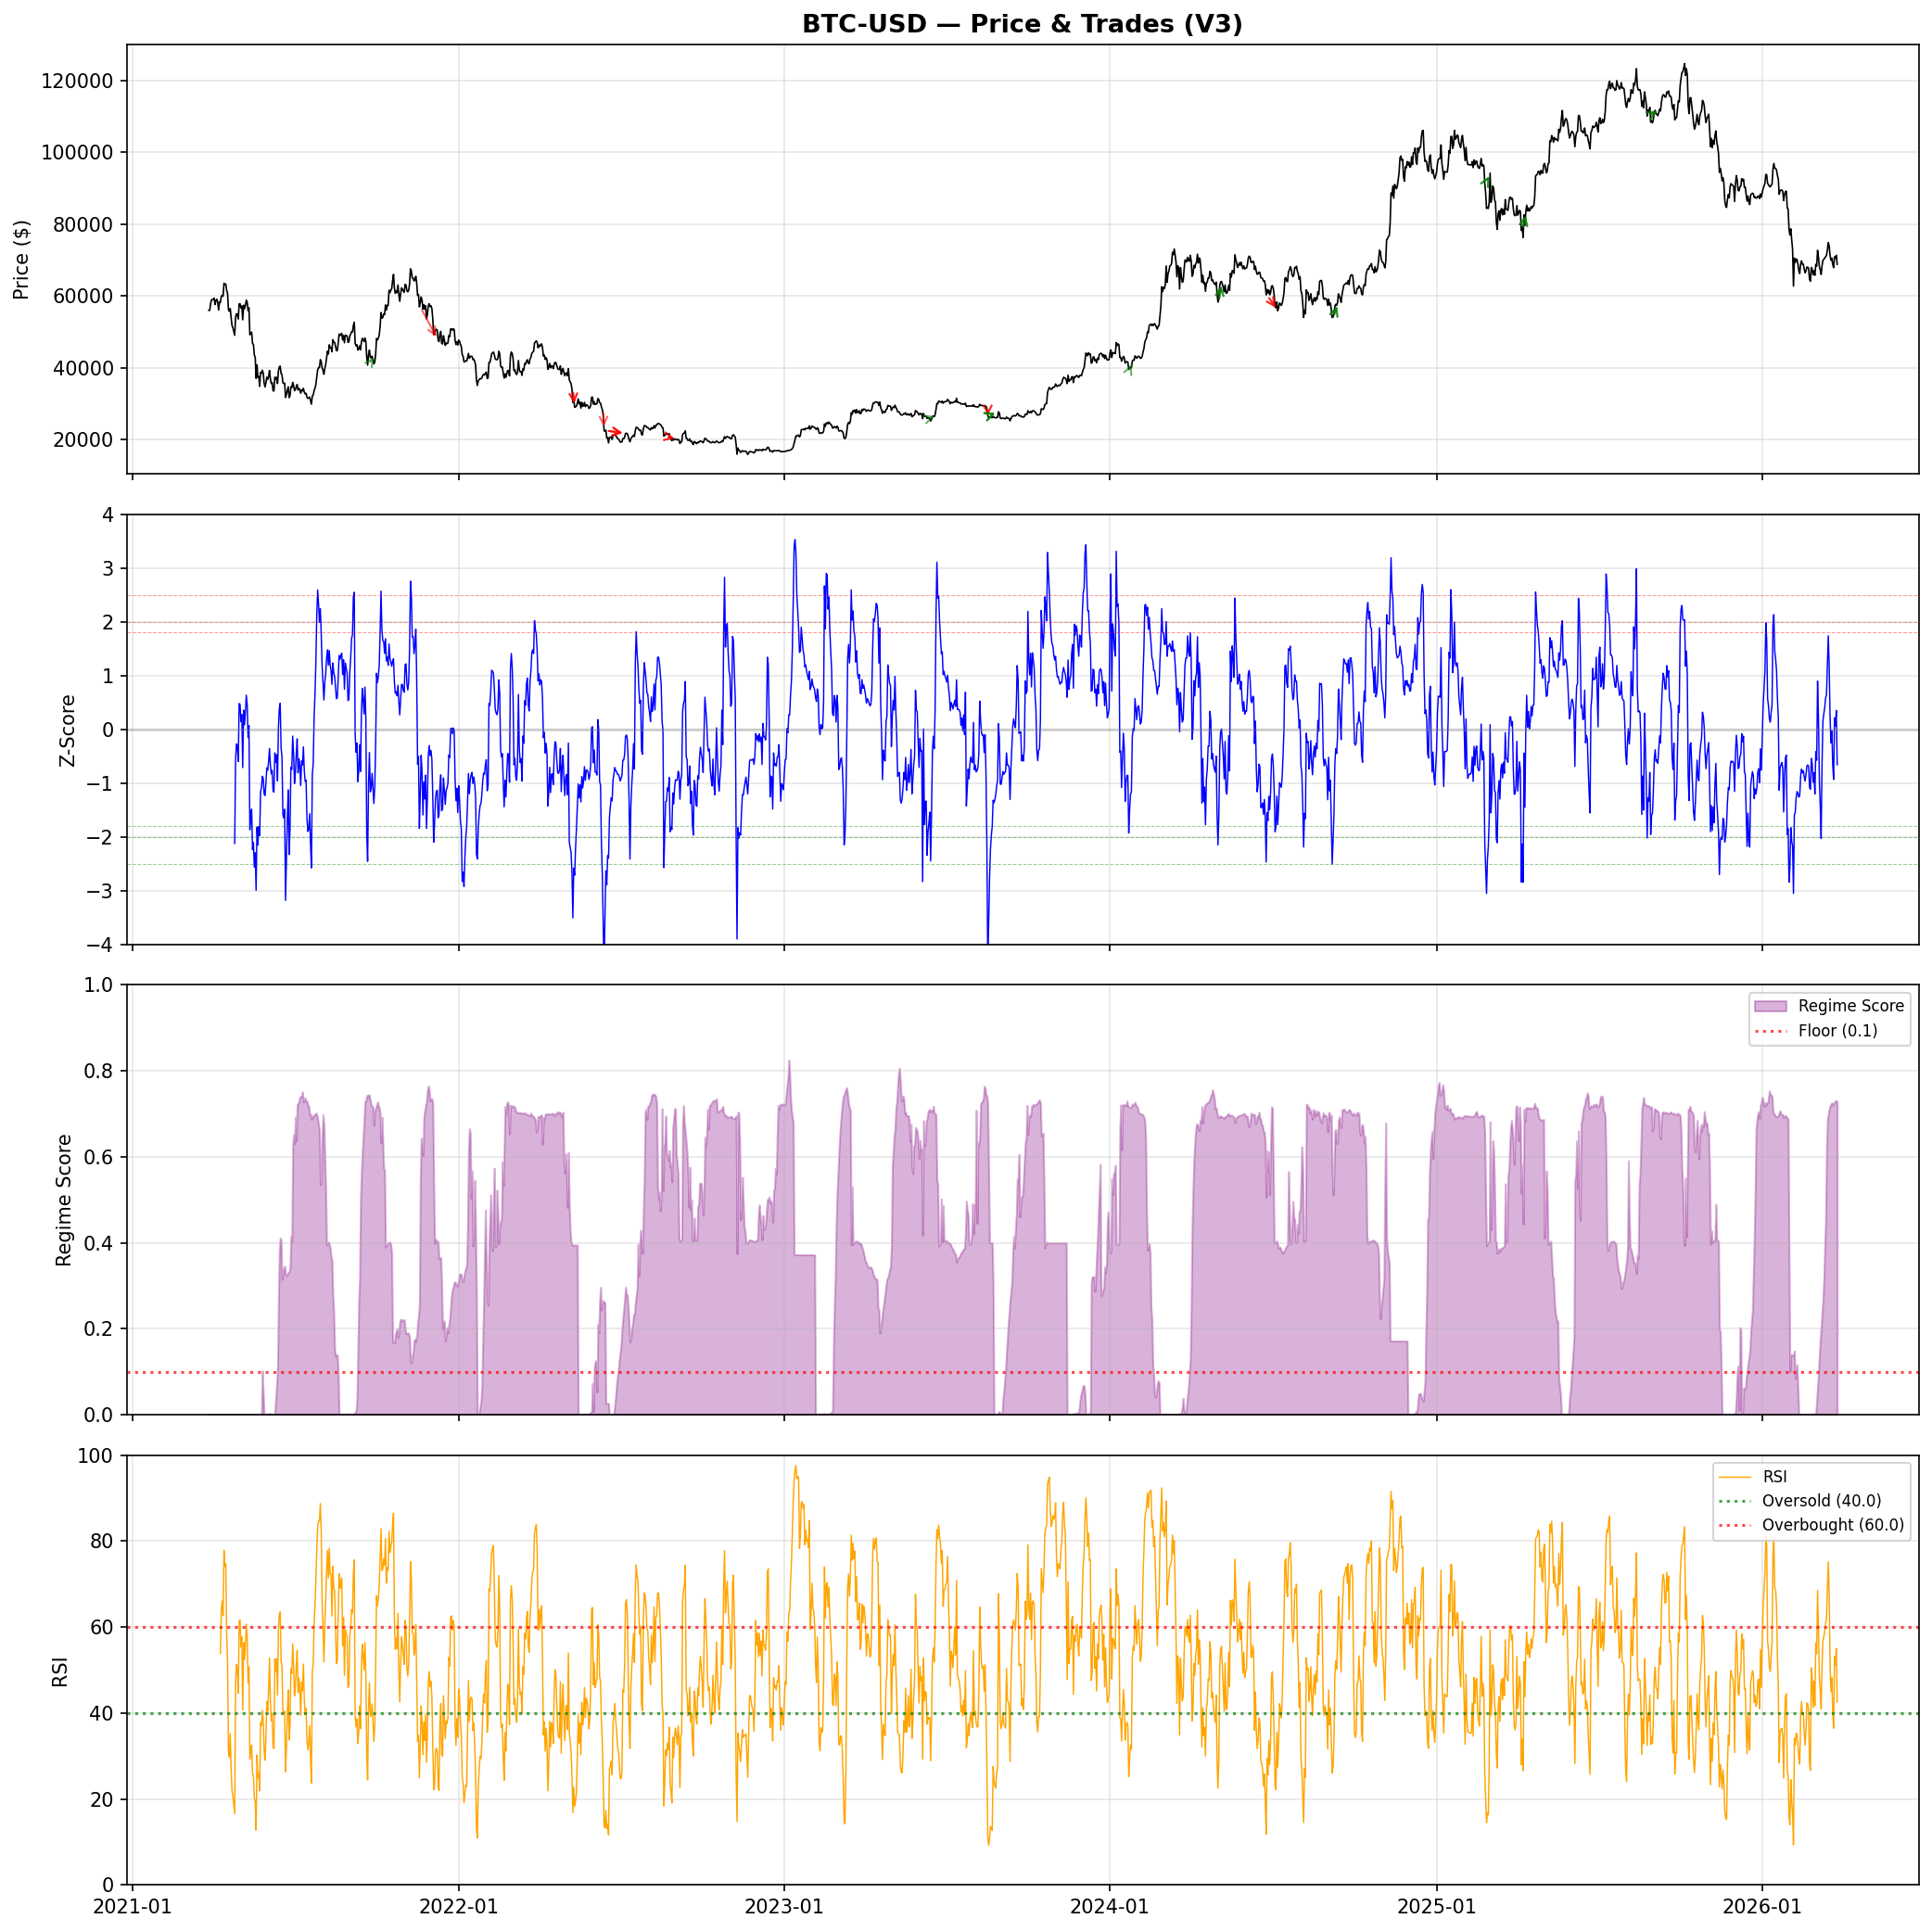
DEEP DIVE
BTC-USD: Price, Z-Score, Regime & RSI
Four-panel signal decomposition showing exactly when and why the strategy trades
Panel 1: Price
Trade arrows show entry → exit. Green = profit, red = loss. Visual confirmation of mean-reversion behavior.
Panel 2: Z-Score
Multi-level thresholds at Z = 1.8, 2.0, 2.5. Entries fire when price deviates significantly from rolling EMA.
Panel 3: Regime
OU-calibrated score. Positions scale continuously with regime quality. Red dashed line = hard floor (0.1).
Panel 4: RSI
Momentum confirmation for weak (Layer 0) signals only. Oversold < 40 required for long entries.
Same 4-panel analysis generated for all 5 assets: BTC, ETH, SOL, BNB, XRP

Slide 11
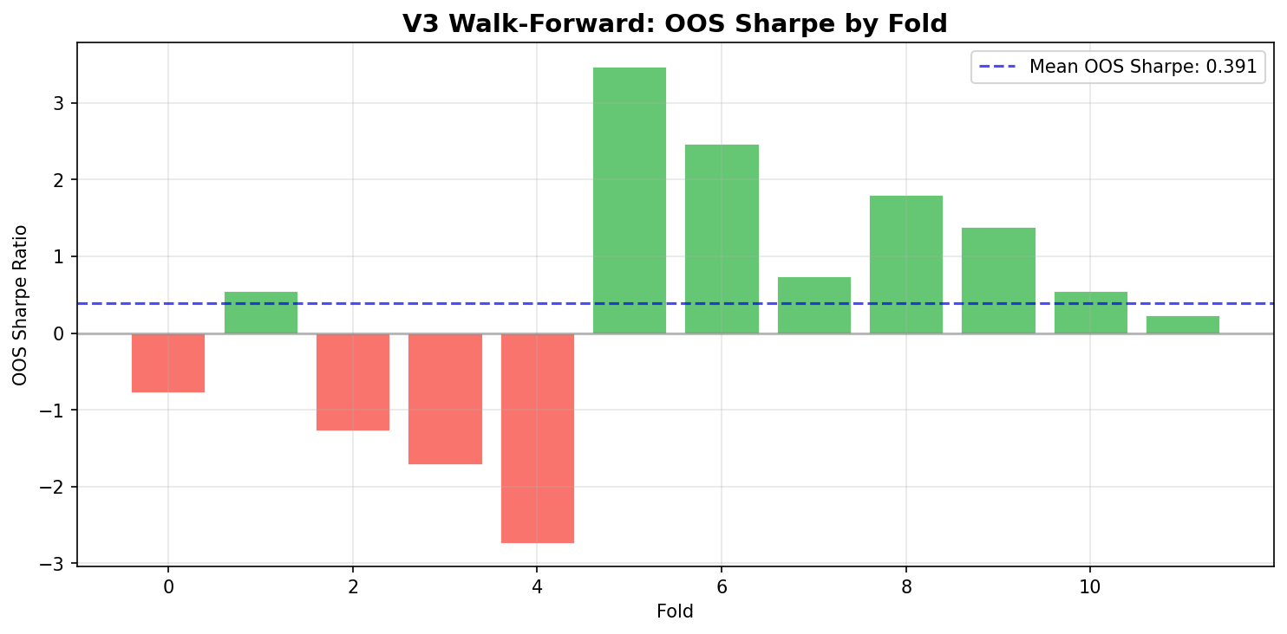
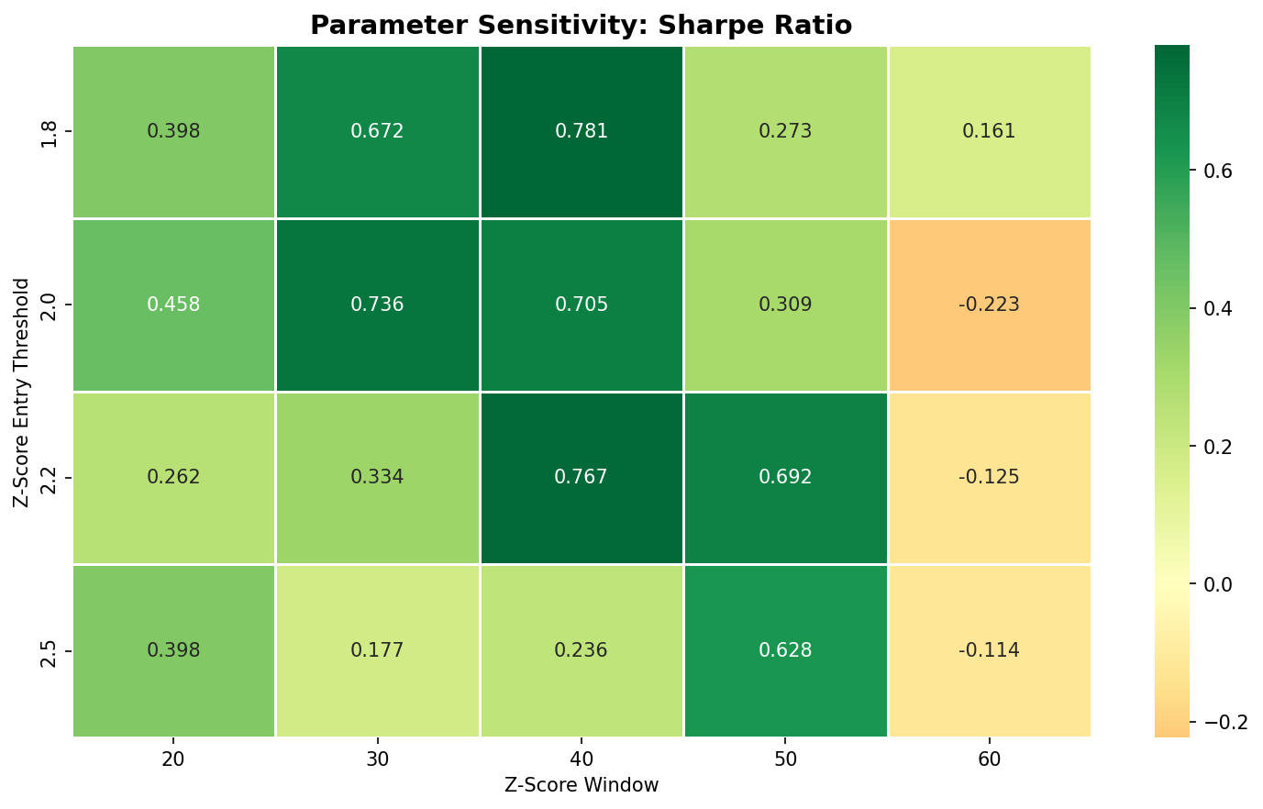
VALIDATION
Walk-Forward Validation & Parameter Sensitivity
Out-of-sample Sharpe ratios by fold + robustness across Z-threshold and window parameter space
Walk-forward: 252d train / 126d test, stepping 126d | Grid search: Z ∈ {1.5, 1.8, 2.0, 2.5}, window ∈ {20, 30, 40, 50, 60}

Slide 12
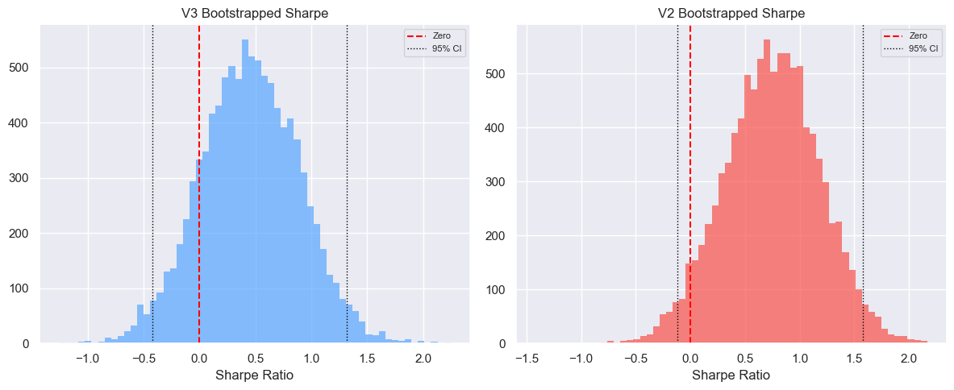
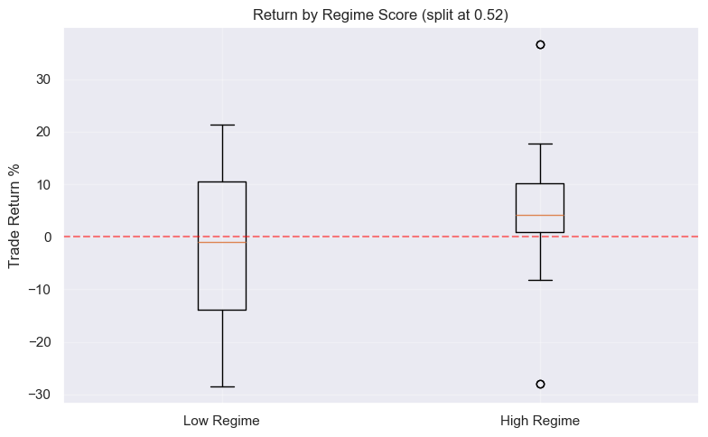
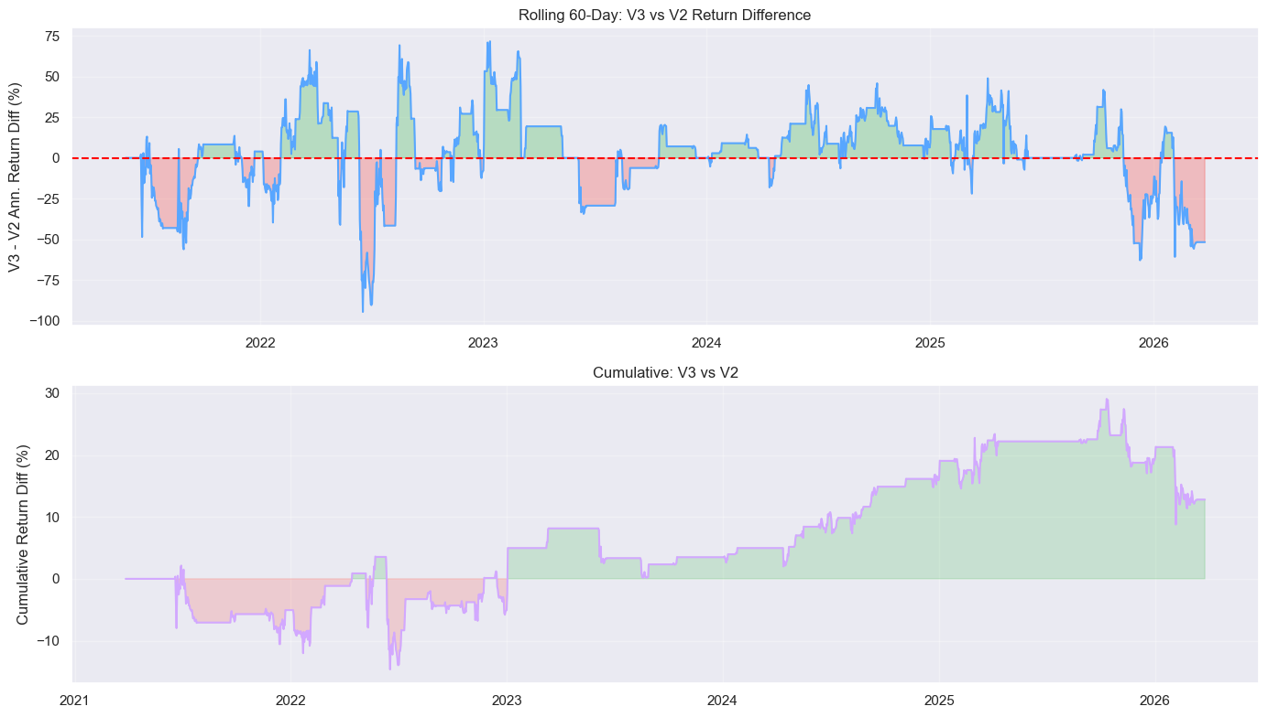
STATISTICS
Statistical Significance & Regime Dependence
Bootstrap confidence intervals on Sharpe ratios + hypothesis test on regime score predictive power
Bootstrap: 10,000 resamples | Regime split: Mann-Whitney U + Welch’s t-test | V2 vs V3: paired t-test + Wilcoxon signed-rank

Slide 13
Key Takeaways
End-to-End Pipeline
Statistically Validated
Built complete research workflow: data ingestion → EDA → signal engineering → backtesting → walk-forward validation → statistical testing
Bootstrap Sharpe CIs, regime dependence tests, Ljung-Box serial correlation checks, paired V2/V3 significance tests
Robust Design
Professional Engineering
Walk-forward OOS confirms out-of-sample predictive power; sensitivity heatmaps show stability across parameter space
Modular Python codebase, interactive Plotly dashboard, frozen dataclass configs, event-driven backtest engine
github.com — Full source code, interactive dashboard, and detailed documentation available

