Slide 1
Predicting ICU Mortality Using deep Learning (FCNN) Maziyar Mirzaei Fall 2024 UT-Austin

Slide 2
Introduction
Objective: Predict ICU mortality using patient data
Approach: Fully Connected Neural Network (FCNN)
Dataset: MIMIC-III (Medical Information Mart for Intensive Care)
A step-by-step guide on building a Fully Connected Neural Network for mortality prediction in ICU patients.
Notes:
In this project, we aim to predict ICU mortality using patient data from the MIMIC-III dataset.
We'll build a Fully Connected Neural Network (FCNN) model to make predictions based on vital signs, lab results, and patient information.

Slide 3
Dataset Overview (MIMIC-III)
Patient Information: Gender, Age, Expire Flag, etc.
Admission Details: Admit time, Discharge time, Diagnosis, etc.
ICU Stay: ICU entry/exit times, Length of Stay (LOS)
Vital Signs & Lab Results: Heart Rate, Blood Pressure, Sodium, Potassium, etc.
Notes:
The MIMIC-III dataset includes various tables with information about patients, their admissions, ICU stays, and vital signs.
We focus on critical features such as vitals and lab results that are captured within the first 24 hours of ICU stay to make early predictions of patient mortality.

Slide 4
Project Overview
Goal: To predict ICU mortality using patient data (vital signs and lab results).
Data Source: ICU data including patient demographics, vitals, and lab tests.
Steps:
Data Collection & Preprocessing
Model Design (FCNN)
Training the Model
Evaluating Performance
Notes:
We want to predict ICU mortality using data such as patient demographics, vital signs, and lab results. The main steps we will follow include data preprocessing, designing a Fully Connected Neural Network, training the model, and finally evaluating its performance to see how well it predicts outcomes.

Slide 5
Data Preprocessing
import pandas as pd # Load data patients = pd.read_csv('PATIENTS.csv', low_memory=False) admissions = pd.read_csv('ADMISSIONS.csv', low_memory=False) icustays = pd.read_csv('ICUSTAYS.csv', low_memory=False) chartevents = pd.read_csv('CHARTEVENTS.csv', low_memory=False) labevents = pd.read_csv('LABEVENTS.csv', low_memory=False) # Merge patient, admission, and ICU stay data merged_df = icustays.merge(admissions, on=['SUBJECT_ID', 'HADM_ID'], how='inner') \ .merge(patients, on='SUBJECT_ID', how='inner') # Add mortality flag as the target variable merged_df['MORTALITY'] = merged_df['HOSPITAL_EXPIRE_FLAG']
Merging patient, admission, and ICU stay data
Adding the MORTALITY flag as the target variable
Filtering data for the first 24 hours of ICU stay
Notes:
To start, we load the data from multiple tables, including patient demographics, admissions, and ICU stays. We then merge these datasets into one comprehensive DataFrame. The key point here is that we add a mortality flag, which will serve as our target variable—basically, a label of whether the patient survived or not

Slide 6
Feature Extraction
# Aggregating vital sign data (mean, min, max) vital_signs_itemids = [220045, 220179, 220180, 220181, 220210, 220277] vital_agg = filtered_vitals.groupby(['ICUSTAY_ID', 'ITEMID']).agg({ 'VALUENUM': ['mean', 'max', 'min'] }).reset_index() # Pivot to create one row per ICU stay vital_features = vital_agg.pivot(index='ICUSTAY_ID', columns='ITEMID', values=['mean', 'max', 'min']) vital_features.columns = ['_'.join(map(str, col)) for col in vital_features.columns] merged_df = pd.merge(merged_df, vital_features, on='ICUSTAY_ID', how='left')
Feature Selection (Vital Signs & Labs)
Slide Content:
Vital signs: Heart Rate, Systolic BP, Diastolic BP, Respiratory Rate, Oxygen Saturation
Lab tests: Sodium, Potassium, Bicarbonate, etc.
Aggregated over the first 24 hours: Mean, Max, Min
Notes:
Next, we extract the important features. These include vital signs like heart rate, blood pressure, and respiratory rate. For each of these, we compute summary statistics such as the mean, max, and min during the first 24 hours of ICU stay. After calculating these, we pivot the data so that each ICU stay has one row, and merge these features back into the main DataFrame.

Slide 7
Data Splitting and Scaling
from sklearn.model_selection import train_test_split from sklearn.preprocessing import StandardScaler # Define features and target X_fcnn = merged_df[vital_cols + lab_cols].values y_fcnn = merged_df['MORTALITY'].values # Standardize the features scaler = StandardScaler() X_fcnn = scaler.fit_transform(X_fcnn) # Split into training and test sets X_train_fcnn, X_test_fcnn, y_train_fcnn, y_test_fcnn = train_test_split(X_fcnn, y_fcnn, test_size=0.3, random_state=42)
Apply StandardScaler to standardize features
Ensures that all features have mean 0 and variance 1
Notes:
Now that we have our features ready, we define our input matrix X and our target variable y. Since neural networks perform better when the data is scaled, we use StandardScaler to standardize the data. Finally, we split the data into training and test sets, with 70% of the data used for training and 30% for testing

Slide 8
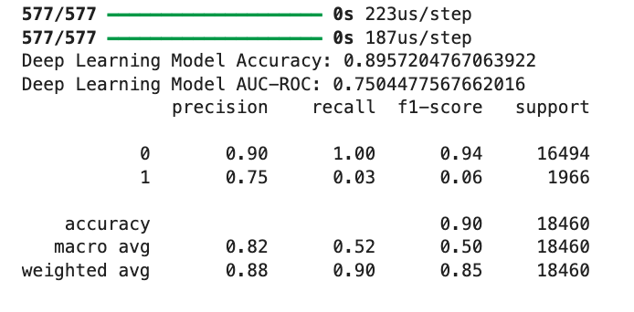
Evaluating the Performance of the Deep Learning Model
from sklearn.metrics import accuracy_score, roc_auc_score, classification_report # Make predictions y_pred = (model.predict(X_test_scaled) > 0.5).astype("int32") # Calculate accuracy and AUC-ROC score accuracy = accuracy_score(y_test, y_pred) y_pred_proba = model.predict(X_test_scaled)
# Probabilities for AUC roc_auc = roc_auc_score(y_test, y_pred_proba) print(f"Deep Learning Model Accuracy: {accuracy}") print(f"Deep Learning Model AUC-ROC: {roc_auc}") # Classification report print(classification_report(y_test, y_pred))
Notes:
After training our model, it’s crucial to evaluate its performance using key metrics. In this case, we’re using:
Accuracy: The proportion of correct predictions over the total number of cases, which is about 90%.
AUC-ROC Score: This is a measure of how well the model distinguishes between classes, with a score of 0.75 in this instance. It tells us how well the model can differentiate between those who survived and those who did not.
Classification Report: This provides us with precision, recall, and F1-score for each class (patients who survived and patients who did not). Notably, our model performs very well in predicting non-mortality cases, but struggles with mortality cases, as shown by the low recall and F1-score for class 1.

Slide 9
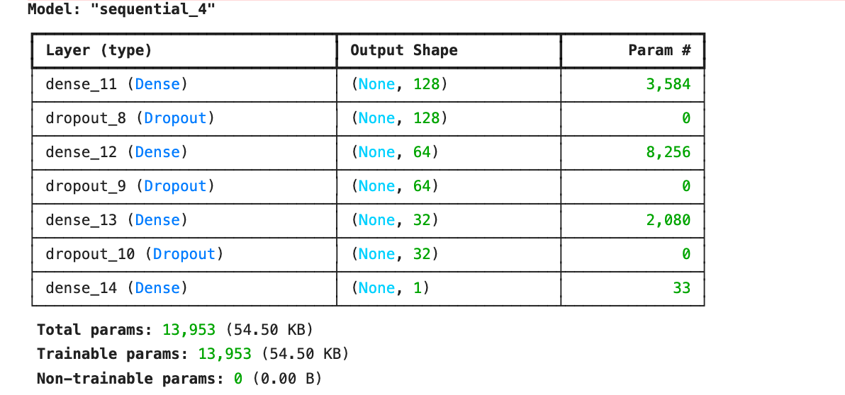
FCNN Model Design
from tensorflow.keras.models import Sequential from tensorflow.keras.layers import Dense, Dropout from sklearn.model_selection import train_test_split from sklearn.preprocessing import StandardScaler import matplotlib.pyplot as plt # Assume merged_df, vital_cols, and lab_cols are defined and X_lstm and y_lstm are prepared # Combine the features for the FCNN X_fcnn = merged_df[vital_cols + lab_cols].values # All features (vitals and labs) y_fcnn = merged_df['MORTALITY'].values # Target variable # Standardize the features scaler = StandardScaler() X_fcnn = scaler.fit_transform(X_fcnn) # Split the data into training and testing sets X_train_fcnn, X_test_fcnn, y_train_fcnn, y_test_fcnn = train_test_split(X_fcnn, y_fcnn, test_size=0.3, random_state=42) # Define a Fully Connected Neural Network (FCNN) model fcnn_model = Sequential() # First dense layer with 128 units fcnn_model.add(Dense(128, activation='relu', input_shape=(X_train_fcnn.shape[1],))) fcnn_model.add(Dropout(0.3)) # Dropout layer to prevent overfitting # Second dense layer with 64 units fcnn_model.add(Dense(64, activation='relu')) fcnn_model.add(Dropout(0.3)) # Third dense layer with 32 units fcnn_model.add(Dense(32, activation='relu')) fcnn_model.add(Dropout(0.3)) # Output layer with sigmoid activation for binary classification fcnn_model.add(Dense(1, activation='sigmoid')) # Compile the model fcnn_model.compile(optimizer='adam', loss='binary_crossentropy', metrics=['accuracy']) # Print model summary fcnn_model.summary()
Notes:
Now let’s dive into the Fully Connected Neural Network (FCNN) design. We start by defining the architecture using Keras. Our network has three hidden layers with 128, 64, and 32 neurons, respectively, each followed by a Dropout layer to prevent overfitting. The output layer uses the sigmoid activation function since this is a binary classification problem—predicting whether the patient survived or not. We compile the model using the Adam optimizer and binary cross-entropy loss.

Slide 10
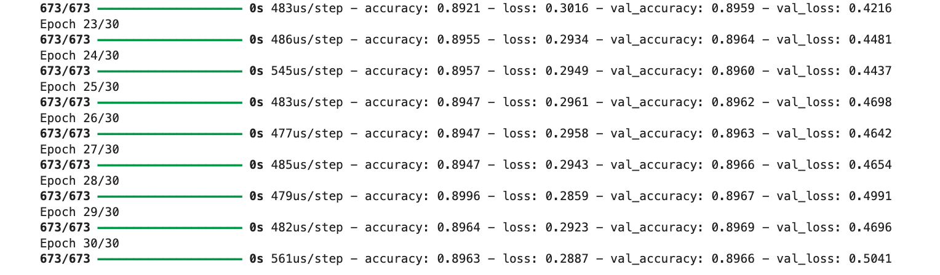
Model Training
# Train the model history_fcnn = fcnn_model.fit(X_train_fcnn, y_train_fcnn, epochs=30, batch_size=64, validation_data=(X_test_fcnn, y_test_fcnn))
Notes:
Once the model is trained, we evaluate its performance on the test set, which the model has never seen before. This helps us understand how well the model generalizes to new, unseen data. In this case, we’re particularly interested in the test accuracy—how often the model correctly predicts mortality.

Slide 11
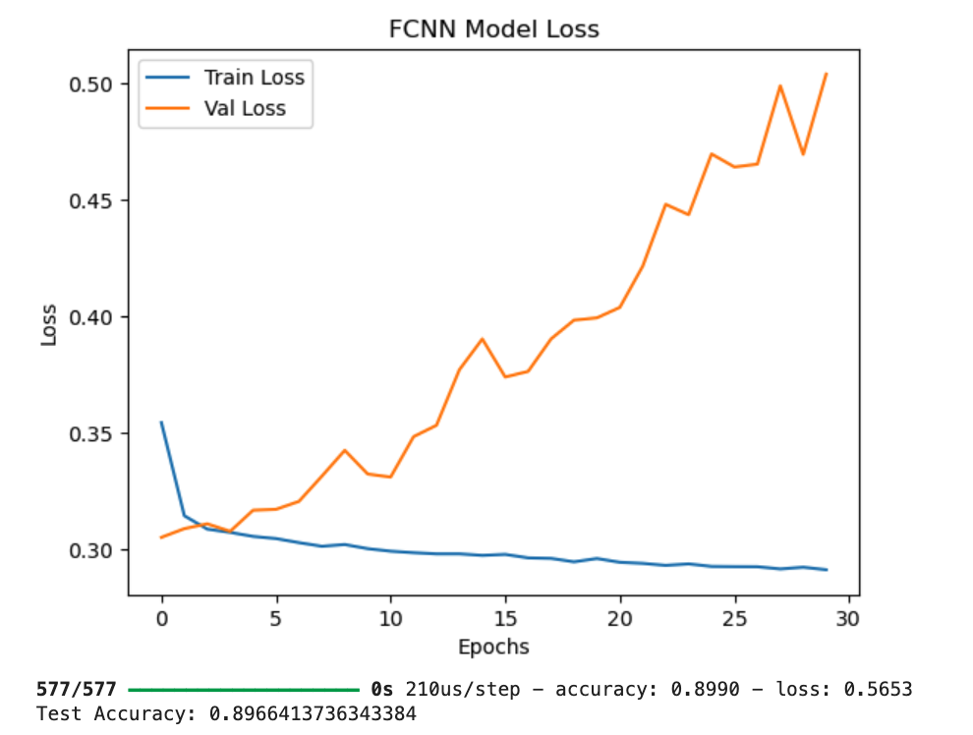
Visualizing Model Accuracy and Loss
# Plot the training history (accuracy) plt.plot(history_fcnn.history['accuracy'], label='Train Accuracy') plt.plot(history_fcnn.history['val_accuracy'], label='Val Accuracy') plt.title('FCNN Model Accuracy') plt.xlabel('Epochs') plt.ylabel('Accuracy') plt.legend() plt.show() # Plot the training history (loss) plt.plot(history_fcnn.history['loss'], label='Train Loss') plt.plot(history_fcnn.history['val_loss'], label='Val Loss') plt.title('FCNN Model Loss') plt.xlabel('Epochs') plt.ylabel('Loss') plt.legend() plt.show() # Evaluate on the test set test_loss, test_accuracy = fcnn_model.evaluate(X_test_fcnn, y_test_fcnn) print(f"Test Accuracy: {test_accuracy}")
Notes:
To better understand the model's performance over time, we plot the accuracy and loss for both the training and validation sets across all 30 epochs. A model that is overfitting will have a validation loss that starts increasing while the training loss continues to decrease, which we can visually check here.

Slide 12
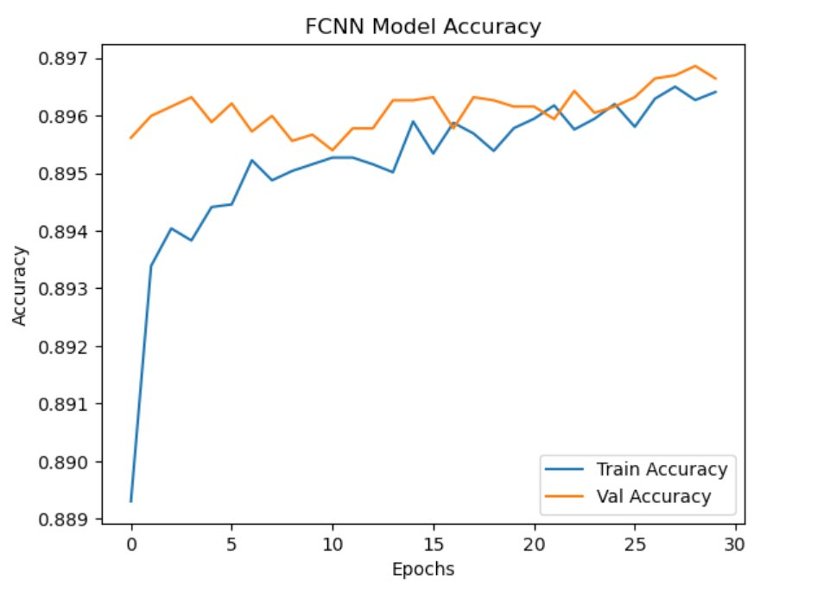

Slide 13
Conclusion
Test Accuracy: ~0.897
Key Points:
FCNN achieved high accuracy (~89%) in predicting ICU mortality.
Model generalizes well but shows some overfitting signs.
Further improvements can be made by tuning hyperparameters or using different models.
Notes:
To summarize, the FCNN model achieved a strong accuracy of around 89%, making it a powerful tool for predicting ICU mortality. However, we observed some signs of overfitting as the validation loss increased toward the end of training. Moving forward, we can experiment with hyperparameter tuning or other models like LSTM to improve results.

Slide 14
THANK YOU
Maziyar Mirzaei

