Slide 1

VCFAAS Scheduler
Example of automatic management of Virtual Machines https://github.ibm.com/IAAS-Solutions/vcfaas_dynamic_workloads

Slide 2
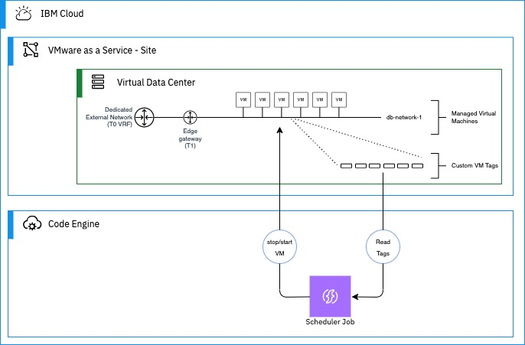
Overview
Goal – To provide a simple example of managing the automatic stopping and starting of Virtual Machines in an IBM Cloud For VMware As A Service environment (VCFaaS).
Architecture
Use Cases / benefits
Fine grain control of resource costs
Automatically stop test environments out of business hours.
Expand Virtual Machines in periods of known high use (for example: end of month)
Notes
Will only benefit environments where hourly resource billing is active. As such, this method will not reduce costs in a dedicated environment.
Scheduler: Custom python script
Code Engine: Executes and manages the script

Slide 3
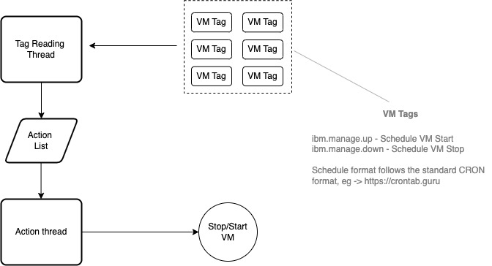
Scheduler
The sample Scheduler is a purpose built custom Python script which can be run on any Python V3.8 or above platform. The code is located here -> https://github.ibm.com/IAAS-Solutions/vcfaas_dynamic_workloads/scheduler
The script is long running and will build a list of stop/start actions similar to CRON and execute the appropriate action at a time designated by the value of the tag.
The repo includes scripts to build, run and delete the code engine job

Slide 4
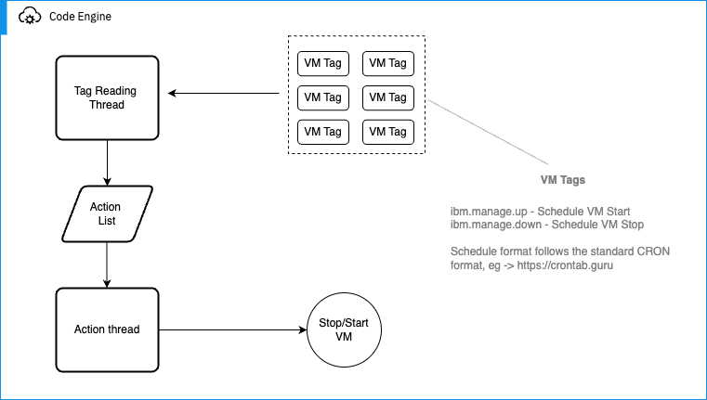
Code Engine
The Scheduler runs serverless on IBM Cloud Code Engine.
The Scheduler job is built to a container with Code Engine job creation and it runs as a serverless daemon job. The repo repo includes scripts to create, run and delete the Code Engine job.

Slide 5
Code Engine Job Execution Example
% ./code-engine-create.sh
################################################################################
Login to IBMCloud with CLI...
################################################################################
API endpoint: https://cloud.ibm.com
Authenticating...
OK
Targeted account IBM - IC4VS - Architecture (72cbd8dc47ae35c60c925005d212fdbc) <-> 1318041
Targeted resource group Default
Targeted region us-south
API endpoint: https://cloud.ibm.com
Region: us-south
User: sami.kuronen@fi.ibm.com
Account: IBM - IC4VS - Architecture (72cbd8dc47ae35c60c925005d212fdbc) <-> 1318041
Resource group: Default
################################################################################
Creating CE a project...
################################################################################
Creating project 'vcd-scheduler-project'...
ID for project 'vcd-scheduler-project' is '2053d54a-0f5a-4e24-bcf4-394df3c87e21'.
Waiting for project 'vcd-scheduler-project' to be active...
Now selecting project 'vcd-scheduler-project'.
OK
################################################################################
Creating CE a secret...
################################################################################
Creating generic secret 'ibmcloud-apikey-to-access-vcfaas'...
OK
################################################################################
Creating CE a job...
################################################################################
Creating job 'vcd-scheduler'...
Packaging files to upload from source path '../scheduler'...
Submitting build run 'vcd-scheduler-run-240906-103451345'...
Creating image 'private.us.icr.io/ce--72cbd-1li7ha093ghr/job-vcd-scheduler'...
Waiting for build run to complete...
Build run status: 'Running'
Build run completed successfully.
Run 'ibmcloud ce buildrun get -n vcd-scheduler-run-240906-103451345' to check the build run status.
OK <<< CONTINUES >>>

Slide 6
Code Engine Job Execution Example cont.
<<< CONTINUED >>>
################################################################################
Follow STDIN log details...
################################################################################
Getting logs for all instances of job run 'vcd-scheduler-run'...
Getting jobrun 'vcd-scheduler-run'...
Getting instances of jobrun 'vcd-scheduler-run'...
OK
vcd-scheduler-run-0-0/vcd-scheduler: 2024-09-06 07:36:08 - INFO - __main__ - 39 - Retrieving Environment....
vcd-scheduler-run-0-0/vcd-scheduler: 2024-09-06 07:36:12 - INFO - __main__ - 86 - ibmcloud_region: us-south
vcd-scheduler-run-0-0/vcd-scheduler: 2024-09-06 07:36:12 - INFO - __main__ - 87 - ibmcloud_vcfaas_site: IBM VCFaaS Multitenant - DAL
vcd-scheduler-run-0-0/vcd-scheduler: 2024-09-06 07:36:12 - INFO - __main__ - 88 - director_url: https://dirw082.us-south.vmware.cloud.ibm.com
vcd-scheduler-run-0-0/vcd-scheduler: 2024-09-06 07:36:12 - INFO - __main__ - 89 - ibmcloud_api_key: <<Secret>>
vcd-scheduler-run-0-0/vcd-scheduler: 2024-09-06 07:36:12 - INFO - __main__ - 90 - ibm_api_key: <<Secret>>
vcd-scheduler-run-0-0/vcd-scheduler: 2024-09-06 07:36:12 - INFO - __main__ - 91 - vmware_access_token: <<Secret>>
vcd-scheduler-run-0-0/vcd-scheduler: 2024-09-06 07:36:12 - INFO - __main__ - 98 - ----- Refreshing Virtual Machine Tags -------
vcd-scheduler-run-0-0/vcd-scheduler: 2024-09-06 07:36:12 - INFO - __main__ - 239 - ----- Start main processing loop -------
vcd-scheduler-run-0-0/vcd-scheduler: 2024-09-06 07:36:12 - INFO - __main__ - 105 - Query all Virtual Machines
vcd-scheduler-run-0-0/vcd-scheduler: 2024-09-06 07:36:12 - INFO - __main__ - 256 - Number of Actions registered after next sleep - 0
vcd-scheduler-run-0-0/vcd-scheduler: 2024-09-06 07:36:12 - INFO - __main__ - 257 - Sleeping for 107 seconds
vcd-scheduler-run-0-0/vcd-scheduler: 2024-09-06 07:36:12 - INFO - __main__ - 130 - Query Virtual Machines Metadata
vcd-scheduler-run-0-0/vcd-scheduler: 2024-09-06 07:36:12 - INFO - lib.tags - 90 - Found Tag - VM: test-cron-1, Name: ibm.manage.down, Value: 05 * * * *
vcd-scheduler-run-0-0/vcd-scheduler: 2024-09-06 07:36:12 - INFO - lib.tags - 90 - Found Tag - VM: test-cron-1, Name: ibm.manage.up, Value: 00 * * * *
vcd-scheduler-run-0-0/vcd-scheduler: 2024-09-06 07:37:12 - INFO - __main__ - 98 - ----- Refreshing Virtual Machine Tags -------
vcd-scheduler-run-0-0/vcd-scheduler: 2024-09-06 07:37:12 - INFO - __main__ - 105 - Query all Virtual Machines
vcd-scheduler-run-0-0/vcd-scheduler: 2024-09-06 07:37:13 - INFO - __main__ - 130 - Query Virtual Machines Metadata
vcd-scheduler-run-0-0/vcd-scheduler: 2024-09-06 07:37:13 - INFO - lib.tags - 90 - Found Tag - VM: test-cron-1, Name: ibm.manage.down, Value: 05 * * * *
vcd-scheduler-run-0-0/vcd-scheduler: 2024-09-06 07:37:13 - INFO - lib.tags - 90 - Found Tag - VM: test-cron-1, Name: ibm.manage.up, Value: 00 * * * *
vcd-scheduler-run-0-0/vcd-scheduler: 2024-09-06 07:37:59 - INFO - __main__ - 261 - Preparing to execute actions...
vcd-scheduler-run-0-0/vcd-scheduler: 2024-09-06 07:37:59 - INFO - __main__ - 39 - Retrieving Environment....
vcd-scheduler-run-0-0/vcd-scheduler: 2024-09-06 07:38:04 - INFO - __main__ - 266 - Executing 0 actions
vcd-scheduler-run-0-0/vcd-scheduler: 2024-09-06 07:38:04 - INFO - __main__ - 239 - ----- Start main processing loop -------
vcd-scheduler-run-0-0/vcd-scheduler: 2024-09-06 07:38:04 - INFO - __main__ - 256 - Number of Actions registered after next sleep - 0
vcd-scheduler-run-0-0/vcd-scheduler: 2024-09-06 07:38:04 - INFO - __main__ - 257 - Sleeping for 115 seconds
vcd-scheduler-run-0-0/vcd-scheduler: 2024-09-06 07:38:13 - INFO - __main__ - 98 - ----- Refreshing Virtual Machine Tags -------
vcd-scheduler-run-0-0/vcd-scheduler: 2024-09-06 07:38:13 - INFO - __main__ - 105 - Query all Virtual Machines
vcd-scheduler-run-0-0/vcd-scheduler: 2024-09-06 07:38:14 - INFO - __main__ - 130 - Query Virtual Machines Metadata
vcd-scheduler-run-0-0/vcd-scheduler: 2024-09-06 07:38:14 - INFO - lib.tags - 90 - Found Tag - VM: test-cron-1, Name: ibm.manage.down, Value: 05 * * * *
vcd-scheduler-run-0-0/vcd-scheduler: 2024-09-06 07:38:14 - INFO - lib.tags - 90 - Found Tag - VM: test-cron-1, Name: ibm.manage.up, Value: 00 * * * *

