Slide 1
Facial Keypoints Detection
Final Project for DTSA 5511 Introduction to Deep Learning
Yasushi Yamanaka
yasushi.yamanaka@colorado.edu

Slide 2
Agenda
1
2
objective
Data preparation
And
Eda
3
4
Model
And
approach
result
5
conclusion

Slide 3
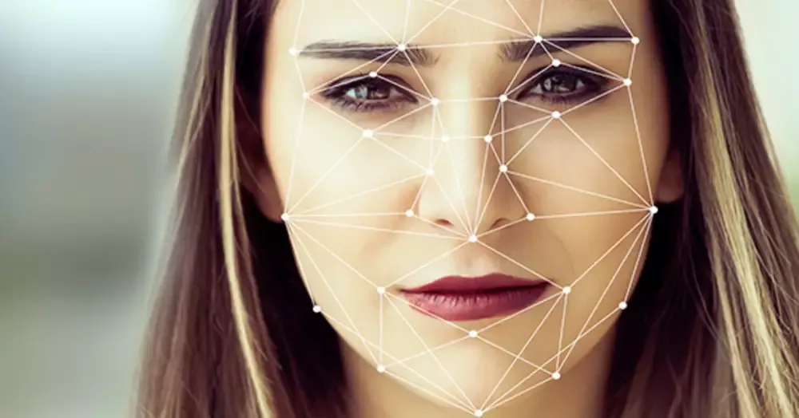
Objective
Facial Keypoints Detection
Wide Range of Applications
Emotion Analysis, Medical Diagnosis, Augmented Reality, Human-Computer Interaction…
Supervised Regression Problem
CNN, Semi-supervised Learning, Multi-Model Method, Transfer Learning

Slide 4
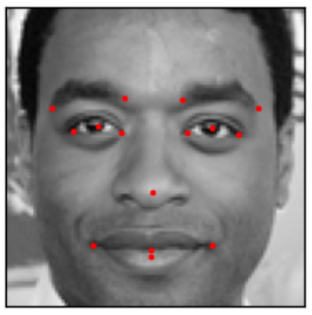
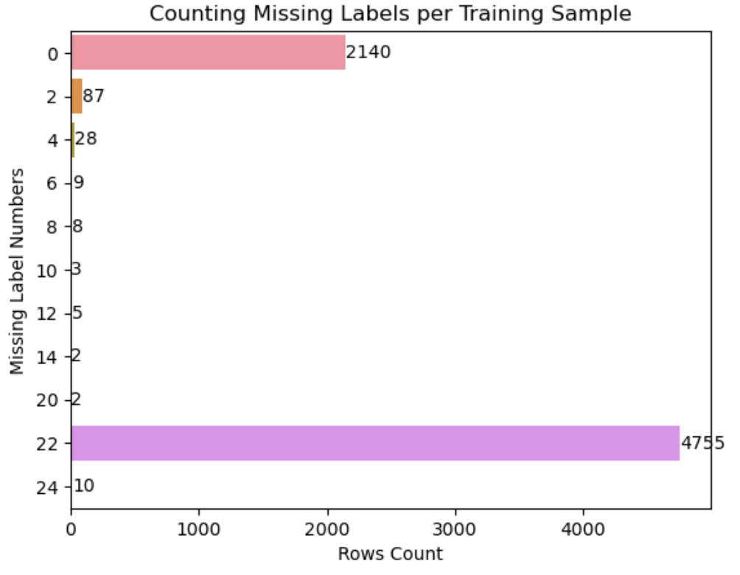
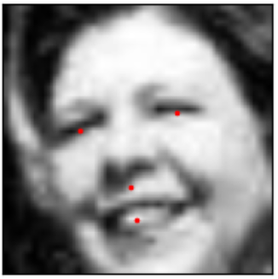
Data preparation And eda
Data with all 15 facial keypoints:
Transform images to CxWxH format
Gray-scale (C=1)
Replicated RGB (C=3)
Normalize by 255 (max intensity)
Deal with missing target values
Simply drop out na
Imputation
Fill forward
Semi-supervised learning
Data with partial facial keypoints:

Slide 5
Model and approach
Approaches for Missing Target Values
Drop-all-missing
Simple imputation (forward fill)
Imputation by Semi-supervised Learning
Two-Model
Deep CNN Models
Self-built CNN
Pretrained Model: EfficientNet-B0

Slide 6
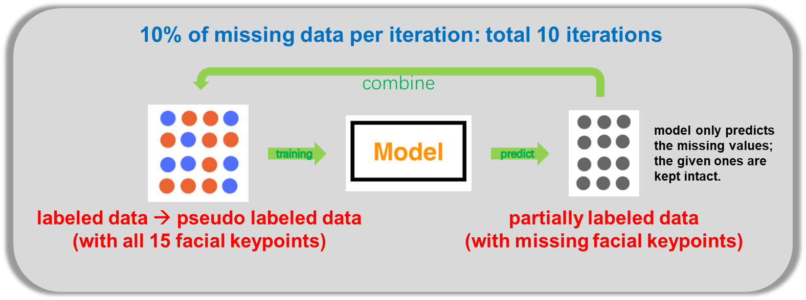
Model and approach
Semi-supervised learning for missing values imputation:

Slide 7
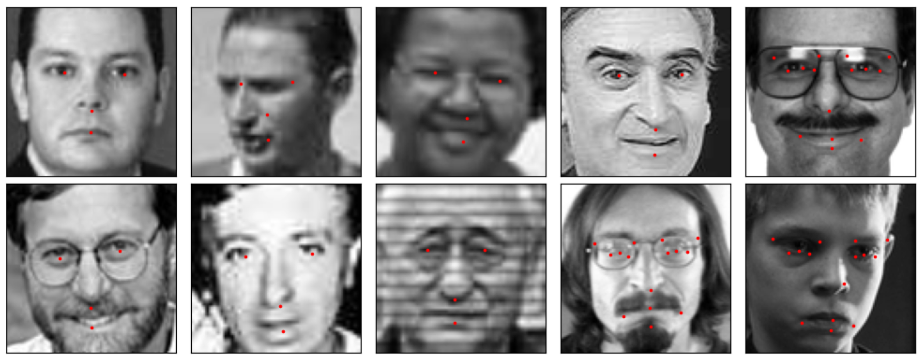
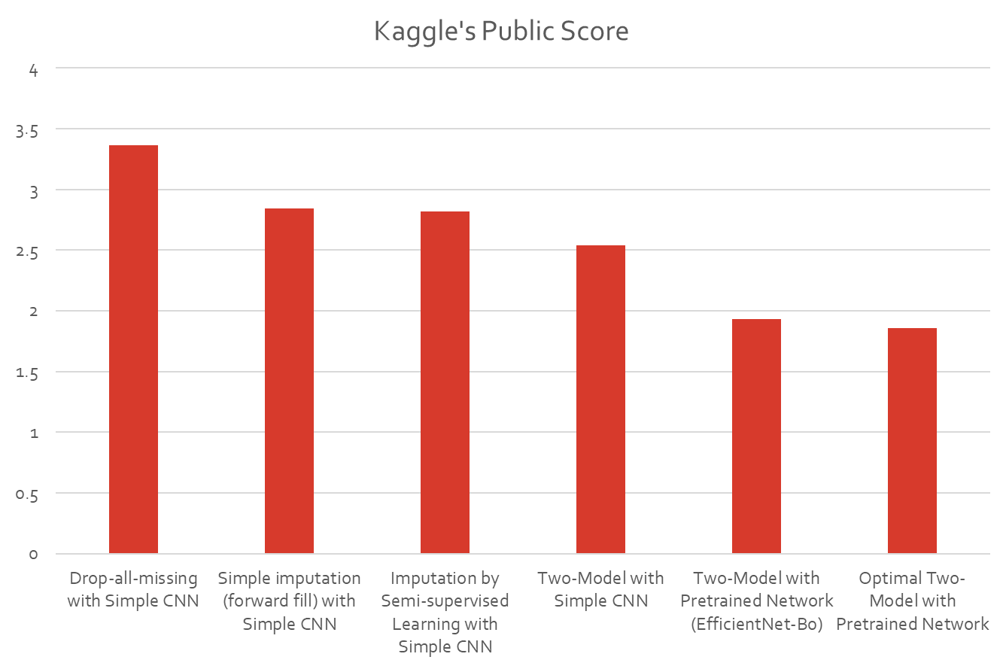
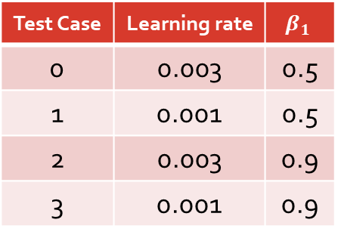
Result
Predictions on test data:
Hyperparameter Tuning:
Test Case | Learning rate | $$β_{1}$$
0 | 0.003 | 0.5
1 | 0.001 | 0.5
2 | 0.003 | 0.9
3 | 0.001 | 0.9

Slide 8

Result
Kaggle’s Scoreboard:
1.85692

Slide 9
conclusion
Multi-Model Methods (Two in this case) work better on this dataset
Different models capture different aspects of the dataset
Semi-supervised imputation performs less than expected
Heterogeneous dataset affects model’s generalizability
Transfer learning performs better than self-built model
Usually for common tasks
Data augmentation and other facial recognition specific pretrained models
EfficientNet pretrained on ImageNet

Slide 10
Thank you

