Slide 1
Credit score Prediction
Final Report for DTSA 5509 Introduction to Machine Learning
Yasushi Yamanaka
yasushi.yamanaka@colorado.edu

Slide 2
Agenda
1
2
objective
Data cleaning
3
4
eda
model
5
6
result
Conclusion

Slide 3
Objective
Credit Score Prediction
Supervised Learning — Multiclass Classification
Model Comparisons — Select Optimal Model

Slide 4
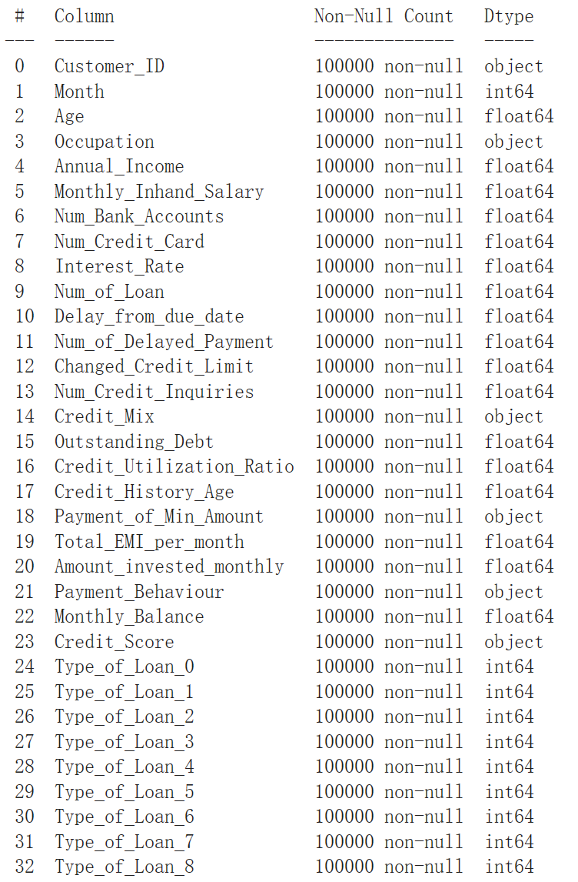
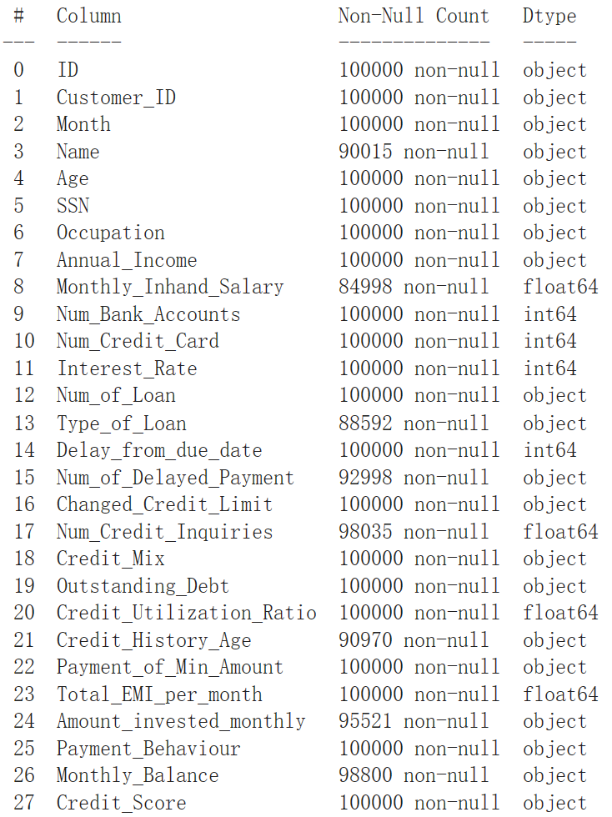
Data Cleaning
Drop irrelevant features
Type conversion
N/A and invalid values
Outliers
Imputation (mode value)

Slide 5
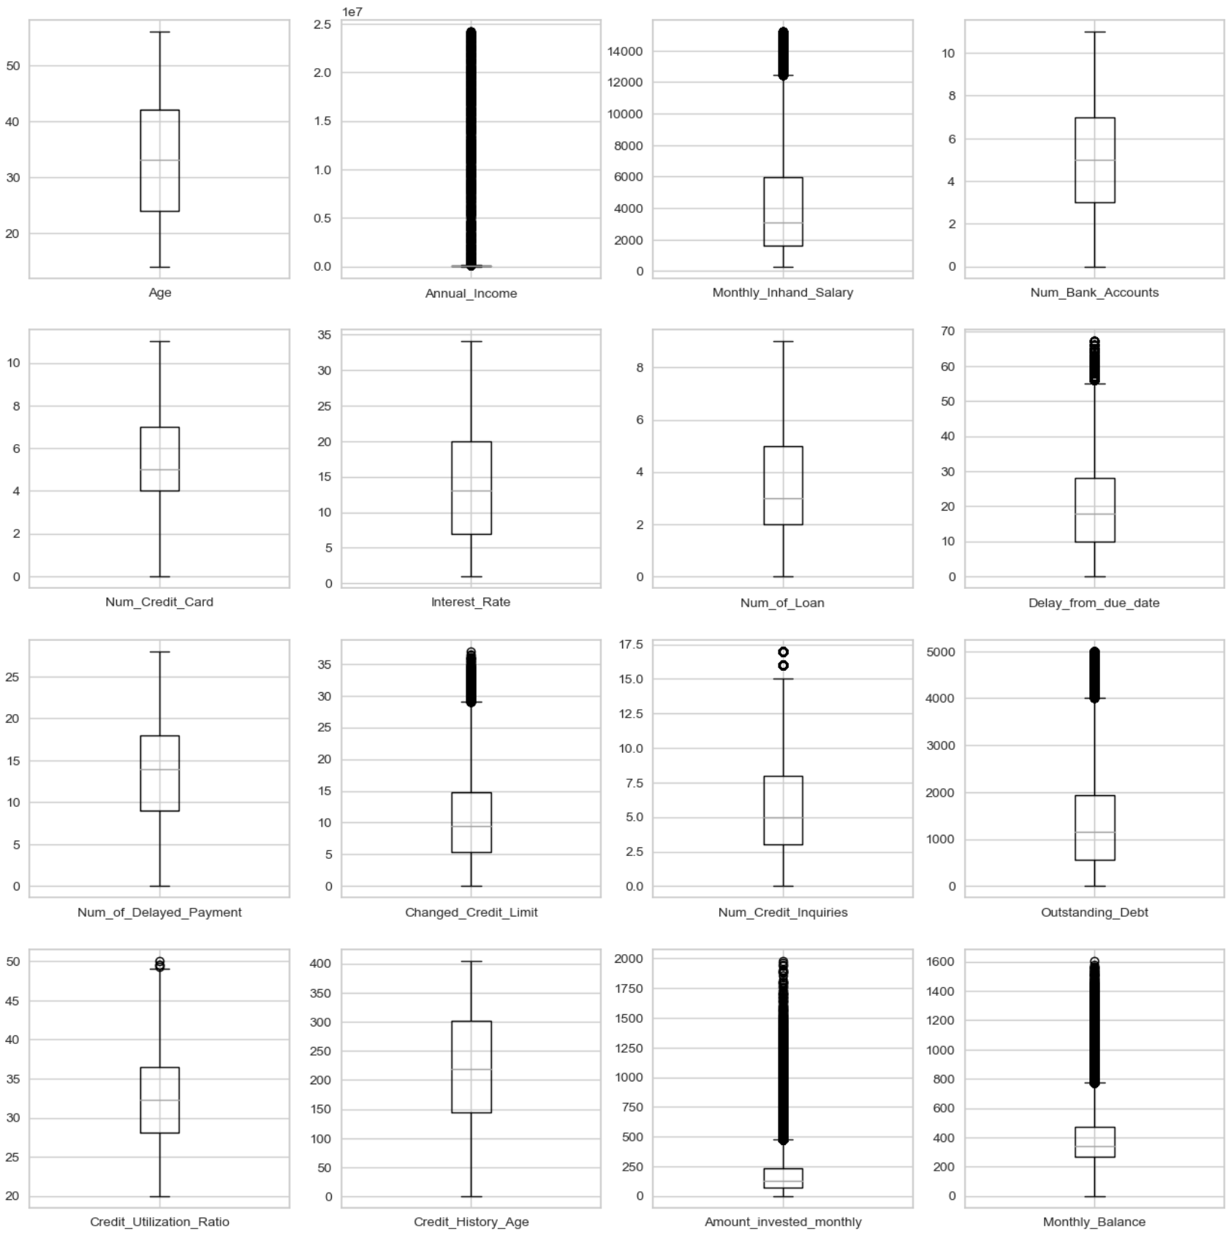
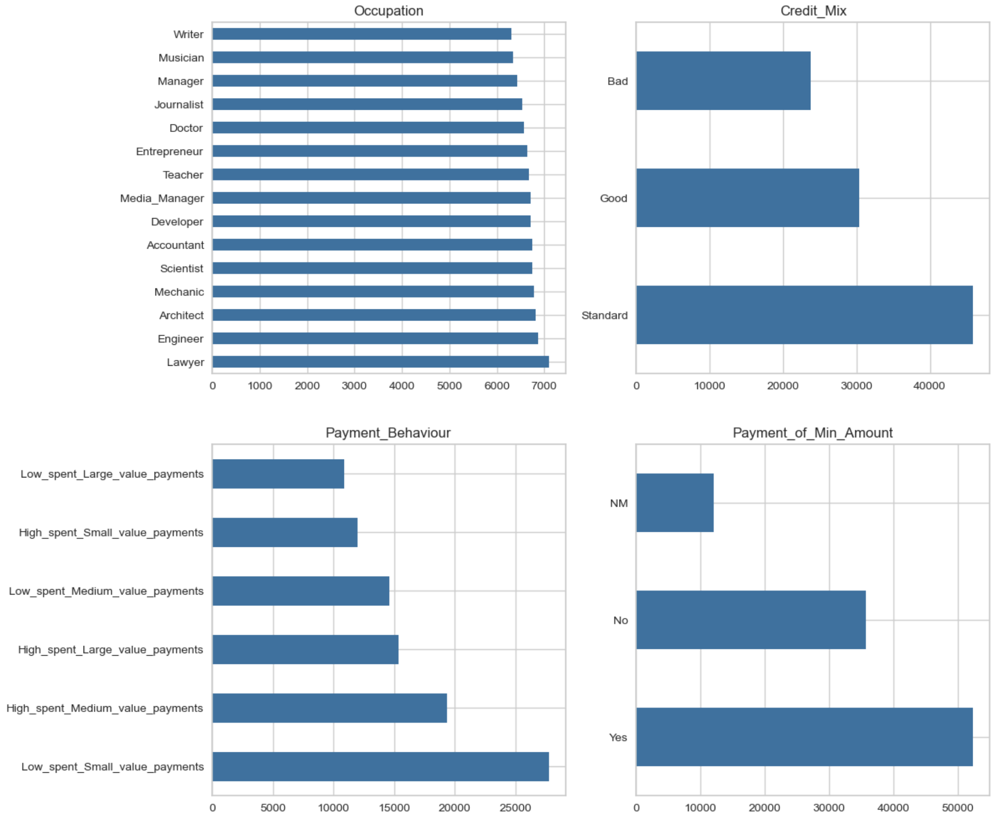
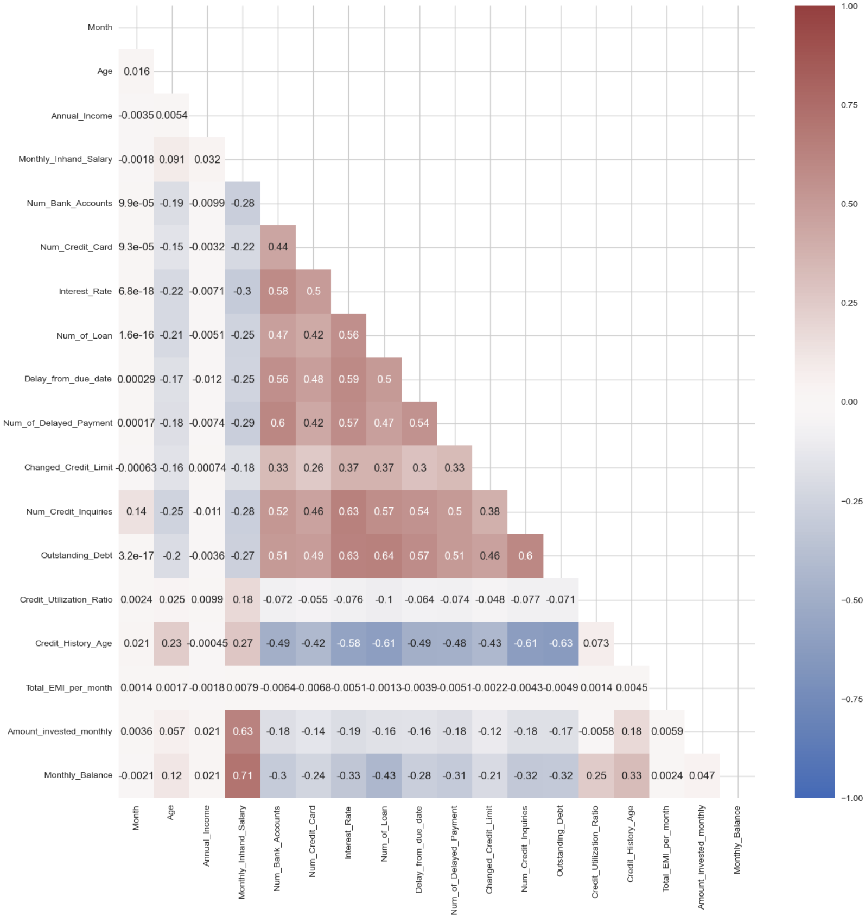
EDA
Numeric
Value
Distribution
Categorical
Value
Imbalance Check
Feature
Correlation
Analysis

Slide 6
model
Logistic Regression
Decision Tree Classifier
Random Forest Classifier
Gradient Boosting Classifier
Feature Selection / Multicollinearity Analysis / Hyperparameter Tuning

Slide 7
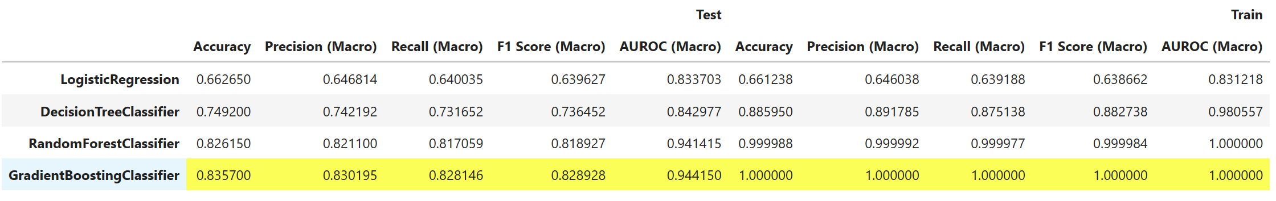
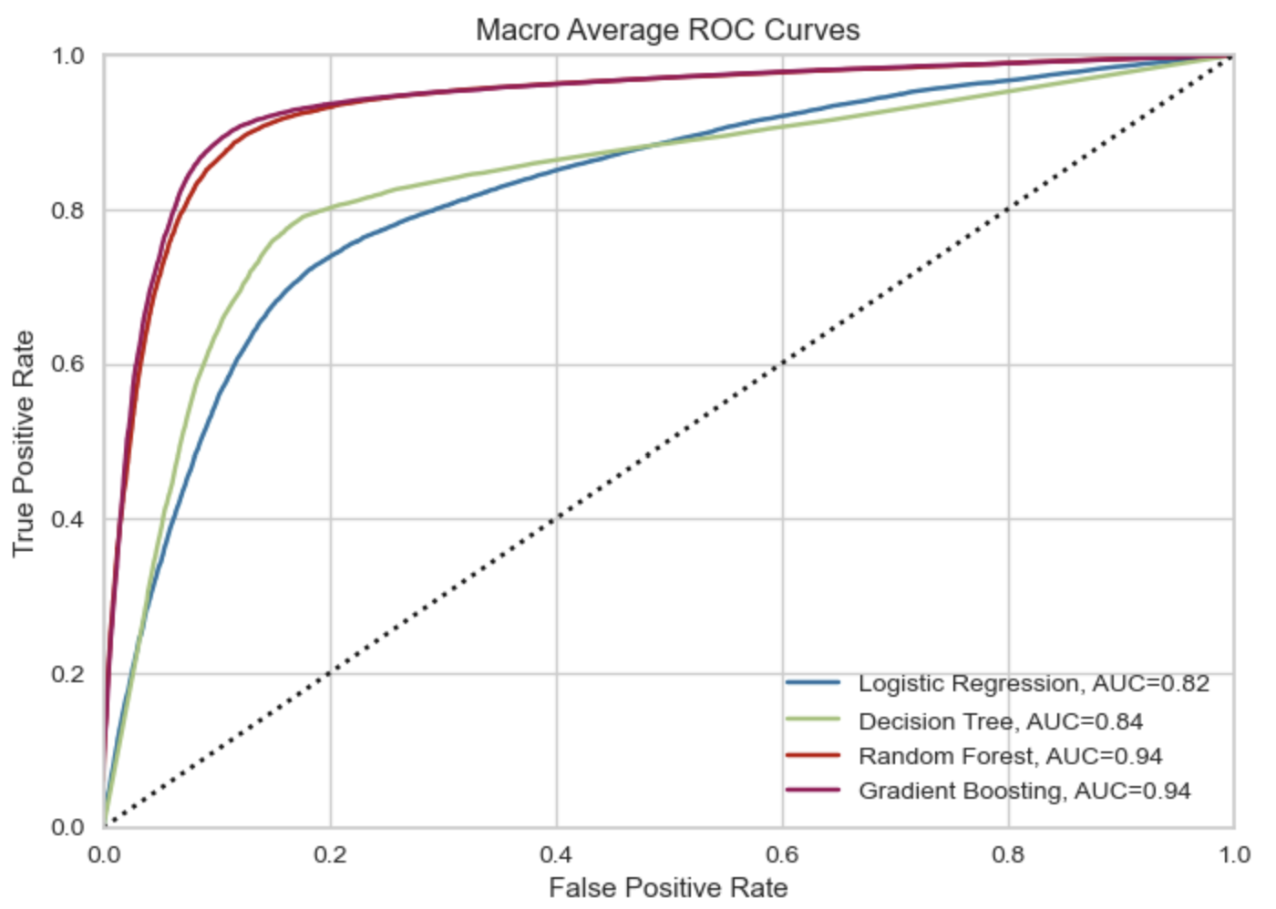
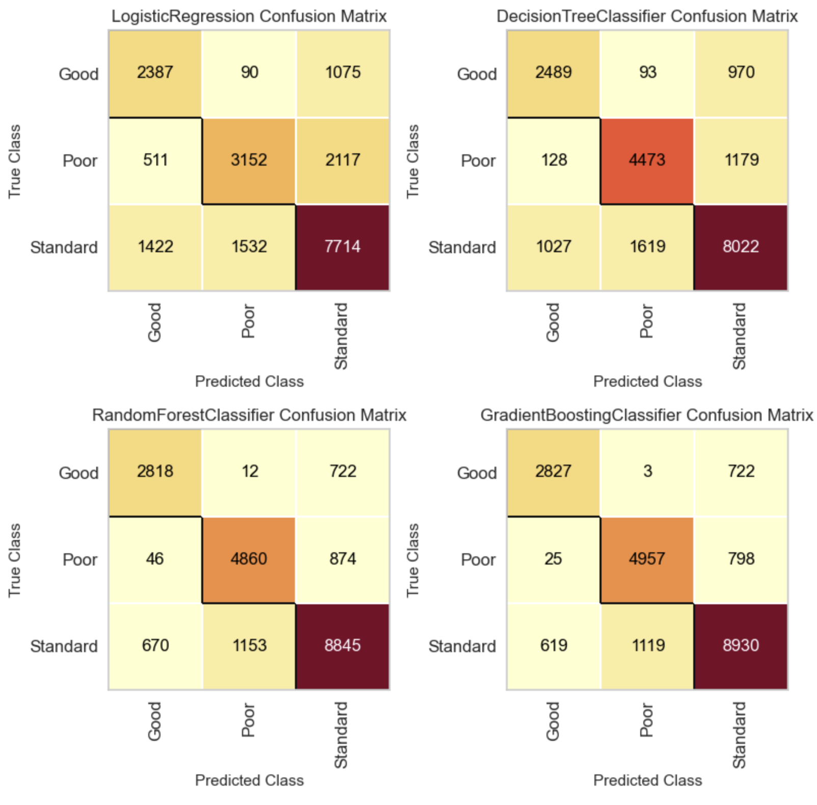
Result
Feature Selection + Multicollinearity Analysis + Hyperparameter Tuning
Metrics
Accuracy
Precision / Recall / F1 Score
AUROC / ROC Curve
Confusion Matrix

Slide 8
conclusion
Gradient Boosting Classifier has the highest accuracy (computationally expensive)
Random Forest Classifier has the best overall performance
Effect of multicollinearity is low in this study
Half of the features contribute most of the predictability

Slide 9
Thank you

