Slide 1
Forest cover type Prediction
Final Project for DTSA 5510 Unsupervised Algorithms in Machine Learning
Yasushi Yamanaka
yasushi.yamanaka@colorado.edu

Slide 2
Agenda
1
2
objective
Data preparation
3
4
eda
model
5
6
result
Conclusion

Slide 3
Objective
Forest Cover Type Prediction
Multiclass Classification
Supervised, Unsupervised, and Semi-supervised Learning

Slide 4
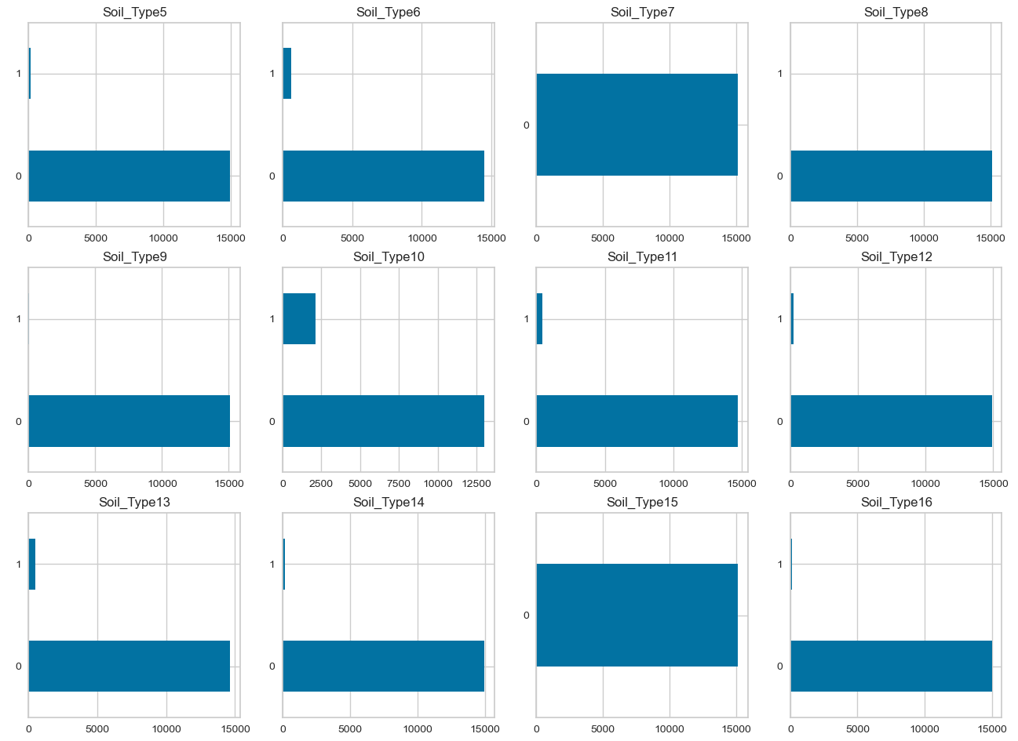
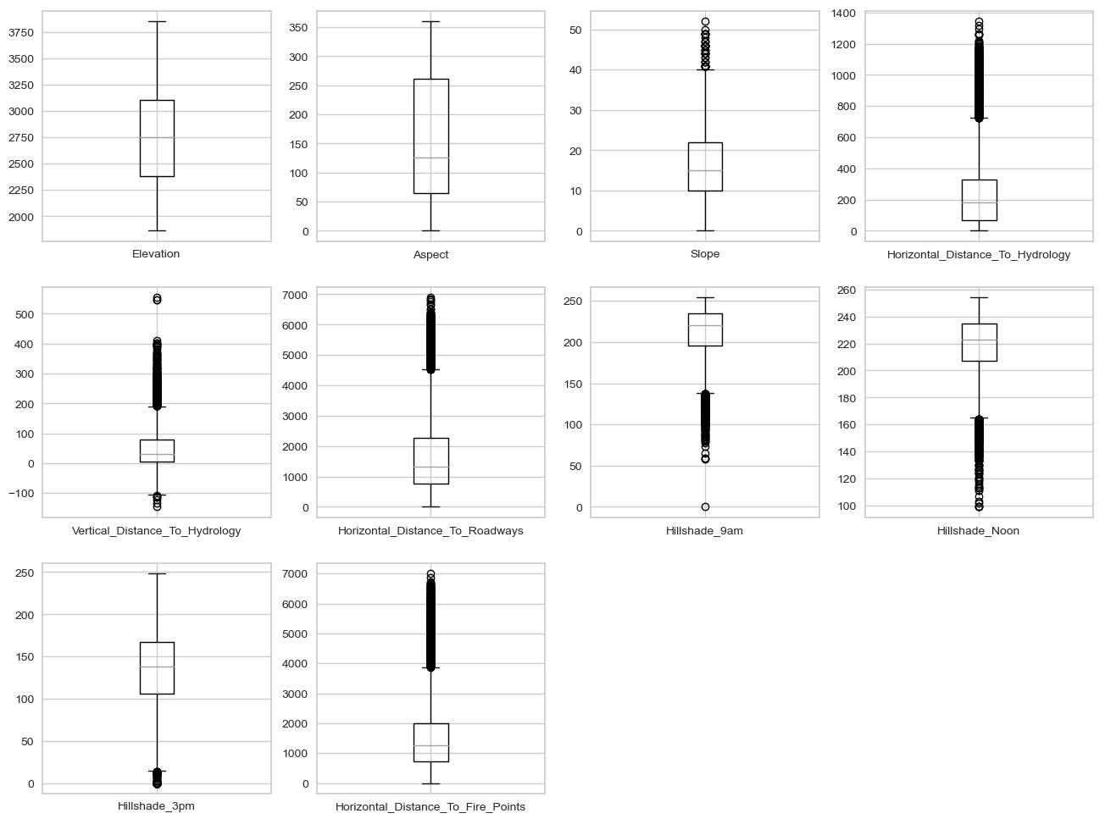
Data preparation
Drop irrelevant features
MinMaxScaler
Train/Test set split

Slide 5
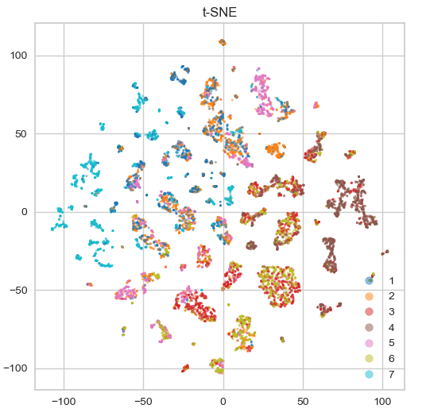
EDA

Slide 6
model
Unsupervised Learning: NMF, K-Means
Supervised Learning: Logistic Regression, SVM, Random Forest
Semi-supervised Learning: PCA/NMF + Supervised Learning
Hyperparameter Tuning

Slide 7
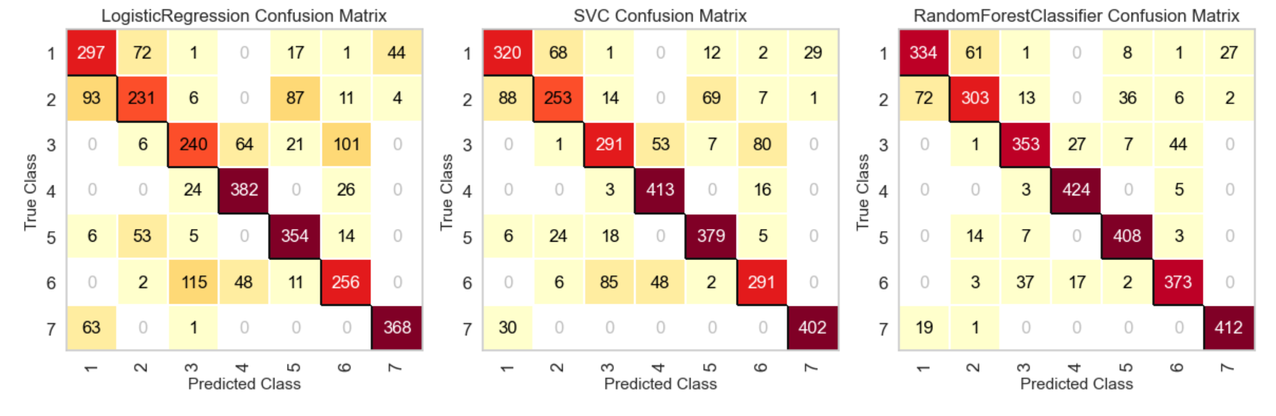
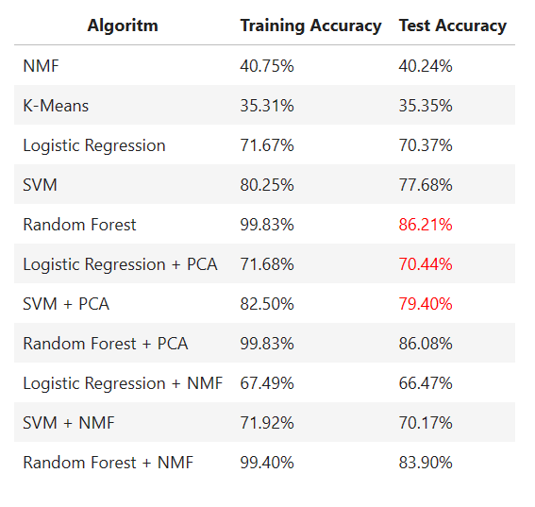
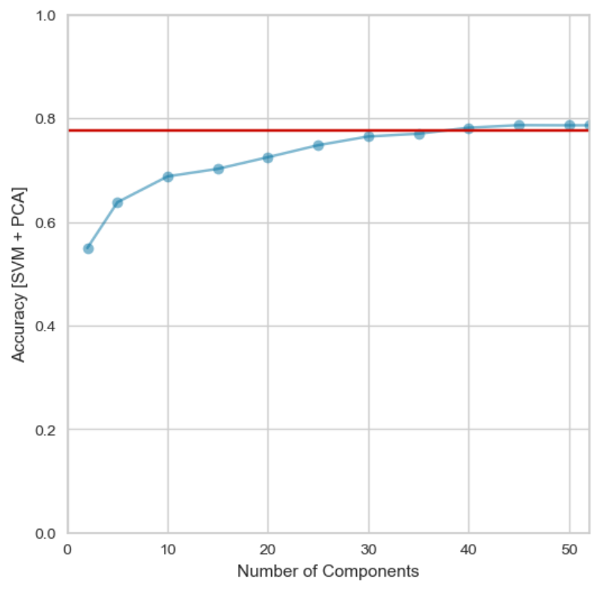
Result
unsupervised
learning
supervised
learning
semi-supervised
learning

Slide 8
conclusion
Unsupervised learning methods (NMF and K-Means) underperform
Most columns (44 out of 55) are categorical
Random Forest takes the highest test accuracy of 86.21%
PCA improves performance of supervised learning model, NMF not
SVM test accuracy 77.68% → 79.40%
SVM with 37 components of PCA achieves equivalent accuracy
Find better unsupervised methods for categorical data

Slide 9
Thank you

