Slide 1
Cyclone V

Slide 2
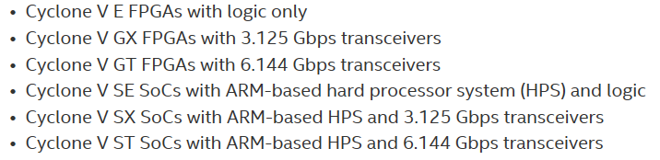
Cechi

Slide 3
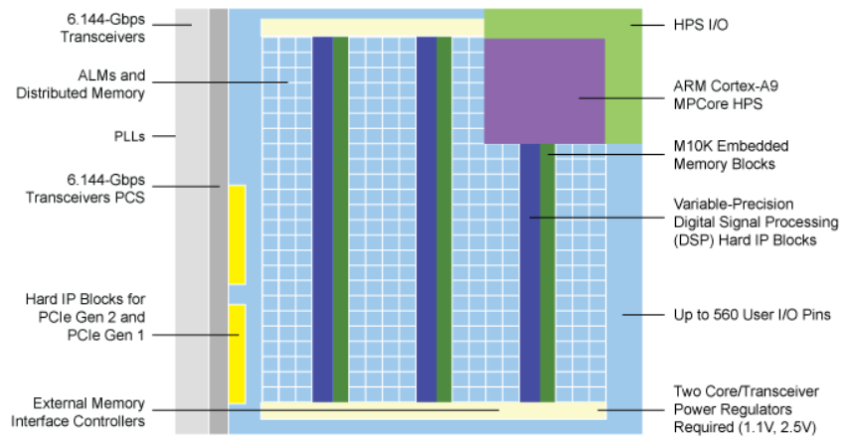
Architektura

Slide 4
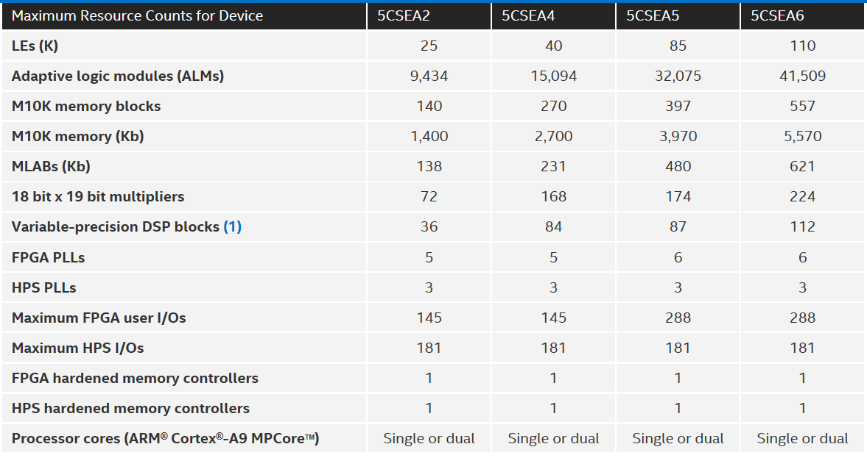
Parametry

Slide 5
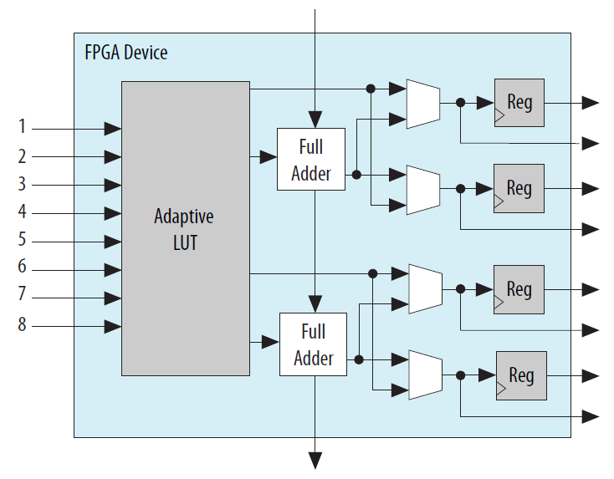
Adaptive Logic Module (ALM)

Slide 6
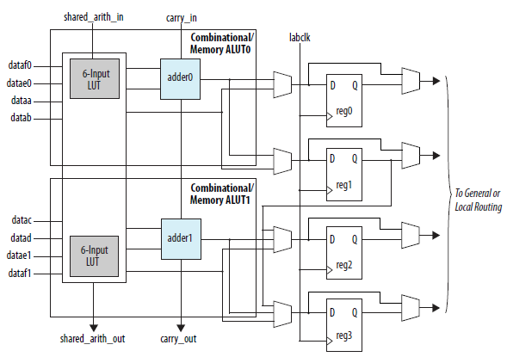
ALM High-Level Block Diagram for Cyclone V Devices

Slide 7
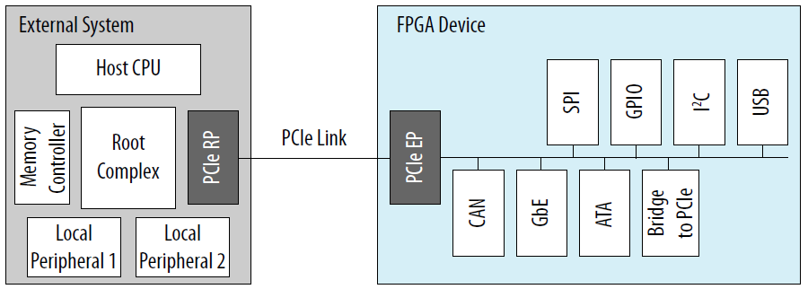
PCIe Multifunction for Cyclone V Devices

Slide 8
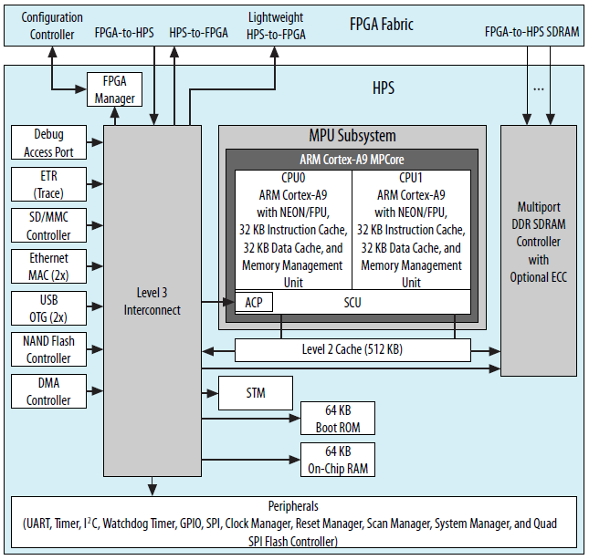
HPS with Dual-Core ARM Cortex-A9 MPCore Processor

Slide 9
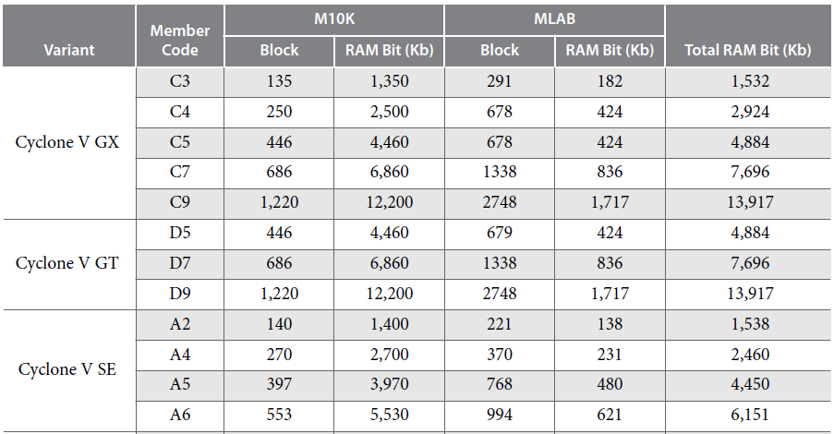
Embedded Memory Blocks in Cyclone V
Devices

Slide 10
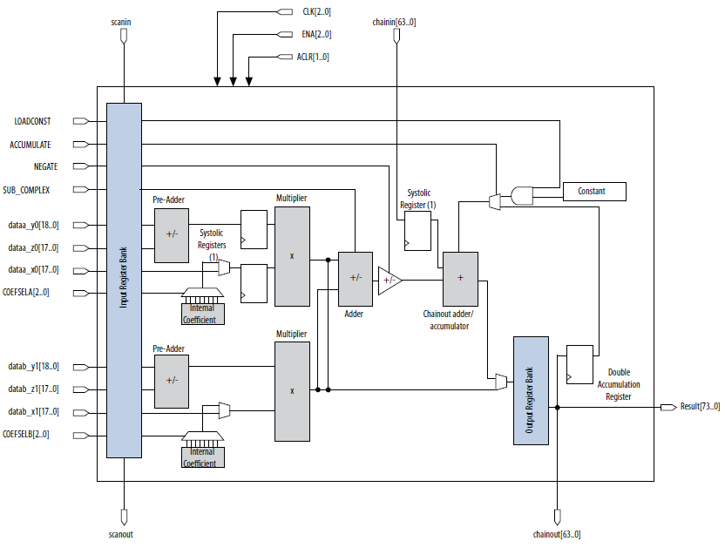
DSP Block Architecture for Cyclone V Devices

Slide 11
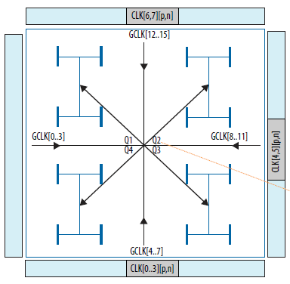
Global Clock Networks

Slide 12
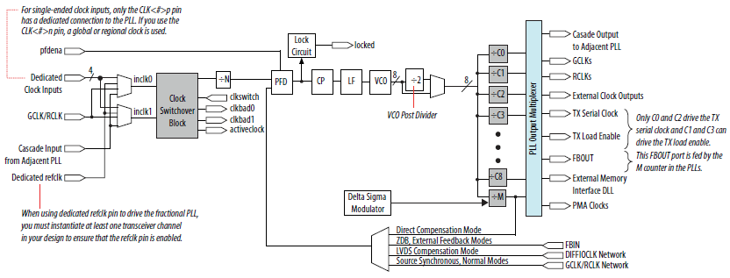
PLL Architecture

Slide 13
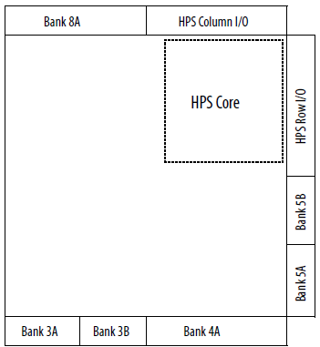
I/O Banks for Cyclone V SE Devices

Slide 14
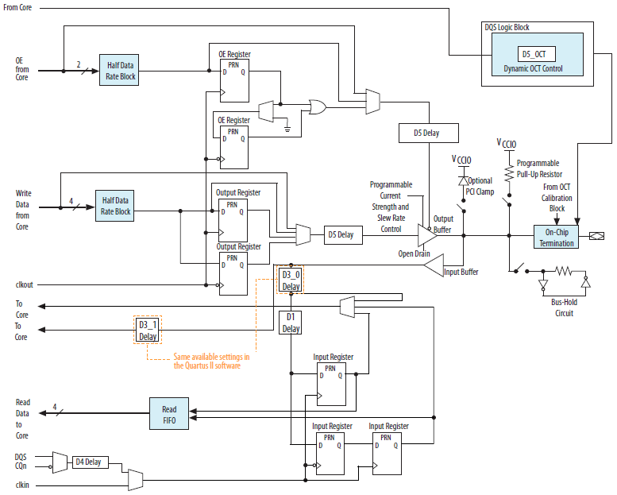
IOE Structure for Cyclone V Devices

Slide 15
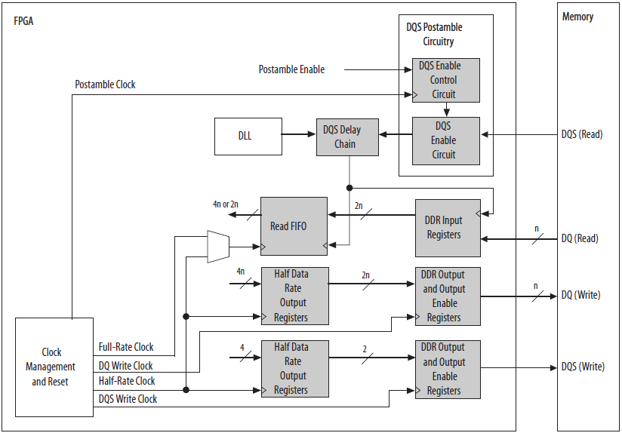
External Memory Interface Datapath Overview for Cyclone V Devices

Slide 16
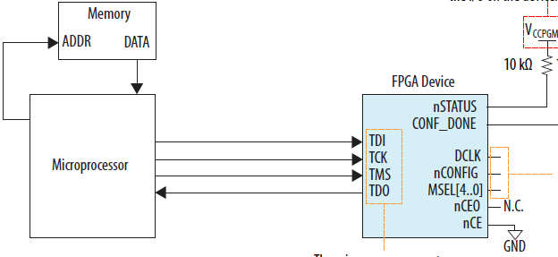
JTAG Configuration of a Single Device Using a Microprocessor

